Slide 1

Mismatched training and dev/test data
Bias and Variance with
mismatched data
distributions
deeplearning.ai

Slide 2
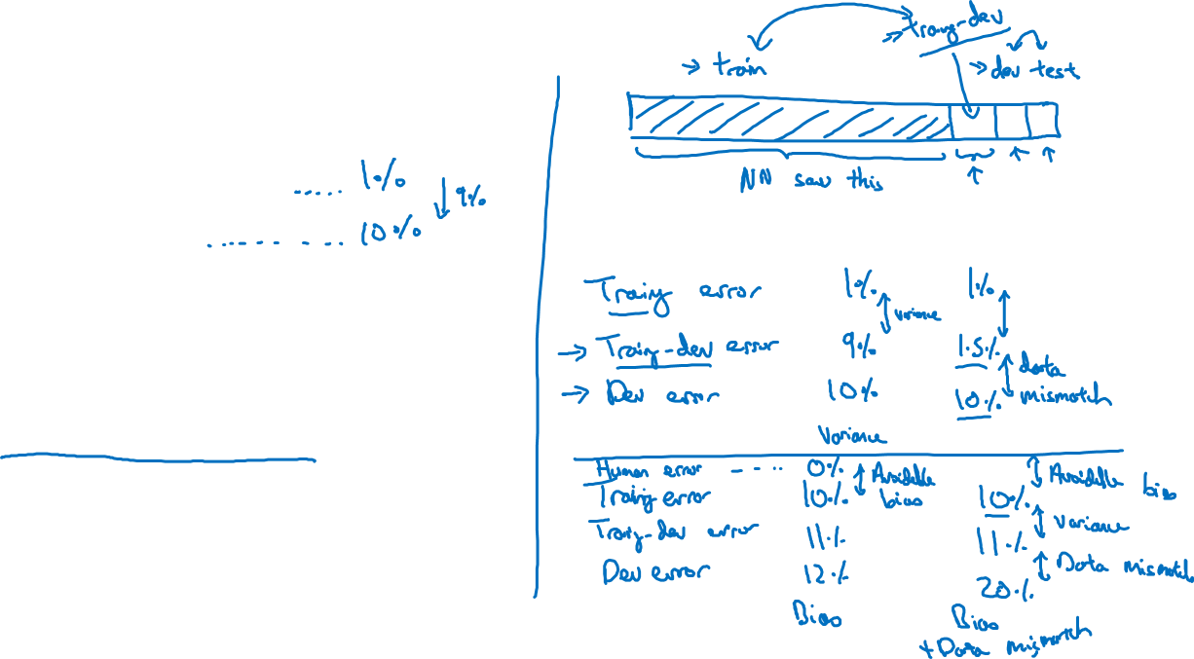
Cat classifier example
Assume humans get ≈ 0% error.
Training error
Dev error
Training-dev set: Same distribution as training set, but not used for training
Notes:
your training error is 1%,
and your dev error is 10%.
If your dev data came from the same distribution as your training set,
you would say that here you have a large variance problem,
that your algorithm's just not generalizing well from the training set
which it's doing well on to the dev set,
=============
But in the setting where your training data and your dev data comes from
a different distribution, you can no longer safely draw this conclusion.
In particular, maybe it's doing just fine on the dev set,
it's just that the training set was really easy because it was high res,
very clear images, and maybe the dev set is just much harder.
===============
One is that the algorithm saw data in the training set but not in the dev set.
Two, the distribution of data in the dev set is different.
And because you changed two things at the same time, it's difficult to know of this
9% increase in error, how much of it is because the algorithm didn't
see the data in the dev set, so that's some of the variance part of the problem.
And how much of it, is because the dev set data is just different.

Slide 3
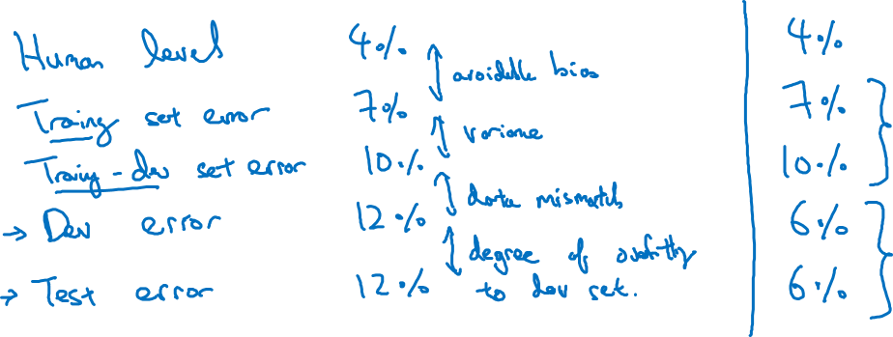
Bias/variance on mismatched training and dev/test sets
Notes:
You shouldn't be doing development on your test set because you don't want to overfit
your test set.
But if you also look at this, then this gap here tells you the degree
of overfitting to the dev set.
So if there's a huge gap between your dev set performance and
your test set performance, it means you maybe overtuned to the dev set.
And so maybe you need to find a bigger dev set, right?
So remember that your dev set and your test set come from the same distribution.
So the only way for there to be a huge gap here, for it to do much better on the dev
set than the test set, is if you somehow managed to overfit the dev set.
And if that's the case, what you might consider doing is going back and
just getting more dev set data.
============

Slide 4
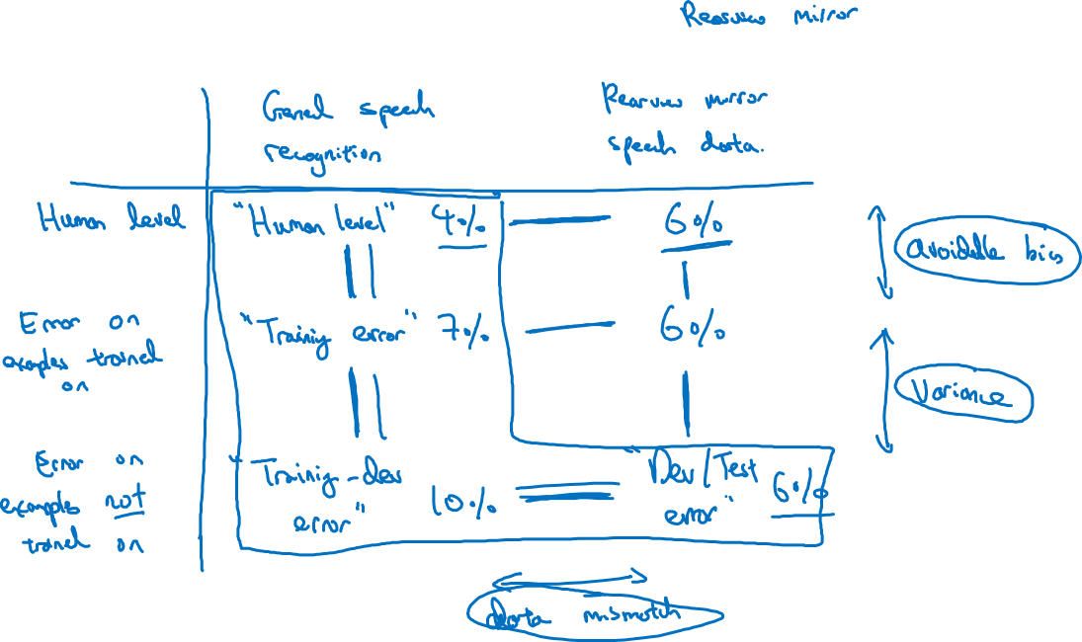
More general formulation
Notes:
每一条紫色的线 都能有一个interpretation
但是最重要的还是红色框框的

