Slide 1

Learning from multiple tasks
Transfer learning
deeplearning.ai
Notes:
you could have the neural network
learn to recognize objects like cats and then use
that knowledge or use part of that knowledge to
help you do a better job reading x-ray scans.

Slide 2

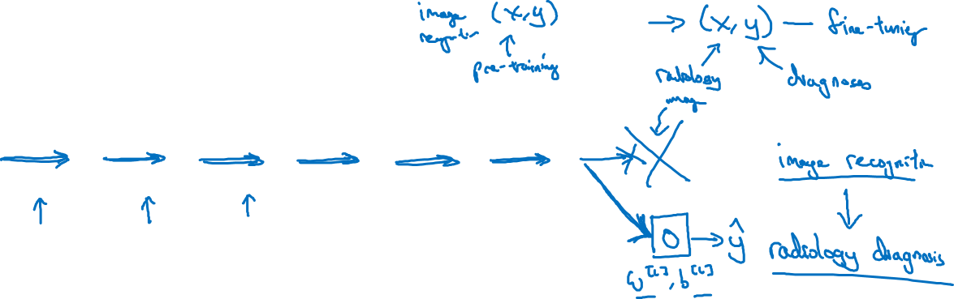

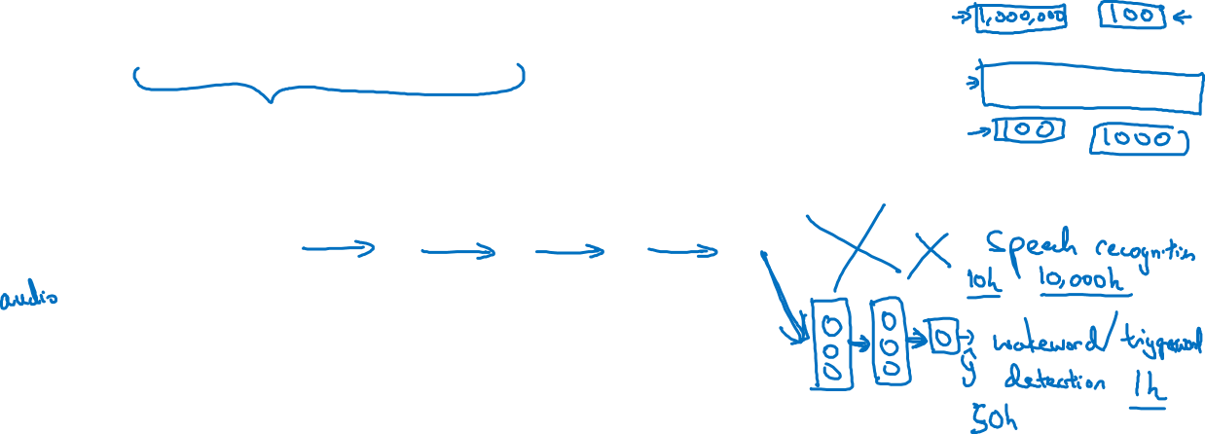
Transfer learning
x
$$\hat{y}$$
x
$$\hat{y}$$
Notes:
And the rule of thumb is maybe if you have a small data set,
then just retrain the one last layer at the output layer.
Or maybe that last one or two layers.
But if you have a lot of data,
then maybe you can retrain all the parameters in the network.
if you retrain all the parameters in the neural network,
then this initial phase of training on
image recognition is sometimes called pre-training,
because you're using image recognitions data
to pre-initialize or really pre-train the weights of the neural network.
And then if you are updating all the weights afterwards,
then training on the radiology data sometimes that's called fine tuning.
.
And the reason this can be helpful is that
a lot of the low level features such as detecting edges,
detecting curves, detecting positive objects.
Learning from that, from a very large image recognition data set,
might help your learning algorithm do better in radiology diagnosis.
Sometimes another thing you could do is actually create not just a single new output,
but actually create several new layers to your neural network to try
to put the labels Y for your wake word detection problem.
when does transfer learning make sense?
Transfer learning makes sense when you have a lot of data for the problem you're
transferring from and usually
relatively less data for the problem you're transferring to.
反之transfer方法就fail了

Slide 3
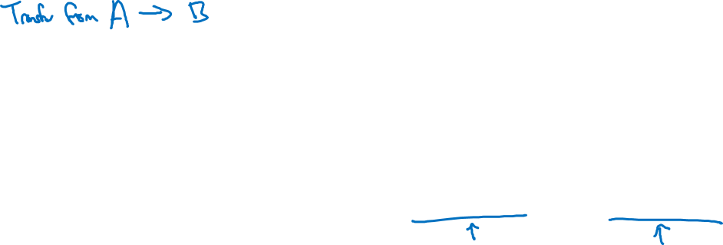
When transfer learning makes sense
Task A and B have the same input x.
You have a lot more data for Task A than Task B.
Low level features from A could be helpful for learning B.
Notes:
.
So to summarize, transfer learning has been most
useful if you're trying to do well on some Task B,
usually a problem where you have relatively little data.
So for example, in radiology,
you know it's difficult to get that
many x-ray scans to build a good radiology diagnosis system.
So in that case, you might find a related but different task,
such as image recognition,
where you can get maybe a million images and learn a lot of load-over features from that,
so that you can then try to do well on Task B on
your radiology task despite not having that much data for it.

