Slide 1

Learning from multiple tasks
Multi-task learning
deeplearning.ai

Slide 2
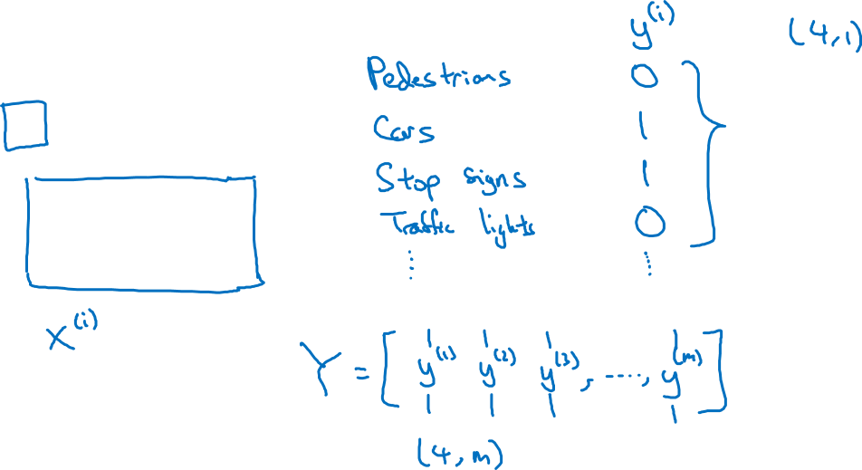
Simplified autonomous driving example

Slide 3

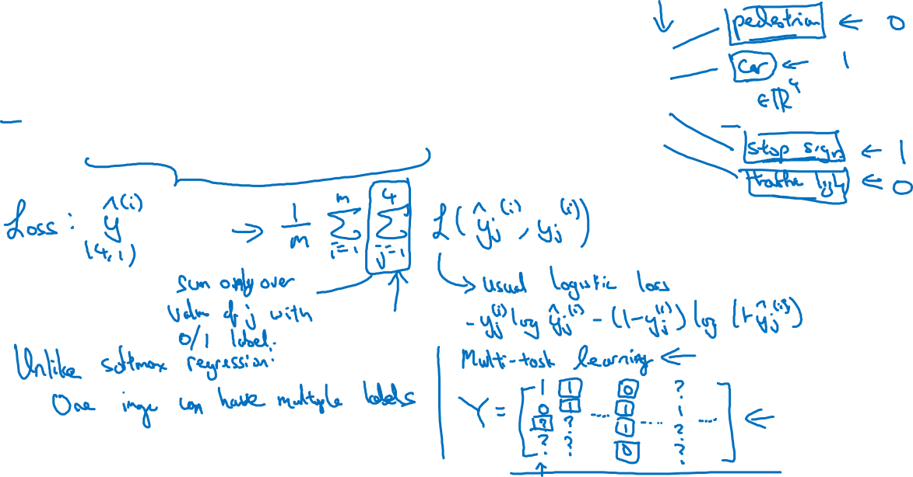
Neural network architecture
x
$$\hat{y}$$
Notes:
one other thing you could have done is just train four separate neural networks,
instead of train one network to do four things.
But if some of the earlier features in neural network can be shared between these
different types of objects, then you find that
training one neural network to do four things results in better performance than
training four completely separate neural networks to do the four tasks separately.
So that's the power of multi-task learning.
the way you train your algorithm,
even when some of these labels are question marks or
really unlabeled is that in this sum over j from 1 to 4,
you would sum only over values of j with a 0 or 1 label.
So whenever there's a question mark, you just omit that term from summation but
just sum over only the values where there is a label.
And so that allows you to use datasets like this as well.
what you may find is that you may have 1,000 examples per task and so
if you focus on the performance of just one task,
let's focus on the performance on the 100th task, you can call A100.
If you are trying to do this final task in isolation,
you would have had just a thousand examples to train this one task,
this one of the 100 tasks that by training on these 99 other tasks.
These in aggregate have 99,000 training examples which could be a big boost,
could give a lot of knowledge to argument this otherwise,
relatively small 1,000 example training set that you have for task A100.
the alternative to multi-task learning would be
to train a separate neural network for each task.
if you can train a big enough neural network, then multi-task learning
certainly should not or should very rarely hurt performance.
And hopefully it will actually help performance compared to if you
were training neural networks to do these different tasks in isolation
I would say that on average transfer learning is used much more today
than multi-task learning,
but In object detection I see more applications of multi-task any where one
neural network trying to detect a whole bunch of objects at the same time works
better than different neural networks trained separately to detect objects.

Slide 4
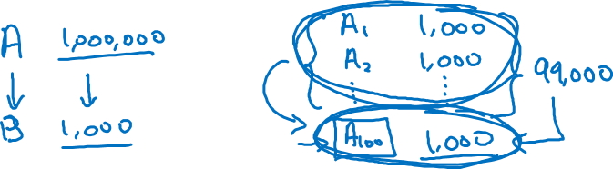
When multi-task learning makes sense
Training on a set of tasks that could benefit from having shared lower-level features.
Usually: Amount of data you have for each task is quite similar.
Can train a big enough neural network to do well on all the tasks.

