Slide 1

Convolutional Neural Networks
More edge detection
deeplearning.ai

Slide 2



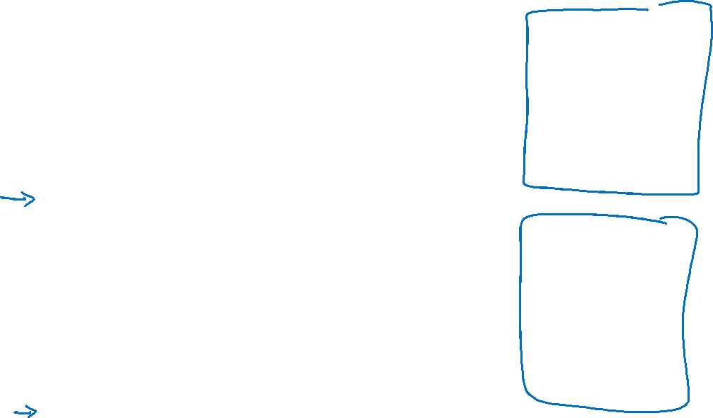
Vertical edge detection examples
10 | 10 | 10 | 0 | 0 | 0
10 | 10 | 10 | 0 | 0 | 0
10 | 10 | 10 | 0 | 0 | 0
10 | 10 | 10 | 0 | 0 | 0
10 | 10 | 10 | 0 | 0 | 0
10 | 10 | 10 | 0 | 0 | 0
0 | 30 | 30 | 0
0 | 30 | 30 | 0
0 | 30 | 30 | 0
0 | 30 | 30 | 0
1 | 0 | -1
1 | 0 | -1
1 | 0 | -1
$$∗$$
$$=$$
0 | 0 | 0 | 10 | 10 | 10
0 | 0 | 0 | 10 | 10 | 10
0 | 0 | 0 | 10 | 10 | 10
0 | 0 | 0 | 10 | 10 | 10
0 | 0 | 0 | 10 | 10 | 10
0 | 0 | 0 | 10 | 10 | 10
0 | -30 | -30 | 0
0 | -30 | -30 | 0
0 | -30 | -30 | 0
0 | -30 | -30 | 0
1 | 0 | -1
1 | 0 | -1
1 | 0 | -1
$$∗$$
$$=$$
Notes:
注意了！ 绝对值越大，不管是-30还是30，绝对值都是30，就越存在horizontal or vertical

Slide 3

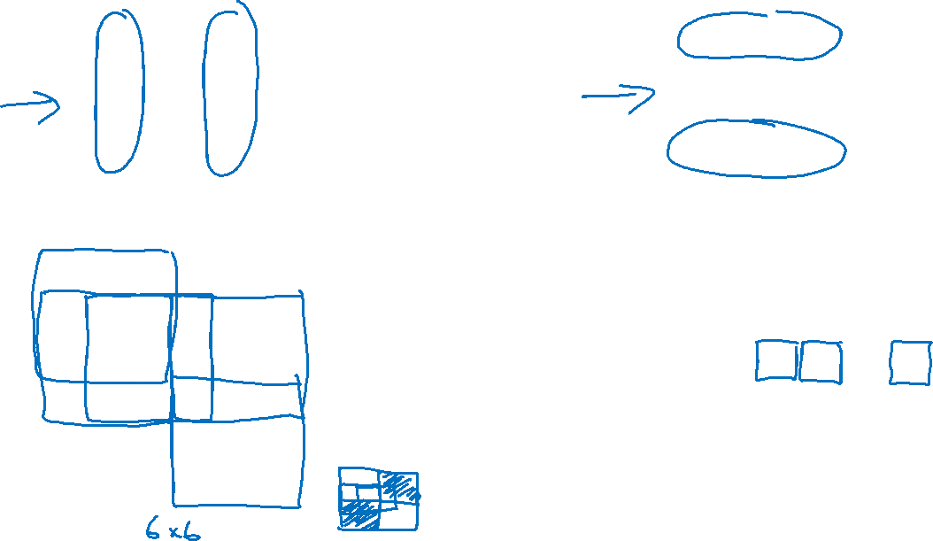
Vertical and Horizontal Edge Detection
1 | 0 | -1
1 | 0 | -1
1 | 0 | -1
1 | 1 | 1
0 | 0 | 0
-1 | -1 | -1
Vertical
Horizontal
10 | 10 | 10 | 0 | 0 | 0
10 | 10 | 10 | 0 | 0 | 0
10 | 10 | 10 | 0 | 0 | 0
0 | 0 | 0 | 10 | 10 | 10
0 | 0 | 0 | 10 | 10 | 10
0 | 0 | 0 | 10 | 10 | 10
0 | 0 | 0 | 0
30 | 10 | -10 | -30
30 | 10 | -10 | -30
0 | 0 | 0 | 0
1 | 1 | 1
0 | 0 | 0
-1 | -1 | -1
$$∗$$
$$=$$
Notes:
注意看对应：
绿色框和绿色框：原始图像中的绿色框存在明显的horizontal，所以卷积图像中的绿色框的绝对值大
黄色框和黄色框：原始图像中的黄色框存在不太明显的horizontal，所以卷积图像中的黄色框的绝对值不是很大
蓝色框和蓝色框：原始图像中的蓝色框不存在horizontal，所以卷积图像中的蓝色框的绝对值很小：是0

Slide 4
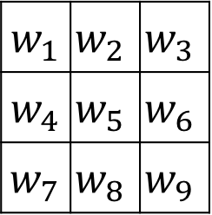
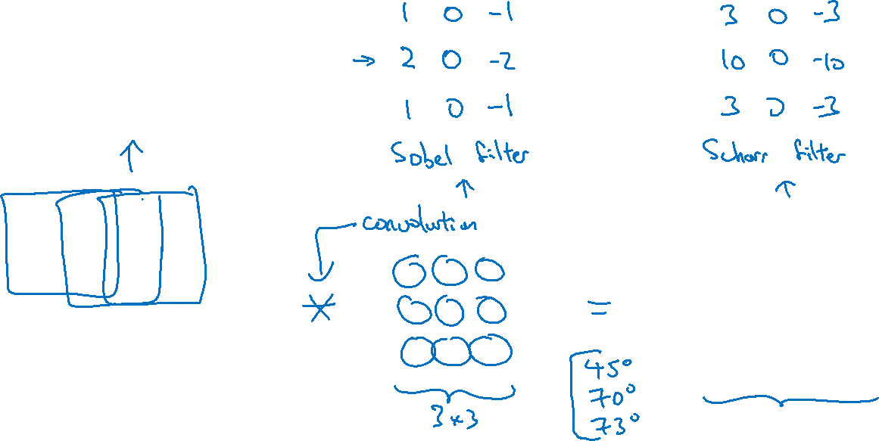
Learning to detect edges
1 | 0 | -1
1 | 0 | -1
1 | 0 | -1
3 | 0 | 1 | 2 | 7 | 4
1 | 5 | 8 | 9 | 3 | 1
2 | 7 | 2 | 5 | 1 | 3
0 | 1 | 3 | 1 | 7 | 8
4 | 2 | 1 | 6 | 2 | 8
2 | 4 | 5 | 2 | 3 | 9
$w_{1}$ | $$w_{2}$$ | $$w_{3}$$
$w_{4}$ | $$w_{5}$$ | $$w_{6}$$
$w_{7}$ | $$w_{8}$$ | $$w_{9}$$
Notes:
Sobel filter: center
Scharr filter: other property
And with the rise of deep learning, one of the things we learned is that when
you really want to detect edges in some complicated image, maybe you don't
need to have computer vision researchers handpick these nine numbers.
Maybe you can just learn them and treat the nine numbers of this matrix
as parameters, which you can then learn using back propagation.
And the goal is to learn nine parameters so that when you take the image,
the six by six image, and convolve it with your three by three filter,
that this gives you a good edge detector.

