Slide 1

Convolutional Neural Networks
Pooling layers
deeplearning.ai

Slide 2
Pooling layer: Max pooling
1 | 3 | 2 | 1
2 | 9 | 1 | 1
1 | 3 | 2 | 3
5 | 6 | 1 | 2
F = 2
S = 2
Notes:
So here's the intuition behind what max pooling is doing
if these features detected anywhere in this filter, It maybe a vertical edge or maybe a higher or whisker
then keep a high number.
But if this feature is not detected,
so maybe this feature doesn't exist in the upper right-hand quadrant.
实践中很好用

Slide 3
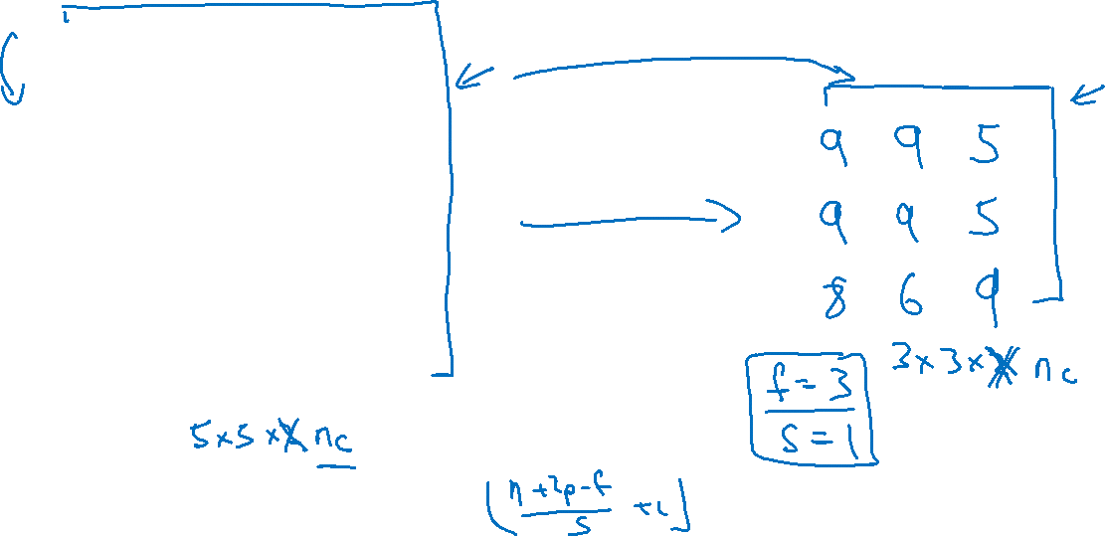
Pooling layer: Max pooling
1 | 3 | 2 | 1 | 3
2 | 9 | 1 | 1 | 5
1 | 3 | 2 | 3 | 2
8 | 3 | 5 | 1 | 0
5 | 6 | 1 | 2 | 9
Notes:
如果后面还有一层，和前面一层一样，分别计算3*3格子里面的max

Slide 4
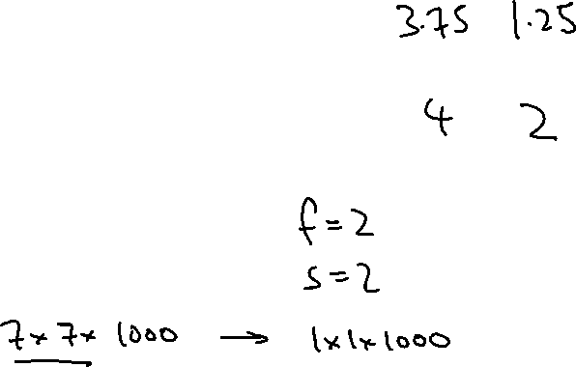
Pooling layer: Average pooling
1 | 3 | 2 | 1
2 | 9 | 1 | 1
1 | 4 | 2 | 3
5 | 6 | 1 | 2

Slide 5
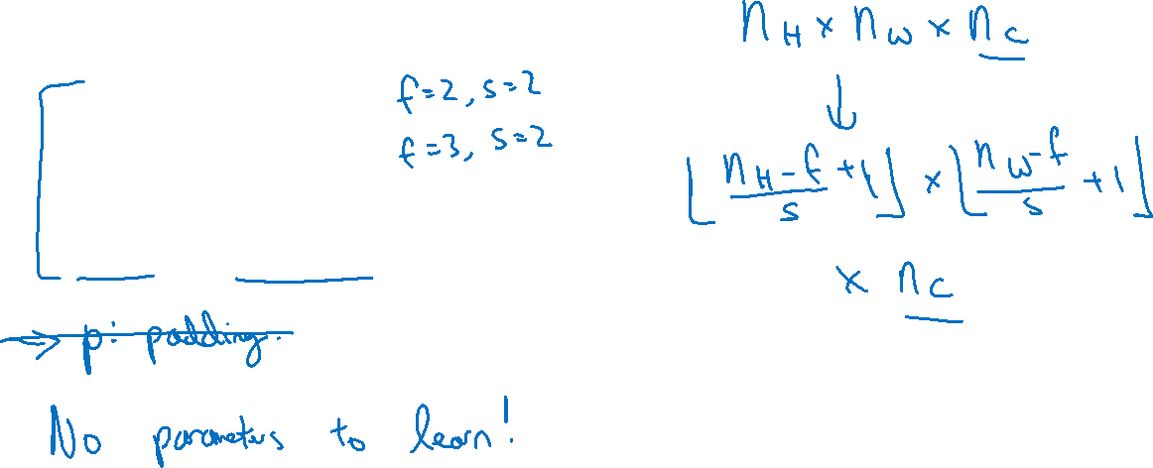
Summary of pooling
Hyperparameters:
f : filter size
s : stride
Max or average pooling

