Slide 1

Convolutional Neural Networks
Convolutional neural network example
deeplearning.ai

Slide 2
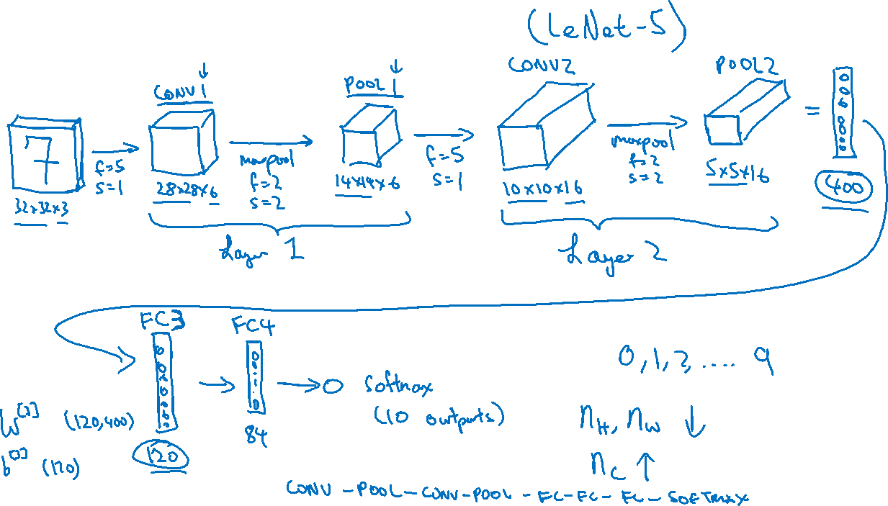
Neural network example
假设有6个filter
假设有16个filter
Notes:
When people report the number of layers in a neural network usually people just
record the number of layers that have weight, that have parameters.
And because the pooling layer has no weights, has no parameters,
only a few hyper parameters, I'm going to use a convention that Conv 1 and
Pool 1 shared together.
I'm going to treat that as Layer 1

Slide 3
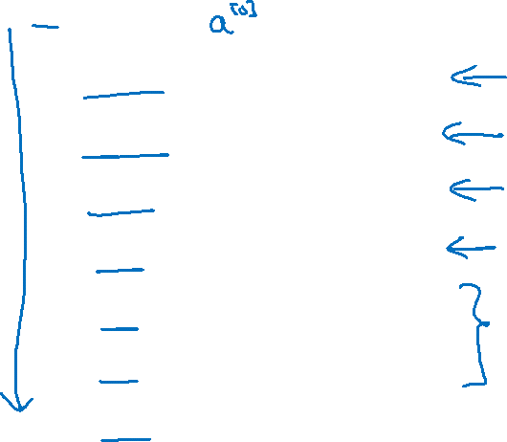
Neural network example
 | Activation shape | Activation Size | # parameters
Input: | (32,32,3) | 3,072 | 0
CONV1 (f=5, s=1) | (28,28,8) | 6,272 | 208
POOL1 | (14,14,8) | 1,568 | 0
CONV2 (f=5, s=1) | (10,10,16) | 1,600 | 416
POOL2 | (5,5,16) | 400 | 0
FC3 | (120,1) | 120 | 48,001
FC4 | (84,1) | 84 | 10,081
Softmax | (10,1) | 10 | 841
Notes:
点开动画就可以看到数字了
First, notice that the max pooling layers don't have any parameters.
Second, notice that the conv layers tend to have relatively
few parameters, as we discussed in early videos.
And in fact, a lot of the parameters tend to be in the fully
collected layers of the neural network
And then you notice also that the activation size tends to
maybe go down gradually as you go deeper in the neural network.
If it drops too quickly, that's usually not great for performance as well

