Slide 1

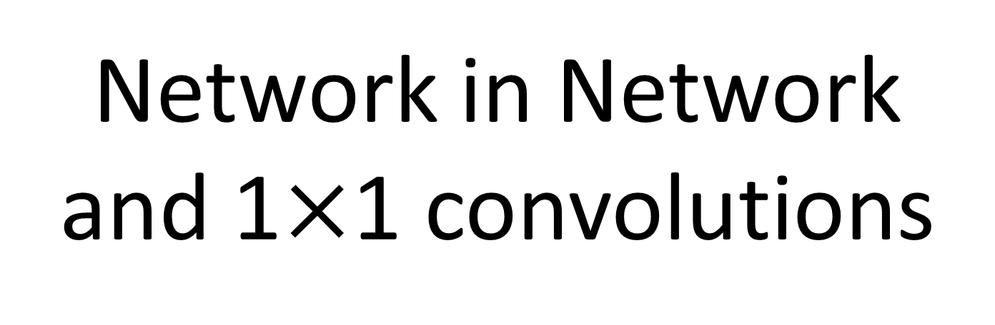
Case Studies
Network in Network and 1$×$1 convolutions
deeplearning.ai

Slide 2
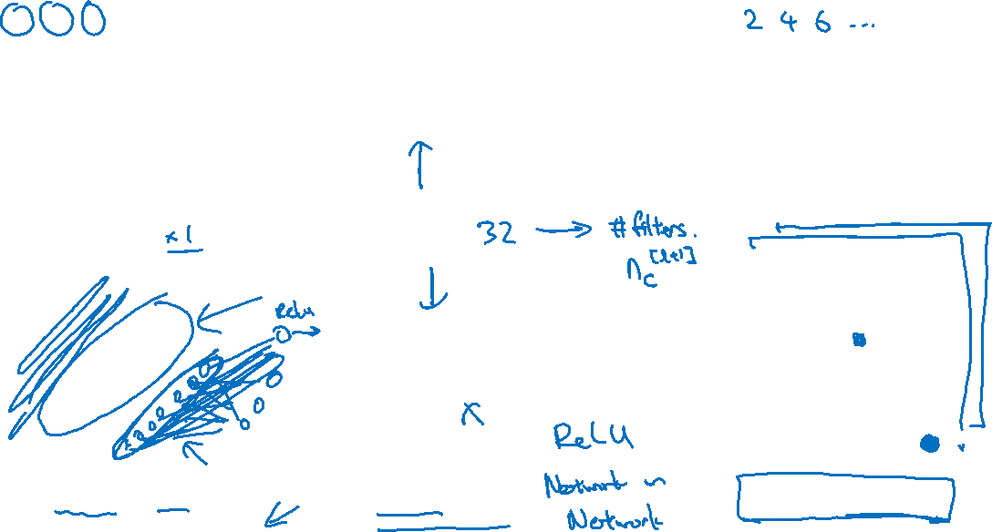





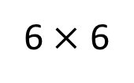
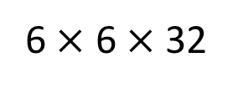
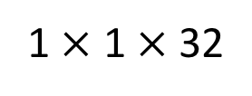
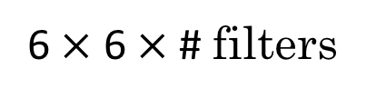
Why does a 1 $×$ 1 convolution do?
1 | 2 | 3 | 6 | 5 | 8
3 | 5 | 5 | 1 | 3 | 4
2 | 1 | 3 | 4 | 9 | 3
4 | 7 | 8 | 5 | 7 | 9
1 | 5 | 3 | 7 | 4 | 8
5 | 4 | 9 | 8 | 3 | 5
$$∗$$
2
$$=$$
6 $×$ 6
$$∗$$
$$=$$
6 $×$ 6 $×$ 32
1 $×$ 1 $×$ 32
6 $×$ 6 $×$ # filters
[Lin et al., 2013. Network in network]

Slide 3

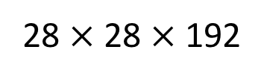
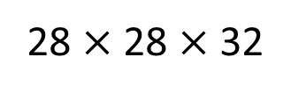
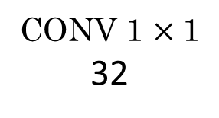
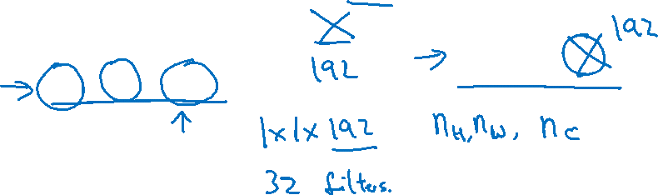
Using 1$×$1 convolutions
ReLU
CONV 1 $×$ 1
32
28 $×$ 28 $×$ 32
28 $×$ 28 $×$ 192
[Lin et al., 2013. Network in network]
Notes:
这个用来skringk nc：channel的数量
也可以increase nc~~

