Slide 1

Case Studies
Inception network motivation
deeplearning.ai
Notes:
So to summarize, if you are building a layer
of a neural network and you don't want to have to decide,
do you want a 1 by 1,
or 3 by 3, or 5 by 5, or pooling layer,
the inception module let's you say let's do them all,
and let's concatenate the results.
And then we run to the problem of computational cost.
And what you saw here was how using a 1 by 1 convolution,
you can create this bottleneck layer
thereby reducing the computational cost significantly

Slide 2
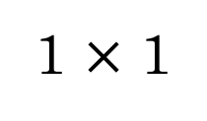
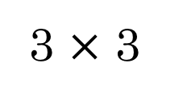
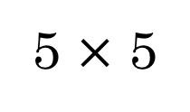
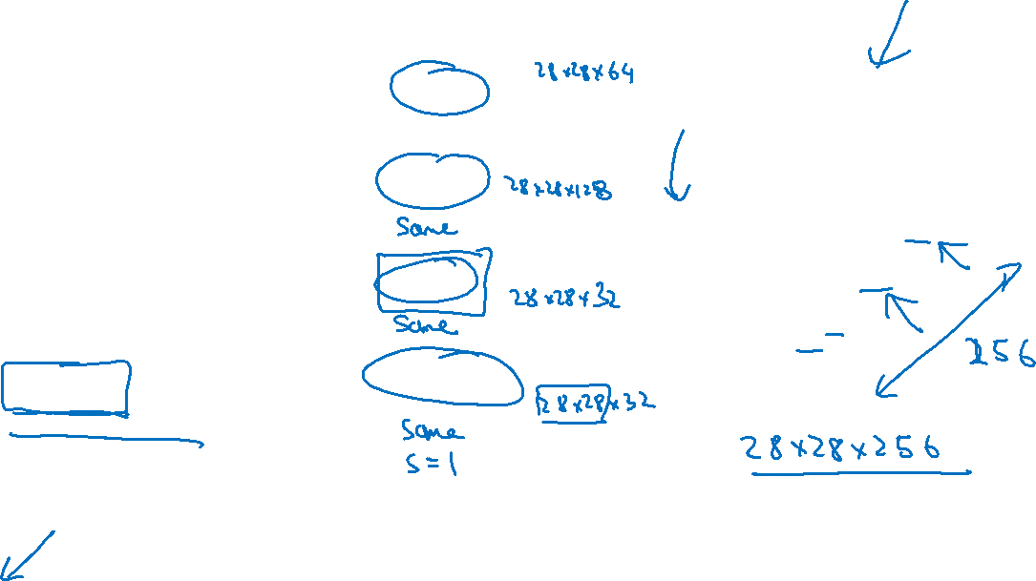
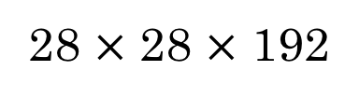
Motivation for inception network
1 $×$ 1
3 $×$ 3
64
5 $×$ 5
128
28
32
32
28
28 $×$ 28 $×$ 192
MAX-POOL
[Szegedy et al. 2014. Going deeper with convolutions]
Note: the colors are intended to correspond to the stacked small hand drawn cube

Slide 3
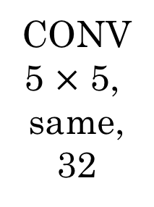
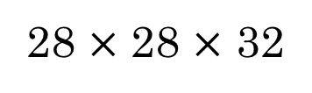
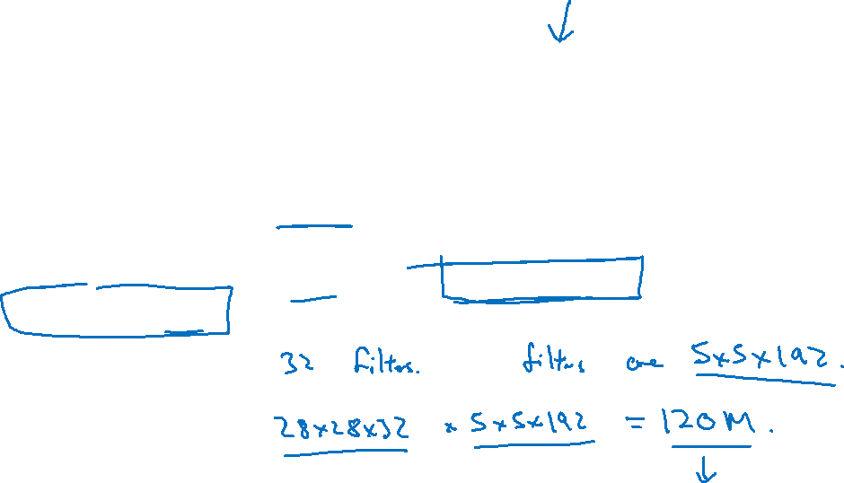
The problem of computational cost
CONV
5 $×$ 5,
same,
32
28 $×$ 28 $×$ 32
28 $×$ 28 $×$ 192

Slide 4

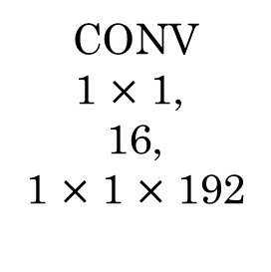

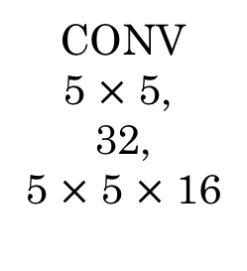

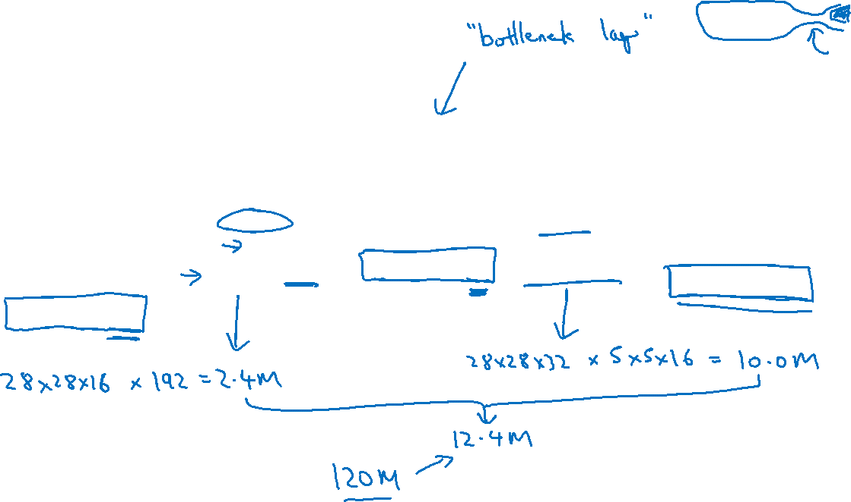

Using 1$×$1 convolution
CONV
1 $×$ 1,
16,
1 $×$ 1 $×$ 192
CONV
5 $×$ 5,
32,
5 $×$ 5 $×$ 16
28 $×$ 28 $×$ 16
28 $×$ 28 $×$ 32
28 $×$ 28 $×$ 192

