Slide 1
Face recognition
One-shot learning
deeplearning.ai

Slide 2
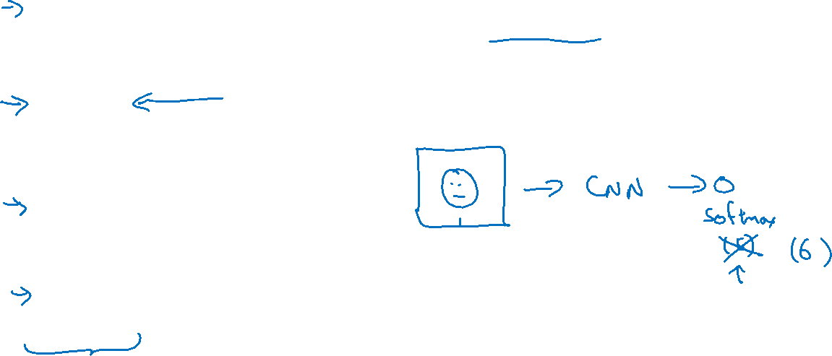
One-shot learning
Learning from one example to recognize the person again

Slide 3

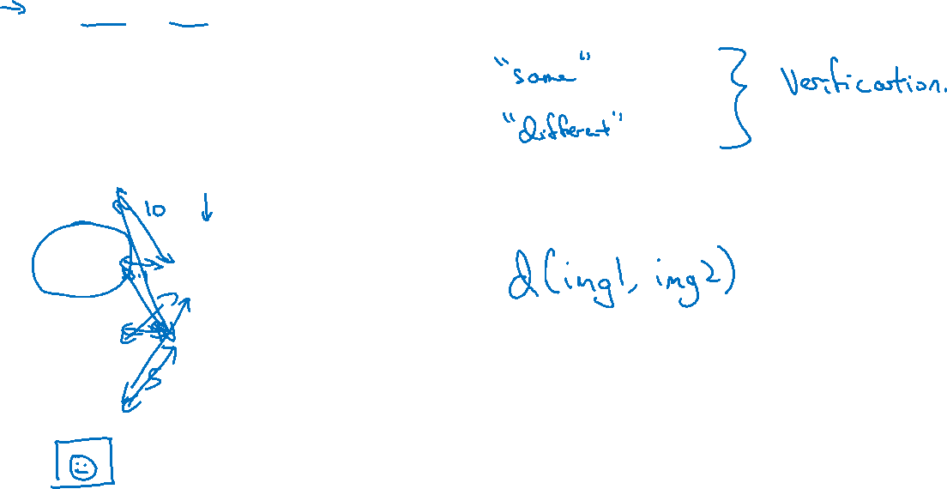
Learning a “similarity” function
d(img1,img2) $=$ degree of difference between images
If d(img1,img2) $≤ τ$
$$> τ$$
Notes:
新增一个人的工作：不需要重新来

