Slide 1

Recurrent Neural Networks
Recurrent Neural Network Model
deeplearning.ai

Slide 2

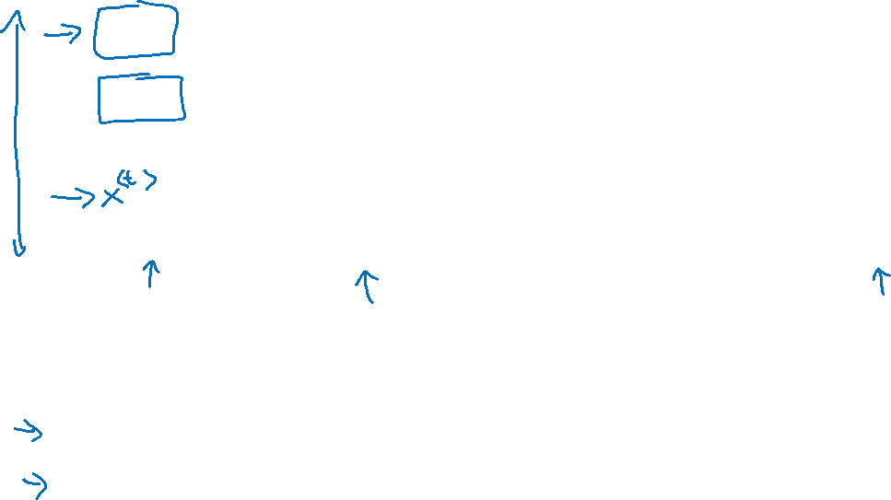









Why not a standard network?
$$x^{<1>}$$
$$y^{<1>}$$
$$x^{<2>}$$
$$y^{<2>}$$
$$⋮$$
$$⋮$$
$$⋮$$
$$⋮$$
$$x^{<T_{x}>}$$
$$y^{<T_{y}>}$$
Problems:
- Inputs, outputs can be different lengths in different examples.
- Doesn’t share features learned across different positions of text.

Slide 3
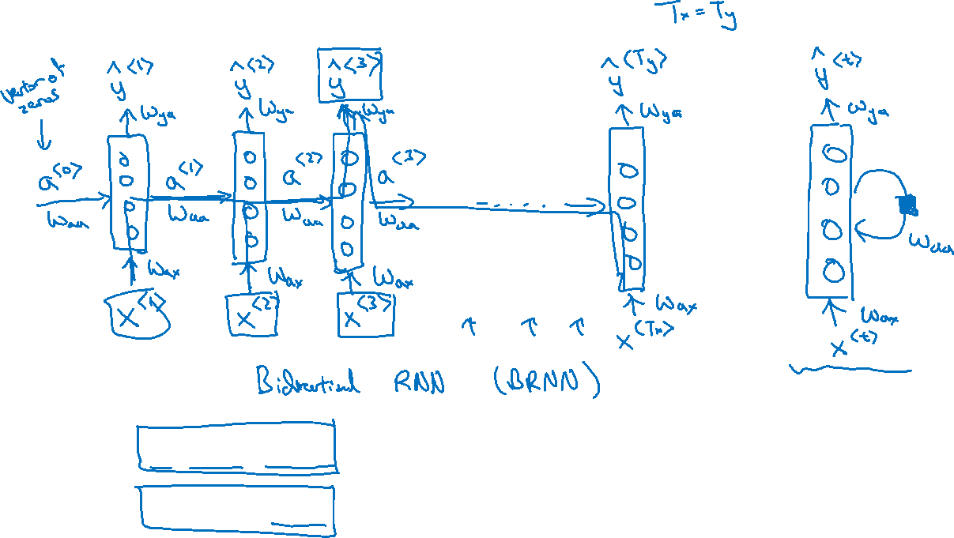
Recurrent Neural Networks
He said, “Teddy Roosevelt was a great President.”
He said, “Teddy bears are on sale!”
Notes:
So, in this recurrent neural network,
what this means is that when making the prediction for y3,
it gets the information not only from X3 but also the information from x1 and x2 because
the information on x1 can pass through this way to help to prediction with Y3.
Now, one weakness of this RNN is that it only uses
the information that is earlier in the sequence to make a prediction.

Slide 4




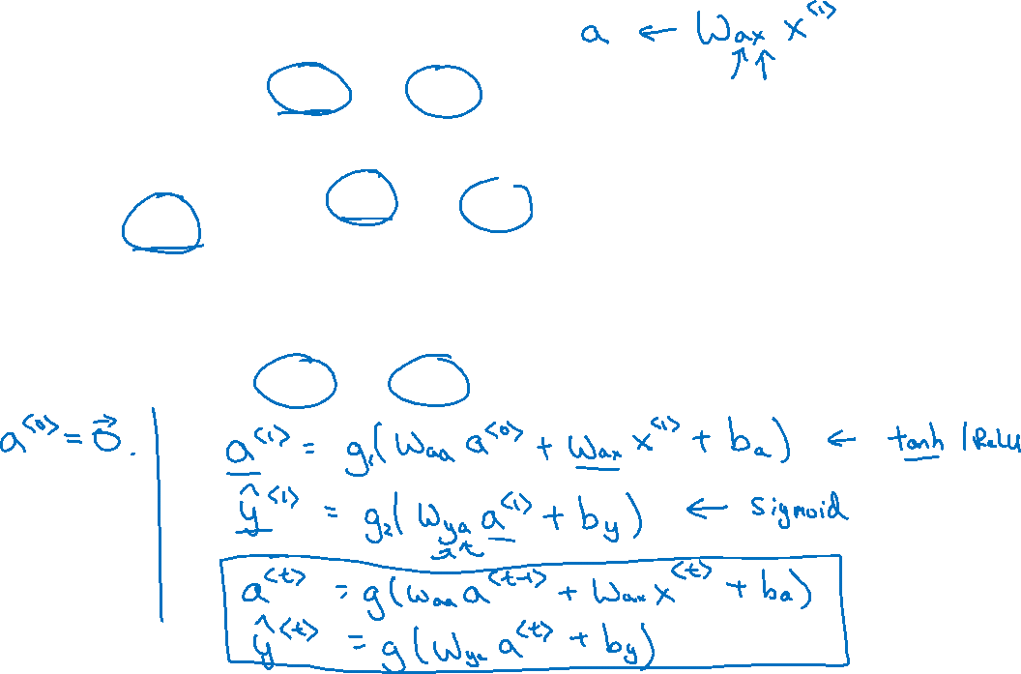









Forward Propagation
$${\hat{y}}^{<1>}$$
$${\hat{y}}^{<2>}$$
$${\hat{y}}^{<3>}$$
$${\hat{y}}^{<T_{y}>}$$
$$a^{<1>}$$
$$a^{<2>}$$
$$a^{<T_{x}−1>}$$
$$a^{<0>}$$
$$⋯$$
$$x^{<1>}$$
$$x^{<2>}$$
$$x^{<3>}$$
$$x^{<T_{x}>}$$

Slide 5

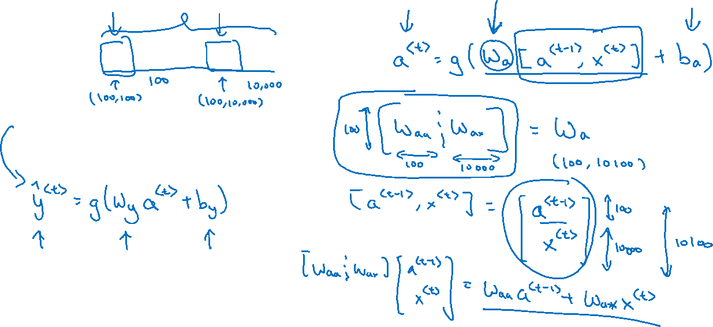

Simplified RNN notation
$$a^{<t>}=g(W_{aa}a^{<t−1>}+W_{ax}x^{<t>}+b_{a})$$
$${\hat{y}}^{<t>}=g(W_{ya}a^{<t>}+b_{y})$$

