Slide 1
Anemic vs. Rich Domain Model

Slide 2

Anemic

Slide 3
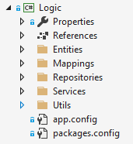
Anemic

Slide 4
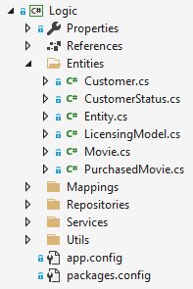
Anemic

Slide 5
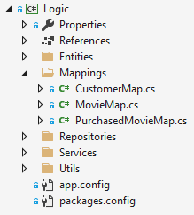
Anemic

Slide 6
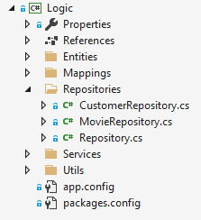
Anemic

Slide 7
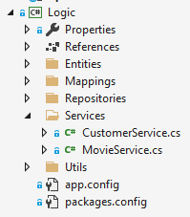
Anemic

Slide 8
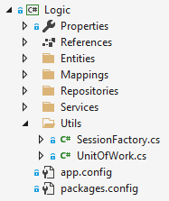
Anemic

Slide 9
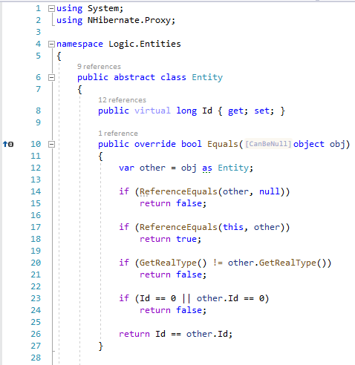
Anemic

Slide 10
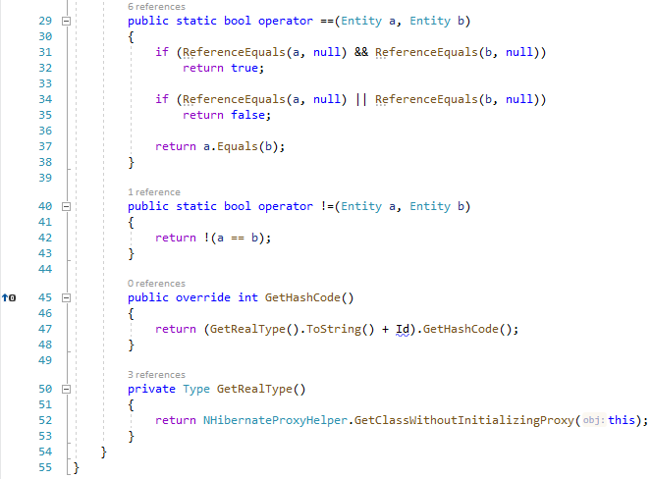
Anemic

Slide 11
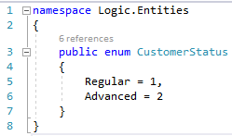
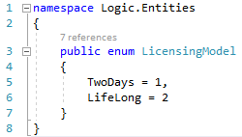
Anemic

Slide 12
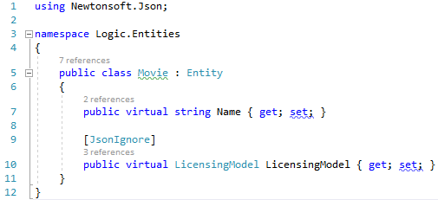
Anemic

Slide 13
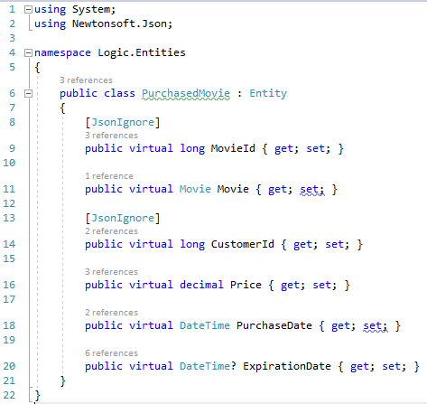
Anemic

Slide 14
Anemic

Slide 15
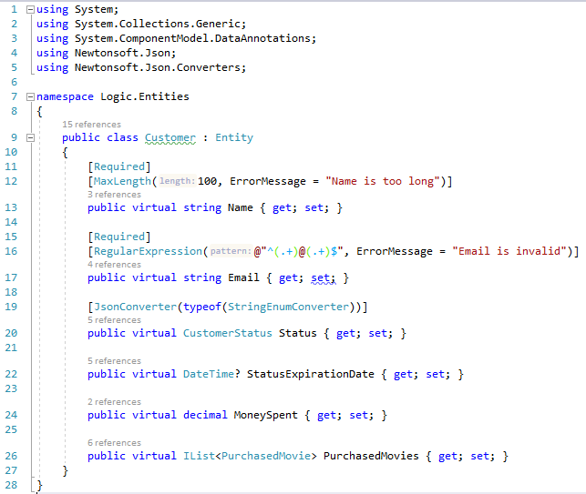
Anemic

Slide 16
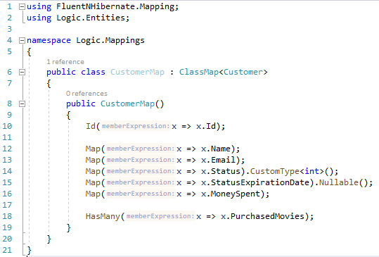
Anemic

Slide 17
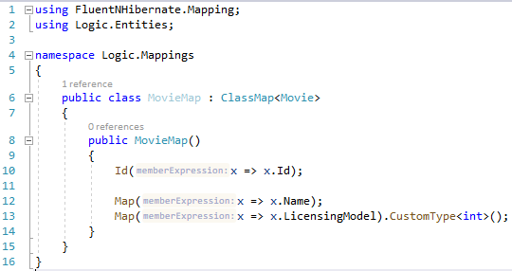
Anemic

Slide 18
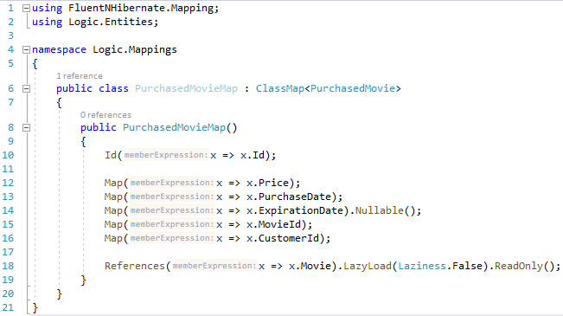
Anemic

Slide 19
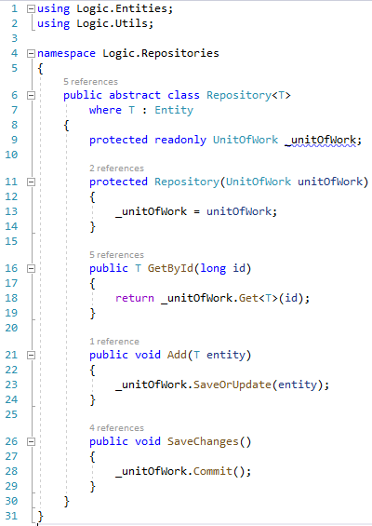
Anemic

Slide 20
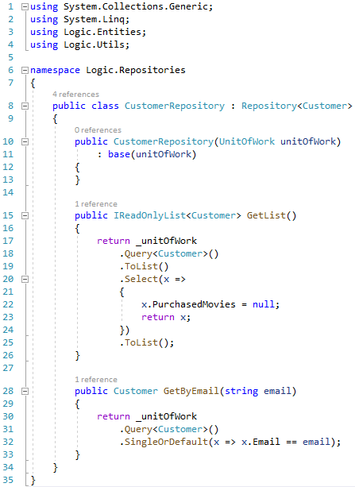
Anemic

Slide 21
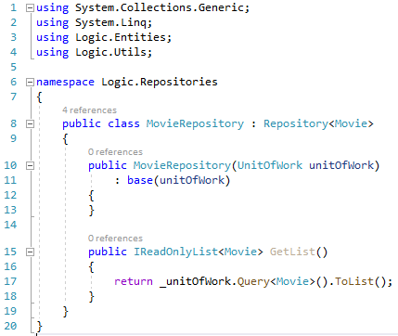
Anemic

Slide 22
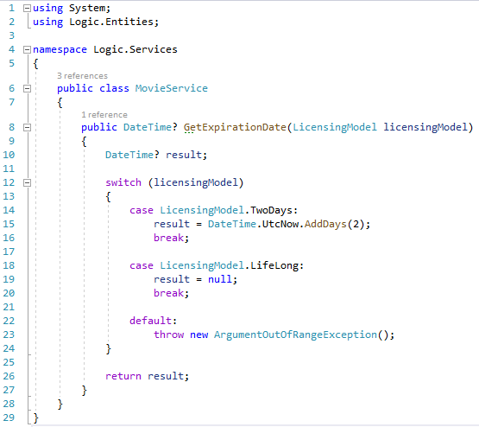
Anemic

Slide 23
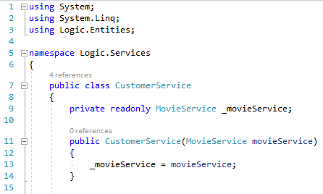
Anemic

Slide 24
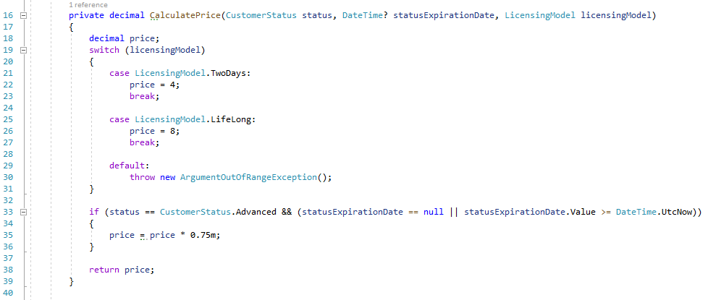
Anemic

Slide 25
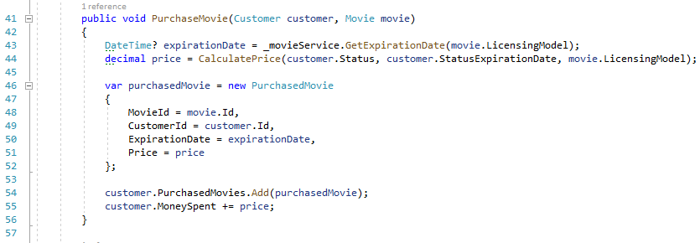
Anemic

Slide 26
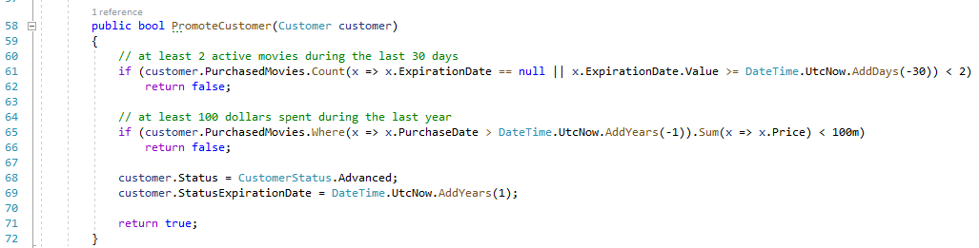
Anemic

Slide 27
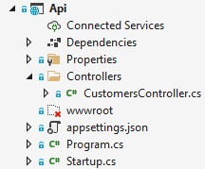
Anemic

Slide 28
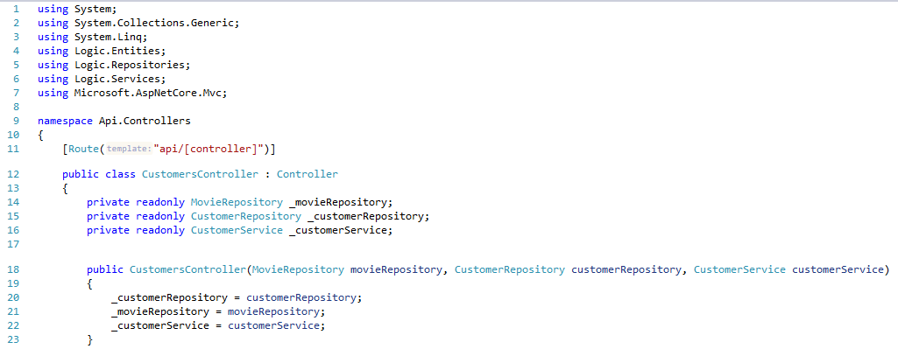
Anemic

Slide 29
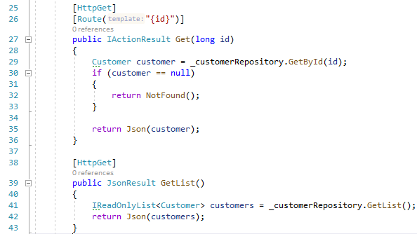
Anemic

Slide 30
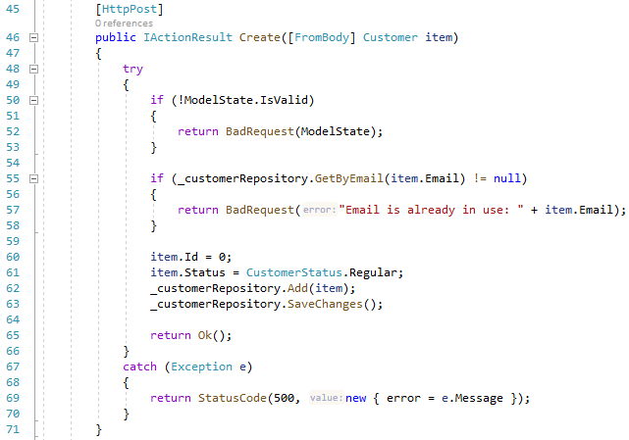
Anemic

Slide 31
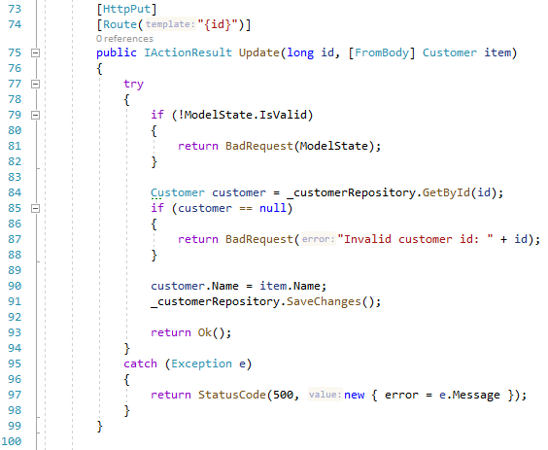
Anemic

Slide 32
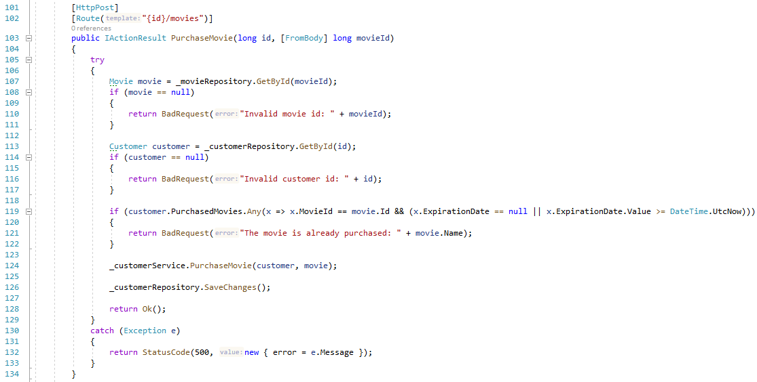
Anemic

Slide 33
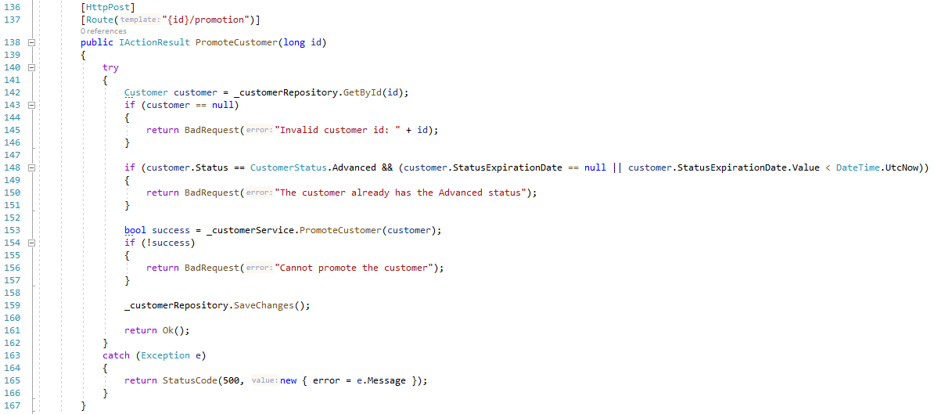
Anemic

Slide 34
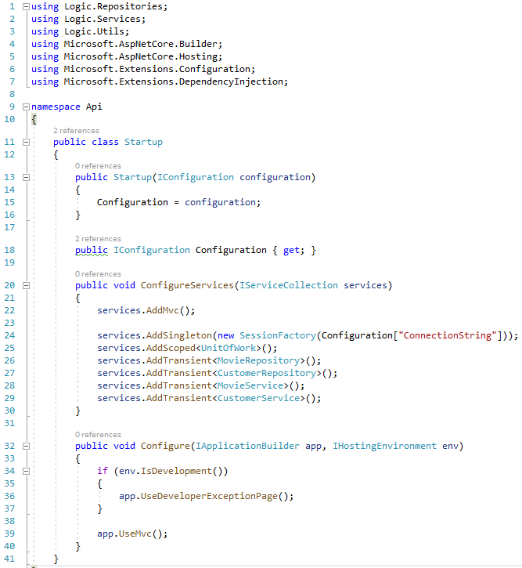
Anemic

Slide 35
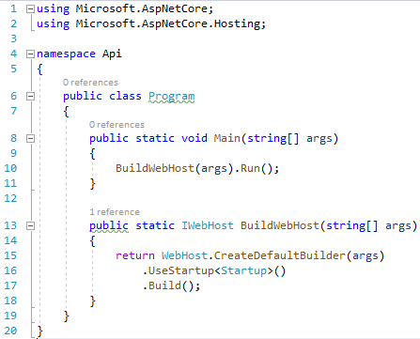
Anemic

Slide 36
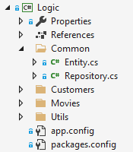
Rich

Slide 37
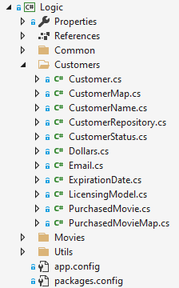
Rich

Slide 38
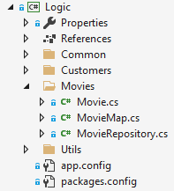
Rich

Slide 39
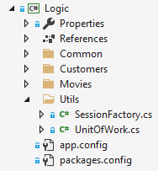
Rich

Slide 40
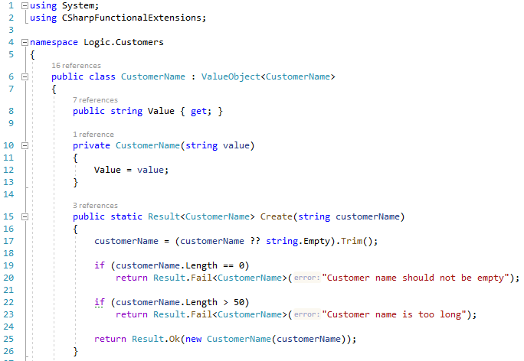
Rich

Slide 41
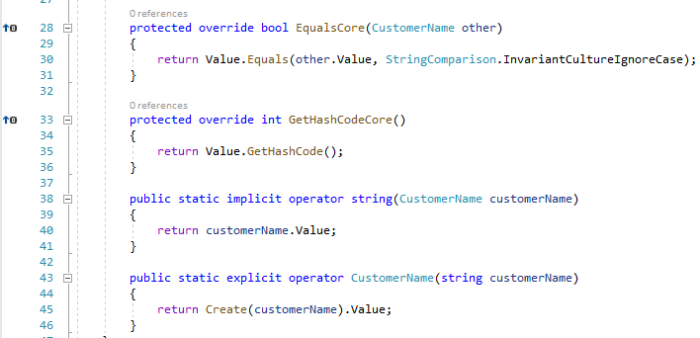
Rich

Slide 42

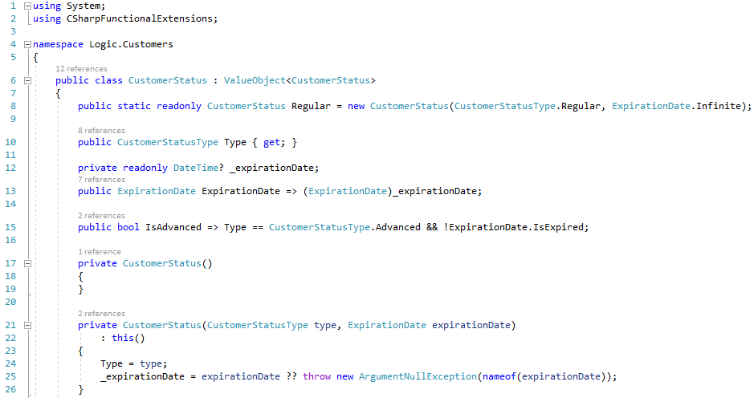
Rich

Slide 43
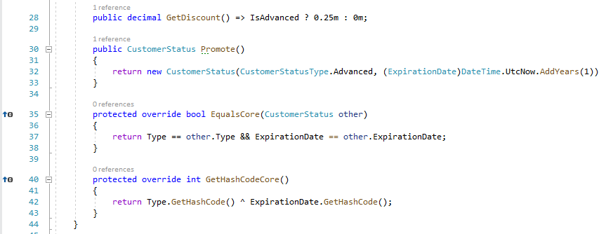
Rich

Slide 44
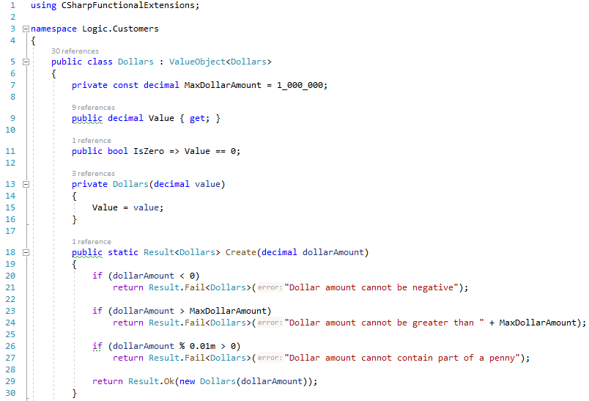
Rich

Slide 45
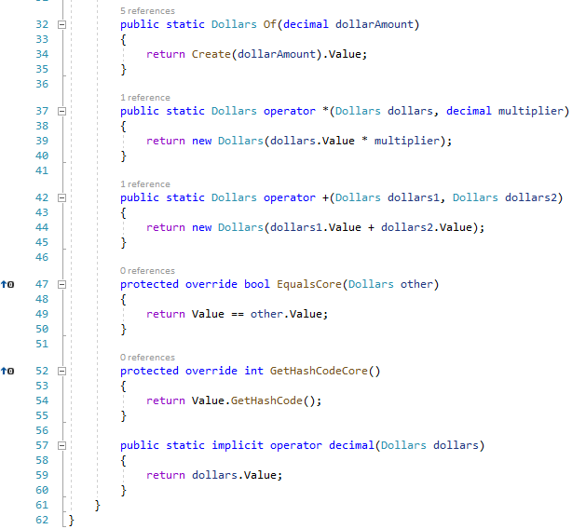
Rich

Slide 46
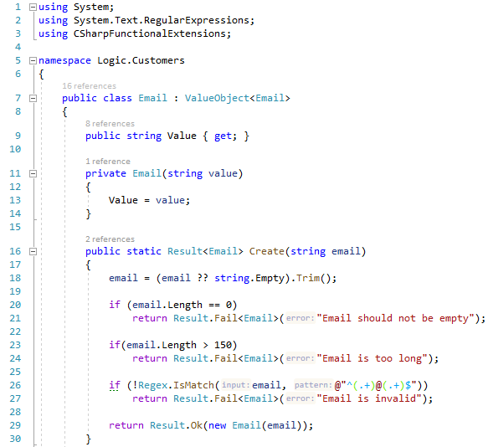
Rich

Slide 47
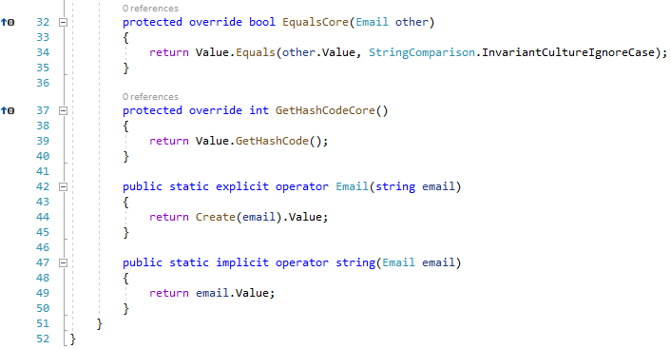
Rich

Slide 48
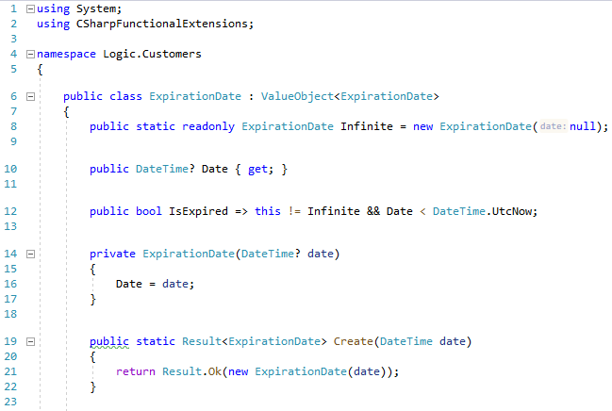
Rich

Slide 49
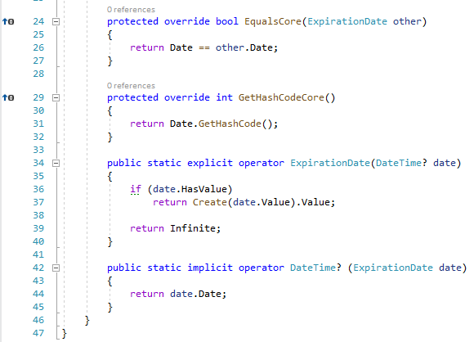
Rich

Slide 50
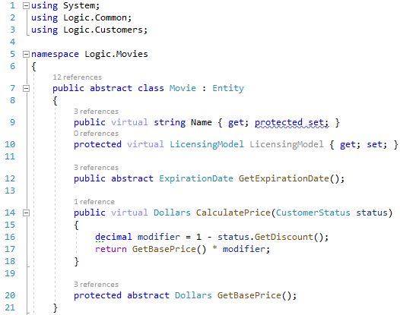
Rich

Slide 51
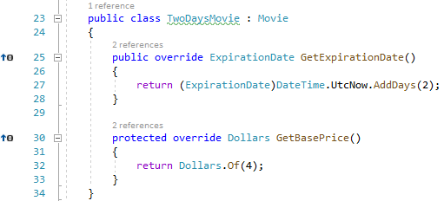
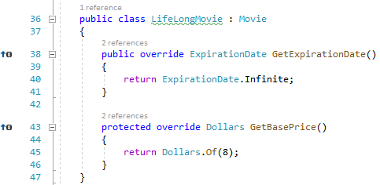
Rich

Slide 52

Rich

Slide 53

Rich

Slide 54

Rich

Slide 55

Rich

Slide 56

Rich

Slide 57

Rich

Slide 58

Rich

Slide 59

Rich

Slide 60

Rich

Slide 61

Rich

Slide 62


Rich

Slide 63

Rich

Slide 64



Rich

Slide 65

Rich

Slide 66

Rich

Slide 67

Rich

Slide 68

Rich

Slide 69

Rich

Slide 70

Rich

Slide 71

Rich

Slide 72

Rich

Slide 73

Rich

Slide 74
Спасибо за внимание!

