Slide 1


Topic : Nucleus
Name : Atharv Chouhan
Class : 9 c

Slide 2

●
What is the Nucleus?
●
The nucleus (plural: nuclei) is the largest and most important organelle found in
eukaryotic cells (cells with a true nucleus, like plant and animal cells).
●
●
It is often called the "Control Center" or "Brain" of the cell because it regulates all
cell activities.
●
●
The most important function is storing the cell's genetic material (DNA).

Slide 3

The Outer Layers
1. Nuclear Membrane
A double-layered membrane that separates the nucleus from the cell's cytoplasm.
It is continuous with the Endoplasmic Reticulum (ER).
2. Nuclear Pores
Tiny openings present in the nuclear envelope.
They act like gateways, controlling the passage of molecules (like RNA and proteins)
between the nucleus and the cytoplasm.

Slide 4


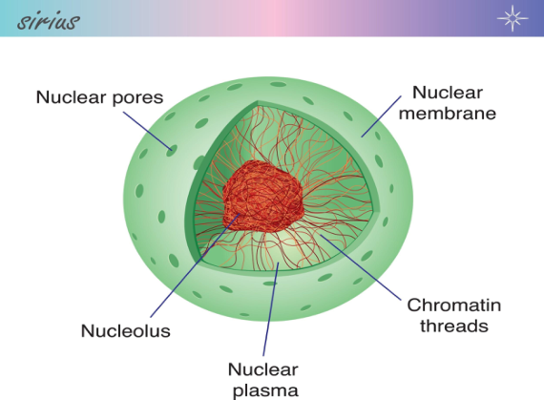
●
Key Functions of the Nucleus
●
Storage of Genetic Material: Stores
the cell's DNA in the form of
chromosomes.
●
●
Control Cell Activities: Directs all
metabolic (life) activities of the
cell, including growth and repair.
●
●
Cell Division: Plays a crucial role
in initiating and regulating cell
division.

Slide 5
Thank You

