Slide 1
Osmosis and Diffusion
St. Arnold Co-Ed School
Name: Akshika Verma
Class: 9th
Subject: Science

Slide 2
Index
1. Introduction
2. Diffusion (Definition & Example)
3. Diagram of Diffusion
4. Osmosis (Definition & Example)
5. Diagram of Osmosis
6. Difference between Osmosis and Diffusion
7. Conclusion

Slide 3
Introduction
Osmosis and diffusion are important processes in science that explain how substances move from one place to another.
Diffusion helps particles spread from an area of high concentration to low concentration.
While osmosis is the movement of water through a semi-permeable membrane.
These processes are essential for the survival of living organisms.

Slide 4
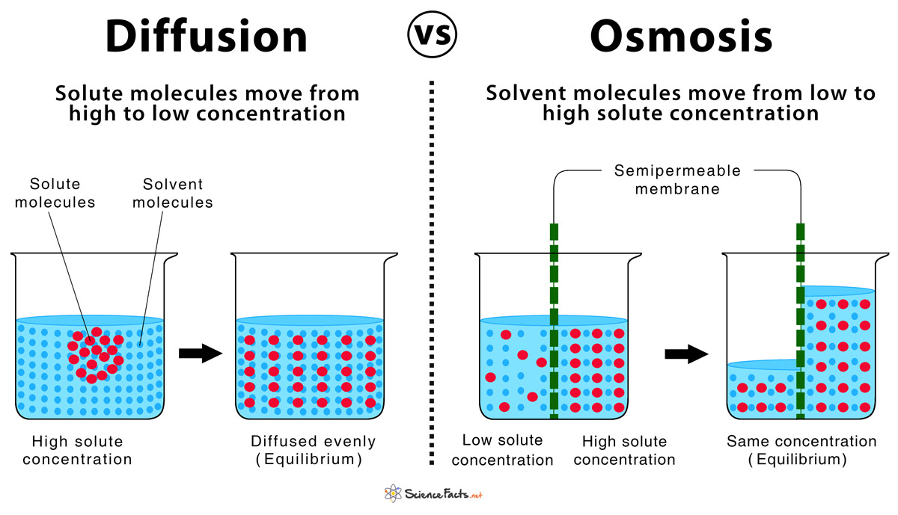

Slide 5
Diffusion
Diffusion is the movement of particles from an area of high concentration to an area of low concentration.
It happens in gases, liquids, and solids.
Diffusion does not need any membrane.
It helps substances spread evenly.
For example, the smell of perfume spreads throughout a room after spraying.

Slide 6
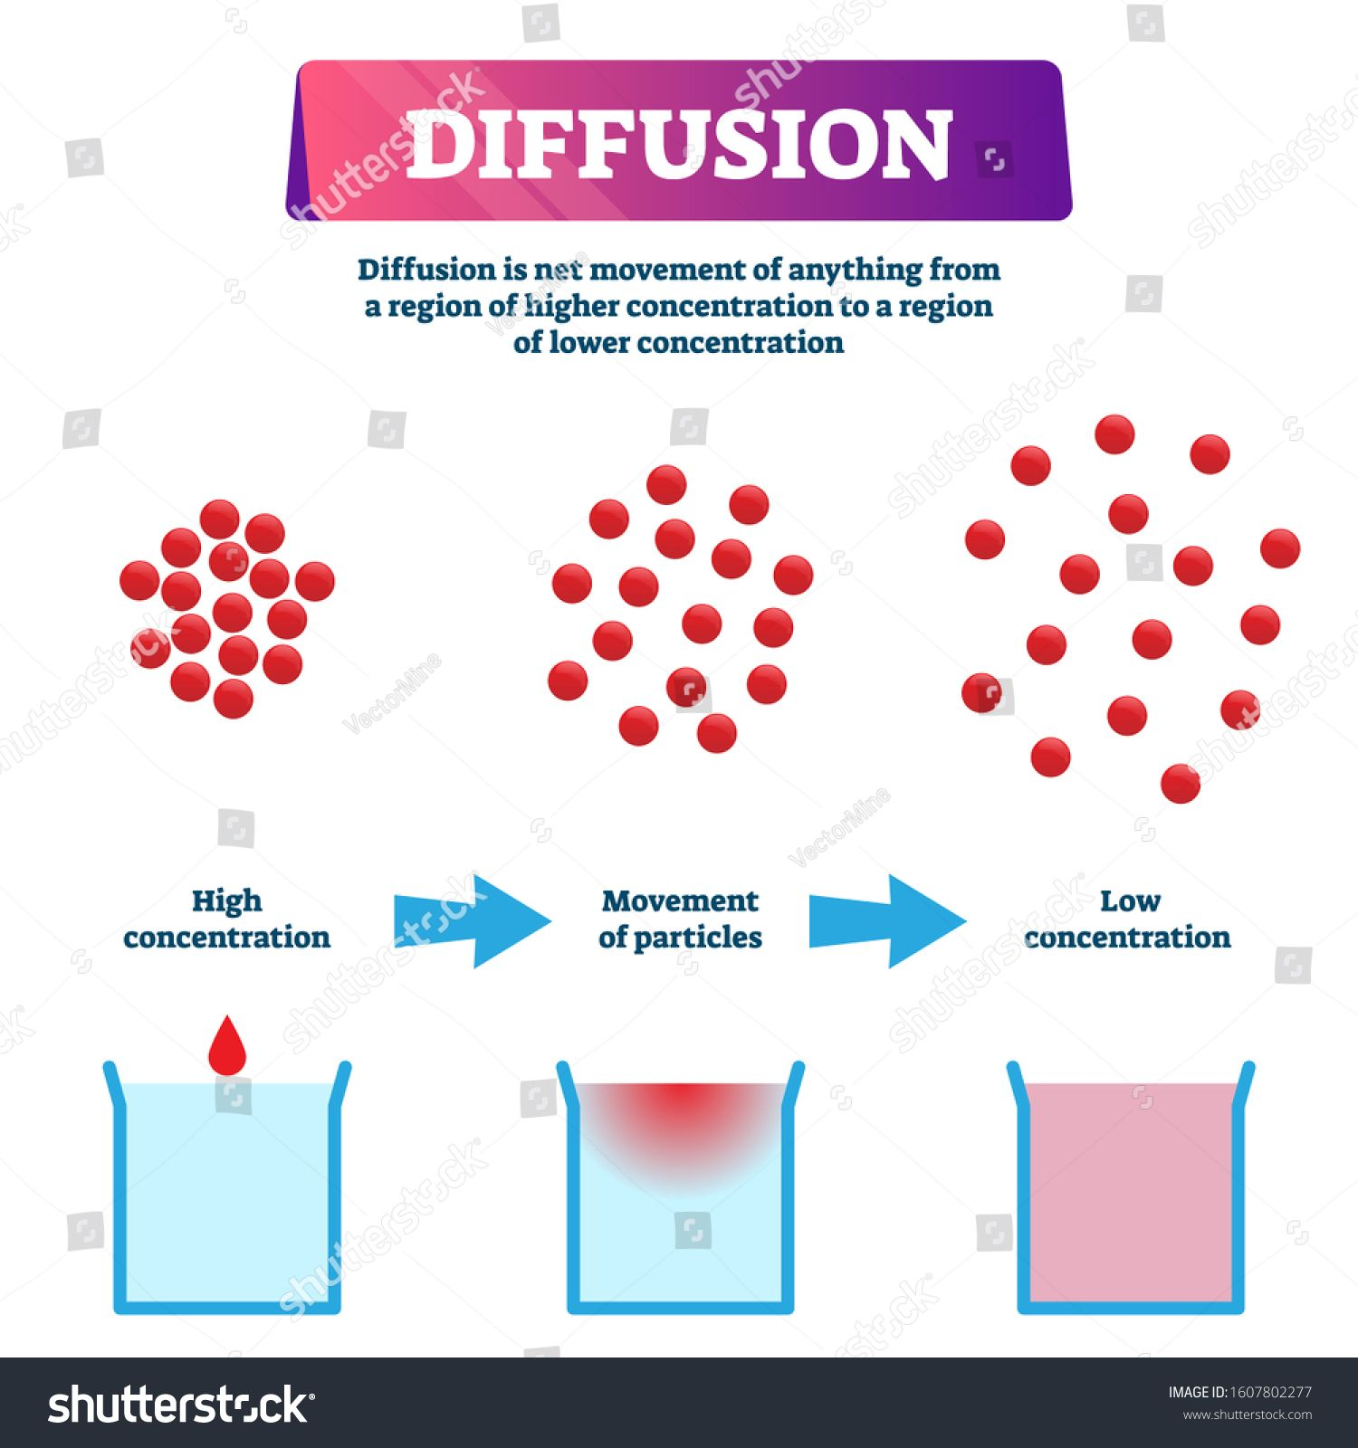

Slide 7
Osmosis:
Osmosis is the movement of water molecules from a dilute solution to a concentrated solution.
It occurs through a semi-permeable membrane.
Only water molecules can pass through the membrane.
Osmosis is important for the survival of plant and animal cells.
For example, a potato strip swells in plain water and shrinks in salt water.

Slide 8
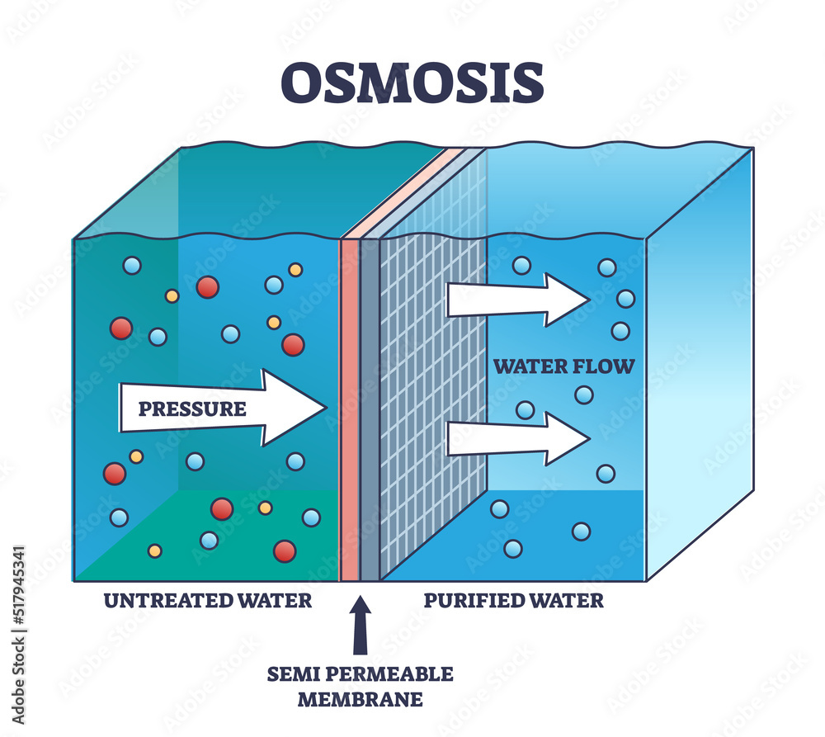

Slide 9
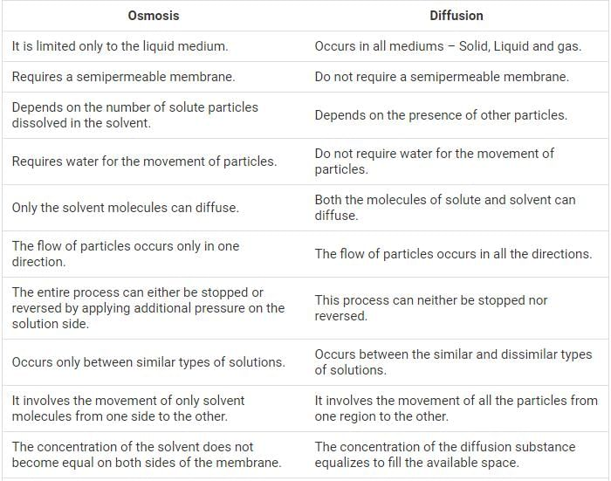

Slide 10
Conclusion:
Osmosis and diffusion are essential processes in living organisms.
Diffusion helps particles move from a region of high concentration to low concentration.
Osmosis is the movement of water through a semi-permeable membrane.
Both processes help in the transport of substances in cells.
They maintain proper balance of water and nutrients in living organisms.
Osmosis and diffusion support growth and survival of plants and animals.
Without these processes, life would not be possible.

Slide 11
References:
NCERT Science Textbook – Class 9, Chapter: The Fundamental Unit of Life
Science Notes provided by school teachers
Biology Lab Manual – Class 9
Educational science websites (for diagrams and understanding)
Classroom lecture notes

Slide 12


