Slide 1
COMP 346 – Fall 2020
Tutorial # 1
1
PROCESSES & THREADS

Slide 2
TUT-Introduction
What do we do in our tutoring sessions?
Quick Review
Working on Fundamentals
Solving Sample Questions
Midterm and Final preparation
How to contact your TA?
E-mail address available on the course outline :

Slide 3


Slide 4
Process
Process is a program in execution
A process has a self-contained execution environment.
Each process has its own memory space.
What the user sees as a single application may in fact be a set of cooperating processes.
Most implementations of the Java virtual machine run as a single process.

Slide 5
Process
Program itself is not a process
Program is a passive entity
Process is active entity
A program becomes a process when an executable file is loaded into memory
Double-clicking
Icon
Two processes can be associated with the same program

Slide 6
Process
Example: MS Word, Google Chrome

Slide 7
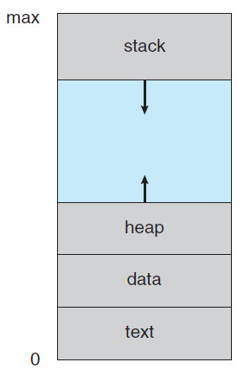
Process in Memory
Stack: contains temporary data
Heap: dynamic memory data
Data: Global variables
Text: code

Slide 8
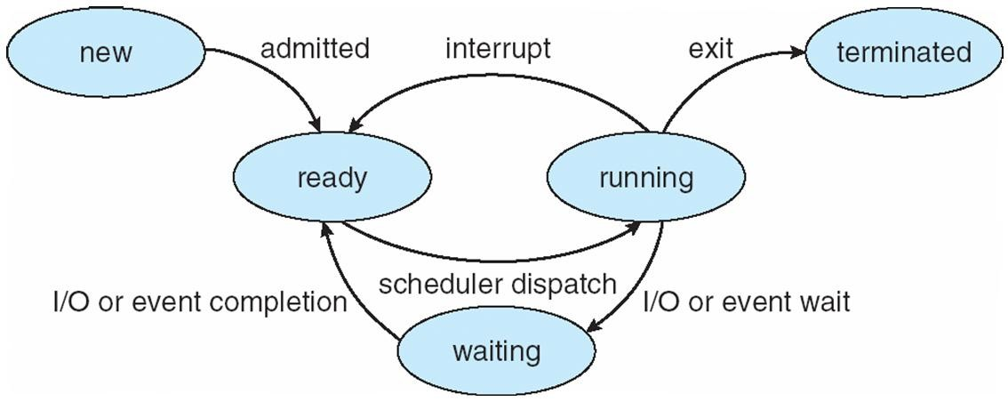
Diagram of Process State

Slide 9
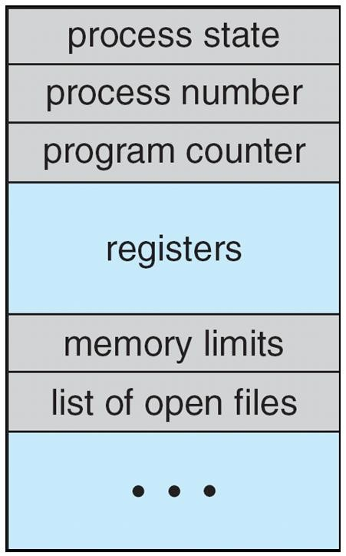
Process Control Block (PCB)
Process State: new, ready, …
Process number: Unique ID
Program counter: the address of the next instruction to be executed
Registers: state information when an interrupt occurs
Memory limits: base and limit of memory address
List of open files:

Slide 10
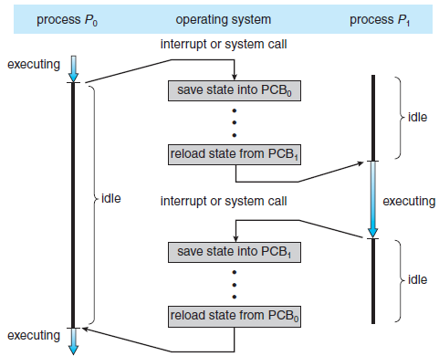
CPU switch from process to process

Slide 11
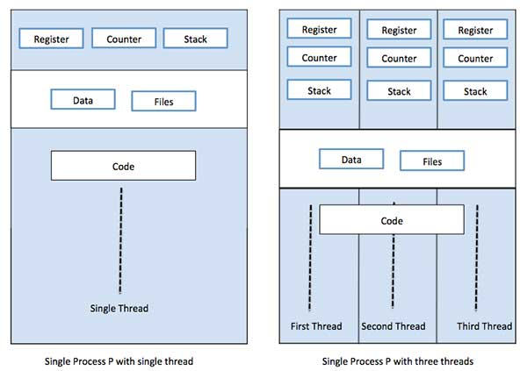
SINGLE & MULTIPLE THREAD OF CONTROL

Slide 12
Difference between Process and Thread
S.N. | Process | Thread
1 | Process is heavy weight or resource intensive. | Thread is light weight, taking lesser resources than a process.
2 | Process switching needs interaction with operating system. | Thread switching does not need to interact with operating system.
3 | In multiple processing environments, each process executes the same code but has its own memory and file resources. | All threads can share same set of open files, child processes.
4 | If one process is blocked, then no other process can execute until the first process is unblocked. | While one thread is blocked and waiting, a second thread in the same task can run.
5 | Multiple processes without using threads use more resources. | Multiple threaded processes use fewer resources.
6 | In multiple processes each process operates independently of the others. | One thread can read, write or change another thread's data.

Slide 13
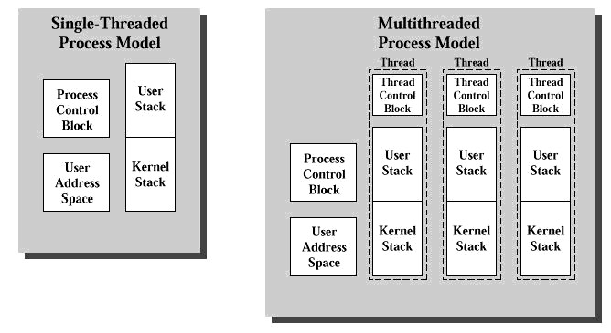
THREAD STRUCTURE [1]

Slide 14
Thread Control Block
The Thread Control Block (TCB) is a structure used to maintain the state of a thread during run-time.
It Includes:
General-Purpose registers
Stacks
Program Counter
Thread ID

Slide 15
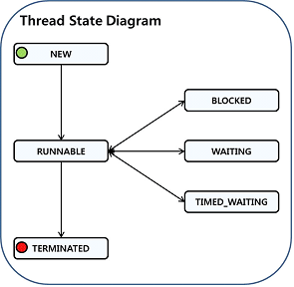
THREAD STATES

Slide 16
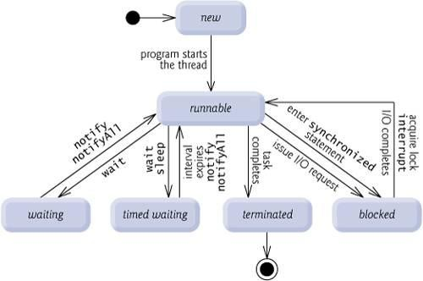
THREAD STATES

Slide 17
THREAD STATES
Figure 1: Thread Status.
NEW: The thread is created but has not been processed yet.
RUNNABLE: The thread is executing in the java virtual machine, but it may be waiting for other resources from operating system such as processor
BLOCKED: The thread is waiting for a different thread to release its lock in order to get the monitor lock.
WAITING: The thread is waiting by using a wait, join method.
TIMED_WAITING: The thread is waiting by using a sleep, wait, join method. (The difference from WAITING is that the maximum waiting time is specified by the method parameter, and WAITING can be relieved by time as well as external changes.)

Slide 18
Advantages of Thread
Threads minimize the context switching time.
Use of threads provides concurrency within a process.
Efficient communication.
It is more economical to create and context switch threads.
Threads allow utilization of multiprocessor architectures to a greater scale and efficiency.

Slide 19
THREAD CREATION
Extending the Thread class
Implementing the Runnable interface

Slide 20
EXAMPLE 1
class ThreadEx1 extends Thread { private string name, ThreadEx1(String name) {
this.name = name;
}
public void run() {
for (int i = 0; i < 100; i++) { System.out.print(“I am “ + name);
}
}
}

Slide 21
EXAMPLE 1
class Test1 {
public static void main(String args[])
{
ThreadEx1 tr1 = new ThreadEx1
(“alpha");
ThreadEx1 tr2 = new ThreadEx1 (“beta");
tr1.start(); // Start the first thread tr2.start(); // Start the second thread
}
}

Slide 22
EXAMPLE 2
class ThreadEx2 implements Runnable { private String name; ThreadEx2(String name) {
this.name = name;
}
public void run() {
for (int i = 0; i < 100; i++) { System.out.print(“I am “ + name);
}
}
}

Slide 23
EXAMPLE 2
class Test2 {
public static void main(String args[]) { Thread tr1 = new Thread(new
ThreadEx2 (“alpha"));
Thread tr2 = new Thread(new
ThreadEx2 (“beta"));
tr1.start(); // Start the first thread tr2.start(); // Start the second thread
}
}

Slide 24
JOIN() METHOD
class Test2 {
public static void main(String args[]) {
Thread tr1,tr2
tr1 = new Thread(new ThreadEx2 "alpha"));
tr2 = new Thread( new ThreadEx2
("beta"));
tr1.start(); // Start the first thread
tr2.start(); // Start the second thread
tr1.join();
Try{
tr2.join();
} catch (InterruptedException e) {}
System.out.println(“main finished”);
}
}
16

Slide 25
Threads Concept
Multiple threads on multiple CPUs
Thread 1
Thread 2
Thread 3
Multiple threads sharing a single CPU
Thread 1
Thread 2
Thread 3

Slide 26
Types of Thread
Threads are implemented in following two ways:
User Level Threads − User managed threads.
Kernel Level Threads − Operating System managed threads acting on kernel, an operating system core

Slide 27
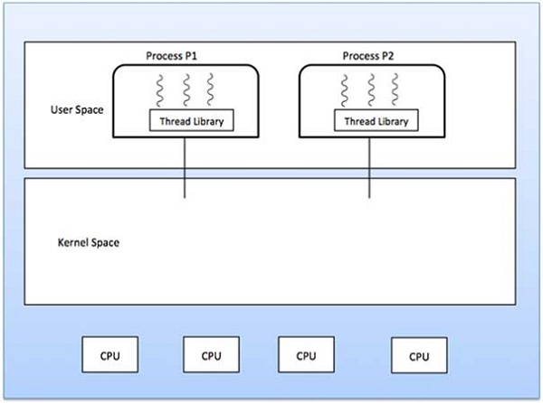
User Level Threads
In this case, the thread management kernel is not aware of the existence of threads.
The thread library contains code for creating and destroying threads, for passing message and data between threads, for scheduling thread execution and for saving and restoring thread contexts.
The application starts with a single thread.

Slide 28
User Level Threads – Cont…
Advantages
Thread switching does not require Kernel mode privileges.
User level thread can run on any operating system.
Scheduling can be application specific in the user level thread.
User level threads are fast to create and manage.
Disadvantages
In a typical operating system, most system calls are blocking.
Multithreaded application cannot take advantage of multiprocessing.

Slide 29
Kernel Level Threads
In this case, thread management is done by the Kernel.
There is no thread management code in the application area.
Kernel threads are supported directly by the operating system.
Any application can be programmed to be multithreaded.
All of the threads within an application are supported within a single process.
The Kernel maintains context information for the process as a whole and for individuals threads within the process.
Scheduling by the Kernel is done on a thread basis.
The Kernel performs thread creation, scheduling and management in Kernel space. Kernel threads are generally slower to create and manage than the user threads.

Slide 30
Kernel Level Threads – Cont…
Advantages
Kernel can simultaneously schedule multiple threads from the same process on multiple processes.
If one thread in a process is blocked, the Kernel can schedule another thread of the same process.
Kernel routines themselves can be multithreaded.
Disadvantages
Kernel threads are generally slower to create and manage than the user threads.
Transfer of control from one thread to another within the same process requires a mode switch to the Kernel.

Slide 31
Difference between User-Level & Kernel-Level Thread
S.N. | User-Level Threads | Kernel-Level Thread
1 | User-level threads are faster to create and manage. | Kernel-level threads are slower to create and manage.
2 | Implementation is by a thread library at the user level. | Operating system supports creation of Kernel threads.
3 | User-level thread is generic and can run on any operating system. | Kernel-level thread is specific to the operating system.
4 | Multi-threaded applications cannot take advantage of multiprocessing. | Kernel routines themselves can be multithreaded.

Slide 32
CONTEXT SWITCH
A context switch (also sometimes referred to as a process switch or a task switch) is the switching of the CPU from one process or thread to another.
A context is the contents of a CPU's registers and program counter at any point in time

Slide 33
STEPS
suspending the progression of one process and storing the CPU's
state (i.e., the context) for that process somewhere in memory
retrieving the context of the next process from memory and restoring it in the CPU's registers
returning to the location indicated by the program counter (i.e., returning to the line of code at which the process was interrupted) in order to resume the process.

Slide 34
Thread Scheduling
Two different thread implementations
“Native thread” implementation (e.g. Windows):
Performs time-slicing. Interrupts the running thread
periodically to give other threads a chance to run.
“Green thread” implementation (e.g. Solaris)
Does not perform time-slicing. It keeps a running thread active until a higher-priority thread awakes and takes control.

Slide 35
Sleep() vs. yield()
There is a big difference
Calling sleep put the current running thread into the blocked state
Calling yield does not put the calling
thread, t1 into the blocked state
It merely let the scheduler kick in and
pick another thread to run.
It might happen that the t1 is select to run again. This happens when t1 has a higher priority than all other runnable threads.

Slide 36
Problem-Solving1
In a non-preemptive system, can a process still go into the waiting state?

Slide 37
Problem-Solving2
Could we run multiple threads on a single core machine without pre-emption?

Slide 38
Problem-Solving3
Explain the difference between the following pairs, or justify why they are identical:
Threads and Processes
Interrupts and System calls
Single Core and Single Program System
fork() and start()
What controls Java Threads?

Slide 39
Problem-Solving4
Thread Concurrency –pseudo code
Translate the deposit() and withdraw() code into pseudo-assembly
When could a context switch / interrupt occur?
Show how a deposit method can fail with two parallel threads
Same for withdraw
Deposit(amount) | Withdraw(amount)
Balance += amount; | Balance -= amount;

Slide 40
REFERENCES
[1] http://users.encs.concordia.ca/~m_barho/COMP346/
[2]ttp://rds.yahoo.com/_ylt=A0LEVVRGJipMblUALJ0PxQt.;_ylu=X3oDMTExbzdyNm41BHNlYwNzcgRwb3MDNgRjb2xvA3JlNAR2dGlkAwRsA1dTMQ/SIG=128rnl1c0/EXP=1277917126/**http%3A//courses.washington.edu/css430/ppt/Threads.ppt
[3] http//:courses.washington.edu/css430/syllabi/w05.html
[4] http://www.pcguide.com/ref/hdd/if/ide/modesDMA-c.html
[5] faculty.uscupstate.edu/fli/fall11/scsc511/Slides/03.ppt
[6] www.cse.ust.hk/~liao/comp201/slides/24slide.ppt
[7] http://architects.dzone.com/articles/how-analyze-java-thread-dumps
[8] http://sivaeluri.blogspot.ca/2012/08/java-programming-interview-questions-2.html
[9] Source of sample questions: Prepared by: François Gingras Myriam Kharma
[10] https://www.tutorialspoint.com/operating_system
[11] http://www.geeksforgeeks.org/

