Slide 1
Comp 346
Tutorial 6 Memory Management

Slide 2
Memory Management
Main memory (RAM) needs to be divided to accommodate multiple programs in execution.
The more efficient the allocation of memory, the more programs will be able to run concurrently.

Slide 3
Requirements
Relocation
Protection
Sharing
Logical Organization
Physical Organization

Slide 4
Memory Management: Requiremtns
Relocation
What it is:
The programmer does not know where the program will be placed in memory when it is executed.
While the program is executing, it may be swapped to disk and returned to main memory at a diﬀerent location.
What it implies:
Memory references must be translated in the code to actual physical memory address.

Slide 5
Memory Management: Requiremtns
Protection (closely related with Relocation)
Why we need it:
To protect a process from interference by other processes.
What it implies:
Processes require permission to access memory in another processes address space.
Because of relocation, it’s impossible to check address in programs since the program could be relocated.
Must be checked at run time!

Slide 6
Memory Management: Requiremtns
Sharing (closely related with Relocation)
What it is:
It allows several processes to access the same data.
It allows multiple programs to share the same program text.
How it’s done:
Each OS provides its own API.
Some libraries provide their own implementation (e.g., Qt, Boost for C++).

Slide 7
Memory Management: Requiremtns
Logical Organization
What it is:
Programs are organized into modules (stack, text, uninitialized data, or logical modules such as libraries, objects, etc.).
What it means:
Code modules may be compiled independently.
Diﬀerent degrees of protection can be given to modules (read-­only, execute-­only).
Modules can be shared.

Slide 8
Memory Management: Requiremtns
Physical Organization
What it is:
Memory is organized into two levels: main and secondary memory.
Main memory is relatively fast, expensive, and volatile.
Secondary memory is relatively slow, cheaper, has larger capacity, and non-volatile.
Why we need it:
The memory available for a program plus its data may be insuﬃcient.

Slide 9
Memory Partitioning Techniques
Without using virtual memory:
Partitioning – Fixed or Dynamic
Simple paging
Simple segmentation
Using virtual memory:
Paging
Segmentation
A combination of both

Slide 10
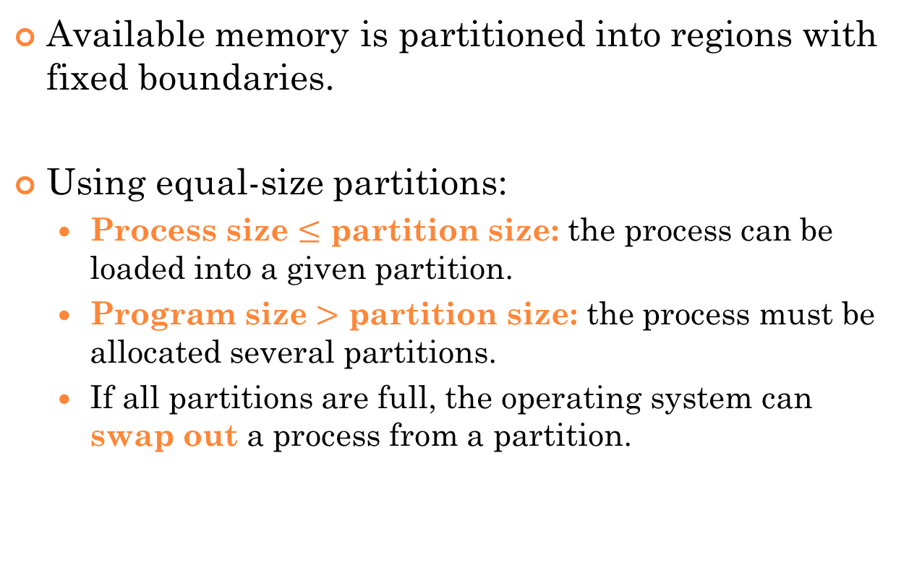
Fixed Partitioning
Available memory is partitioned into regions with fixed boundaries.
Using equal-size partitions:
Process size $≤$ partition size: the process can be loaded into a given partition.
Program size $>$ partition size: the process must be allocated several partitions.
If all partitions are full, the operating system can swap out a process from a partition.

Slide 11
Fixed Partitioning – Equal size
Main memory use is efficient:
Internal fragmentation – part of partition unused.
Operating System 8 M
8 M
Process 1
Unused
8 M
8 M

Slide 12
Fixed Partitioning – Unequal Sizes
Lessens the problem with equal-size partitions.
Operating System 8 M
2 M
Process 1 (4M)
6 M
8 M
8 M
12 M

Slide 13
Placement Algorithms with Partitions
Equal-size partitions:
Because all partitions are of equal size, it does not matter which partition is used.
Unequal-size partitions:
Processes can be allocated the first available partition (“First Fit” algorithm).
Processes can be allocated the next available partition (“Next Fit” algorithm).
Each process can be allocated the smallest partition within which it will ﬁt (“Best Fit” algorithm).

Slide 14

One Process Queue per Partition
Operating
System
New Processes

Slide 15
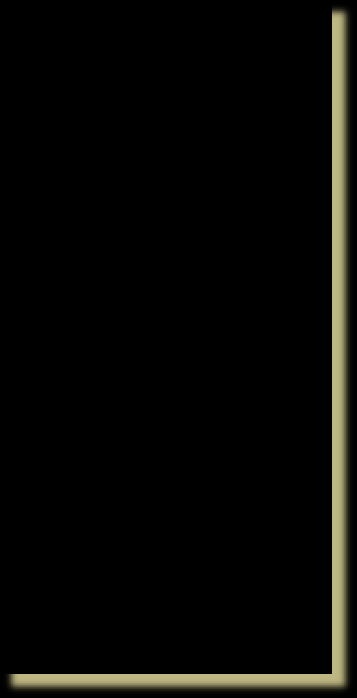
One Process Queue for All
Smallest available partition that will hold the process is selected.
Operating System
New Processes

Slide 16
Dynamic Partitioning
Partitions are of variable length and number.
A process is allocated exactly the required amount of memory.
Compaction – shifting processes so they are contiguous and all free memory is in one block.
External fragmentation – small holes in memory between allocated partitions.

Slide 17

Example of Dynamic Partitioning
Operating System
Operating System
Process 1
Operating System
Process 1
Process 2
128 K
320 K
320 K
224 K
896 K
576 K
352 K

Slide 18
Example of Dynamic Partitioning
Operating System
Process 1
Process 2
Process 3
Operating System
Process 1
Process 3
Operating System
Process 1
Process 4
Process 3
320 K
320 K
320 K
224 K
224 K
128 K
96 K
288 K
288 K
288 K
64 K
64 K
64 K

Slide 19
Example of Dynamic Partitioning
Operating System
Process 4
Process 3
Operating System
Process 2
Process 4
Process 3
320 K
128 K
96 K
288 K
64 K
224 k
96 K
128 K
96 K
288 K
64 K

Slide 20
Dynamic Partitioning Placement Algorithm
“First-­ﬁt” algorithm
Chooses the first block from the beginning that will fit the requirements of the process.
The fastest:
May have to scan through a large number of existing processes.

Slide 21
Dynamic Partitioning Placement Algorithm
“Next-­ﬁt” algorithm
Chooses the next block from the last allocation that will fit the requirements of the process.
Average overall performance:
Often involves allocating the last available block in memory.
Requires a significant number of compaction operations.

Slide 22
Dynamic Partitioning Placement Algorithm
“Best-­ﬁt” algorithm
Chooses block that is closest in size to the request
Worst performance overall:
Results in minimally sized fragments, requiring compaction.

Slide 23
Dynamic Partitioning Placement Algorithm
8K |  |  | alloc 16K block | 8K
12K |  |  | First Fit | 12K
22K
 |  |  | Best Fit | 6K
Last allocated
18K
block (14K)
2K
8K
6K
8K
6K
Allocated block Free block
Next Fit
14K
14K
36K
20K
Before
After

Slide 24
Q1
Consider a memory manager that maintains a free list of blocks of sizes 600, 400, 1000, 250, 1600, and 1050 bytes. Assume that the block of 600 bytes is at the head of the list. Also, suppose that there are 5 processes (say P1, P2, P3, P4, P5) with respective sizes of 1352, 167, 753, 572, and 1050 bytes. Memory is allocated to the processes in order P1, P2, P3, P4, P5, and all the processes are loaded in memory prior to their execution.
(i) Using the best fit placement algorithm, show which memory block is assigned to a given process.
(ii) Using the next fit placement algorithm, show which memory block is assigned to a given process. Assume that the pointer currently points at the head of the list.
(iii) Calculate the total internal fragmentation for the placement algorithms used in (i).
(iv) Calculate the total internal fragmentation for the placement algorithms used in (ii).

Slide 25
S1
(i) Using the best fit placement algorithm, show which memory block is assigned to a given process.
P1 ←1600, P2 ← 250, P3 ← 1000, P4 ← 600, P5 ← 1050
(ii) Using the next fit placement algorithm, show which memory block is assigned to a given process. Assume that the pointer currently points at the head of the list.
P1 ← 1600, P2 ← 1050, P3 ← 1000, P4 ← 600, P5 ← none (external fragmentation)
(iii) Calculate the total internal fragmentation for the placement algorithms used in (i).
fi = (1600-1352) + (250-167) + (1000-753) + (600-572) + (1050-1050) = 248 + 83 + 247 + 28 + 0 = 606 bytes
(iv) Calculate the total internal fragmentation for the placement algorithms used in (ii).
fi = (1600-1352) + (1050-167) + (1000-753) + (600-572) = 248 + 883 + 247 + 28 = 1403 bytes

Slide 26
Relocation
As a process is created, absolute memory locations are assigned to it.
These locations are different every time the program is executed.
Compaction also causes changes to these locations.

Slide 27
Addresses
Logical
A reference to a memory location independent of the current assignment of data to memory.
Requires a mapping with the physical address.
Physical
The absolute address or actual location in memory.

Slide 28
Hardware Support For Relocation
Relative address
Base Register
Process Control
Block
Adder
Program
Absolute
Bounds Register
address
Comparator
Data
Interrupt to operating system
Stack
Process image in
main memory

Slide 29
Paging
Partitions memory into equal-­sized chunks.
These are called frames.
Divide each process into same-sized chunks.
These are called pages.
The operating system maintains a page table for each process.
Contains a mapping between a page and a frame.
absolute = page_number * chunk_size + offset

Slide 30
Paging
Frame Number
0 |  | 0 | A.0 | 0
1 |  | 1 | A.1 | 1
2 |  | 2 | A.2 | 2
3 |  | 3 | A.3 | 3
4 |  | 4 |  | 4
5 |  | 5 |  | 5
6 |  | 6 |  | 6
7 |  | 7 |  | 7
8 |  | 8 |  | 8
9 |  | 9 |  | 9
10 |  | 10 |  | 10
11 |  | 11 |  | 11
12 |  | 12 |  | 12
13 |  | 13 |  | 13
14 |  | 14 |  | 14
A.0
A.1
A.2
A.3
B.0
B.1
B.2

Slide 31
Paging
0
1
2
3
4
5
6
7
8
9
10
11
12
13
14
A.0
0
1
2
3
4
5
6
7
8
9
10
11
12
13
14
A.0
A.1
A.2
A.3
C.0
C.1
C.2
C.3
0
1
2
3
4
5
6
7
8
9
10
11
12
13
14
A.0
A.1
A.2
A.3
D.0
D.1
D.2
C.0
C.1
C.2
C.3
D.3
D.4
A.1
A.2
A.3
B.0
B.1
B.2
C.0
C.1
C.2
C.3

Slide 32
Page Tables for Example
0 | 0 | 0 | --- | 0 | 7 | 0 | 4 |  | 13
1 | 1 | 1 | --- | 1 | 8 | 1 | 5 |  | 14
2 | 2 | 2 | --- | 2 | 9 | 2 | 6
3
3
3
10
3
4
11
12
Free Frame List
Process B
Process C
Process A
Process D

Slide 33
Segmentation
Segments do not have to be the same length.
However, there is a maximum segment length.
Addressing consists of two parts - a segment number and an offset.
Since segments are not equal, segmentation is similar to dynamic partitioning.
31

Slide 34
Addressing Segments
The segment number is used as an index in a mapping table (similar to paging).
This table contains the physical address of the start of the segment (called the base address).
The offset is added to the base address to generate the physical address.
The offset is checked against a limit (the size of the segment).
absolute = base_address + offset
32

Slide 35
Addressing Segments
limit
base
S
o
logical address
segment table
yes
Physical Address
o < limit
+
no
33
error

Slide 36
Q.2
Consider a system with a logical address space of 1 GB, a physical memory of 64 MB, a block size of 1 KB, and a process address space of 143 KB.
(i) Calculate the format of a logical address .
(ii) Calculate the format of a physical address .
(iii) For the logical address 20514 calculate the physical address . Assume that the page that contains the logical address 20514 is loaded in frame number 4100.

Slide 37


S.2
(i) Calculate the format of a logical address.
(ii) Calculate the format of a physical address.
(iii) For the logical address 20514 calculate the physical address. Assume that the page that contains the logical address 20514 is loaded in frame number 4100.
Page number of address 20514 is: floor(20514/1024) = 20
Displacement within page 20 is: 20514 % 1024 = 34
Base address of frame number 4100 in physical memory is: 4100 * 1024 = 4198400
Physical address: 4198400 + 34 = 4198434

