Slide 1
Memory Management (Virtual Memory)
Comp 346

Slide 2
Virtual Memory
A process may be broken up into pieces (pages or segments) that do not need to be located contiguously in main memory
Memory references are dynamically translated into physical addresses at run time
a process may be swapped in and out of main memory such that it occupies different regions
These characteristics lead to a breakthrough: it is not necessary for all pages/segments of a process to be in main memory during execution
Execution can proceed as long as the instruction and data needed next are in main memory
2

Slide 3
Advantages of Partial Loading
More processes can be maintained in main memory
We only load some of the pieces of each process, so there is room for more processes
with more processes in main memory, it is more likely that a process will be in the Ready state at any given time, improving processor utilization
A process can now execute even if it is larger than the main memory size
3

Slide 4
Possibility of Thrashing
To accommodate as many processes as possible, only a few pieces of each process are maintained in main memory
But main memory may be full: when the OS brings one piece in, it must swap one piece out
The OS must not swap out a piece of a process just before that piece is needed
If it does this too often this leads to thrashing:
the processor spends most of its time swapping pieces rather than executing user instructions
4

Slide 5
Principle of Locality
Principle of locality states that program and data references within a process tend to cluster
Hence, only a few pieces of a process will be needed over a short period of time
Use principle of locality to make intelligent guesses about which pieces will be needed in the near future to avoid thrashing
5

Slide 6
Address Translation in a Paging System
Translate virtual (logical) address into real (physical) address using page table
Virtual address: (page #, offset)
Real address: (frame #, offset)
Page # is used to index the page table and look up the corresponding frame #
Frame # combined with the offset produces the real address
6

Slide 7
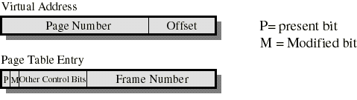
Paging
Each page table entry contains a present bit to indicate whether the page is in main memory or not.
if it is in main memory, the entry contains the frame number of the corresponding page in main memory
if it is not in main memory, the entry may contain the address of that page on disk or the page number may be used to index another table (often in the PCB) to obtain the address of that page on disk
Typically, each process has its own page table
7

Slide 8
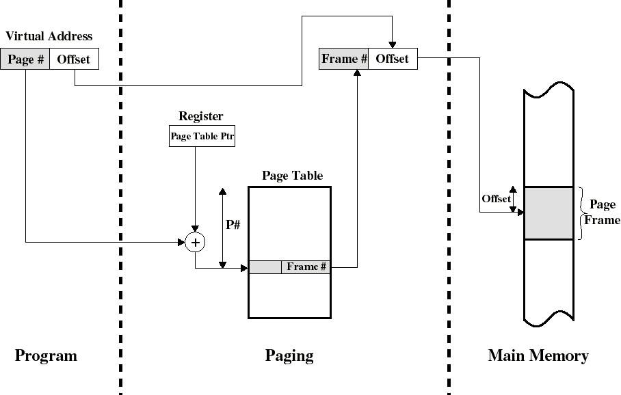
Address Translation in a Paging System
8

Slide 9
Page Tables and Virtual Memory
Most computer systems support a very large virtual address space
32 to 64 bits are used for logical addresses
if (only) 32 bits are used with 4KB pages, a page table may have 2²⁰ entries
The entire page table may take up too much main memory. Hence, page tables are often also stored in virtual memory and subjected to paging
when a process is running, part of its page table must be in main memory (including the page table entry of the currently executing page)
9

Slide 10
Multilevel Page Tables
Since a page table will generally require several pages to be stored. One solution is to organize page tables into a multilevel hierarchy
when 2 levels are used (ex: 386, Pentium), the page number is split into two numbers p1 and p2
First level: root page table (outer page table or page directory)
Second level: process page table (user page table)
The root page table entries point to pages of the process page table
p1 indexes the outer page table and p2 indexes the resulting page in the process page table
Page directory is always kept in main memory, but part of the process page table may be swapped out.
10

Slide 11
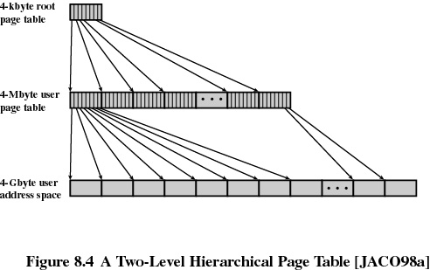
Two-level Page Tables
11

Slide 12
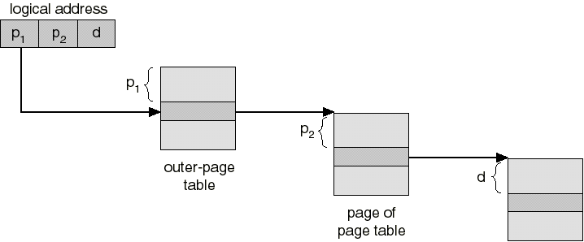
Two-level Page Tables
page of
process
12

Slide 13
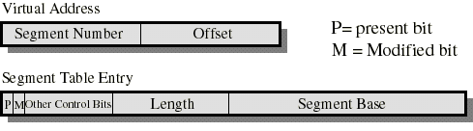
Segmentation
Typically, each process has its own segment table
Similarly to paging, each segment table entry contains a present bit and a modified bit
If the segment is in main memory, the entry contains the starting (base) address and the length of that segment
Other control bits may be present if protection and sharing is managed at the segment level
Logical to physical address translation is similar to paging except that the offset is added to the starting address (instead of being appended)
13

Slide 14
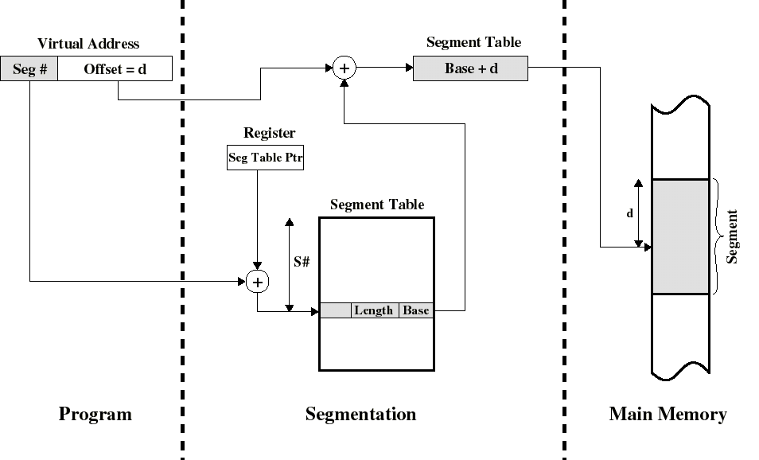
Address Translation in a Segmentation System
Physical address
14

Slide 15
Combined Segmentation and Paging
To combine their advantages some processors and OS page the segments
Several combinations exists. Here is a simple one
Each process has:
one segment table
several page tables: one page table per segment
The virtual address consists of:
a segment number: used to index the segment table whose entry gives the starting address of the page table for that segment
a page number: used to index that page table to obtain the corresponding frame number
an offset: used to locate the word within the frame
15

Slide 16
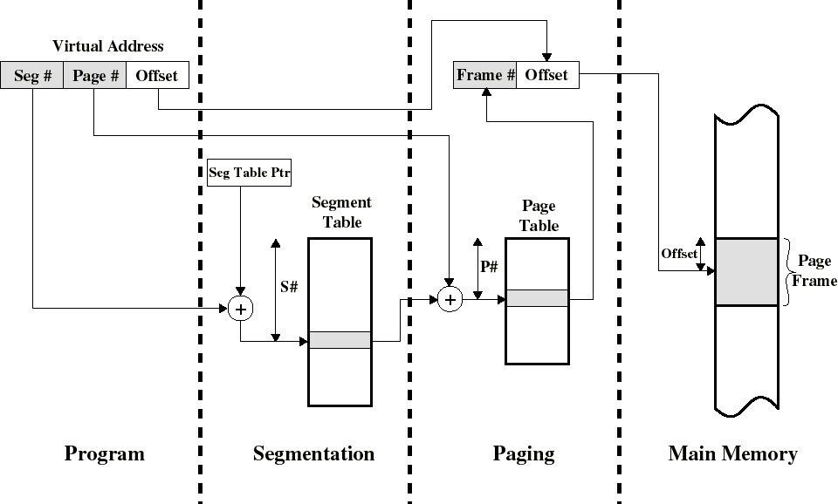
Address Translation in a combined Segmentation/Paging System
16

Slide 17
Static Paging Algorithms
When process starts, it is allocated a fixed number of frames in RAM.
Paging Policies: defines how pages will be loaded/unloaded into frames allocated to the process.
17

Slide 18
Basic Paging Policies
1.Fetch Policy: determines when a page should be loaded into RAM.
2.Replacement Policy: if all frames are full, determines which page should be replaced.
18

Slide 19
Demand Paging
Since the page reference stream is not known ahead of time, we can’t “pre-fetch” pages.
We know which page to load during run-time so we load them on “demand”.
Result: concentrate on replacement policies.
19

Slide 20
Replacement Algorithms
Optimal policy
selects for replacement the page for which the time to the next reference is the longest
produces the fewest number of page faults
impossible to implement (need to know the future) but serves as a standard to compare with the other algorithms we shall study
Least recently used (LRU)
First-in, first-out (FIFO)
Clock
20

Slide 21
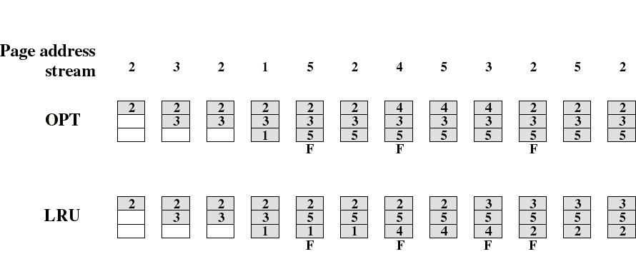
LRU Policy
Replaces the page that has not been referenced for the longest time
by the principle of locality, this page is least likely to be referenced in the near future
performs nearly as well as the optimal policy
Example: A process of 5 pages with an OS that fixes the resident set size to 3
21

Slide 22
FIFO Policy
Treats page frames allocated to a process as a circular buffer; pages removed in round-robin style
When the buffer is full, the page that has been in memory the longest is replaced. Hence, first-in, first-out
A page fetched into memory a long time ago may now have fallen out of use
But a frequently used page is often the oldest, so it will be repeatedly paged out by FIFO
Simple to implement
requires only a pointer that circles through the page frames of the process
22

Slide 23

Comparison of FIFO with LRU
LRU recognizes that pages 2 and 5 are referenced more frequently than others but FIFO does not
FIFO performs relatively poorly
23

Slide 24

Clock Policy
The set of frames that are candidates for replacement (local or global scope) is considered as a circular buffer
When a page is replaced, a pointer is set to point to the next frame in buffer
A use bit for each frame is set to 1 whenever
a page is first loaded into the frame
the page is referenced
When it is time to replace a page, the first frame encountered with the use bit set to 0 is replaced
during the search for replacement, each use bit set to 1 is changed to 0
24

Slide 25
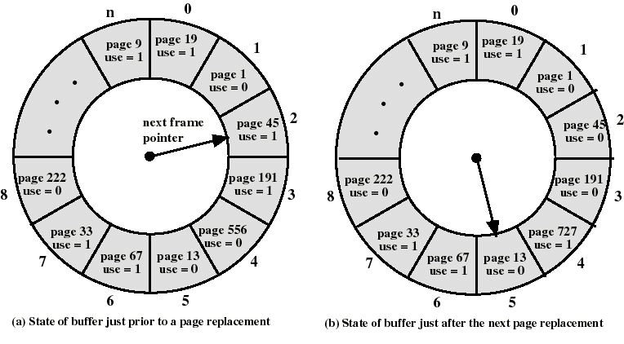
Clock Policy: An Example
25

Slide 26
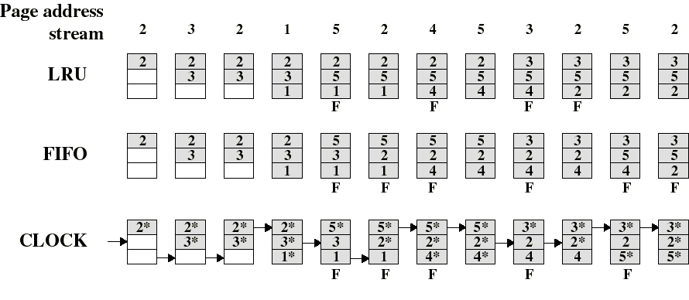
Comparison of Clock with FIFO and LRU
Asterisk indicates that the corresponding use bit is set to 1
Clock protects frequently referenced pages by setting the use bit to 1 at each reference
26

Slide 27
Clock policy: Comments
If all frames have a use bit of 1, then the pointer will make one full circle setting all use bits to 0. It stops at the starting position because it can now replace the page in that frame.
Similar to FIFO, except frames with use bit set to 1 are passed over
Numerical experiments tend to show that performance of Clock is close to that of LRU
Many OS’es use variations of the clock algorithm. Example: Solaris
27

Slide 28
Problem solving 1
Show the memory representation using the LRU algorithms and calculate the page fault rate.
Consider the reference string R={0, 1, 0,1, 0, 1, 2, 3, 4, 5, 3, 4, 5, 6, 7, 8, 9} and an allocation of 3 frames for a given process.

Slide 29
Solution

