Slide 1
Comp 346
Tutorial 8 CPU Scheduling

Slide 2
Why do we need scheduling?
To manage processes according to requirements of a system, like:
User responsiveness or
Throughput
Performance of a scheduler is determined mainly by:
Context switch time
Scheduling policy

Slide 3
Context Switch!
Switching from one process running on the CPU to another process:
Saves all the registers of outgoing process (to memory), then loads all the registers of incoming process (from memory)
Can be time-costly; mostly hardware-dependent

Slide 4
Scheduling
The mechanism that determines when the CPU will be allocated to processes, and in what order.
Two classes of scheduling strategies:
Non-preemptive
Preemptive

Slide 5
Non-preemptive policies
Allow any process to run to completion once it has been allocated to the CPU. Current process does not get interrupted.
Some examples:
First Come First Serve (FCFS)
Shortest Job First (SJN)
Priority scheduling

Slide 6
Preemptive policies
Allow another process to interrupt current process if:
It has a higher priority
The time quantum has elapsed
Some examples:
Round Robin
Multiple-level Queues

Slide 7
Scheduling Criteria
CPU utilization – keep the CPU as busy as possible
Throughput – number of processes that complete their execution per time unit
Turnaround time – amount of time to execute a particular process
Waiting time – amount of time a process has been waiting in the ready queue
Response time – amount of time it takes from when a request was submitted until the first response is produced, not output (for time-sharing environment)

Slide 8
Scheduling examples
Given three threads, their execution times and I/O needs, apply scheduling policies:
Threads are placed on ready queue in order: T1, T2 then T3
Specific to Round Robin:
Time Quantum of 3ms.
Context switch time considered negligible in this example.

Slide 9
First Come First Serve (FCFS)
Thread | CPU | 1st I/O | 2nd I/O
T1 | 10 ms | n/a | n/a
T2 | 15 ms | at 2ms for 5ms | n/a
T3 | 12 ms | at 4ms for 2ms | at 8ms for 2ms
CPU:
1
2
3
2
3
3
0
5
10
15
20
25
30
35
40
I/O:
2
3
3

Slide 10
Shortest Job First (Nonpreemptive)
Thread | CPU | 1st I/O | 2nd I/O
T1 | 10 ms | n/a | n/a
T2 | 15 ms | at 2ms for 5ms | n/a
T3 | 12 ms | at 4ms for 2ms | at 8ms for 2ms
CPU:
1
3
2
3
2
3
0
5
10
15
20
25
30
35
40
I/O:
3
2
3

Slide 11
Shortest Job First (Preemptive)
Thread | CPU | 1st I/O | 2nd I/O
T1 | 10 ms | n/a | n/a
T2 | 15 ms | at 2ms for 5ms | n/a
T3 | 12 ms | at 4ms for 2ms | at 8ms for 2ms
CPU:
1
3
2
3
2
3
2
0
5
10
15
20
25
30
35
40
I/O:
3
2
3

Slide 12
Priority (Preemptive)
Thread | Prio | CPU | 1st I/O | 2nd I/O
T1 | 2 | 10 ms | n/a | n/a
T2 | 3 | 15 ms | at 2ms for 5ms | n/a
T3 | 1 | 12 ms | at 4ms for 2ms | at 8ms for 2ms
CPU:
3
1
3
1
3
1
2
2
0
5
10
15
20
25
30
35
40
I/O:
3
3
2

Slide 13
Round Robin (3ms)
Thread | CPU | 1st I/O | 2nd I/O
T1 | 10 ms | n/a | n/a
T2 | 15 ms | at 2ms for 5ms | n/a
T3 | 12 ms | at 4ms for 2ms | at 8ms for 2ms
3
1
3
3
2
CPU:
1
2
3
1
2
1
3
2
2
3
2
0
5
10
15
20
25
30
35
40
I/O:
2
3
3
Notes:
Time CPU R.Q. I/O Comments
0 1 23 -
3 2 31 -
5 3 1 2 T2 needs to do I/O
8 1 3 2
10* 1 32 - T2 finishes I/O; is appended to ready queue
11 3 21 - T3 needs to go do I/O after 1 ms
12 2 1 3
14* 2 13 - T3 finishes I/O, goes back on Ready Queue
15 1 32 -
18 3 21 -
21 2 13 -
24 1 32 - T1 finishes executing after 1 ms
25 3 2 - T3 needs to go do I/O after 1 ms
26 2 - 3
28* 2 3 - T3 finishes I/O, goes on ready queue
29 3 2 -
32 2 3 -
35 3 2 - T3 finishes after 1 ms
36 2 - -
All done!
And No Idle Time!

Slide 14
Multilevel Queue (2)
Highest Priority
System Processes
Interactive Processes
Interactive Editing Processes
Batch Processes
Application Processes
Lowest Priority

Slide 15
Multilevel Feedback Queue (1)
Another multilevel queuing strategy allows processes to change their priorities over time, thus, changing levels of the queue.
E.g.: an interactive editing process might become compute intensive, so it’s priority may change to higher.
A strategy, that allows processes change queues is called multilevel feedback queue. (Used in BSD UNIX, for example).

Slide 16
Multilevel Feedback Queue (2)
There is a notion of external priority, that, in addition to the main priority, influence process’s queue.
It’s denoted by a nice value of process. Nice value decreases if a process used CPU for many times during last N time units, and increases if the process hasn’t run for relatively long time, making scheduling more fair.
The scheduler recomputes processes’ priorities once per quantum.
Different quantum lengths on different queue levels attempt to shorten execution of short jobs, make it more fair for longer jobs and reducing frequency of context switching at the same time.

Slide 17
Multilevel Feedback Queue (3)
Multilevel feedback queues.
quantum = 8
quantum = 16
FCFS

Slide 18
Problem-Solving 1 (take home exercises)
Determine the throughput for the following scenario given a Round Robin scheduling algorithm with quantum time = 3 ms, with context switching time = 1 ms

Slide 19
Problem-Solving 2
Consider a system having the following characteristics :
2 parallel CPUs.
1 ready queue that is shared by both CPUs.
Round-robin scheduling is used with a time quantum of 5 units.
Context switching time is infinitely small (i.e. 0).
2 instances of an I/O device that is used by all the processes for their I/O operations.
A load of 4 processes as described in table 1.

Slide 20
Problem-Solving 2 - Solution

Slide 21
Problem-Solving 2 - Solution

Slide 22
Problem-Solving 3
The procedure ContextSwitch is called whenever there is a switch in context from a running program A to another program B. The procedure is a straight-forward assembly language routine that saves and restores registers, and must be atomic (i.e., unbreakable). Something disastrous can happen if the routine ContextSwitch is not atomic.
Explain why ContextSwitch must be atomic, possibly with an example.
Explain how the atomicity can be achieved in practice (Hint: It has something to do with interrupts).

Slide 23
Problem-Solving 3 (Solution)
If the context switch routine is interrupted then the system may become unstable because the next process may resume with an inconsistent state. Context switch must be atomic in order to avoid the system instability.
Atomicity is achieved mostly by disabling the interrupts.

Slide 24
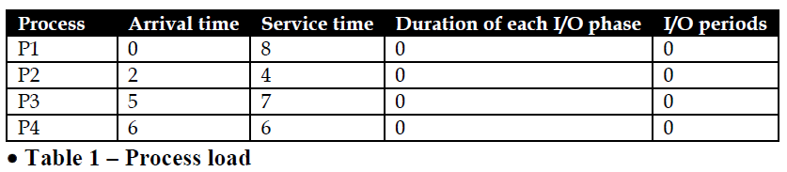
Problem-Solving 4
Consider a system having the following characteristics :
2 parallel CPUs.
1 ready queue that is shared by both CPUs.
Round-robin scheduling is used with a time quantum of 5 units.
Context switching time is infinitely small (i.e. 0).
No I/O operations.
A load of 4 processes as described in table 1.

Slide 25
Problem-Solving 4
Draw a Gantt chart. Show the 2 CPUs and the ready queue.
Calculate the average turnaround time.
Calculate the average waiting time.
Calculate the CPU utilization percentage for the total time period.
Calculate the throughput for the total time period.
Suppose we had a single CPU, would the overall performance be worst, same, or better? Explain for each case (i through v) above.

Slide 26
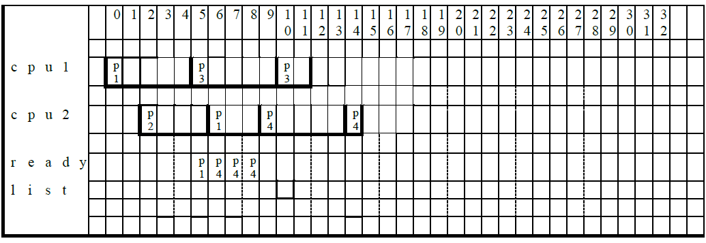
Problem-Solving 4 (Solution)
(i)

Slide 27
Problem-Solving 4 (Solution)
(ii) Calculate the average turnaround time.
Tt = ( (9-0) + (6-2) + (12-5) + (15-6) ) / 4 = (9 + 4 + 7 + 9) / 4 = 29/4 = 7.25
(iii) Calculate the average waiting time.
Tw = (1 + 0 + 0 + 3) / 4 = 4/4 = 1.0
(iv) Calculate the CPU utilization percentage for the total time period.
Tcpu1 = 12/15 = 80% and Tcpu2 = 13/15 = 86.6%
Tcpu = 25/30 = 0.83.33%
(v) Calculate the throughput for the total time period.
Ttp = 4/15= 0.26

Slide 28
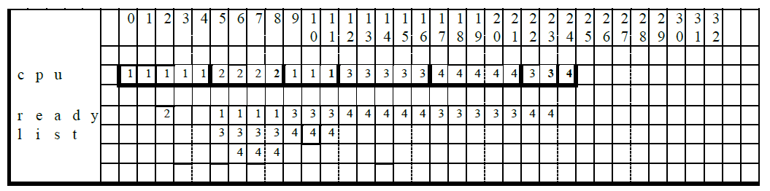
Problem-Solving 4 (Solution)
(vi)

Slide 29
Problem-Solving 4 (Solution)
(vi)
The average turnaround time would be (12+7+19+19)/4 = 57/4 = 19.25.
The average waiting time would be (4+1+12+13)/4 = 30/4 = 7.5.
The percent cpu utilization would be 25/25 = 100%.
The throughput would be 4/25 = 0.16.

Slide 30
References
Previous Tutorial Materials (By Mr. Antonio Maiorano & Mr. Paul Di Marco).
A. Silbershatz, P.B. Galvin, G. Gagne: Operating System Concepts, 9th Ed. John Wiley & Sons, Inc. 2013.
Problem solving questions by François Gingras Myriam Kharma and Kerly Titus

