Slide 1
Comp-346
Deadlock

Slide 2
Topics
Deadlock brief
Simplest Example
Necessary Deadlock Conditions
Resource Allocation Graph
Deadlock Handling
Deadlock with Semaphores
Examples

Slide 3

Deadlock
Simplest example:
Two processes require two resources to complete (and release the resources).
There are only two instances of these resources.
If they acquire one resource each, they block indefinitely waiting for each other to release the other resource =>
DEADLOCK, one of the biggest problems in multiprogramming.
R2
P1
P2
R1

Slide 4
Necessary Deadlock Conditions
Recall which conditions must hold :
Mutual Exclusion: at least one process exclusively uses a resource.
Hold and wait: a process possesses at least one resources and requires more, which are held by others.
No preemption: resources are released only in voluntary manner by processes holding them.
Circular wait: P₁→P₂ → P₃ → … → P_{N} → P_{1.}

Slide 5
Resource-Allocation Graph
An easy way to illustrate resource allocation and visually detect the deadlock situation(s)
Example:
N+1 resources
N processes
Every process needs 2 resources
Upon acquiring 2 resources, a process releases them
Is there a deadlock?
• • • •
?
P1
P2
P3

Slide 6
Handling Deadlocks
Deadlock Ignorance
Deadlock Prevention
Deadlock Avoidance
Deadlock Detection and Recovery

Slide 7
Deadlock Ignorance
System designers pretend that deadlocks don’t happen.
If they do happen, they don’t happen very often.
Most common approach because it’s cheap (in terms of human labor, complexity of the system and system’s performance).
Highest resource utilization.
System administrator can simply kill deadlocked processes or restart the system if it’s not responding.

Slide 8
Deadlock Prevention
Recall necessarily deadlock conditions.
Deadlock prevention algorithms assure at least one of these conditions do not hold, thus preventing occurrence of the deadlock.
Possible Disadvantages:
Low device utilization
Reduced system’s throughput

Slide 9
Deadlock Avoidance
Unlike deadlock prevention, deadlock avoidance algorithms do not watch for necessary deadlock conditions, but use additional priority information about future resource requests.
This information will help the system to avoid entering the unsafe state.
Disadvantages: again, lower resource utilization (because resources may not be granted sometimes even if they are unused).

Slide 10
Deadlock Detection and Recovery
Instead of preventing or avoiding deadlocks we allow them to happen and also provide mechanisms to recover.
Problems:
How often do we run detection algorithms?
How do we recover?
What is the cost of detection and recovery?

Slide 11
1- Deadlock with Semaphores
Semaphore alpha = new Semaphore(1);
Semaphore beta = new Semaphore(1);
Thread 1:
alpha.Wait();
beta.Wait();
DoSomething();
beta.Signal();
alpha.Signal();
Thread 2:
beta.Wait();
alpha.Wait();
DoSomething();
alpha.Signal();
beta.Signal();

Slide 12
A Solution
Semaphore alpha = new Semaphore(1);
Semaphore beta = new Semaphore(1);
Thread 1:
alpha.Wait();
beta.Wait();
DoSomething();
beta.Signal();
alpha.Signal();
Thread 2:
alpha.Wait();
beta.Wait();
DoSomething();
beta.Signal();
alpha.Signal();

Slide 14
Available= Available + Allocation

Slide 16
Problem 1
In operating systems that implement multi-threading, the resources are allocated to the controlling process but it is the threads that can become deadlocked.
(i) What is the advantage to allocate the resources to the process?
(ii) What is the advantage that only the threads can be deadlocked?

Slide 17
Solution 1
(i) The resources can be shared by all the threads of a process.
(ii) Blocking of a thread does not block the other threads.

Slide 18
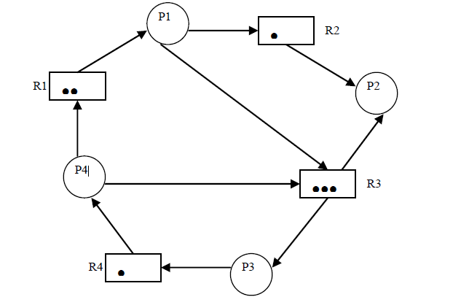
Problem 2
Consider the following resource allocation graph. Using the graph reduction method, show that there is no deadlock.

Slide 19
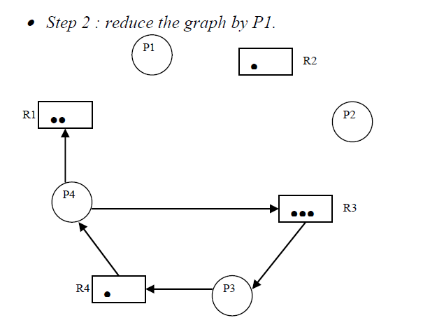
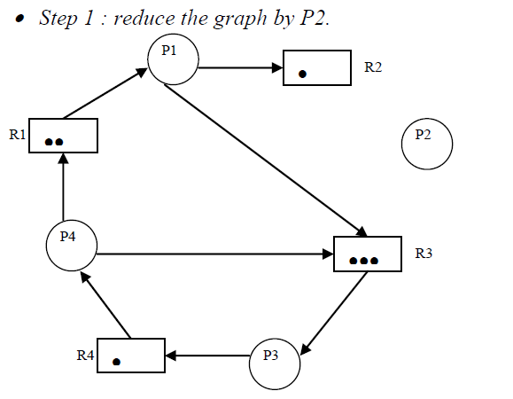
Solution 2

Slide 20
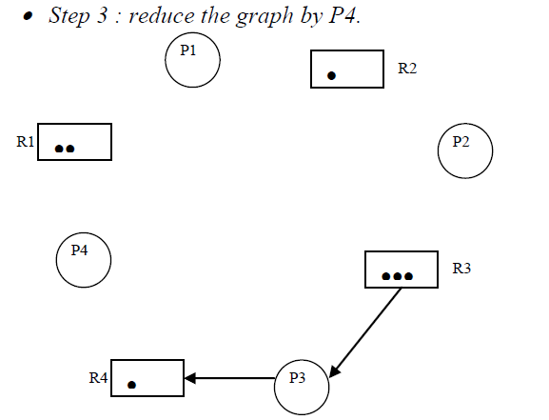
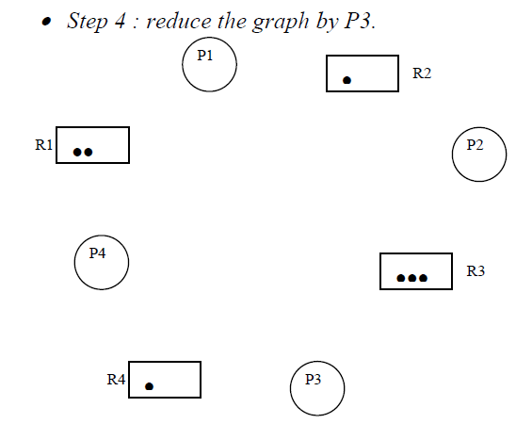
Solution 2 - Continue

Slide 21
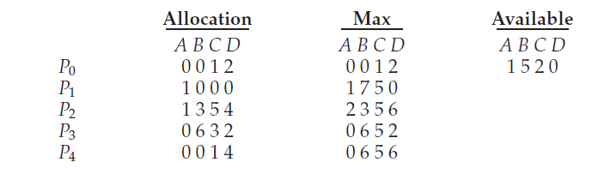
Problem 3
Consider the following snapshot of a system:
Answer the following questions using the banker’s algorithm:
a. What is the content of the matrix Need?
b. Is the system in a safe state?
c. If a request from process P1 arrives for (0,4,2,0), can the request be granted immediately?

Slide 22
Solution 3
a. The values of Need for processes P0 through P4 respectively are (0,0, 0, 0), (0, 7, 5, 0), (1, 0, 0, 2), (0, 0, 2, 0), and (0, 6, 4, 2).
b. The system is in a safe state? Yes. With Available being equal to (1, 5, 2, 0), either process P0 or P3 could run. Once process P3 runs, it releases its resources, which allow all other existing processes to run.
c. The request can be granted immediately? This results in the value of Available being (1, 1, 0, 0). One ordering of processes that can finish is P0, P2, P3, P1, and P4.

