Slide 1
Tensorflow
关于tensorflow编程框架的相关调研

Slide 2
Introduction

Slide 3
Introduction
近年来机器学习不断取得不错的成就：
Sophisticated machine learning models
更多更易于获取的数据集
相关编程框架创立和完善

Slide 4
Abstract
TensorFlow is a machine learning system that operates at large scale and in heterogeneous environments.
Developed by Google Brain Team.
An open-source software library

Slide 5
Main idea?

Slide 6
Design principles
Dataflow graphs of primitive operators(数据流图)
Deferred execution（推迟执行）
Common abstraction for heterogeneous accelerators（对不同底层体系结构的相同抽象）

Slide 7
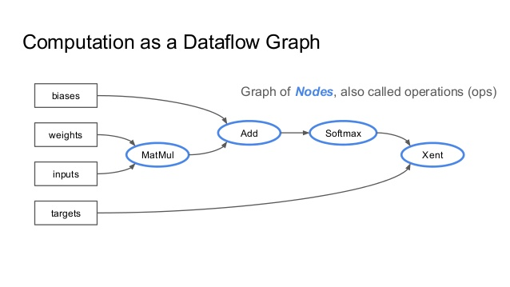
Dataflow graphs of primitive operators

Slide 8
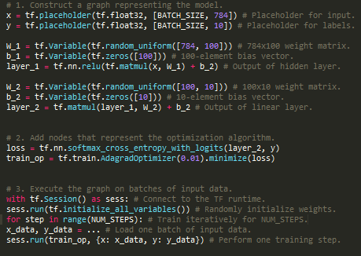
Deferred execution
Notes:
Operations build the dataflow graph; eval() fetches the result.

Slide 9
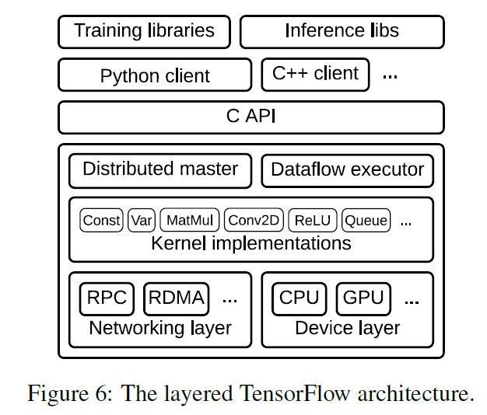
Common abstraction for heterogeneous accelerators

Slide 10
Execution model

Slide 11
Execution model
TensorFlow uses a single dataflow graph to represent all computation and state in a machine learning algorithm.
Notes:
Feature:
The model supports multiple concurrent executions on overlapping subgraphs of the overall graph.
Individual vertices may have mutable state that can be shared between different executions of the graph

Slide 12
Basic concept
Tensors
Operations
Notes:
In TensorFlow, we model all data as tensors (n-dimensional arrays) with the elements having one of a small number of primitive types, such as int32, float32, or string etc.
At the lowest level, all TensorFlow tensors are dense. Two alternatives for representing sparse data: either encode the data into variable-length string elements of a dense tensor, or use a tuple of dense tensors.
An operation takes m tensors as input and produces n tensors as output. An operation has a named “type” (such as Const, MatMul, or Assign).
An operation can contain mutable state that is read and/or written each time it executes. A Variable operation owns a mutable
Buffer. Variable has no inputs, and produces a reference handle. The simplest queue is FIFOQueue, which owns an internal queue of tensors, and allows concurrent access in first-in-first-out order.
Enqueue will block if its given queue is full, and Dequeue will block if its given queue is empty.

Slide 13
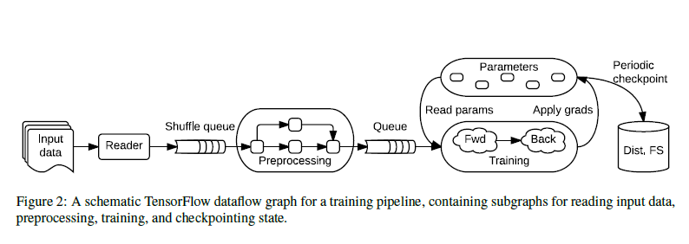
Basic concept -- Stateful operations
Notes:
Stateful operations: variables
Stateful operations: queues
In TensorFlow, we model all data as tensors (n-dimensional arrays) with the elements having one of a small number of primitive types, such as int32, float32, or string etc.
At the lowest level, all TensorFlow tensors are dense. Two alternatives for representing sparse data: either encode the data into variable-length string elements of a dense tensor, or use a tuple of dense tensors.
An operation takes m tensors as input and produces n tensors as output. An operation has a named “type” (such as Const, MatMul, or Assign).
An operation can contain mutable state that is read and/or written each time it executes. A Variable operation owns a mutable
Buffer. Variable has no inputs, and produces a reference handle. The simplest queue is FIFOQueue, which owns an internal queue of tensors, and allows concurrent access in first-in-first-out order.
Enqueue will block if its given queue is full, and Dequeue will block if its given queue is empty.

Slide 14
Execution model
特点：
The model supports multiple concurrent executions on overlapping subgraphs of the overall graph.（并行性）
Individual vertices may have mutable state that can be shared between different executions of the graph.
Notes:
Feature:
The model supports multiple concurrent executions on overlapping subgraphs of the overall graph.
Individual vertices may have mutable state that can be shared between different executions of the graph

Slide 15
Differentiation and optimization
Many learning algorithms train a set of parameters using some variant of SGD(Stochastic gradient descent).
TensorFlow includes a user-level library that differentiates a symbolic expression for a loss function and produces a new symbolic expression representing the gradients(differentiation algorithm)
Notes:
performs breadth-first search to identify all of the backwards paths from the target operation and sums the partial gradients that each path contributes.
We have extended the algorithm to differentiate conditional and iterative subcomputations (§3.4) by adding nodes to the graph that record the control flow decisions in the forward pass, and replaying those decisions in reverse during the backward pass.

Slide 16
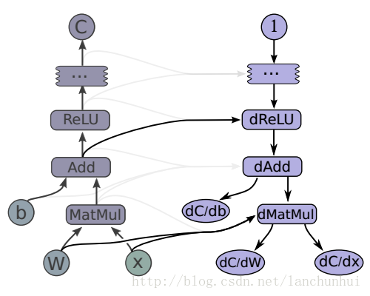
Gradient Computation
当 TensorFlow 需要计算 tensor C 对 tensor I 的梯度时，它首先找到从 I 到 C 的计算路径.
之后，从 C 反向回溯到 I，对于反向路径上的每个节点，TensorFlow 都会添加一个节点，并根据前向操作使用求导的「链式法则」得到「梯度计算函数」。
Notes:
当 TensorFlow 需要计算 tensor CC 对 tensor II 的梯度时，它首先找到从 II 到 CC 的计算路径，之后，从 CC 反向回溯到 II，对于反向路径上的每个节点，TensorFlow 都会添加一个节点，并根据前向操作使用求导的「链式法则」得到「梯度计算函数」。每个「梯度计算函数」可能被注册到任意操作，它会将偏导数和前向计算过程的输出作为输入。

Slide 17
Partial and concurrent execution
The client selects zero or more edges to feed input tensors into the dataflow, and one or more edges to fetch output tensors from the dataflow; the runtime then prunes the graph to contain the necessary set of operations.
Notes:
Adding mutable state and coordination via queues makes it possible to specify
a wide variety of model architectures in user-level code, which enables advanced users to experiment without modifying the internals of the TensorFlow runtime.

Slide 18
Partial and concurrent execution
feed_0
fetch
MatMul
feed_1

Slide 19
Partial and concurrent execution
Partial and concurrent execution is responsible for much of TensorFlow’s flexibility
Notes:
Adding mutable state and coordination via queues makes it possible to specify
a wide variety of model architectures in user-level code, which enables advanced users to experiment without modifying the internals of the TensorFlow runtime.

Slide 20
Distributed execution
The TensorFlow runtime places operations on devices, subject to implicit or explicit constraints in the graph
Notes:
The TensorFlow runtime places operations on devices, subject to implicit or explicit constraints in the graph.

Slide 21
Distributed execution
Placement algorithm
设备分配分配算法需要将成本模型（cost model）作为参数，它包含了每个 node 中计算操作的输入和输入张量的大小（以字节为单位）和该 node 估计的计算时间。
设备分配算法模拟数据流图的计算过程并使用贪心策略（greedy heuristic）来为每个 node 分配运算设备。
设备分配算法首先从数据流图的源头开始对每个 node 的计算过程进行模拟。当某个 node 需要计算资源时，设备分配算法会将运行该计算的预计时间最短的可用设备分配给该节点。对于需要多个计算设备的 node，分配算法会使用贪心策略考虑将计算分配到不同设备后所需要的计算时间，并会考虑设备间数据通信的成本。总之，分配算法会将执行某计算操作最快的可用设备分配给 node。
Notes:
The TensorFlow runtime places operations on devices, subject to implicit or explicit constraints in the graph.

Slide 22
Dynamic control flow
TensorFlow supports advanced machine learning algorithms that contain conditional and iterative control flow.(RNN, LSTM)
Add conditional (if statement) and iterative (while loop) programming constructs in the dataflow graph itself, and thus able to build higher-order constructs.
Borrow the Switch and Merge primitives from classic dynamic dataflow architectures.
Notes:
The execution of iterations can overlap, and TensorFlow can also partition conditional branches and loop bodies across multiple devices and processes.

Slide 23
Implementation

Slide 24
Implementation--Client
Defines the computation as a dataflow graph.
Initiates graph execution using a session

Slide 25
Implementation
The TensorFlow runtime is a cross-platform library.
a C API separates userlevel code in different languages from the core runtime

Slide 26
Implementation
The core TensorFlow library is implemented in C++ for portability and performance.
It can run on almost all the usual operating systems

Slide 27
Implementation-- Distributed master
Prunes a specific subgraph from the graph, as defined by the arguments to Session.run()
Partitions the subgraph into multiple pieces that run in different processes and devices.
Distributes the graph pieces to worker services.
Initiates graph piece execution by worker services.

Slide 28
Implementation -- Worker Services
Schedule the execution of graph operations using kernel implementations appropriate to the available hardware (CPUs, GPUs, etc).
Send and receive operation results to and from other worker services.

Slide 29
Implementation
Perform the computation for individual graph operations

Slide 30
Implementation
Specialize Send and Recv operations for each pair of source and destination device types.
use the cudaMemcpyAsync() API to overlap computation and data transfer between local CPU and GPU devices.

Slide 31
Related work
Single-machine frameworks
Batch dataflow systems
Parameter servers

Slide 32
Previous system: DistBelief
DistBelief is the first-generation system and Tensorflow is developed based on it.
DistBelief uses the parameter server architecture which both simplifying and generalizing it to enable researchers to explore a wider variety of ideas with relative ease.
Disadvatages: Lack of flexibility
Defining new layers
Refining the training algorithms
Defining new training algorithms
Notes:
In the parameter server architecture, a job comprises two disjoint sets of processes: stateless worker processes that perform the bulk of the computation when training a model, and stateful parameter server processes that maintain the current version of the model parameters.

Slide 33
Thank You

