Slide 1
Cambricon
An Instruction Set Architecture for Neural Networks
Presented by
韦清 PB15000027

Slide 2
01
Background
02
Overview
CONTENT
03
Instruction Set
04
Prototype Accelerator

Slide 3
1
PART ONE
BACKGROUND
Application and prevailing of Neural Networks and
exsiting hardware accelerators for NN techniques.

Slide 4
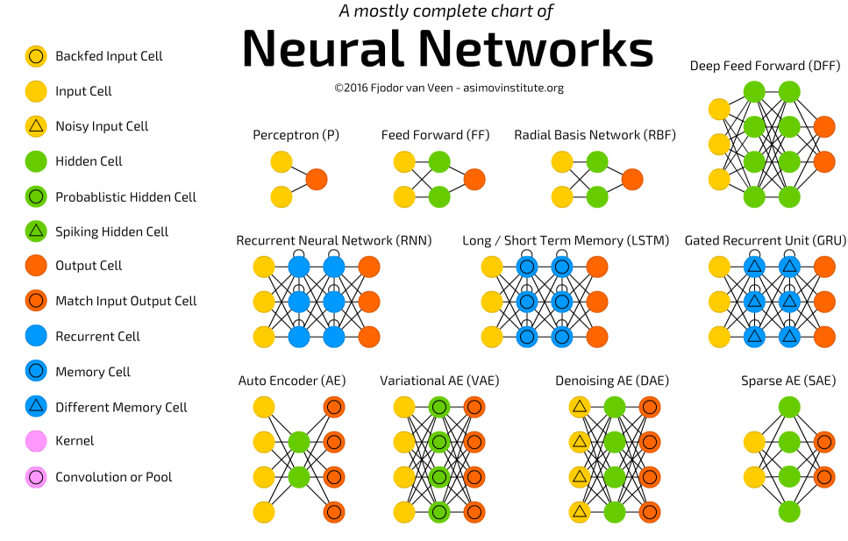
BACKGROUND
Artificial Neural Network
Artificial neural networks (ANNs) are computing systems vaguely inspired by the biological neural networks that constitute animal brains.
Such systems "learn" to perform tasks by considering examples, generally without being programmed with any task-specific rules.
Notes:
人工神经网络（Artificial Neural Network，即ANN ），是20世纪80 年代以来人工智能领域兴起的研究热点。它从信息处理角度对人脑神经元网络进行抽象， 建立某种简单模型，按不同的连接方式组成不同的网络。
神经网络是一种运算模型，由大量的节点（或称神经元）之间相互联接构成。每个节点代表一种特定的输出函数，称为激励函数（activation function）。每两个节点间的连接都代表一个对于通过该连接信号的加权值，称之为权重，这相当于人工神经网络的记忆。网络的输出则依网络的连接方式，权重值和激励函数的不同而不同。而网络自身通常都是对自然界某种算法或者函数的逼近，也可能是对一种逻辑策略的表达。
最近十多年来，人工神经网络的研究工作不断深入，已经取得了很大的进展，其在模式识别、智能机器人、自动控制、预测估计、生物、医学、经济等领域已成功地解决了许多现代计算机难以解决的实际问题，表现出了良好的智能特性；在很多应用中，使用神经网络模型的人工智能技术，都表现出了不低于人类的正确率和效率。

Slide 5
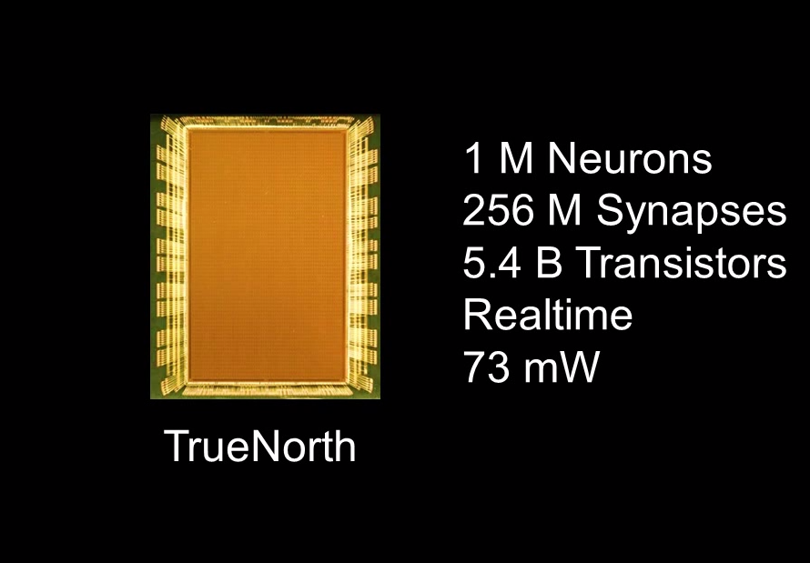
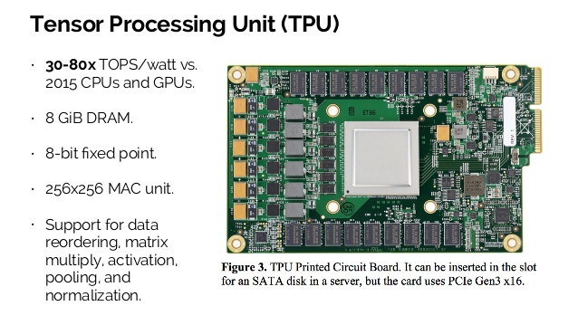
BACKGROUND
Existing NN accelerators
Notes:
NN技术已经取得了很多重大的成果，但神经网络训练的效率还有待提升。目前运行神经网络模型的硬件设备主要还是CPU、GPU这种通用设备。通用处理器的设计目标是解决大部分软件问题，它们必须能够灵活地支持不同的工作负载，这样以来，在运行NN程序时，额外的硬件资源还是会被浪费在这种“通用支持”上，导致了通用处理器在运行NN程序时出现了效率和硬件利用率较低，能源浪费的问题。
因此，为了解决这种问题，面向神经网络应用的专用硬件加速器被设计出来。然而这种加速设备只针对于小部分有相似计算模式的NN技术做了优化。
一种这样的NN加速器是DaDianNao。它使用了一种较为复杂的ISA，对部分计算模式相似的NN layer直接做抽象。这种ISA虽然可以很方便、直接地执行那些只使用了它所优化了的NN技术的程序，但却因此缺乏灵活性，难以支持更多可能更加完备有效的NN技术。此外，由于ISA的复杂性，硬件设计、验证也较为复杂。
IBM 在2014年研发出脉冲神经网络芯片TrueNorth，走的是“类脑计算”路线。用神经电子元件制造与人脑神经网络相似的电子神经网络。
TrueNorth为片上多核网络结构，具有4096个核，每个核拥有256个可编程模拟神经元，总计超过一百万个神经元。每个神经元都有256个可编程的“突触”，传达它们之间的信号。
张量处理器TPU是一种ASIC芯片(application specific Integrated Circuit)
TPU专为Google机器学习应用TensorFlow打造，能够降低运算精度，在相同时间内处理更复杂、更强大的机器学习模型并将其更快地投入使用。但它实际上只在特定应用中作为辅助使用，程序主体部分还是要运行在CPU或GPU上。

Slide 6
2
PART TWO
OVERVIEW
Cambricon is a novel domain-specific ISA for NN accelerators, based on a comprehensive analysis of existing NN techniques.

Slide 7
OVERVIEW OF CAMRICON
Design guidelines
01. RISC ISA
02. Data-Level Parallelism
Load-Store architecture
Simple and short instructions
DLP enabled by vector/matrix instructions can be more efficient than ILP of traditional scalar instructions, and corresponds to higher code density
03. Customized Vector/Matrix Instructions
Design
Guidelines
For NN techniques, fundamental operations defined in existing algebra libraries are not necessarily effective and efficient choices.
Many common operations of NN techniques that are not covered by traditional linear algebra libraries
04. Using On-Chip Scratchpad Memory
NN techniques often require intensive, contiguous, and variable-length accesses to vector/matrix data

Slide 8
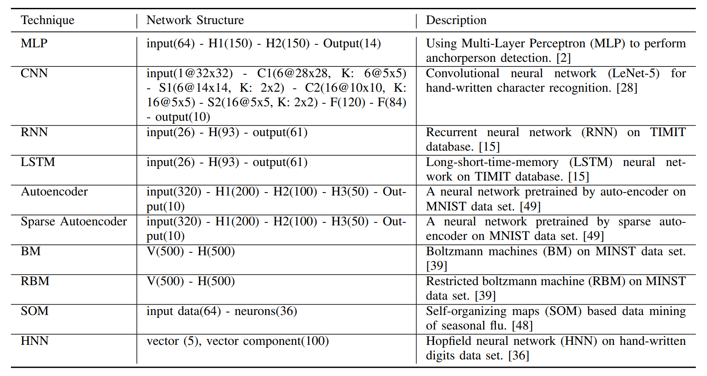
OVERVIEW OF CAMRICON
Performance
10 distinct NN techniques benchmarks:

Slide 9
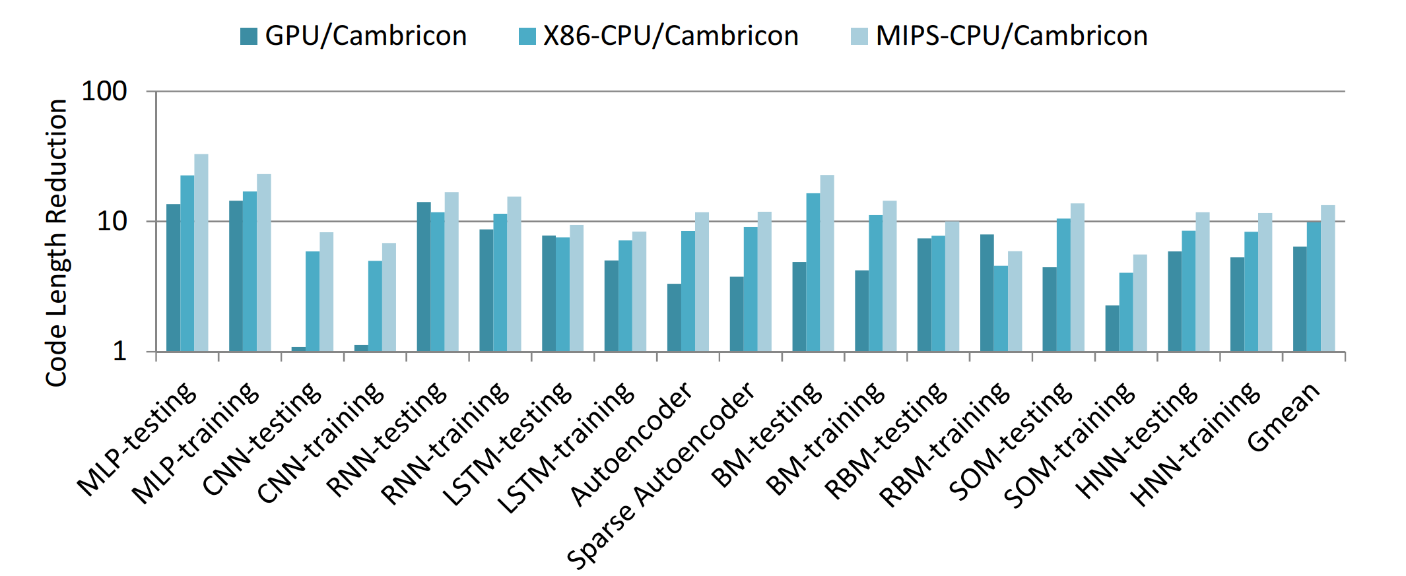
OVERVIEW OF CAMRICON
Performance
The reduction of code length against GPU, x86-CPU, and MIPS-CPU

Slide 10
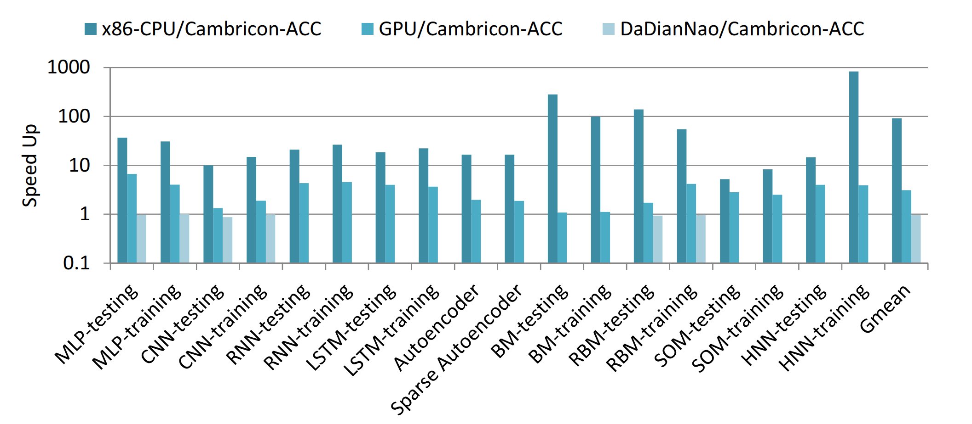
OVERVIEW OF CAMRICON
Performance
The speedup of Cambricon-ACC against x86-CPU, GPU, and DaDianNao.

Slide 11
3
PART THREE
INSTRUCTION SET
Cambricon is a load-store architecture that integrates scalar, vector, matrix, logical, data transfer, and control instructions

Slide 12
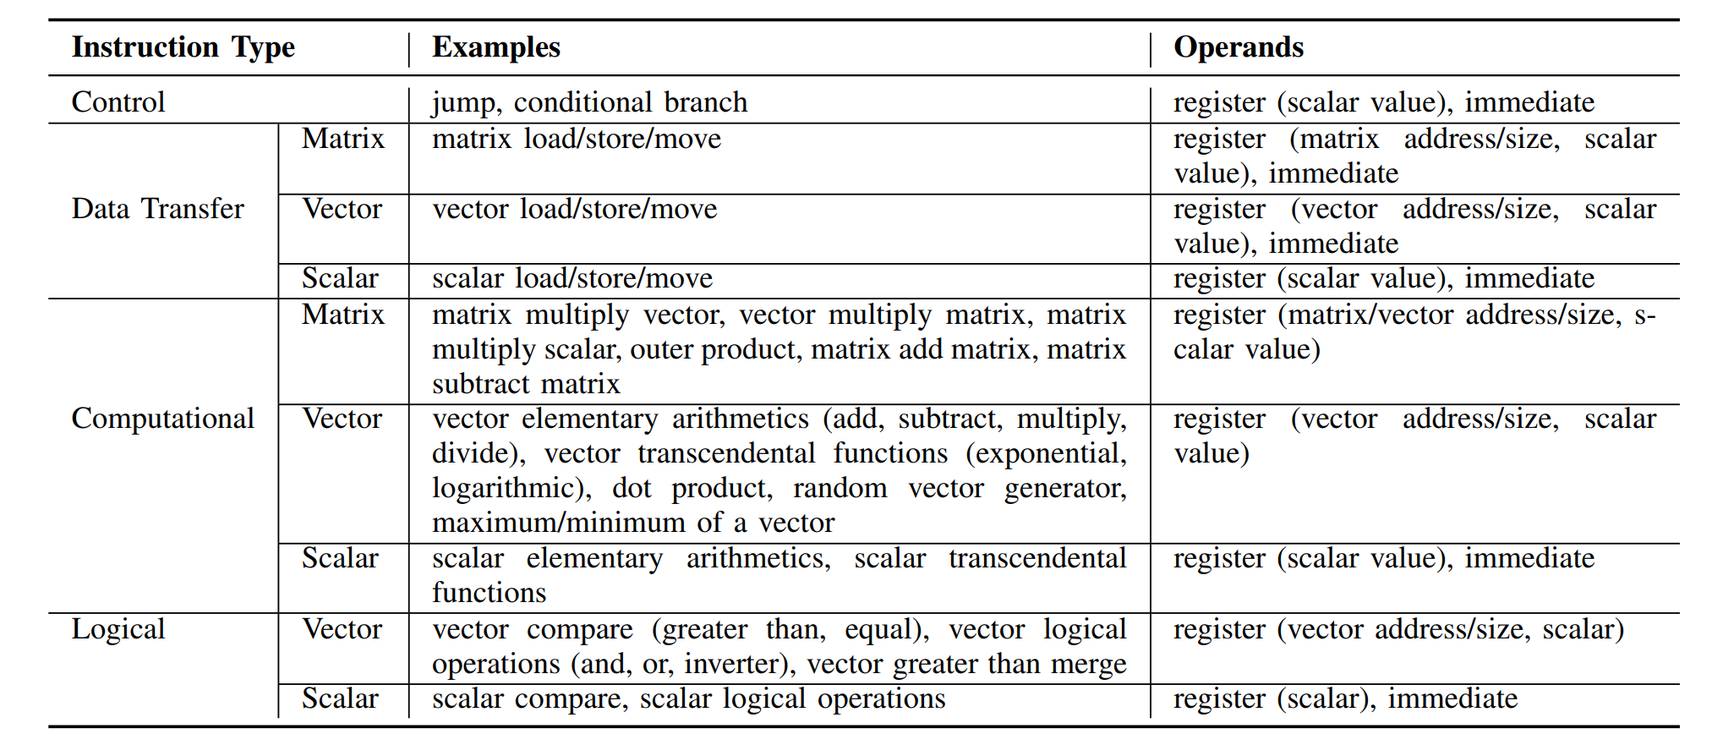
INSTRUCTION SET
An overview to Cambricon instructions.

Slide 13
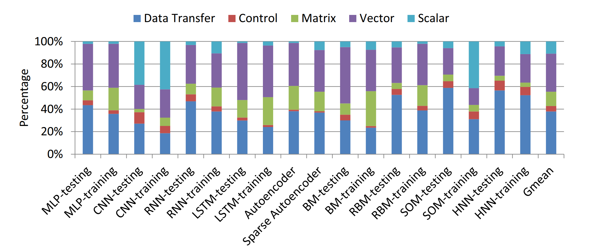
INSTRUCTION SET
An overview to Cambricon instructions.
The percentages of instruction types among all benchmarks:

Slide 14
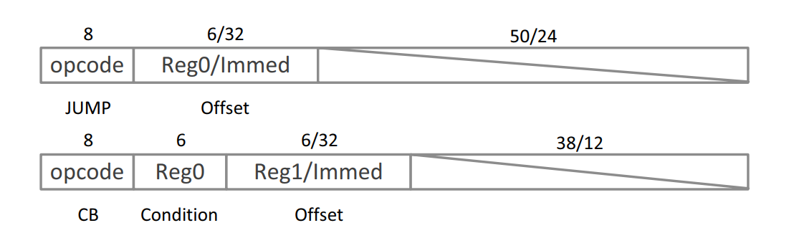
INSTRUCTION SET
Control Instructions
There are two control instructions in Cambricon: jump and conditional branch.
The jump instruction specifies the offset via either an immediate or a GPR value, which will be accumulated to PC.
The conditional branch instruction specifies the predictor (stored in a GPR) in addition to the offset, and the branch target is determined by a comparison between the predictor and zero.

Slide 15
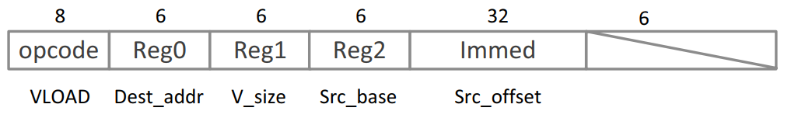
INSTRUCTION SET
Data Transfer Instructions
Data transfer instructions in Cambricon can load/store variable-size data blocks from/to the main memory to/from the on-chip scratchpad memory, or move data between the on-chip scratchpad memory and scalar GPRs.
Vector LOAD (VLOAD): load a vector with the size of v_size from the main memory to the vector scratchpad memory.
Vector STORE (VSTORE), Matrix LOAD (MLOAD), Matrix STORE (MSTORE)

Slide 16

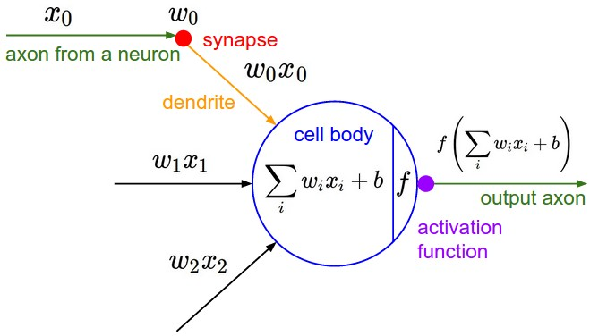
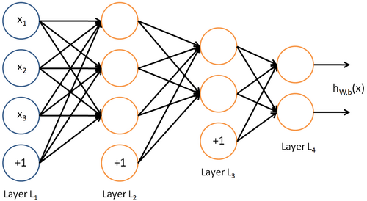
INSTRUCTION SET
Matrix Instructions

Slide 17
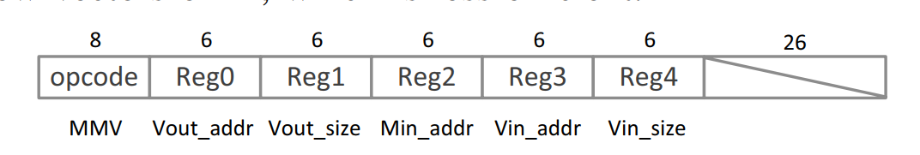

INSTRUCTION SET
Matrix Instructions
To compute $Wx$, we need a matrix-mult-vector instruction.
Input Matrix size: Vout_size x Vin_size
Input Vector size: Vin_size
Output Vector size: Vout_size

Slide 18


INSTRUCTION SET
Matrix Instructions
To compute the gradient vector in Back Propagation, we need a vector-mult-matrix instruction.
Input Matrix size: Vin_size x Vout_size
Input Vector size: Vin_size
Output Vector size: Vout_size
$$J\left(θ\right)=\frac{1}{2}{\left(Xθ−Y\right)}^{T}\left(Xθ−Y\right)$$
$$\frac{∂}{∂θ}J\left(θ\right)=X^{T}\left(Xθ−Y\right)$$
VMM

Slide 19

INSTRUCTION SET
Matrix Instructions
In training an NN, the weight matrix W often needs to be incrementally updated with
W = W + ηΔW ,
where η is the learning rate, and ΔW is estimated as the outer product of two vectors.
Cambricon provides an Outer-Product (OP) instruction, a Matrix-Mult-Scalar (MMS) instruction, and a Matrix-Add-Matrix (MAM) instruction to collaboratively perform the weight updating.
In addition, Cambricon also provides a Matrix-Subtract-Matrix (MSM) instruction to support the weight updating in Restricted Boltzmann Machine (RBM)

Slide 20
INSTRUCTION SET
Matrix Instructions
Matrix Mult Vector (MMV)
Vector Mult Matrix (VMM)
Outer Product (OP)
Matrix Mult Scalar (MMS)
Matrix Add Matrix (MAM)
Matrix Subtract Matrix (MSM)

Slide 21
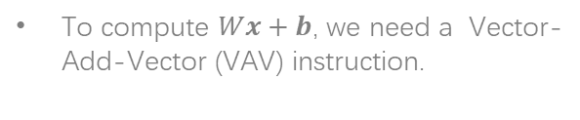
INSTRUCTION SET
Vector Instructions
To compute $Wx+b$, we need a Vector-Add-Vector (VAV) instruction.

Slide 22
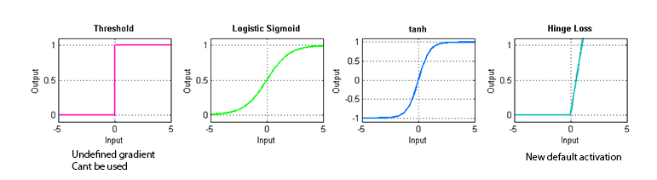

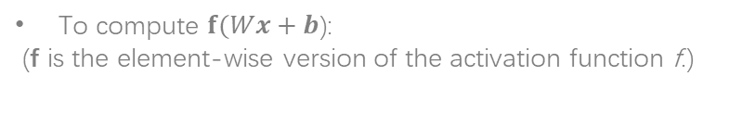
INSTRUCTION SET
Vector Instructions
To compute $f(Wx+b$):
(f is the element-wise version of the activation function f.)
$f\left(a\right)=\frac{1}{1+e^{−a}}=\frac{e^{a}}{e^{a}+1}$

Slide 23
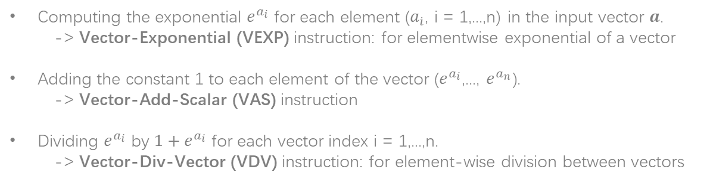
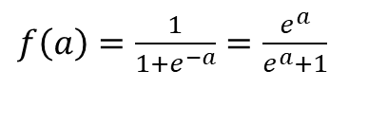
INSTRUCTION SET
Vector Instructions
$f\left(a\right)=\frac{1}{1+e^{−a}}=\frac{e^{a}}{e^{a}+1}$
Computing the exponential $e^{a_{i}}$ for each element ($a_{\dot{i}}$, i = 1,...,n) in the input vector $a$.
-> Vector-Exponential (VEXP) instruction: for elementwise exponential of a vector
Adding the constant 1 to each element of the vector ($e^{a_{i}}$,..., $e^{a_{n}}$).
-> Vector-Add-Scalar (VAS) instruction
Dividing $e^{a_{i}}$ by ${1+e}^{a_{i}}$ for each vector index i = 1,...,n.
-> Vector-Div-Vector (VDV) instruction: for element-wise division between vectors

Slide 24
INSTRUCTION SET
Vector Instructions
Vector-Mult-Vector (VMV), Vector-Sub-Vector (VSV), Vector-Logarithm (VLOG)
Use CORDIC technique to calculate transcendental functions (e.g. logarithmic, trigonometric and anti-trigonometric functions) using addition, subtract, shift and table-lookup operations.

Slide 25
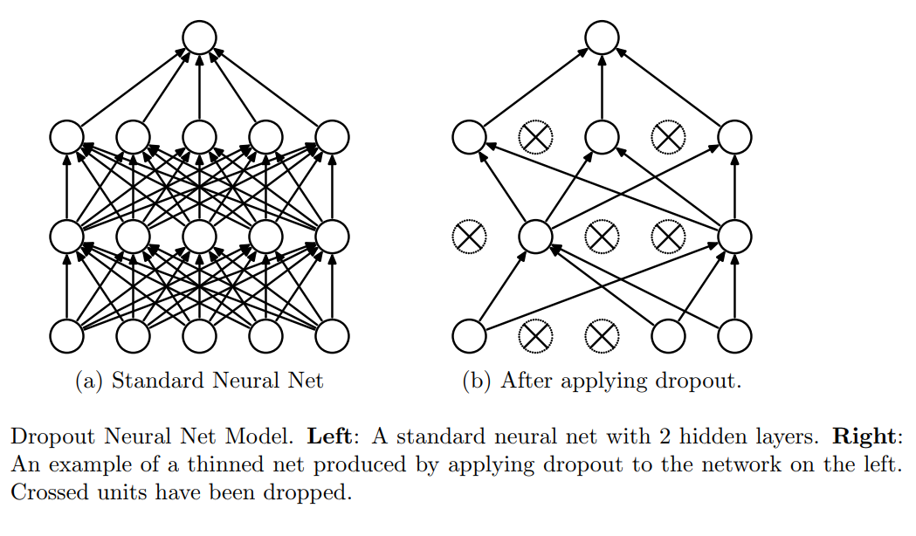
INSTRUCTION SET
Vector Instructions
Random-Vector (RV): generates a vector of random numbers obeying the uniform distribution at the interval [0,1].
Given uniform random vectors, we can further generate random vectors obeying other distributions (e.g., Gaussian distribution) using the Ziggurat algorithm.

Slide 26
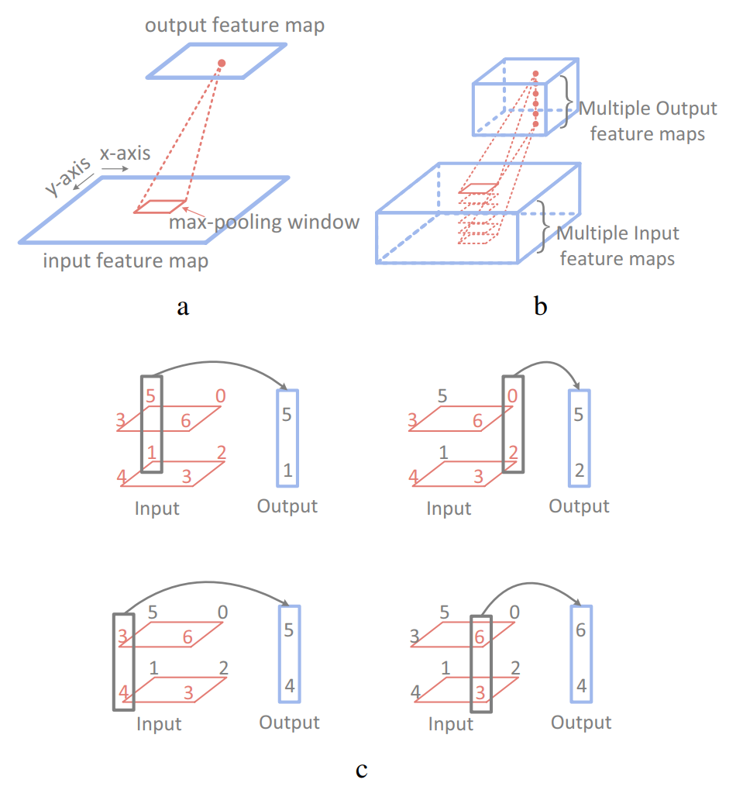
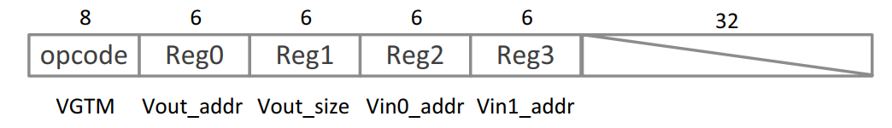
INSTRUCTION SET
Logical Instructions
Vector-Greater-Than-Merge (VGTM)
Vout[i] = (Vin0[i] > Vin1[i])?Vin0[i] : Vin1[i]
Vector-Greater-than (VGT)
Vector-Equal instruction (VE)
Vector AND/OR/NOT instructions(VAND/VOR/VNOT)

Slide 27
4
PART THREE
PROTOTYPE ACCELERATOR
Present a prototype accelerator of Cambricon

Slide 28
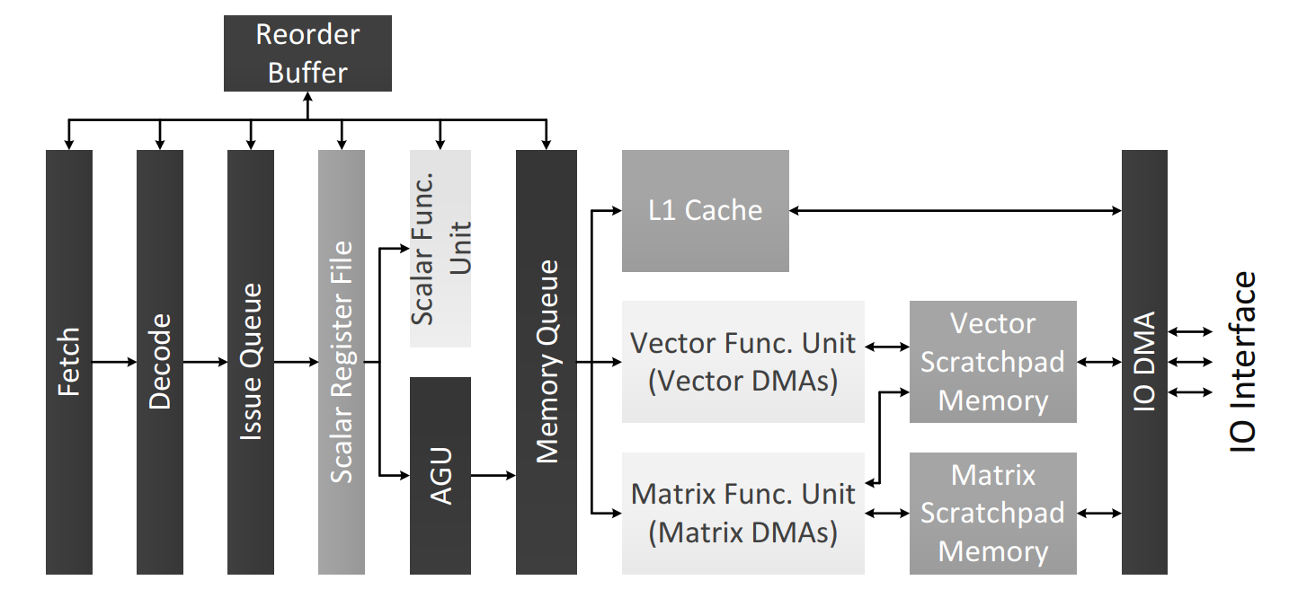
PROTOTYPE ACCELERATOR
Architecture
7 pipeline stages: fetching, decoding, issuing, register reading, execution, writing back, committing
Notes:
Address Generation Unit (AGU) 在取址、译码阶段后，指令进入一个有序发射队列。在从标量寄存器中成功地取得指令的操作数，包括标量数据或矩阵/向量的地址/大小，指令会根据它的类型被传送到不同的执行部件开始指令。控制指令和标量计算/逻辑指令由标量部件直接处理。写回阶段后，已执行未提交的最早的指令的结果，被从重排缓冲区(reorder buffer)中提交。
数据传送指令，向量/矩阵计算指令和向量逻辑指令可能会访问L1 cache和暂存存储器，所以这些指令会被传送到地址计算部件(Address Generation Unit, AGU)，加入一个顺序的内存队列，等待AGU计算这些类型的指令与该内存队列中在它们之前的指令是否有数据依赖。在此之后，标量数据传送指令的访存请求会被发送到L1 cache，向量的数据传送/计算/逻辑指令会被发送到向量功能部件，矩阵的数据传送/计算指令被发送到矩阵功能部件。在执行段结束后，指令会从内存队列中出队，当它是当前已执行未提交的最早的指令时，将结果从重拍缓存区中提交。
加速器中实现了向量和矩阵功能部件。向量部件中由32个16位加法器，32给16位乘法器，64KB暂存存储器。矩阵部件包括1024给乘法器和1024给加法器，为了避免长距离数据传送的能耗和线路拥塞，这些乘法器和加法器被分成32给计算块，每个计算块都有一个独立的24KB暂存器。

Slide 29
THANKS FOR YOUR WATCHING
weiq618@mail.ustc.edu.cn

Slide 30
References
* Liu, Shaoli, et al. "Cambricon: An instruction set architecture for neural networks." ACM SIGARCH Computer Architecture News. Vol. 44. No. 3. IEEE Press, 2016.
* Hennessy, J.L., Patterson, D.A. Computer Architechture: A Quantitative Approach, Fifth Edition.
* Rosenblatt, Frank. x. Principles of Neurodynamics: Perceptrons and the Theory of Brain Mechanisms. Spartan Books, Washington DC, 1961
* Rumelhart, David E., Geoffrey E. Hinton, and R. J. Williams. "Learning Internal Representations by Error Propagation". David E. Rumelhart, James L. McClelland, and the PDP research group. (editors), Parallel distributed processing: Explorations in the microstructure of cognition, Volume 1: Foundation. MIT Press, 1986.
* Cybenko, G. 1989. Approximation by superpositions of a sigmoidal function Mathematics of Control, Signals, and Systems, 2(4), 303–314.
* Deep Learning; Ian Goodfellow, Yoshua Bengio, Aaaron Courville; MIT Press; 2016, p 196.
* V. Kantabutra. On hardware for computing exponential and trigonometric functions. Computers, IEEE Transactions on, 1996.
* G Marsaglia and W W. Tsang. The ziggurat method for generating random variables. Journal of statistical software, 2000.
* Srivastava N, Hinton G, Krizhevsky A, et al. Dropout: A simple way to prevent neural networks from overfitting[J]. The Journal of Machine Learning Research, 2014, 15(1): 1929-1958.

