Slide 1
Global State, Vector Time and Dynamic Race Detection
Yongzhou Chen

Slide 2
Global State:
In an asynchronous distributed system, as no process has a consistent and immediate view of the all the process states. The following traditional control tasks of operating system are difficult:
mutual exclusion
deadlock detection
concurrency control

Slide 3
Global State:
What’s more, there are more new problems:
distributed agreement
distributed termination detection
election problem.

Slide 4
Race Detection in multithreaded program:
A race condition occurs when a program’s execution contains two accesses to the same memory location that are not ordered by the happens-before relation, where at least one of the accesses is a write.

Slide 5
Static Race Detector:
Perform a compile-time analysis of the program’s source code.
Advantage: Globally, and be able to warn about any data race that might occur in an execution of the program.
Disadvantage: Conservative, and always result in excessive false alarms.

Slide 6
Dynamic Race Detector:
Detect whether a particular execution of the program actually exhibited data races.
Advantage: detect only those apparent data races that actually occurred during real executions.
Disadvantage: only one speciﬁc execution path of the program each time.

Slide 7
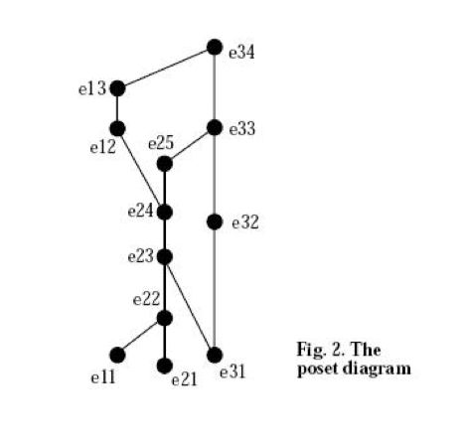
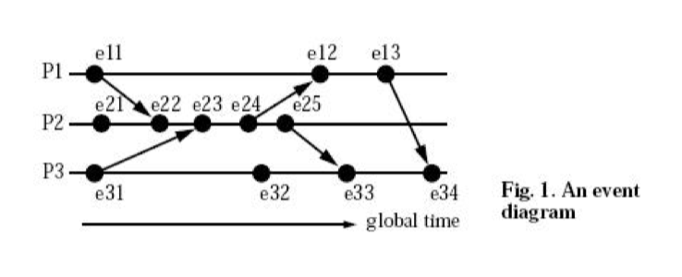
Time diagram and Poset-diagram

Slide 8
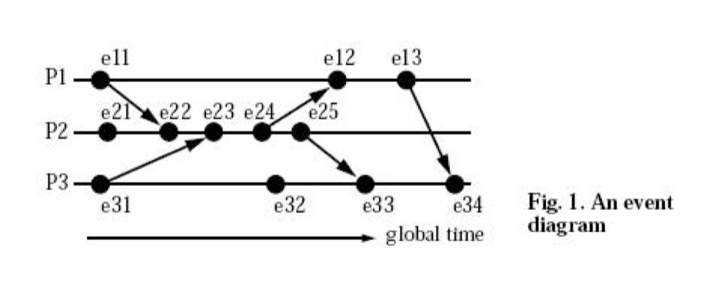
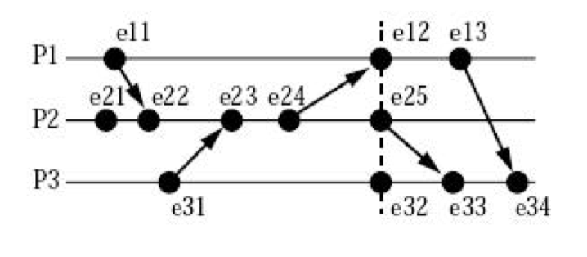
Equivalence of Time diagram

Slide 9
Vector Time(Motivates)
Friedemann come up with the notion “Vector Time”. He argue that a linearly ordered structure of time is not always adequate for distributed systems and that a partially ordered system of vectors forming a lattice(格) structure is a natural representation of time in a distributed system.

Slide 10
Vector Time(Definition)
Each process Pi with a clock Ci consisting of a vector of length n, where n is the total number of processes. With each event the local clock “ticks”. Process Pi ticks by incrementing its own component of its clock: Ci[i] =Ci[i] + 1

Slide 11
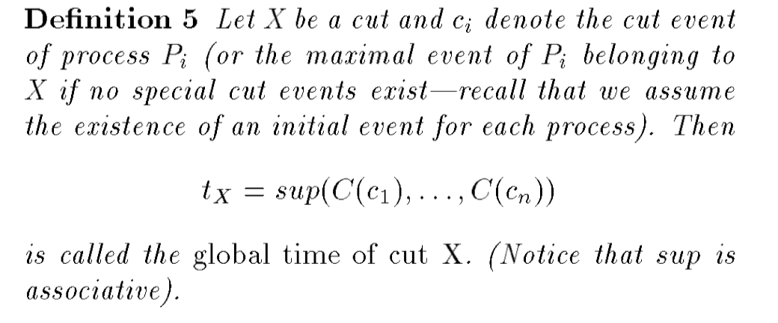
Global State(Definition)

Slide 12
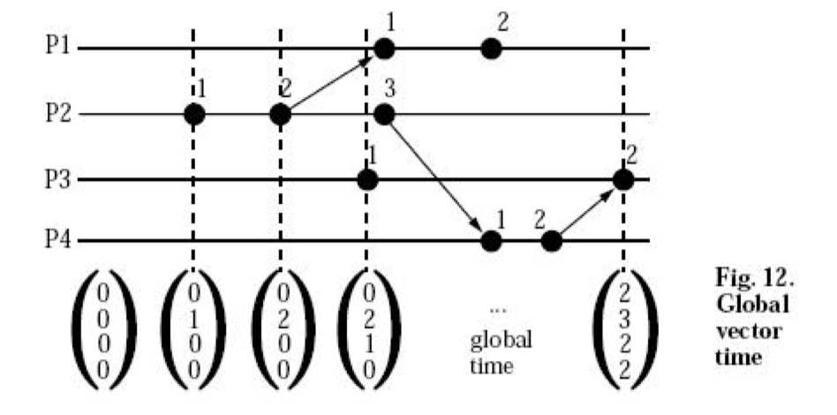
Global State(Definition)

Slide 13
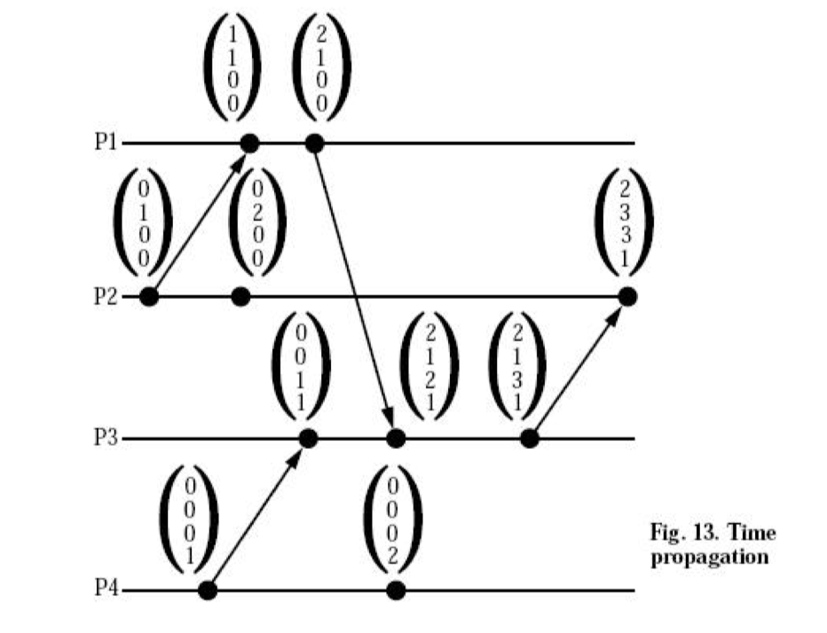
Time Propagation

Slide 14
DJIT+Algorithm
Djit + relies on a formal framework called vector time frames, which is based on Mattern’s virtual time vector time-stamps.
The general idea of the algorithm is to log every shared access and to check whether it “happens-before” prior accesses to same location.

Slide 15
Preliminary
Happen-before relation
Program order: e and e' are events in same process and e precedes e’
Send/Recv: e send message and e' receive
Locking: The two operations acquire or release the same lock.
Fork-join: One operation is fork(t, u) or join(t, u) and the other operation is by thread u.
Transitive: exist e'' such that e < e'' and e'' < e’

Slide 16
Preliminary
CONCURRENT: Two events A and B are synchronized if either A < B or B < A. If A and B are not synchronized, A and B are concurrent events.
DATA RACE: If two concurrent operations both access (read or write) the same variable, and at least one of the operations is a write. We say there exists an apparent data race.

Slide 17
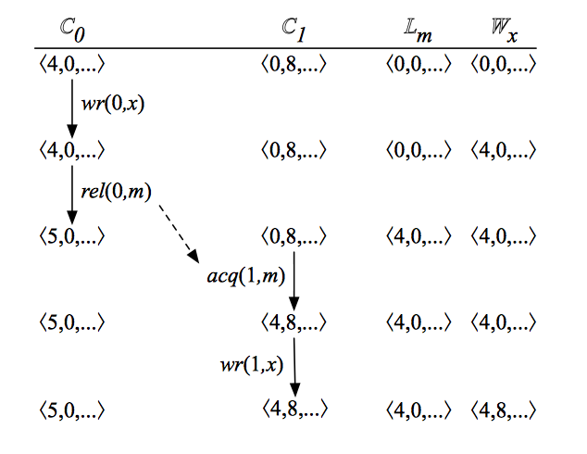
Protocol: initialization
Each initializing thread t ﬁlls its vector of time frames with ones.
The access history of each shared location v is ﬁlled with zeros (since no thread has accessed it yet).
The vector of each synchronization object S is ﬁlled with zero.

Slide 18
Protocol: Release Lock
The issuing thread t starts a new time frame. Therefore, it increments the entry corresponding to t in t’s vector—
Each entry in S’s vector is updated to hold the maximum between the current value and that of t’s vector—

Slide 19
Protocol: Acquire Lock
The issuing thread t updates each entry in its vector to hold the maximum between its current value and that of S’s vector

Slide 20
Protocol: Read/Write
The issuing thread t updates the relevant entry in the history of variable v.
If the access is a read, it performs
If the access is a write, it performs

Slide 21
Protocol: Race Detection
If the access is a read, thread t checks whether there exists another thread u which also wrote to v, such that
If the access is a write, thread t checks whether a thread u read/wrote to v
If the above inequalities hold, there is a race

Slide 22
FastTrack Algorithm
Motivates
A limitation of VC-based race detectors such as DJIT + is their performance. If a target program has n threads, then each vector clock requires O(n) storage space and each vector clock operation (copying, comparing, joining, etc) requires O(n) time.

Slide 23
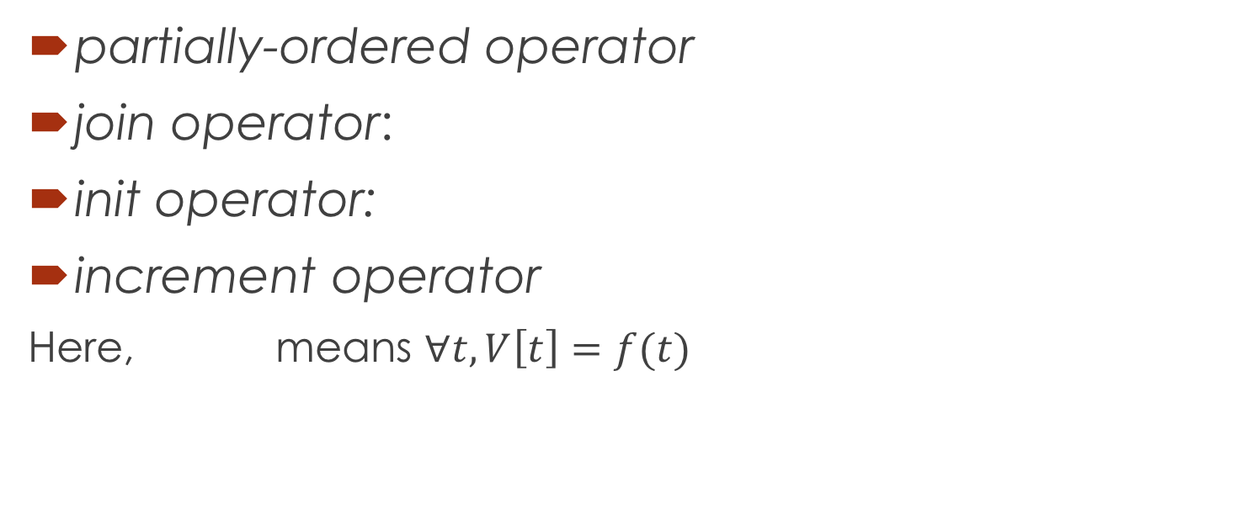
FastTrack Algorithm(Fix notations)
partially-ordered operator
join operator:
init operator:
increment operator
Here, means $∀t, V\left[t\right]=f(t)$

Slide 24
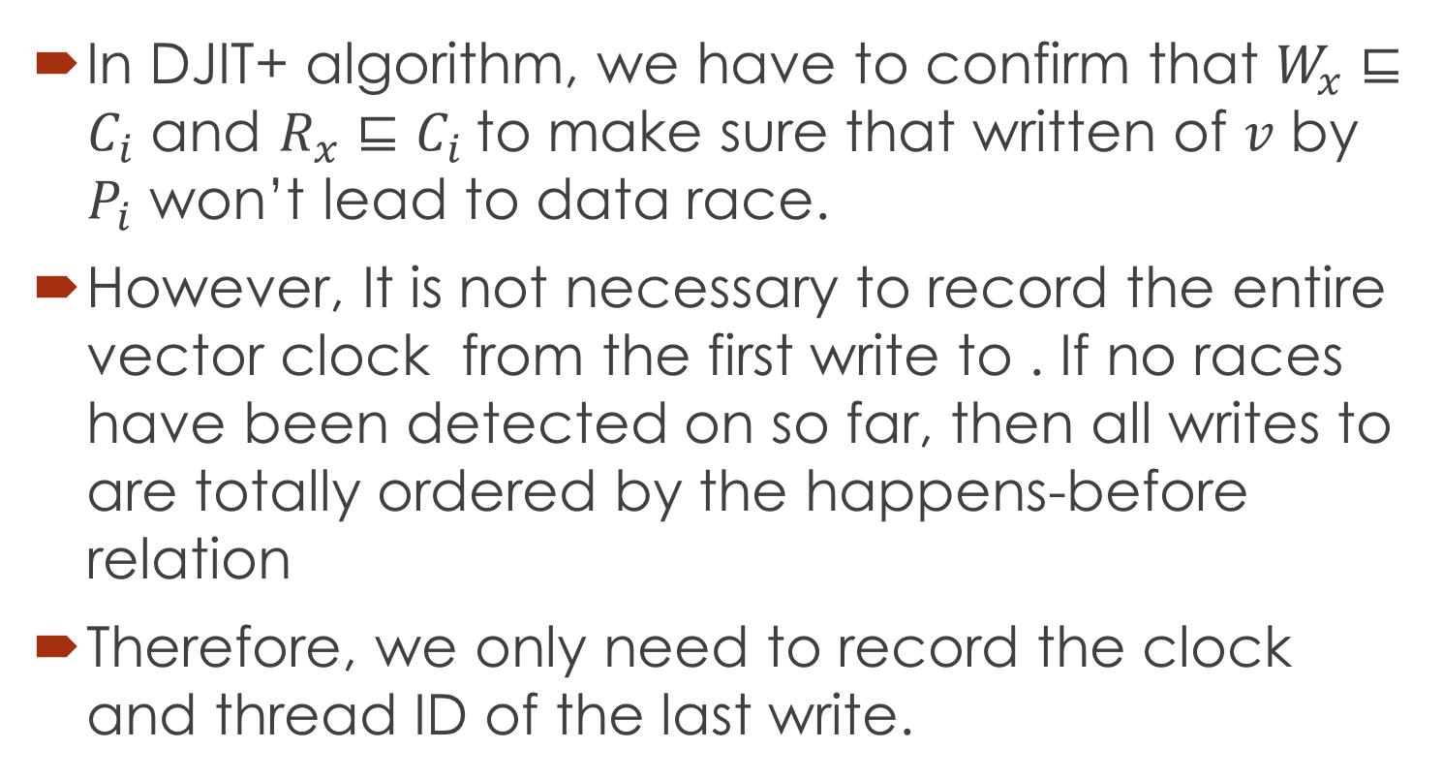
Principle: Write-Write Race
In DJIT+ algorithm, we have to confirm that $W_{x}⊑C_{i}$ and $R_{x}⊑C_{i}$to make sure that written of $v$ by $P_{i}$ won’t lead to data race.
However, It is not necessary to record the entire vector clock from the first write to . If no races have been detected on so far, then all writes to are totally ordered by the happens-before relation
Therefore, we only need to record the clock and thread ID of the last write.

Slide 25
Principle: Write-Read Race
It’s the same, and we only need to record the clock and thread ID of the last write.

Slide 26
Principle: Read-Write Race
Unlike write operations, which are totally ordered (if no race detected so far), reads are not totally ordered even in race-free programs.
Thus, a write to a variable x could potentially conﬂict with the last read of x performed by any other thread, not just the last read in the entire trace seen so far.
Hence, we need to record an entire vector clock for variable x.

Slide 27



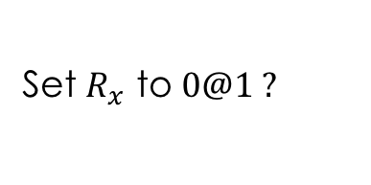

Thread 0, $C_{0}=(1,0)$
Thread 1, $C_{0}=(0,0)$
$$R_{x}=1@0$$
Read
Read
Set $R_{x}$ to $0@1 ?$
$$1@0$$
Read

Slide 28
Principle: Read-Write Race
However, there are usually two kind of ordered read in practice:
Thread-local data: only one thread accesses a variable, and hence these accesses are totally ordered by program-order.
Lock-protected data: a protecting lock is held on each access to a variable, and hence all access are totally ordered, either by program order or synchronization order.

Slide 29
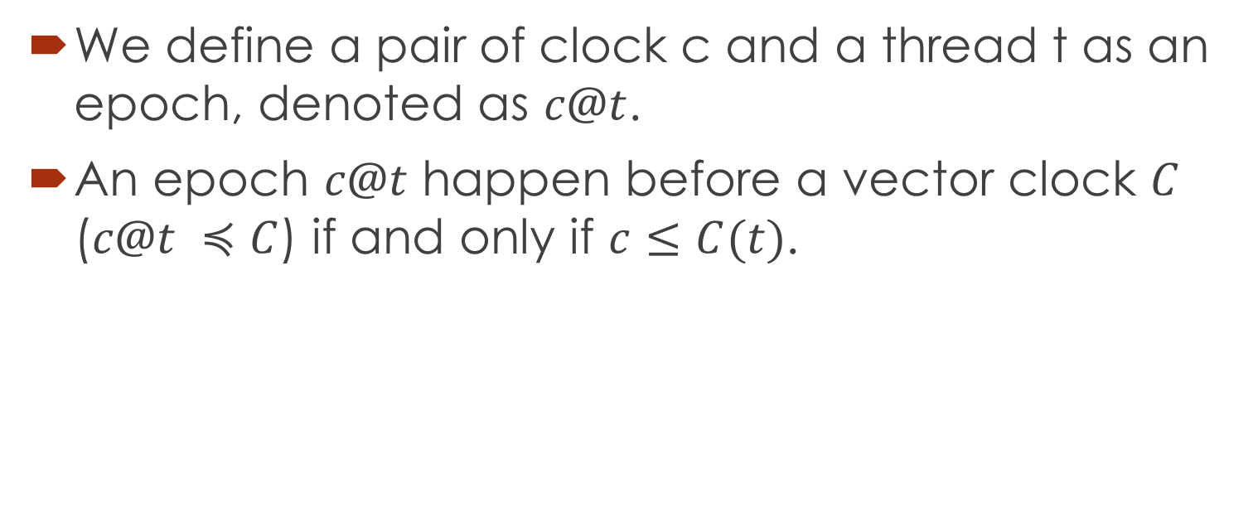
New notation: epoch
We define a pair of clock c and a thread t as an epoch, denoted as $c@t$.
An epoch $c@t$ happen before a vector clock $C$ ($c@t ≼C$) if and only if $c≤C(t)$.

Slide 30

Principle: Read-Write Race
For unordered(shared) read, we record the entire vector clock for $R_{v}$.
For ordered(exclusive) read, we record the latest read epoch for $R_{v}$.

Slide 31
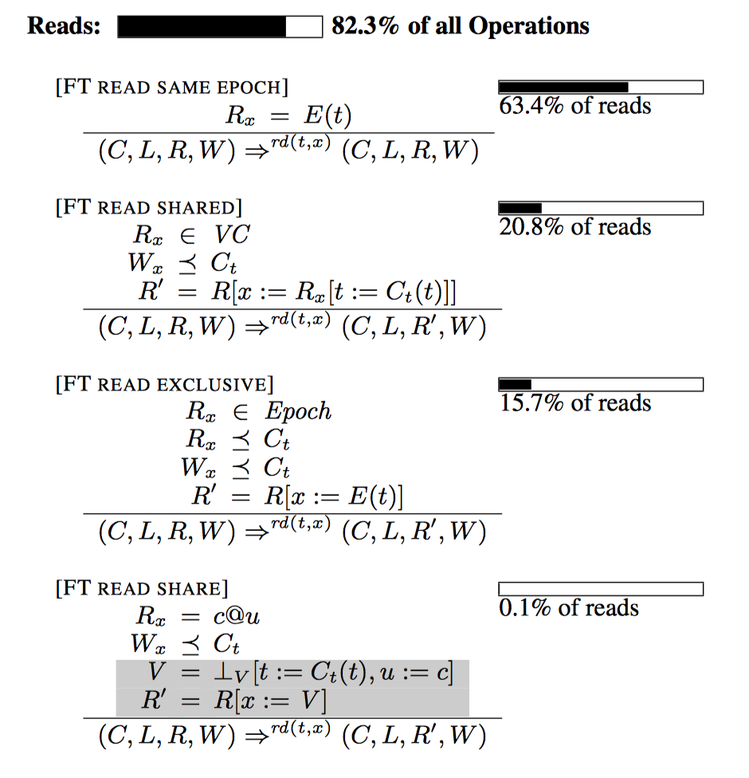
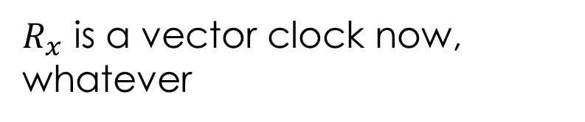

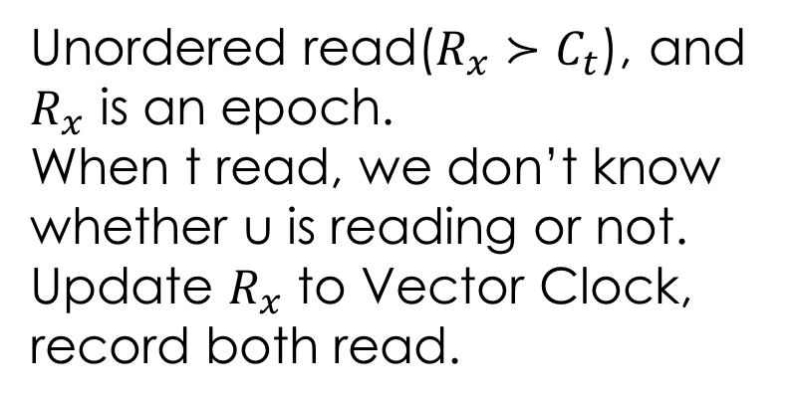
Read in the same epoch
$R_{x}$ is a vector clock now, whatever
Ordered read($R_{x}≼C_{t}$)
Unordered read($R_{x}≻C_{t}$), and $R_{x}$ is an epoch.
When t read, we don’t know whether u is reading or not.
Update $R_{x}$ to Vector Clock, record both read.

Slide 32
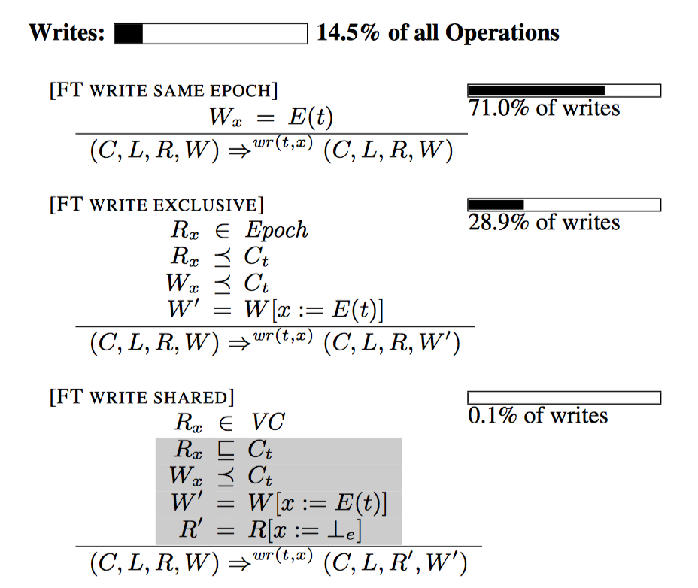
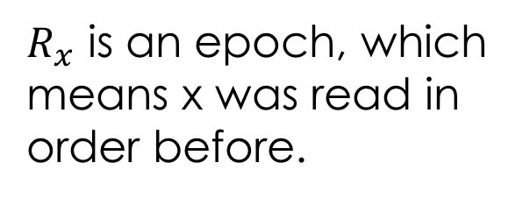
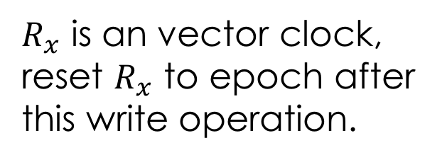
Write in same epoch
$R_{x}$ is an epoch, which means x was read in order before.
$R_{x}$ is an vector clock, reset $R_{x}$ to epoch after this write operation.

Slide 33
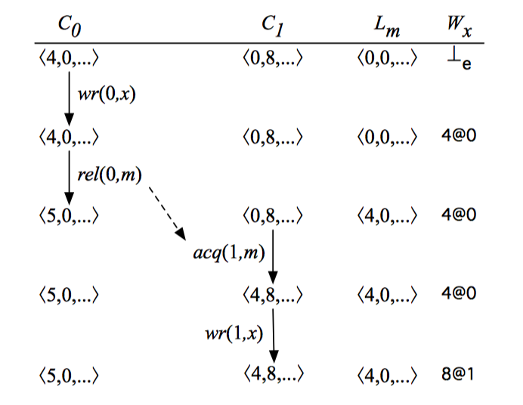
Comparison

