Slide 1
Tensorflow
关于tensorflow编程框架的相关调研

Slide 2
Introducting
In recent years, machine learning has driven advances in many different fields.
Sophisticated machine learning models.
The availability of large datasets for tackling problems in these fields.
Development of software platforms that enable the easy use of large amounts of computational resources for training such models on these large datasets.

Slide 3
Abstract
TensorFlow is a machine learning system that operates at large scale and in heterogeneous environments.
Developed by Google Brain Team.
TensorFlow is an open-source software library.

Slide 4
Previous system: DistBelief
DistBelief is the first-generation system and Tensorflow is developed based on it.
DistBelief uses the parameter server architecture which both simplifying and generalizing it to enable researchers to explore a wider variety of ideas with relative ease.
Disadvatages: Lack of flexibility
Defining new layers
Refining the training algorithms
Defining new training algorithms
Notes:
In the parameter server architecture, a job comprises two disjoint sets of processes: stateless worker processes that perform the bulk of the computation when training a model, and stateful parameter server processes that maintain the current version of the model parameters.

Slide 5
Design principles
Dataflow graphs of primitive operators
Deferred execution
Common abstraction for heterogeneous accelerators

Slide 6
Execution model

Slide 7
Execution model
TensorFlow uses a single dataflow graph to represent all computation and state in a machine learning algorithm.
Feature:
The model supports multiple concurrent executions on overlapping subgraphs of the overall graph.
Individual vertices may have mutable state that can be shared between different executions of the graph

Slide 8
Dataflow graph elements
Tensors
Operations
Stateful operations: variables
Stateful operations: queues
Notes:
In TensorFlow, we model all data as tensors (n-dimensional arrays) with the elements having one of a small number of primitive types, such as int32, float32, or string etc.
At the lowest level, all TensorFlow tensors are dense. Two alternatives for representing sparse data: either encode the data into variable-length string elements of a dense tensor, or use a tuple of dense tensors.
An operation takes m tensors as input and produces n tensors as output. An operation has a named “type” (such as Const, MatMul, or Assign).
An operation can contain mutable state that is read and/or written each time it executes. A Variable operation owns a mutable
Buffer. Variable has no inputs, and produces a reference handle. The simplest queue is FIFOQueue, which owns an internal queue of tensors, and allows concurrent access in first-in-first-out order.
Enqueue will block if its given queue is full, and Dequeue will block if its given queue is empty.

Slide 9
Partial and concurrent execution
The client selects zero or more edges to feed input tensors into the dataflow, and one or more edges to fetch output tensors from the dataflow; the runtime then prunes the graph to contain the necessary set of operations.
Partial and concurrent execution is responsible for much of TensorFlow’s flexibility
Notes:
Adding mutable state and coordination via queues makes it possible to specify
a wide variety of model architectures in user-level code, which enables advanced users to experiment without modifying the internals of the TensorFlow runtime.

Slide 10
Distributed execution
Makes communication between subcomputations explicit to simplifies distributed execution.
Each operation resides on a particular device,
A device is responsible for executing a kernel for each operation assigned to it.
TensorFlow allows multiple kernels to be registered for a single operation.
Placement algorithm
Notes:
The TensorFlow runtime places operations on devices, subject to implicit or explicit constraints in the graph.

Slide 11
Dynamic control flow
TensorFlow supports advanced machine learning algorithms that contain conditional and iterative control flow.(RNN, LSTM)
Add conditional (if statement) and iterative (while loop) programming constructs in the dataflow graph itself, and thus able to build higher-order constructs.
Borrow the Switch and Merge primitives from classic dynamic dataflow architectures.
Notes:
The execution of iterations can overlap, and TensorFlow can also partition conditional branches and loop bodies across multiple devices and processes.

Slide 12
Extensibility case studies

Slide 13
Differentiation and optimization
Many learning algorithms train a set of parameters using some variant of SGD(Stochastic gradient descent).
TensorFlow includes a user-level library that differentiates a symbolic expression for a loss function and produces a new symbolic expression representing the gradients(differentiation algorithm)
Notes:
performs breadth-first search to identify all of the backwards paths from the target operation and sums the partial gradients that each path contributes.
We have extended the algorithm to differentiate conditional and iterative subcomputations (§3.4) by adding nodes to the graph that record the control flow decisions in the forward pass, and replaying those decisions in reverse during the backward pass.

Slide 14
Advanced optimization schemes
Difficult to express as a single write operation.
E.g. Momentum, AdaGrad, AdaDelta, RMSProp, Adam, and L-BFGS

Slide 15
Training very large models
Common to use a distributed representation, which embeds a training example as a pattern of activity across several neurons, and which can be learned by backpropagation.

Slide 16
Fault tolerance
Implement user-level checkpointing for fault tolerance(Save, Restore)
During training, a typical client runs all of the Save operations periodically to produce a new checkpoint; when the client starts up, it attempts to Restore the latest checkpoint.

Slide 17
Synchronous replica coordination
SGD is robust to asynchrony.
Train deep neural networks using asynchronous parameter updates comes at the cost of using stale parameter values in training steps.
Since GPUs enable training with thousands of machines, synchronous training may be faster (in terms of time to quality) than asynchronous training on the same platform.
TensorFlow originally designed for asynchronous training but have begun experimenting with synchronous methods.
Notes:
TensorFlow graph enables users to change how parameters are read and written when training a model, and we implement three alternatives

Slide 18
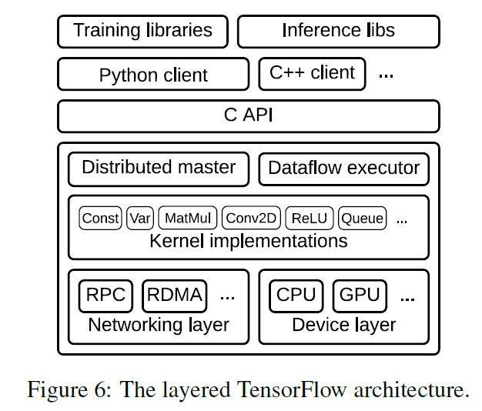
Implementation
The TensorFlow runtime is a cross-platform library.
a C API separates userlevel code in different languages from the core runtime

Slide 19
Implementation
The core TensorFlow library is implemented in C++ for portability and performance.
It can run on almost all the usual operating systems

Slide 20
Implementation
Distributed master translates user requests into execution across a set of tasks

Slide 21
Implementation
The dataflow executor in each task handles requests from the master, and schedules the execution of the kernels that comprise a local subgraph.

Slide 22
Implementation
The runtime contains over 200 standard operations, including mathematical, array manipulation, control flow, and state management operations.
Many of the operation kernels are implemented using Eigen::Tensor

Slide 23
Implementation
Specialize Send and Recv operations for each pair of source and destination device types.
use the cudaMemcpyAsync() API to overlap computation and data transfer between local CPU and GPU devices.

Slide 24
Related work
Single-machine frameworks
Batch dataflow systems
Parameter servers

Slide 25
Thank You

