Slide 1


Instructor
臧斌宇
Email: byzang@sjtu.edu.cn
Office phone: 13917124245
Office hour: make an appointment
Room: 1312 software Bld.
陈榕
Email: rongchen@sjtu.edu.cn
Office phone: 13616861826

Slide 2
Teaching Assistants & Grading
杨帆、柯学翰、张文浩、余天依
  软件楼3号楼4层（3-403）
Recitation
  Wednesday: 18:00～19:30 (once every two weeks)
Exams(70%)
  Mid term (35%)
  Final (35%)
  All exams are open books/open notes.
Labs (30%)

Slide 3
Memory Hierarchy (I)

Slide 4
Outline
Random-Access Memory (RAM)
Nonvolatile Memory
Data transfer between memory and CPU
Hard Disk
Data transfer between memory and disk
Suggested Reading: 6.1

Slide 5
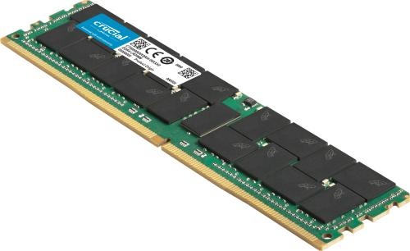
Random-Access Memory (RAM)
Key features
  RAM is packaged as a chip.
  Basic storage unit is a cell (one bit per cell).
  Multiple RAM chips form a memory.

Slide 6
Random-Access Memory (RAM)
Static RAM (SRAM)
  Each cell stores bit with a six-transistor circuit.
  Retains value indefinitely, as long as it is kept powered.
  Relatively insensitive to disturbances such as electrical noise.
Dynamic RAM (DRAM)
  Each cell stores bit with a capacitor and transistor.
  Value must be refreshed every 10-100 ms.
  Sensitive to disturbances.

Slide 7
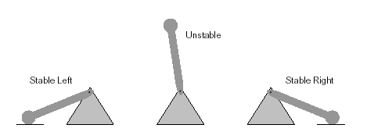
SRAM vs DRAM summary
Tran. Access
per bit time Persist? Sensitive? Cost Applications
SRAM 6 1X Yes No 1000x cache memories
DRAM 1 10X No Yes 1X Main memories,
frame buffers
SRAM

Slide 8
Conventional DRAM organization
d x w DRAM:
  dw total bits organized as d supercells of size w bits
pins
16 x 8 DRAM chip
cols
memory
controller
0
1
2
3
2 bits
/
0
addr
1
rows
2
supercell
(2,1)
(to CPU)
8 bits
/
3
data
internal row buffer

Slide 9
Reading DRAM supercell (2,1)
Step 1(a): Row access strobe (RAS) selects row 2.
Step 1(b): Row 2 copied from DRAM array to row buffer.
16 x 8 DRAM chip
cols
memory
controller
RAS=2
0
1
2
3
2
/
0
addr
1
rows
2
3
8
/
data
row 2
internal row buffer

Slide 10
Reading DRAM supercell (2,1)
Step 2(a): Column access strobe (CAS) selects column 1.
Step 2(b): Supercell (2,1) copied from buffer to data lines, and eventually back to the CPU.
16 x 8 DRAM chip
cols
memory
controller
CAS=1
0
1
2
3
2
/
0
addr
1
rows
supercell
(2,1)
2
3
8
/
data
internal row buffer

Slide 11
Memory modules
addr (row = i, col = j)
: supercell (i,j)
DRAM 0
64 MB
memory module
consisting of
eight 8Mx8 DRAMs
DRAM 7
data
DIMM: dual in-line memory module
240-pin for DDR2 and DDR3
280-pin for DDR4
bits
56-63
bits
48-55
bits
40-47
bits
32-39
bits
24-31
bits
16-23
bits
8-15
bits
0-7
63
56
55
48
47
40
39
32
31
24
23
16
15
8
7
0
Memory
controller
64-bit doubleword at main memory address A
64-bit doubleword to CPU chip

Slide 12
Bus Structure Connecting CPU and memory
A bus is a collection of parallel wires that carry address, data, and control signals
Buses are typically shared by multiple devices

Slide 13
Bus Structure Connecting CPU and memory
CPU chip
register file
ALU
system bus
memory bus
main
memory
bus interface
I/O
bridge
memory controller

Slide 14
Memory read transaction
1. CPU places address A on the memory bus
register file
ALU
Load operation: movl A, %eax
%eax
main memory
I/O bridge
0
A
bus interface
x
A

Slide 15
Memory read transaction
2. Main memory reads A from the memory bus,
retrieves word x, and places it on the bus.
register file
ALU
Load operation: movl A, %eax
%eax
main memory
I/O bridge
0
X
bus interface
x
A

Slide 16
Memory read transaction
3. CPU read word x from the bus and copies it into register %eax.
register file
ALU
Load operation: movl A, %eax
%eax
X
main memory
I/O bridge
0
bus interface
x
A

Slide 17
Memory write transaction
1. CPU place address A on bus. Main memory reads it and waits for the corresponding data to arrive.
register file
ALU
Store operation: movl %eax, A
%eax
Y
main memory
I/O bridge
0
A
bus interface
A

Slide 18
Memory write transaction
2. CPU places data word Y on the bus.
register file
ALU
Store operation: movl %eax, A
%eax
Y
main memory
I/O bridge
0
Y
bus interface
A

Slide 19
Memory write transaction
3. Main memory read data word Y from the bus and stores it at address A
register file
ALU
Store operation: movl %eax, A
%eax
Y
main memory
I/O bridge
0
bus interface
Y
A

Slide 20
Read the Block from the DIMM
To access data in the address A in a form A’xxx
Put A’ on the Bus
CPU chip
register file
ALU
Cache
memory
system bus
memory bus
main memory
0
A’
bus interface
I/O
bridge
x
A’

Slide 21
Read the Block from the Memory
Main memory reads A’ from the memory bus, retrieves 8 bytes x, and places it on the bus
CPU chip
register file
ALU
Cache
memory
system bus
memory bus
main memory
0
X
bus interface
I/O
bridge
x
A’

Slide 22
Enhanced DRAMs
All enhanced DRAMs are built around the conventional DRAM core
Fast page mode DRAM (FPM DRAM)
  Access contents of row with [RAS, CAS, CAS, CAS, CAS] instead of [(RAS,CAS), (RAS,CAS), (RAS,CAS), (RAS,CAS)].

Slide 23
Enhanced DRAMs
Extended data out DRAM (EDO DRAM)
  Enhanced FPM DRAM with more closely spaced CAS signals.
Synchronous DRAM (SDRAM)
  Driven with rising clock edge instead of asynchronous control signals
  Clock is electronic signals as the following
Clock

Slide 24
Enhanced DRAMs
Double data-rate synchronous DRAM (DDR SDRAM)
  Enhancement of SDRAM that uses both clock edges as control signals.
  Different sizes of small prefetch buffers that increase the effective bandwidth
  DDR (2 bits), DDR2 (4 bits), DDR3 (8 bits), and DDR4(16bits)

Slide 25
Enhanced DRAMs
Video RAM (VRAM)
  Like FPM DRAM, but output is produced by shifting row buffer
  Dual ported (allows concurrent reads and writes)

Slide 26
Nonvolatile memories
DRAM and SRAM are volatile memories
  Lose information if powered off.
Nonvolatile memories retain value even if powered off
  Generic name is read-only memory (ROM).
  Misleading because some ROMs can be read and modified.

Slide 27
Types of ROMs
Programmable ROM (PROM)
  Write once
Erasable programmable ROM (EPROM)
  Erase by ultraviolet light
  Write by a special device
  About 1000 times
Electrically erasable PROM (EEPROM)
  Reprogramming in-place on printed circuit cards
  About 100,000 times
Flash memory
  Based on EEPROM

Slide 28
Nonvolatile memories
Firmware
  Program stored in a ROM
  BIOS (basic input/output system)
    Boot time code
    a small set of primitive input and output functions
  graphics cards, disk controllers
    Translate I/O (input/output) requests from the CPU

Slide 29
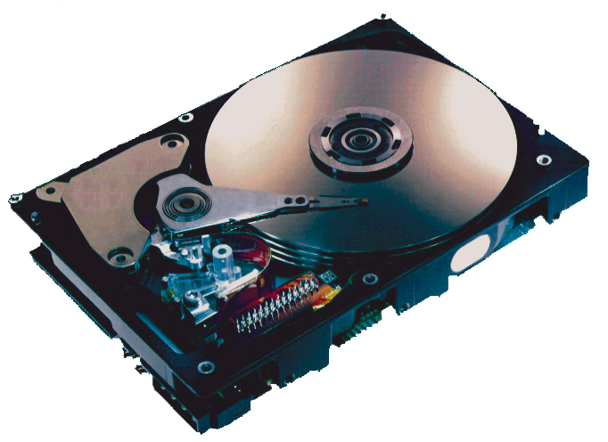
What’s inside a disk drive?
Spindle
Arm
Platters
Actuator
Electronics
(including a
processor
and memory!)
SCSI
connector
Image courtesy of Seagate Technology

Slide 30
Disk geometry
Disks consist of platters, each with two surfaces.
Each surface consists of concentric rings called tracks.
Each track consists of sectors separated by gaps.
tracks
surface
track k
gaps
spindle
sectors

Slide 31
Disk geometry (muliple-platter view)
Aligned tracks form a cylinder.
cylinder k
surface 0
platter 0
surface 1
surface 2
platter 1
surface 3
surface 4
platter 2
surface 5
spindle

Slide 32
Disk capacity
Capacity
  maximum number of bits that can be stored
  Vendors express capacity in units of gigabytes (GB), where 1 GB = 10^9.
Capacity is determined by these technology factors:
  Recording density (bits/in): number of bits that can be squeezed into a 1 inch segment of a track.
  Track density (tracks/in): number of tracks that can be squeezed into a 1 inch radial segment.
  Areal density (bits/in²): product of recording and track density.

Slide 33
Disk capacity
Old fashioned disks
  Each track has the same number of sectors
Modern disks partition tracks into disjoint subsets called recording zones
  Each track in a zone has the same number of sectors, determined by the circumference of innermost track
  Each zone has a different number of sectors/track

Slide 34
Computing disk capacity
Capacity = (# bytes/sector)
x (avg. # sectors/track)
x (# tracks/surface)
x (# surfaces/platter)
x (# platters/disk)
Example:
  512 bytes/sector
  300 sectors/track (on average)
  20,000 tracks/surface
  2 surfaces/platter
  5 platters/disk
Capacity = 512 x 300 x 20000 x 2 x 5
= 30,720,000,000
= 30.72 GB

Slide 35
Disk operation (single-platter view)
The disk surface
spins at
a fixed
rotational
rate
The read/write head
is attached to the end of
the arm and flies over
the disk surface on
a thin cushion of air.
spindle
By moving radially,
the arm can position the read/write head over any track.

Slide 36
Disk operation (multi-platter view)
read/write heads
move in unison
from cylinder to cylinder
arm
spindle

Slide 37
Disk Structure - top view of single platter
Surface organized into tracks
Tracks divided into sectors
Notes:
Goal:
Show the inefficeincy of current disk requests.
Conveyed Ideas:
Rotational latency is wasted time that can be used to service tasks
Background Information:
None.
Slide Background:
None.
Kill text and arrows

Slide 38
Disk Access
Head in position above a track
Notes:
Goal:
Show the inefficeincy of current disk requests.
Conveyed Ideas:
Rotational latency is wasted time that can be used to service tasks
Background Information:
None.
Slide Background:
None.
Kill text and arrows

Slide 39
Disk Access
Rotation is counter-clockwise
Notes:
Goal:
Show the inefficeincy of current disk requests.
Conveyed Ideas:
Rotational latency is wasted time that can be used to service tasks
Background Information:
None.
Slide Background:
None.
Kill text and arrows

Slide 40
Disk Access – Read
About to read blue sector
Notes:
Goal:
Show the inefficeincy of current disk requests.
Conveyed Ideas:
Rotational latency is wasted time that can be used to service tasks
Background Information:
None.
Slide Background:
None.
Kill text and arrows

Slide 41
Disk Access – Read
After BLUE read
After reading blue sector
Notes:
Goal:
Show the inefficeincy of current disk requests.
Conveyed Ideas:
Rotational latency is wasted time that can be used to service tasks
Background Information:
None.
Slide Background:
None.
Kill text and arrows

Slide 42
Disk Access – Read
After BLUE read
Red request scheduled next
Notes:
Goal:
Show the inefficeincy of current disk requests.
Conveyed Ideas:
Rotational latency is wasted time that can be used to service tasks
Background Information:
None.
Slide Background:
None.
Kill text and arrows

Slide 43
Disk Access – Seek
After BLUE read
Seek for RED
Seek to red’s track
Notes:
Goal:
Show the inefficeincy of current disk requests.
Conveyed Ideas:
Rotational latency is wasted time that can be used to service tasks
Background Information:
None.
Slide Background:
None.
Kill text and arrows

Slide 44
Disk Access – Rotational Latency
After BLUE read
Seek for RED
Rotational latency
Wait for red sector to rotate around
Notes:
Goal:
Show the inefficeincy of current disk requests.
Conveyed Ideas:
Rotational latency is wasted time that can be used to service tasks
Background Information:
None.
Slide Background:
None.
Kill text and arrows

Slide 45
Disk Access – Read
After BLUE read
Seek for RED
Rotational latency
After RED read
Complete read of red
Notes:
Goal:
Show the inefficeincy of current disk requests.
Conveyed Ideas:
Rotational latency is wasted time that can be used to service tasks
Background Information:
None.
Slide Background:
None.
Kill text and arrows

Slide 46
Disk Access – Service Time Components
After BLUE read
Seek for RED
Rotational latency
After RED read
Data transfer
Seek
Rotational
latency
Data transfer
Notes:
Goal:
Show the inefficeincy of current disk requests.
Conveyed Ideas:
Rotational latency is wasted time that can be used to service tasks
Background Information:
None.
Slide Background:
None.
Kill text and arrows

Slide 47
Disk access time
Average time to access some target sector approximated by
  T_{access} = T_{avg} _{seek} + T_{avg} _{rotation} + T_{avg} _{transfer}
Seek time
  Time to position heads over cylinder containing target sector.
  Typical T_{avg} _{seek} = 9 ms

Slide 48
Disk access time
Rotational latency
  Time waiting for first bit of target sector to pass under r/w head.
  T_{avg} _{rotation} = 1/2 x 1/RPMs x 60 sec/1 min
Transfer time
  Time to read the bits in the target sector.
  T_{avg transfer} = 1/(avg # sectors/track) x 1/RPM x 60 secs/1 min.

Slide 49
Disk access time example
Example:
  Rotational rate 7,200 RPM
  T_{avg} _{seek} 9 ms
  Avg # sectors/track 400
  T_{avg} _{rotation} = 1/2 * (60secs/7200RPM) * 1000ms/sec
  = 4ms
  T_{avg transfer} = 1/400secs/track x 60sec/7200RPM * 1000ms/sec
  = 0.02 ms
  T_{access} = 9 ms + 4 ms + 0.02 ms

Slide 50
Disk access time example
Important points
  Access time dominated by seek time and rotational latency, about 10ms for 512bits
  First bit in a sector is the most expensive, the rest are free
  SRAM access time is about 4 ns/64-bit word
  DRAM is about 60 ns/64-bit word
  Disk is about 40,000 times slower than SRAM
  Disk is about 2,500 times slower then DRAM

Slide 51
Logical disk blocks
Modern disks present a simpler abstract view of the complex sector geometry:
  The set of available sectors is modeled as a sequence of b-sized logical blocks (0, 1, 2, ...)
Mapping between logical blocks and actual (physical) sectors
  Maintained by hardware/firmware device called
  disk controller
  Converts requests for logical blocks into
  (surface, track, sector) triples.

Slide 52
Formatted disk capacity
Allows controller to set aside spare cylinders for each zone
  Accounts for the difference in “formatted capacity” and “maximum capacity”

Slide 53
Peripheral Component Interconnect
(PCI)
CPU chip
register file
ALU
system bus
memory bus
I/O
bridge
main
memory
bus interface
I/O bus
Expansion slots for
other devices such
as network adapters
USB
controller
graphics
adapter
Host Bus
Adaptor
SCSI/SATA
mouse
keyboard
monitor
solid stat disk
disk
controller
Disk drive
disk

Slide 54
Memory-mapped I/O
I/O Port
  A reserved address in the address space
  for the CPU to communicate with an I/O device
Each device is associated with (or mapped to)
  One or more ports when it is attached to the bus

Slide 55
Reading a disk sector
CPU chip
1. CPU initiates a disk read by writing a command, logical block number, and destination memory address to a port (address) associated with disk controller
register file
ALU
main
memory
bus interface
I/O bus
USB
controller
graphics
adapter
disk
controller
mouse
keyboard
monitor
disk

Slide 56
Reading a disk sector
CPU chip
2. Disk controller reads the sector and performs a DMA (direct memory access) transfer into main memory
register file
ALU
main
memory
bus interface
I/O bus
USB
controller
graphics
adapter
disk
controller
mouse
keyboard
monitor
disk

Slide 57
DMA
Direct memory access
A device performs a read or write bus transaction on its own, without any involvement of the CPU
The transfer of data is known as a DMA transfer

Slide 58
Reading a disk sector
CPU chip
3. When the DMA transfer completes, the disk controller notifies the CPU with an interrupt (i.e., asserts a special “interrupt” pin on the CPU)
register file
ALU
Interrupt
main
memory
bus interface
I/O bus
USB
controller
graphics
adapter
disk
controller
mouse
keyboard
monitor
disk

Slide 59
Interrupt
I/O devices trigger interrupts by signaling a pin on the processor chip
  network adapters, disk controllers, timer chips
I/O devices place a number onto the system bus
  identifies the device that caused the interrupt
Cause the CPU stop what it is currently working on, and jump to an operating system routine

