Slide 1
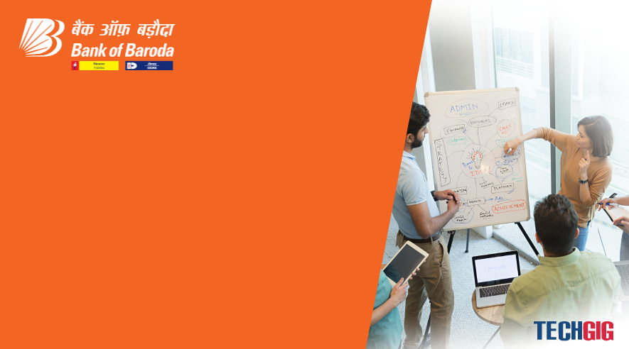

Bank of Baroda Hackathon - 2022
Technology Partner
Your Team Name : Best Of Battle
Your team bio :Pradeepa.B
Ranjithaa.S
Tamilselvi.S
Vijayapriya.P
Date :14/09/2022

Slide 2
Problem Statement?
Why did you decide to solve this Problem statement?
Bank is already a hectic place. Cheque processing consumes lot of time for bank employees.
So we decided not to spend their time in processing cheques.
Instead they simply use automated cheque processing.
We planned to help them to save their time by creating the application for cheque processing.

Slide 3
User Segment & Pain Points
Which user /advertiser segment would be early adopter of your product & why?
Cheque is scanned to verify their signatures
Validates the Cheque if it matches with the signature stored in database
PAIN POINTS
Sometimes Cheque get bounce and manual process takes too much time

Slide 4
Pre-Requisite
What are the alternatives/competitive products for the problem you are solving?
MICR- Magnetic Ink Character Recognition
AI-Artificial intelligence

Slide 5
Azure tools or resources
Azure tools or resources which are likely to be used by you for the prototype, if your idea gets selected OCR scanner-Optical Character Recognition
It recognize text within a digital image.OCR software can be used to convert a physical paper document or an image into an accessible electronic version with text.
Modern OCR system use intelligent character recognition (ICR) technology to read the text in the same way humans do.

Slide 6
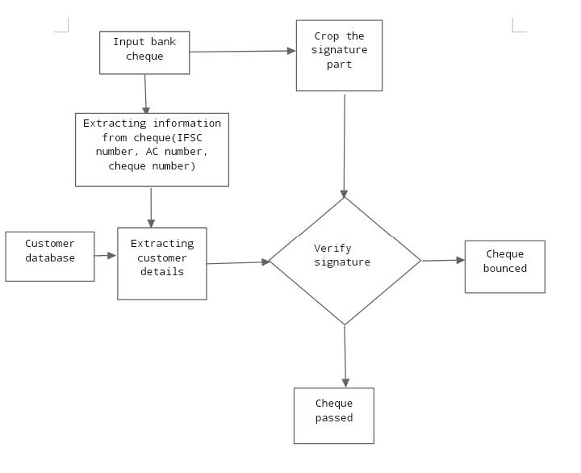
Any Supporting Functional Documents
Present your solution, talk about methodology, architecture & scalability

Slide 7
Key Differentiators & Adoption Plan
How is your solution better than alternatives and how do you plan to build adoption?
OCR supports wide variety of inks and fonts whereas MICR supports only ink created using Iron oxide and few fonts like E-138 & CMC-7.
OCR is very fast and fairly accurate of transferring hard copies into a computer files rather than Checking it manually.

Slide 8
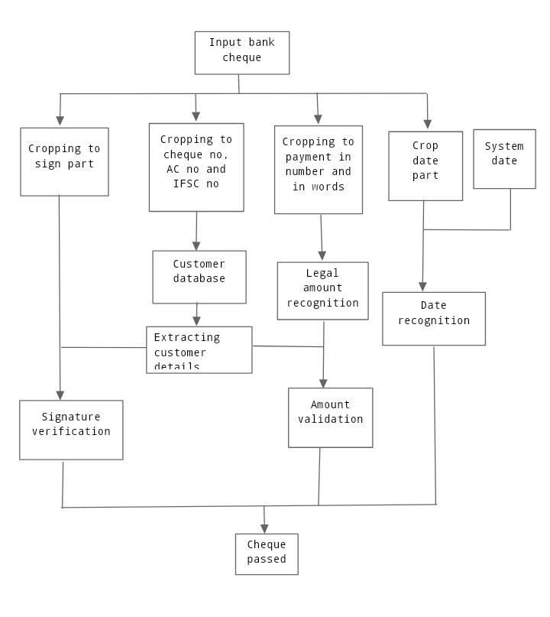
GitHub Repository Link & supporting diagrams, screenshots, if any
How far it can go?

Slide 9
Thank You
Team member names: Pradeepa B
Ranjithaa S
Tamilselvi S
Vijayapriya P

