Slide 1

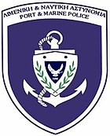


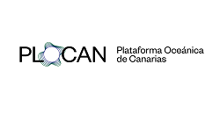



Command and Control Interface
Software Licensing
Authorities
Sales
Rental
Training Support
Sales and
Rental
DAS Interrogator Technology
Integrator of All Components
Submarine Cable Operators
Software Licensing
Detection Software
Sales of Cable Components
Subsea Cable Installers
Fiber Optic Cables

Slide 2


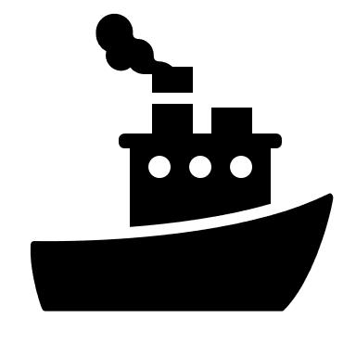


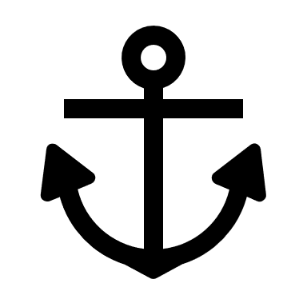





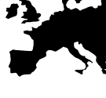

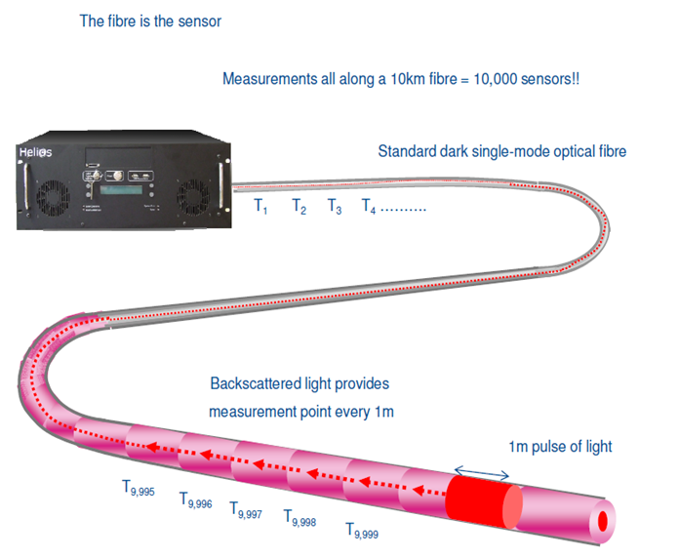



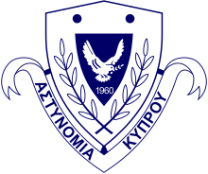




training data
AIS Tracking Data
data fusion
DAS Technology Provider
System Integration
Detection Algorithm
Command and Control Interface
special purpose fibre cable technology
DAS Interrogator
real-time DAS data:
strain rate
spectral energy
higher level information
real-time predictive analysis:
classification
identification
tracking
behavior analysis & prediction
Subsea infrastructure with fiber optic cable
User Interface for Operators and Authorities
Data Storage
Authorities
Operators
Ocean Technology Cluster
Requirements Analysis
Workshops
Dissemination
Training

Slide 3
ID | Use Case/Threat | Likelihood | Severity | Risk | Intervention (if early warning) | Intervention Type | Collection of Evidence
 | NATURAL
1 | Seismic activity | Low | Cable Damage | Medium | No direct intervention | Long term changes in design | Useless****
2 | Submarine landslide | Low | Cable Damage | Medium | No direct intervention | Long term changes in design | Useless****
3 | Submarine current drag | Low | Cable Damage | High | No direct intervention | Long term changes in design | Useless****
4 | Shark/other animal bite | Low | Cable Damage | Low | Possible/ex-post! | Alert to O&M team | Useful
5 | Degradation of cable | High | Cable Damage | High | Possible | Alert to O&M team | Useful
 | HUMAN
6 | Anchor Drop | High | Cable Damage | High | Possible | Radio Call | Useful
7 | Trawling | High | Cable Damage (unburied cable) | High | Possible | Radio Call | Useful
8 | Divers work at cable/Sabotage | Low (?) | Cable Damage | Low | Unclear (?) | Coast Guard Intervention | Useful
9 | Works on Seafloor/Dredging (Buoys Weights, Excavation, Sand Collection) | Low | Cable Damage | Low | Possible | Radio Call | Useful
10 | Loitering** | Medium | Espionage | Medium | Possible (?) | Coast Guard Intervention | Useful
11 | Submarine explosives/Sabotage | Low | Cable Damage | Medium | Possible | Coast Guard Intervention | Useful
12 | UAV unmanned sub ROV/Sabotage | Low | Espionage | Medium | Possible | Coast Guard Intervention | Useful

Slide 4
ID | Use Case/Threat | Intervention Type | Collection of Evidence | Increase of know-how | Impact of DAS System
 | NATURAL
1 | Seismic activity | Long term changes in design | Useless**** | Investigation and threat knowledge | Know-how
2 | Submarine landslide | Long term changes in design | Useless**** | Investigation and threat knowledge | Know-how
3 | Submarine current drag | Long term changes in design | Useless**** | Investigation and threat knowledge | Know-how
4 | Shark/other animal bite | Alert to O&M team | Useful | Investigation and threat knowledge | Know-how
5 | Degradation of cable | Alert to O&M team | Useful |  | Medium
 | HUMAN
6 | Anchor Drop | Radio Call | Useful |  | High
7 | Trawling | Radio Call | Useful |  | High
8 | Divers work at cable/Sabotage | Coast Guard Intervention | Useful |  | High
9 | Works on Seafloor/Dredging (Buoys Weights, Excavation, Sand Collection) | Radio Call | Useful |  | High
10 | Loitering** | Coast Guard Intervention | Useful |  | High
11 | Submarine explosives/Sabotage | Coast Guard Intervention | Useful |  | High
12 | UAV unmanned sub ROV/Sabotage | Coast Guard Intervention | Useful |  | High

Slide 5
Name/Title | Description | Reference | Addressed by FOSMARIN
PROJECTS
FIBERSENSE | Feasibility study on using fiber optical cables for maritime situational awareness
SUBMERSE | Development of a research instrument using Distributed Acoustic Sensors, State of Polarization, and Polarimeter technologies.
SEASEC | A system that uses dark fibers within fiber-optic cables to detect maritime traffic near subsea infrastructure like pipelines and cables
VIGIMARE | Development, testing, and evaluation of an information sharing environment to enhance security and reduce risks of physical and cyber-attacks on submarine cables and pipelines
PUBLICATIONS
Toward Detecting Ship Characteristics and Movements using DAS and Machine Learning | DAS Technology and Machine Learning Algorithms to detect ships crossing water surface above an undersea power cable | Malaprade et al. 2019 | Speed and Direction Detection for Security and Safety
Distributed acoustic sensing recordings of low-frequency whale calls and ship noise offshore Central Oregon |  | Wilcock et al. 2023
Simultaneous tracking of multiple whales using two fiber-optic cables in the Arctic |  | Rørstadbotnen et al. 2023

