Slide 3
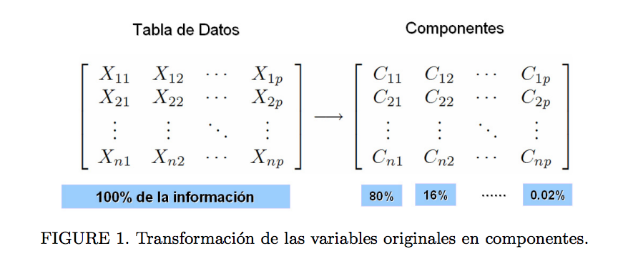
http://www.oldemarrodriguez.com/yahoo_site_admin/assets/docs/cap2.143111051.pdf

