Slide 1

BETAPOINT TECHNOLOGIES
BetaP-AMS
A Complete End-to-End Dynamic Asset Management and Tracking System.

Slide 2
About the Product
BTrack is an asset management and tracking product based on Active and Passive RFID.
BTrack is one stop solution for Complete Industrial/Commercial Asset Managment System.

Slide 3
Target Problem
⚫ | Industries and Enterpise firm/companies manages their asset using various legacy and modern methods of technologies, this methods often uses technologies like hand-held scanner, legacy pen-and-paper logs, human security inception and QR & Barcode based tracking. Some of this technologies consists major serious issues such as:
⚫ | No Digital track of asset.
⚫ | No Remote tracking application.
⚫ | In-house Server's or On-premises Server. This incrases risk of data security.
⚫ | No Live movement tracking.
⚫ | Lack of dynamic alert system.
⚫ | No Automated process from aseet registration till delivery.
⚫ | Tags or Barcode lacks security that can be hacked(changing tags details or barcode details using tags/barcode writer device).
⚫ | Lack proper dynamic Dashboard.
⚫ | No Cloud Backup.
⚫ | No Cloud application and dynamic on-prenise to cloud load balancer.
⚫ | Cannot be integrated into any system such as SAP, Azure, AWS or GCP

Slide 4
Proposed Solution
⚫ | Active RFID based tracking and monitoring.
⚫ | IoT based RFID device that can be tracked and monitored anywhere from the world.
⚫ | In-house and Azure based Servers. Best in class Azure network rules and policies.
⚫ | Live movement tracking from starting point to destination.
⚫ | Well defined automation system keeps track of each indivisual asset using AI.
⚫ | Alerts system such as Email, SMS, IoT Alert, smart devices, Google Assistant(integration), Digital Display boards.
⚫ | Self analysing application that manages and automates program even if the readers are disconnected.
⚫ | Master Web Application, Web App that provides Asset Management, Asset Tracking, Live Dashboard, Approval System, Third Party Integration such as SAP, MS-SQLSERVER and etc.
⚫ | Various types of Active Rfid tags are tagged accroding to the type of Asset such as Plastic, Steel, Metal, Water-based, Static-Sensitive.
⚫ | Web Applcation backed by best in class nginx web server and Azure Backup Server.
⚫ | Highly-Benchmarked Web Server and Server side program that can handle 255-350 readers operation at a time.
⚫ | High efficient and low latency upto 0.4 sec server response time for each reader connected to Server.
⚫ | Provision to configure RFID Readers with server using Mesh and Hybrid Arrangement.
⚫ | Active Beacon based tracking for asset that are on frequent moment such as Hospital bed, Testing equipment, projectors and etc.
⚫ | Live Dashboard for both Beacon and Active RFID setup.

Slide 5
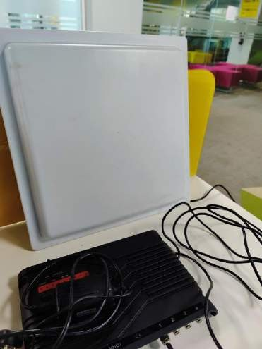
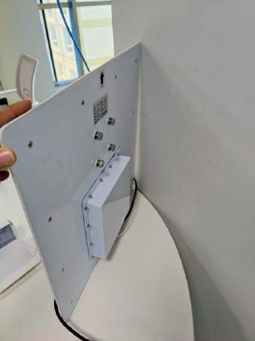
POC Product Images
UHF Active Readers: Room Setup
The image below is the Active RFID Reader setup for a
room
Each Room or Floor with entry and exit gates can be fixed with Active RFID, in this case 2 rooms each with one entry can be use same rfid or use multiport rfid reader to multiple gates/entry.

Slide 6
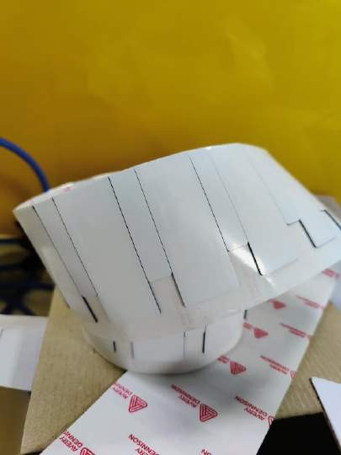
POC Product Images
Active RFID Tags
The below images are the tags that are tagged to an asset. These tags are designed for data encryption and secure id. It consist of 128 bit read/write feature.

Slide 7
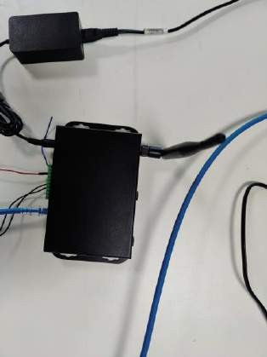
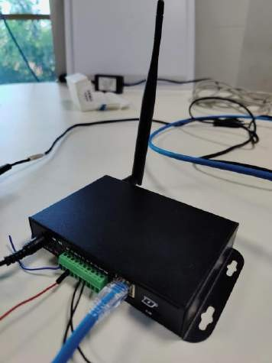
POC Product Images
Active BLE Beacon Reader.
The Beacon reader consist of same connection as of Active RFID(LAN, MODBUS, RS232, Serial Comm.
The Beacon is specially desinged to track BLE tracker(beacons)
with various filters and TCP Server inbuilt.

Slide 8
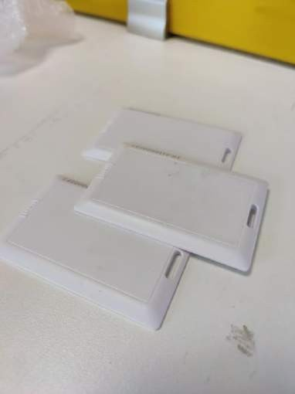
POC Product Images
Active BLE Beacon Card.
The Beacon card are enabled with 3+ year battery life, the
beacon consist of several features such as:
Encrypted Data storage.
Dust and Water Resistive.
Battery Status
RSSI distance status.

Slide 9
Technical Details
Server:
Linux Server
Web Server(Nginx)
Load Balancer with Backup Web App
DR using RAID.
32 GB RAM
275 Thread
MS-SQL Server Database.

Slide 10
Technical Details
Backend
Python Application.
Server Side Automation program.
Asset Monitoring and Track program.
Server Side Reader-Scan program.
Database operation program.

Slide 11
Technical Details
WebApp
Complete Dashboard
Secure Login using AES256 encryption.
Asset Management Portal
Request Asset Portal
Approval and Tracking Portal
Server Monitoring Portal.
Asset Movement and Logistics Portal.

