Slide 1
Code Dojo – Session 3
11/12/2013

Slide 2

Code Dojo Some Principles
Communicate
with your partner, be a pair, with the group
Code is design
No design talk without code, no code without talking
Slow down
No due date, no delivery, no tricks
Learning
Open-minded, from others
Challenge yourself
don’t be reluctant to try something new
Notes:
29/04/2013

Slide 3



Some tools (optionals)
JetBrains Resharper (R#)
Productivity tool
Third hand of the developer
Must have for safe refactoring
Ncrunch
Continuous testing tool
Increase speed and feedback of unit testing
TDD without knowing
nFluent
Better assertions
Gorgeous error messages

Slide 4
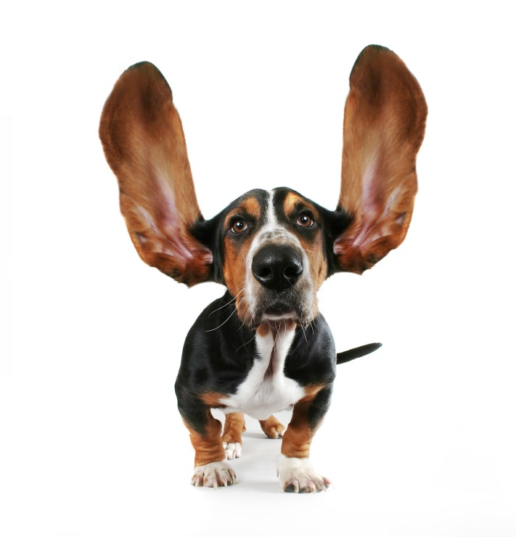
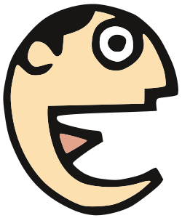
Some tips
Talk
Baby steps
Red Green Refactor
Talk
Switch pilot as much as possible
(Listen)

Slide 5

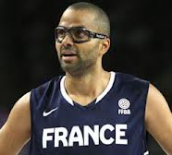
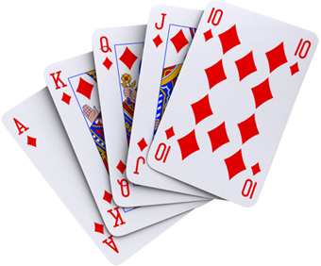
Kata 4 : Poker Score
Welcome to Betclic Poker TP Time!
Unfortunately Tony is not used to his new glasses
and he cannot see the cards!!!
Help him to calculate the score of each hands
At the end, help Tony to declare a winner!

Slide 6
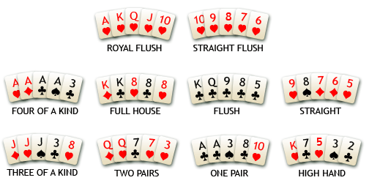
Kata 4 : Poker Score Rules

Slide 7
Kata 4 : Poker Score Tips
Start :
Calculate each hands’ score
Declare a winner
Tests :
“2H 6S 9S KS JD” hand, scores High Card
“2H 6C 9S 2D JD” hand, scores Pair
“2H 6S 9S AS JD” is higher than “2H 6S 9S KS JD”

Slide 8
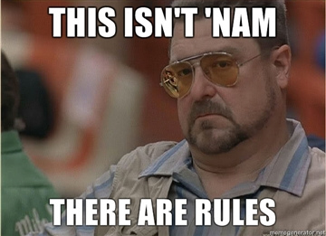
Thank you and remember :

