Slide 1
Code Dojo – Session 2
08/10/2013

Slide 2

Code Dojo Some Principles
Communicate
with your partner, be a pair, with the group
Code is design
No design talk without code, no code without talking
Slow down
No due date, no delivery, no tricks
Learning
Open-minded, from others
Challenge yourself
don’t be reluctant to try something new
Notes:
29/04/2013

Slide 3



Some tools (optionals)
JetBrains Resharper (R#)
Productivity tool
Third hand of the developer
Must have for safe refactoring
Ncrunch
Continuous testing tool
Increase speed and feedback of unit testing
TDD without knowing
nFluent
Better assertions
Gorgeous error messages

Slide 4


Some tips
Talk
Baby steps
Red Green Refactor
Talk
Switch pilot as much as possible
(Listen)

Slide 5
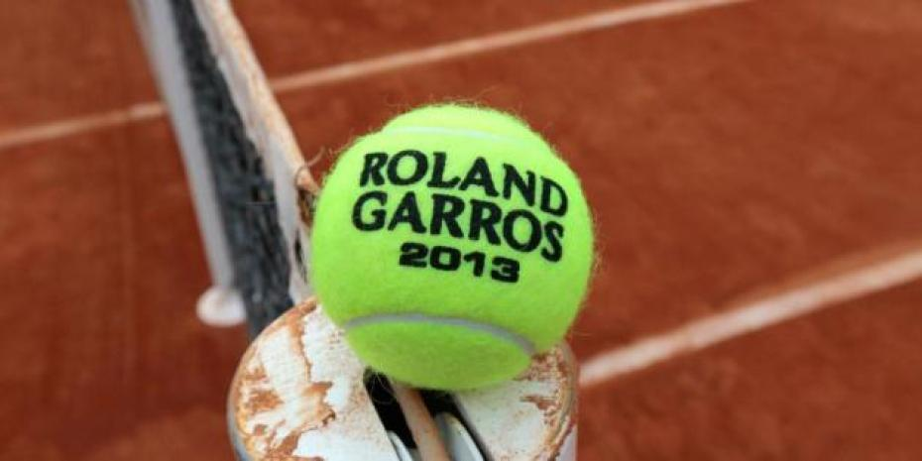
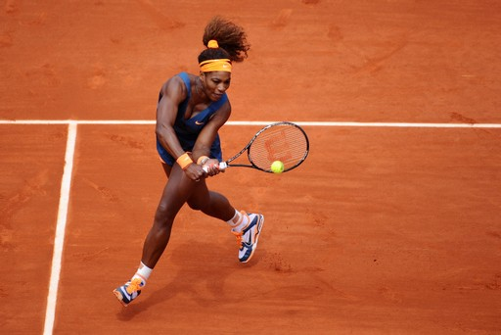
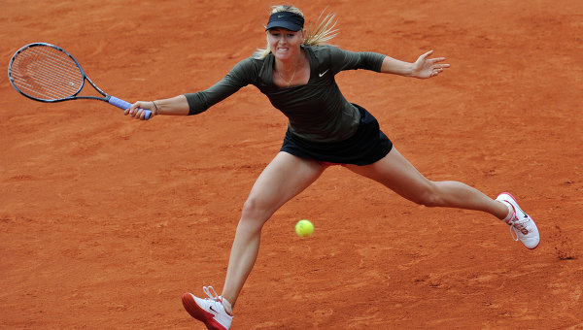
Kata 3 : Tennis Scorer
Welcome to Roland-Garros Grand Slam !
The finale between Maria Sharapova and Serena Williams is about to begin.
The referee is sick at the last moment !
Hopefully you have made that wonderful application that will help you to make this finale a great moment…
Hooo Hiiiiiiii !!!

Slide 6
Kata 3 : Tennis Scorer Rules
Basics :
In a game of tennis, a player starts with a score of 0. With each success, the player earns more points. The points are earned in this sequence.
0 -> 15 -> 30 -> 40
If a player has 40 and scores again that player wins the game as long as the other player does not also have 40 points.
If both players reach 40 points it is referred to as “deuce”.
Deuce:
Scoring during deuce gives a player “advantage”. If the other player scores again the score returns to deuce.
If a player has advantage and scores again, that player wins the game
http://en.wikipedia.org/wiki/Tennis#Scoring
Note : You need only report the score for the current game. Sets and Matches are out of scope.

Slide 7
Kata 3 : Tennis Scorer Tips
Start :
Players must be able to score points (one server, one receiver).
The game must be able to be completed with a winner.
The "deuce" case should be handled.
After a game has been won, a winner must be determined.
Be able to get the current score of either player at any point during the game.
Tests :
Game starts with 0-0
If one player scores 4 times in a row, he win the game
If both player score 3 times, score is « Deuce »

Slide 8
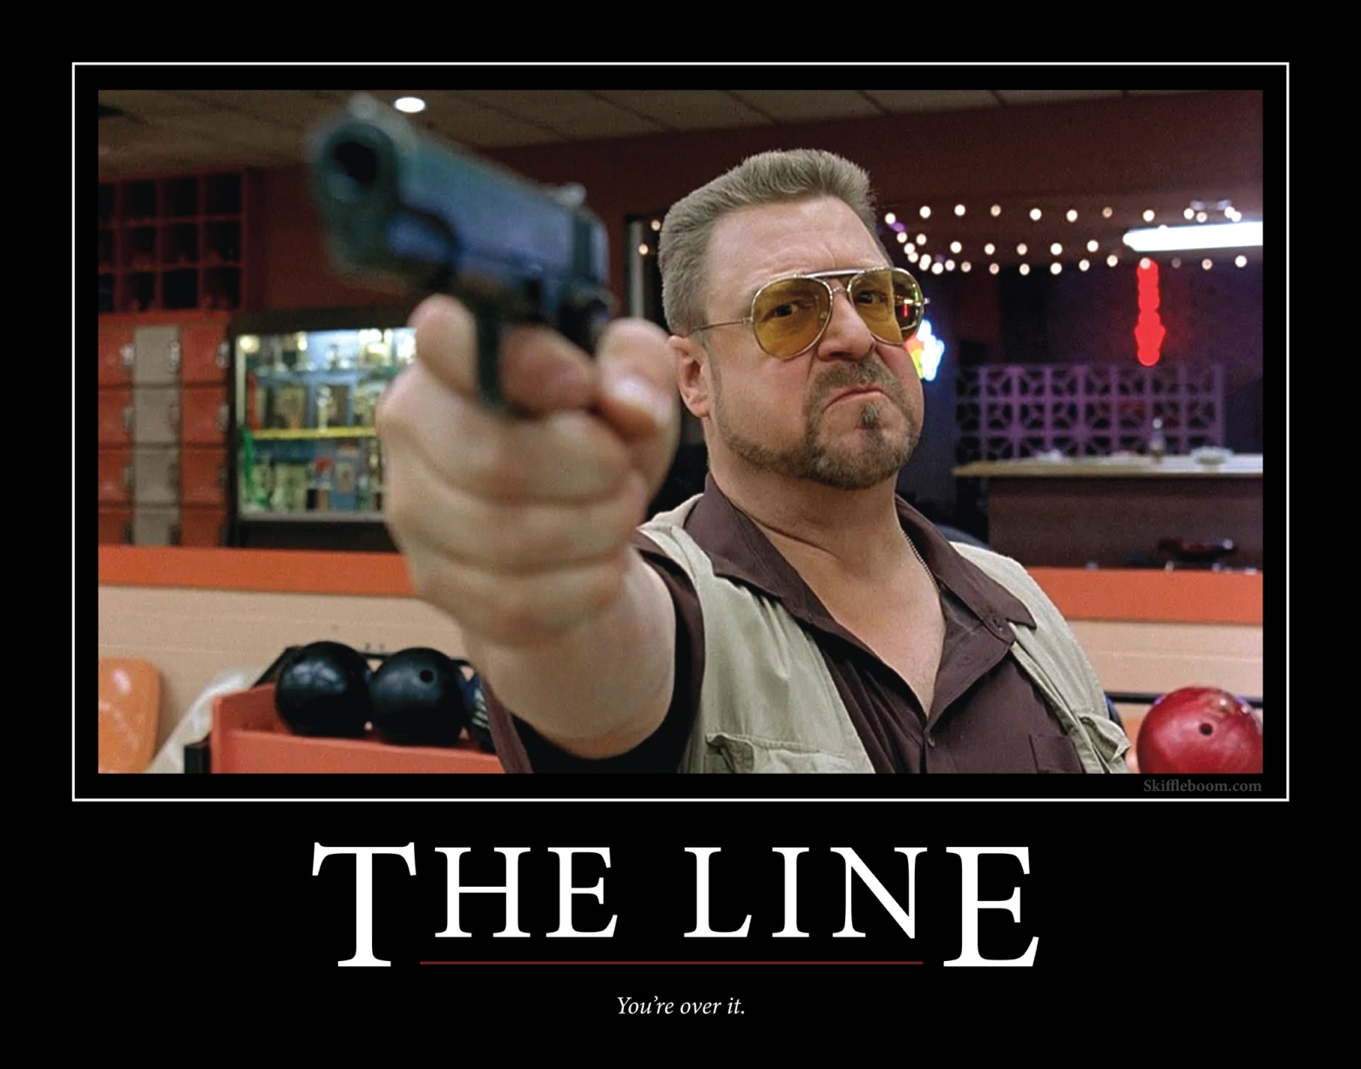
Thank you and remember :
THERE ARE RULES !

