Slide 1
Code Dojo – Game of life
02/06/2015

Slide 2

Code Dojo Some Principles
Communicate
with your partner, be a pair, with the group
Code is design
No design talk without code, no code without talking
Slow down
No due date, no delivery, no tricks
Learning
Open-minded, from others
Challenge yourself
don’t be reluctant to try something new
Notes:
29/04/2013

Slide 3



Some tools (optionals)
JetBrains Resharper (R#)
Productivity tool
Third hand of the developer
Must have for safe refactoring
Ncrunch
Continuous testing tool
Increase speed and feedback of unit testing
TDD without knowing
nFluent
Better assertions
Gorgeous error messages

Slide 4



Some tips
Talk
Baby steps
Red Green Refactor
Talk
Switch pilot as much as possible
(Listen)

Slide 5
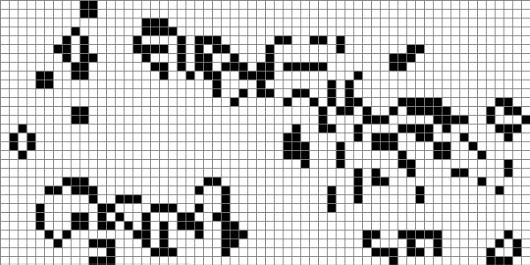
Conway’s Game Of Life!

Slide 6
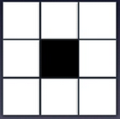

The Problem
Any live cell with fewer than two live neighbours dies, as if caused by under-population
Gen n
Gen n+1

Slide 7
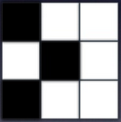

The Problem
Any live cell with two or three live neighbours lives on to the next generation
Gen n
Gen n+1

Slide 8


The Problem
Any live cell with more than three live neighbours dies, as if by overcrowding
Gen n
Gen n+1

Slide 9
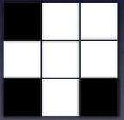
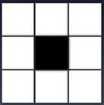
The Problem
Any dead cell with exactly three live neighbours becomes a live cell, as if by reproduction
Gen n
Gen n+1

Slide 10

Summary
Any live cell with fewer than two live neighbours dies, as if caused by under-population
Any live cell with two or three live neighbours lives on to the next generation
Any live cell with more than three live neighbours dies, as if by overcrowding
Any dead cell with exactly three live neighbours becomes a live cell, as if by reproduction

Slide 11
Session
Pick a pair
Code
Delete
Retrospect

Slide 12
Notes
All rules are applied simultaneously
No pressure, do not complete the task but master it
No GUI. Yes, you have to use tests instead :p
At the end of each session :
You have to destroy your code
You have to change your pair
You can change your language (C#, F#, Javascript, …)

Slide 13

Iteration 1
Get to know the problem using TDD

Slide 14
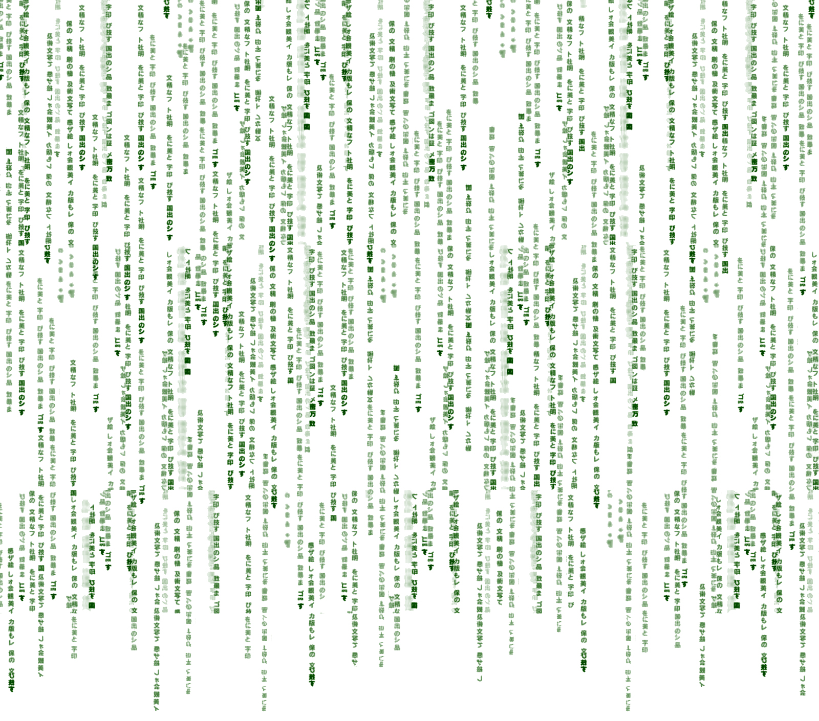
Iteration 2
Max 5 lines of code per method

Slide 15

Iteration N
Select a constraint:
switch keyboard each minute
no mouse
no loop
no if else
no collection like array or list
immutable structure

Slide 16

Final Iteration
Mute ping-pong

Slide 17
Retrospect
Learn through pairing
Experimenting
Track yourselft and see progress
And you?

