Slide 1
Code Dojo – Labyrinth
17/11/2014

Slide 2

Code Dojo Some Principles
Communicate
with your partner, be a pair, with the group
Code is design
No design talk without code, no code without talking
Slow down
No due date, no delivery, no tricks
Learning
Open-minded, from others
Challenge yourself
don’t be reluctant to try something new
Notes:
29/04/2013

Slide 3



Some tools (optionals)
JetBrains Resharper (R#)
Productivity tool
Third hand of the developer
Must have for safe refactoring
Ncrunch
Continuous testing tool
Increase speed and feedback of unit testing
TDD without knowing
nFluent
Better assertions
Gorgeous error messages

Slide 4

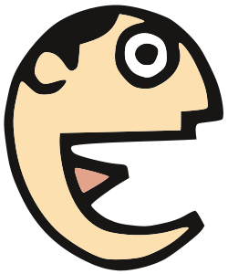
Some tips
Talk
Baby steps
Red Green Refactor
Talk
Switch pilot as much as possible
(Listen)

Slide 5

YOUR MISSION

Slide 6
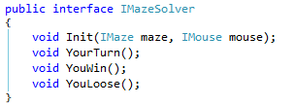


Kata: Labyrinth!
YOUR GEAR:
One main interface to implement: IMazeSolver (StupidSolver provided)
RULE:
One Mouse.Move(); per Turn!

Slide 7
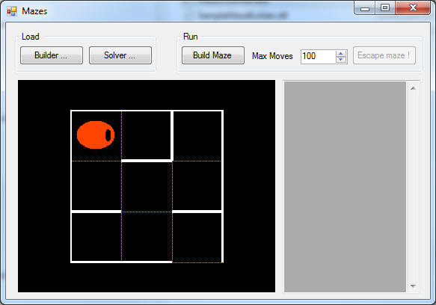
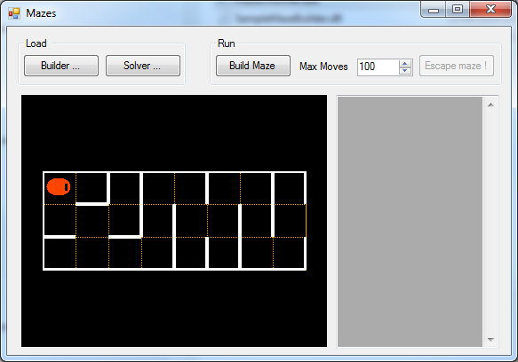
Kata: Labyrinth!
YOUR GEAR:
A runner to test with 2 different builders

Slide 8

Kata: Labyrinth!
THE ULTIMATE BUILDER IS MINE!
AHAHAHAHAHAHAHAH!!!

Slide 9
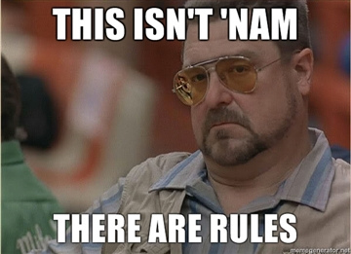
Thank you and remember :

