Slide 1
Quantum Light
Sisinty Sasmita Patra
Jeanne Victor
Smita Kundargi

Slide 2
Project focus:
Quantifying the input data and displaying various LED patterns based on quantification.
Quantifying Weather data

Slide 3
Weather data
Temperature
Wind

Slide 4
Quantum Light : Block diagram
sensor data
??
NO
Get
online data
Display
LED
PATTERNS
Using ARDUINO
YES
Capture sensor data
Using Arduino
Classify
data using Computer

Slide 5
Classifying Weather data
Temperature
Cold
Normal
Hot
More Windy
Less Windy
No Windy
wind

Slide 6
Assigning patterns based on classification
TEMPERATURE | WIND SPEED | LED PATTERN
0 | 0 | 0 => Cold No Windy
0 | 1 | 1 => Cold Less Windy
0 | 2 | 2 => Cold More Windy
1 | 0 | 3 => Normal No Windy
1 | 1 | 4 => Normal Less Windy
1 | 2 | 5 => Normal More Windy
2 | 0 | 6 => Hot No Windy
2 | 1 | 7 => Hot Less Windy
2 | 2 | 8 => Hot More Windy

Slide 7
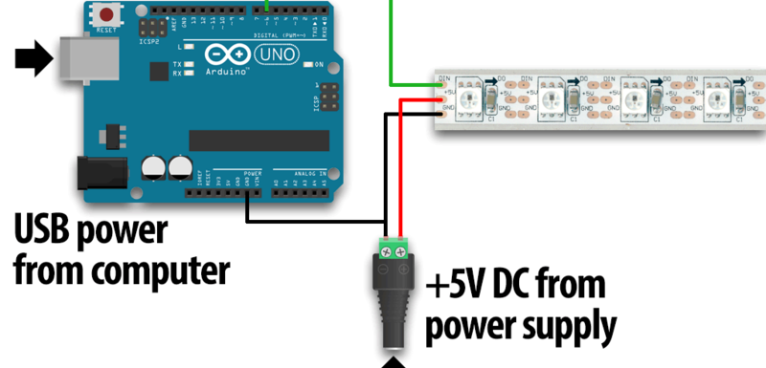
Connecting Arduino and LED strip

Slide 8
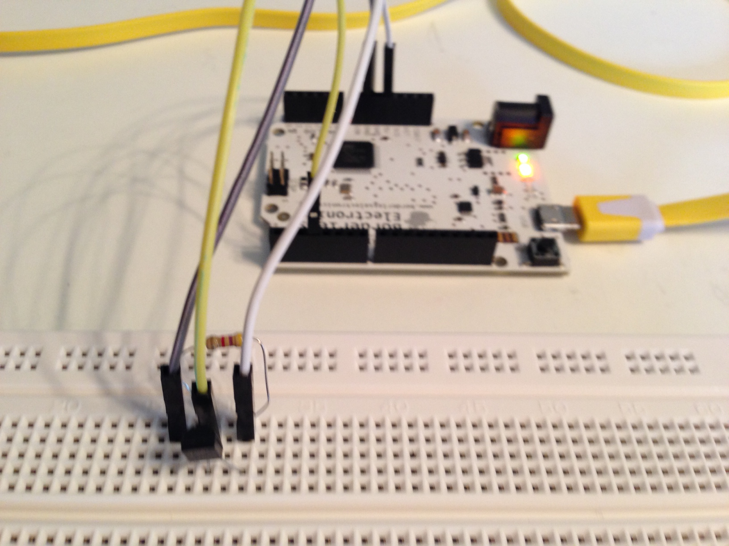
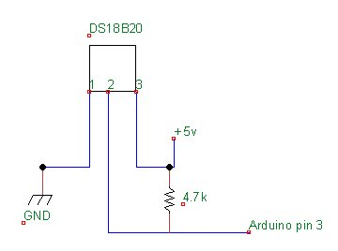
Connecting Indoor sensor with ARDUINO
Pin 3
Block diagram

Slide 9
Results
Small Video snippet how LED pattern varies based on the input conditions

Slide 10
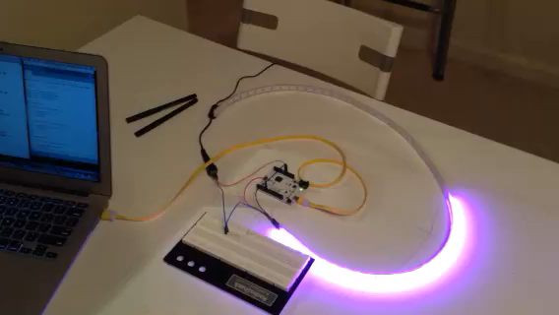
Normal Temp and Less Windy

Slide 11
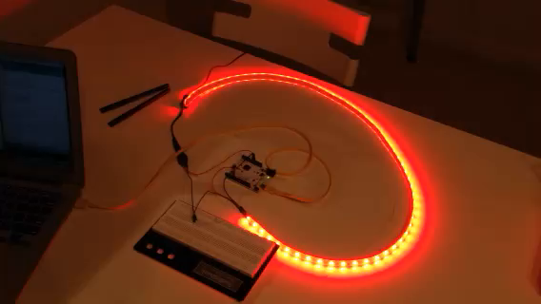
Hot Temp and No Windy

Slide 12
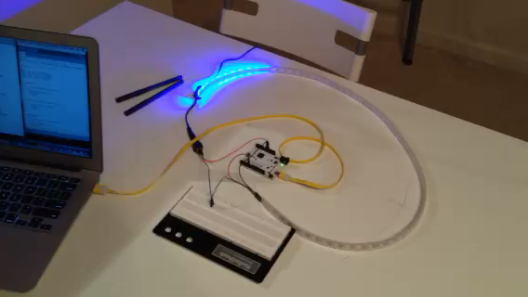
Cold temp and More Windy

Slide 13
COMPONENTS USED
ARDUINO board
NeoPixel digital RGB LED Strip
http://www.adafruit.com/products/1138
Temperature Sensors(DS18B20)
http://www.adafruit.com/products/374
Resistors
Jumper wires

Slide 14
LIBRARY USED
Weather API (pywapi)
To get weather data from online
Serial
Python module to Communicate between computer and Arduino via serial port
Onewire
To get temperature data using indoor sensors
Adafruit_NeoPixel
To light led patterns using led strip

Slide 15
Future work
Creating an App that has following features
Picture of weather
Temp, wind , humidity, rain, precipitation
Max, Min temp in a day/week
Comparing indoor and outdoor sensors data and coming up with LED patterns to show the differences.
Using Wifi on Galileo
Fix the modules to work on Galileo

Slide 16
Challenges

Slide 17
Github link: https://github.com/sasmita/QuantumLight
References :
http://arduino.cc/en/Tutorial/HomePage
https://github.com/adafruit/Adafruit_NeoPixel
http://playground.arduino.cc/interfacing/python

Slide 18
QUESTIONS ??

