Slide 1
Quantum Light
Sisinty Sasmita Patra
Jeanne Victor
Smita Kundargi

Slide 2
Project focus:
Quantifying the input data and displaying various LED patterns based on quantification.

Slide 3
Weather data
Temperature
Wind

Slide 4
Classifying Weather data
Weather
Data
Temperature
Cold
Normal
wind
NoWindy
Hot
MoreWindy
LessWindy

Slide 5
QuantumLight : Block diagram
sensor data
??
NO
Get
online data
Display
LED
PATTERNS
Using ARDUINO
YES
Capture sensor data
Using Arduino
Classify
data using Computer

Slide 6
Assigning patterns based on classification
TEMPERATURE | WIND SPEED | LED PATTERN
0 | 0 | 0 => Cold No Windy
0 | 1 | 1 => ColdLessWindy
0 | 2 | 2 => ColdMoreWindy
1 | 0 | 3 => NormalNoWindy
1 | 1 | 4 => NormalLessWindy
1 | 2 | 5 => NormalMoreWindy
2 | 0 | 6 => HotNoWindy
2 | 1 | 7 => HotLessWindy
2 | 2 | 8 => HotMoreWindy

Slide 7
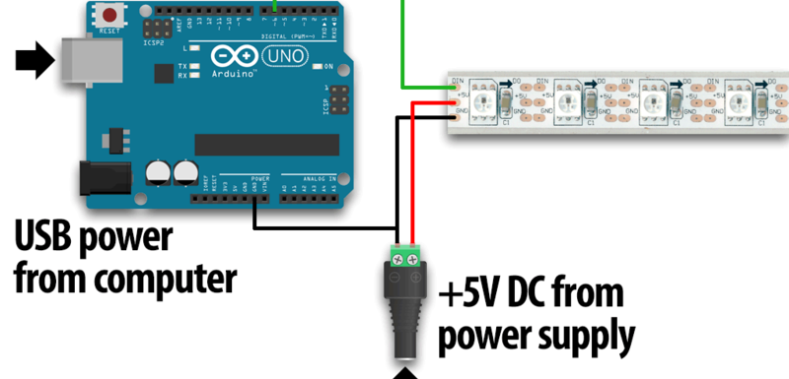
Connecting Arduino and LED strip

Slide 8
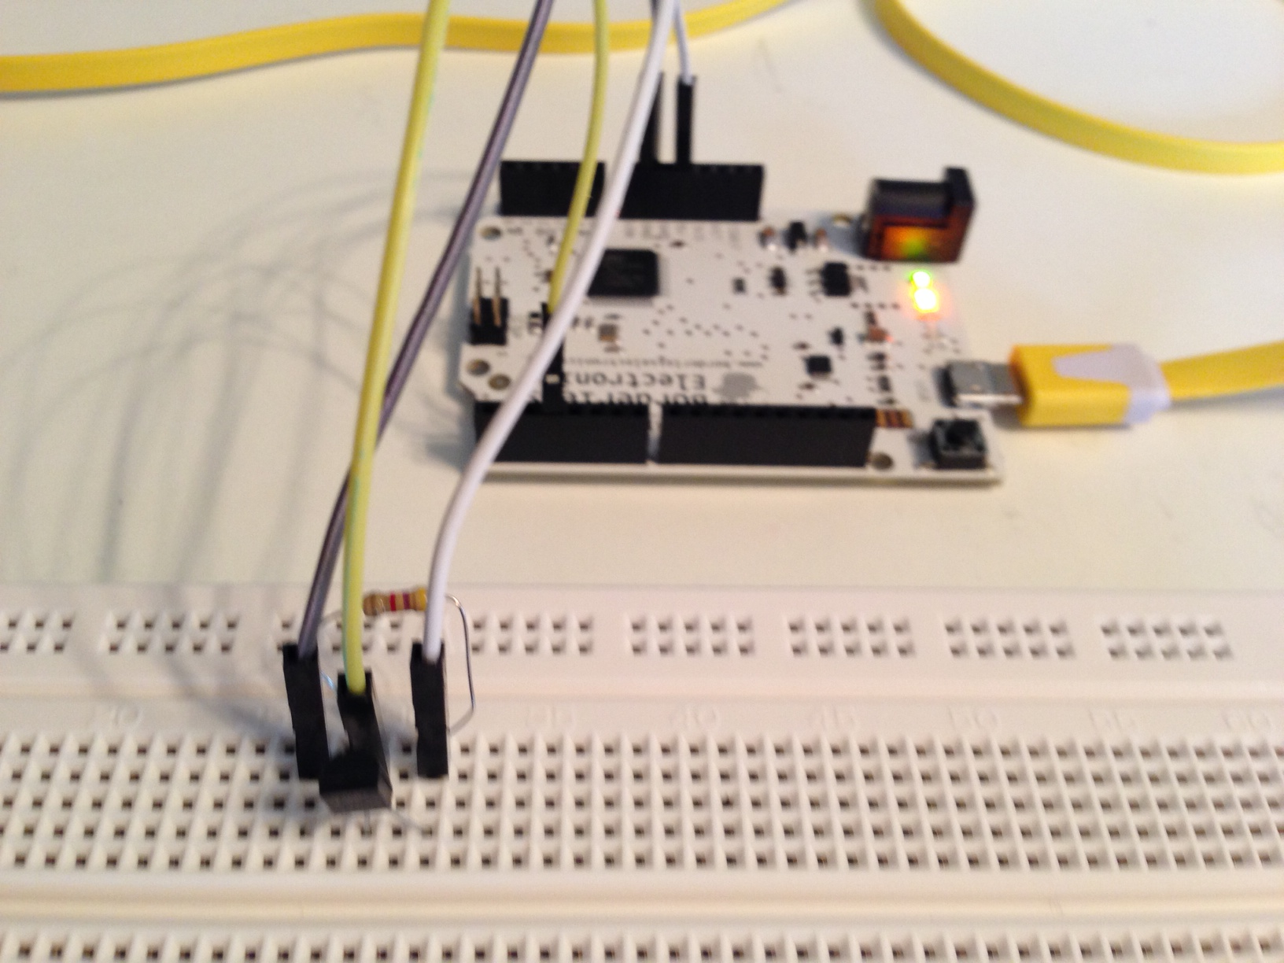
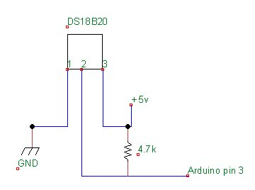
Connecting Indoor sensor with ARDUINO
Pin 3
Block diagram

Slide 9
Small Video snippets
Small Video snippet how LED pattern varies based on the input conditions

Slide 10
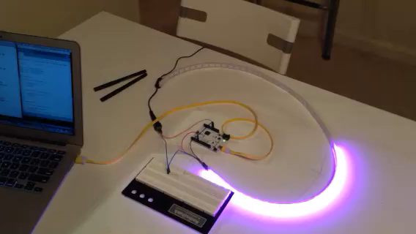
Normal Temp and Less Windy

Slide 11
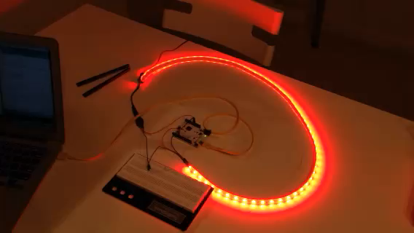
Hot Temp and No Windy

Slide 12
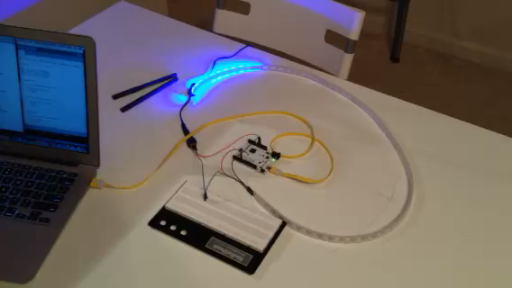
Cold temp and More Windy

Slide 13
LIBRARY USED
Weather API (pywapi)
To get weather data from online
Serial
Python module to Communicate between computer and Arduino via serial port
Onewire
To get temperature data using indoor sensors
Adafruit_NeoPixel
To light led patterns using led strip

Slide 14
COMPONENTS USED
ARDUINO board
Resistors
Jumper wires
Temperature Sensors(DS18B20)
http://www.adafruit.com/products/374
NeoPixel digital RGB LED Strip
http://www.adafruit.com/products/1138

Slide 15
Future Enhancements
Creating an App that has following features
Picture of weather
Temp, wind , humidity, rain, precipitation info
Max, Min temp in a day
Max, min temp over a week
Comparing indoor and outdoor sensors values on the basis of LED patterns produced.

Slide 16
References :
http://arduino.cc/en/Tutorial/HomePage
https://github.com/adafruit/Adafruit_NeoPixel
http://playground.arduino.cc/interfacing/python
Github link: https://github.com/sasmita/QuantumLight

