Slide 1
Quantum Light
Sisinty Sasmita Patra
Jeanne Victor
Smita Kundargi

Slide 2
Project focus:
Quantifying the input data and displaying various LED patterns based on quantification.
Quantifying Weather data

Slide 3
Quantum Light : Block diagram
sensor data
??
NO
Get
online data
Display
LED
PATTERNS
(Using ARDUINO)
YES
Capture sensor data
(Using Arduino)
Classify
data (using Computer)

Slide 4
Classifying Weather data
Temperature
Cold
Normal
Hot
More Windy
Less Windy
No Windy
wind

Slide 5
Assigning patterns based on classification
TEMPERATURE | WIND SPEED | LED PATTERN
0 | 0 | 0 => Cold No Windy
0 | 1 | 1 => Cold Less Windy
0 | 2 | 2 => Cold More Windy
1 | 0 | 3 => Normal No Windy
1 | 1 | 4 => Normal Less Windy
1 | 2 | 5 => Normal More Windy
2 | 0 | 6 => Hot No Windy
2 | 1 | 7 => Hot Less Windy
2 | 2 | 8 => Hot More Windy

Slide 6
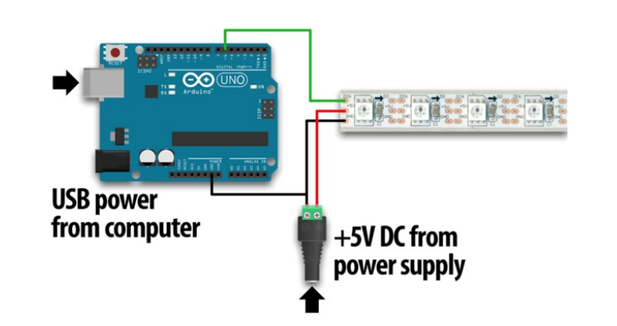
Connecting Arduino and LED strip

Slide 7
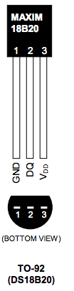
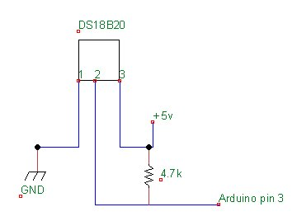
Connecting temperature sensor with ARDUINO

Slide 8
Implementation details
Sensor?
On the PC Side
On the Arduino side
Yes
No
Get Sensor Data
Send Sensor Data
Get Internet Data
While loop
Loop()
Classify
Display LED Pattern
Send Pattern

Slide 9
Results
Small Video snippets that show LED pattern varies based on the input conditions

Slide 10
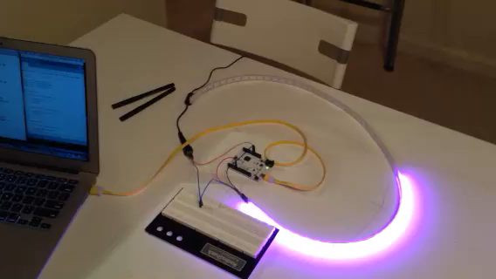
Normal Temp and Less Windy

Slide 11
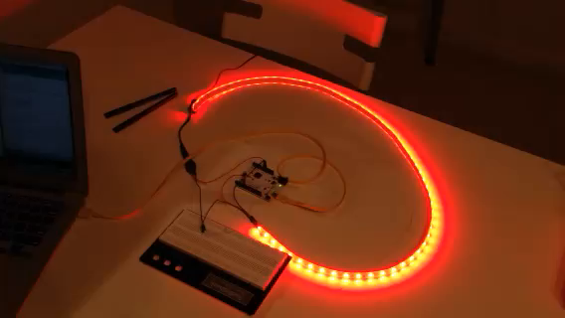
Hot Temp and No Windy

Slide 12
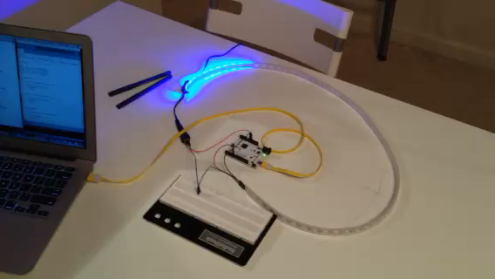
Cold temp and More Windy

Slide 13
Data Collection & Parsing
Python
Yahooweather – to collect weather data’s
Parsing data to collect current temperature & windspeed

Slide 14
Classification Details
WEATHER DATA | CLASSIFICATION | RANGE
TEMPERATURE | 0 | <=10
 | 1 | > 10 and <= 20
 | 2 | 20 and above
WIND SPEED | 0 | <= 5
 | 1 | >5 and <= 10
 | 2 | 10 and above
HUMIDITY | 0 | <= 50
 | 1 | > 50 and <= 75
 | 2 | 75 and above

Slide 15
DATA ANALYSIS
Analyzing data from Graphs

Slide 16
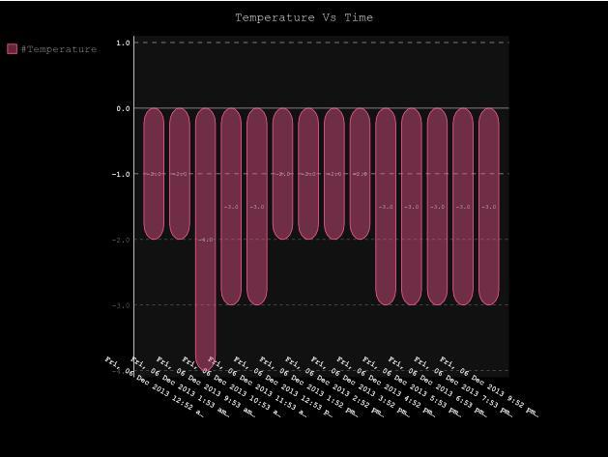
Graphs – Temp Vs Time

Slide 17
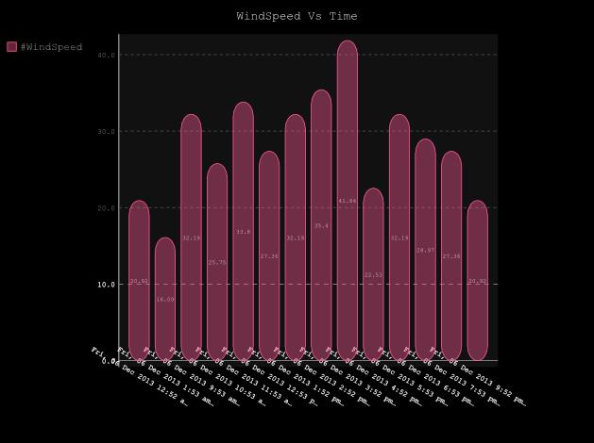
WindSpeed Vs Time

Slide 18
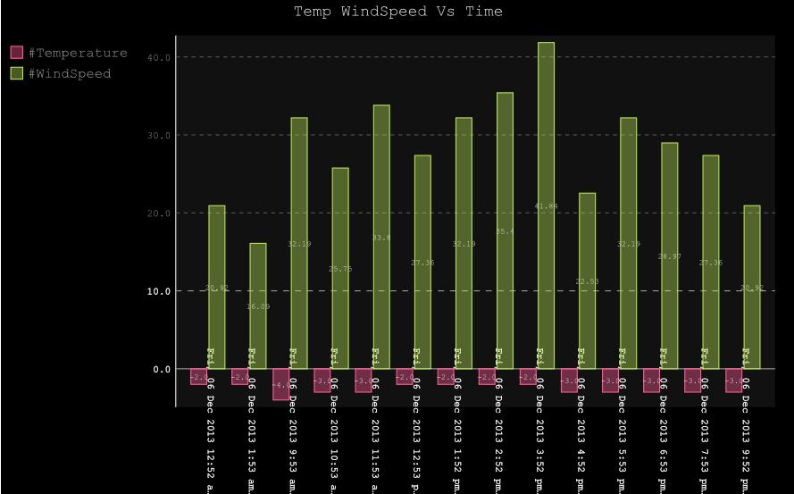
Temp/WindSpeed Vs Time

Slide 19
COMPONENTS USED
ARDUINO board
NeoPixel digital RGB LED Strip
http://www.adafruit.com/products/1138
Temperature Sensors(DS18B20)
http://www.adafruit.com/products/374
Resistors
Jumper wires

Slide 20
LIBRARY USED
Weather API (pywapi)
To get weather data from online
Serial
Python module to Communicate between computer and Arduino via serial port
Onewire
To get temperature data using indoor sensors
Adafruit_NeoPixel
To light led patterns using led strip

Slide 21
Challenges
Making one Arduino sketch to work for both sensor sketch and LED displaying sketch.
Problems with loops every where: Changing LED patterns automatically based on current temperature.

Slide 22
Future work
Creating an App that has following features
Picture corresponding to weather data
Show temperature, wind , humidity, rain, precipitation
Max, Min temp in a day/week
Use of other sensors : humidity and wind
Comparing indoor and outdoor sensors data and coming up with LED patterns to show the differences.
Using Wifi on Galileo
Get the modules to work for Galileo

Slide 23
References
Our Project Github link: https://github.com/sasmita/QuantumLight
http://arduino.cc/en/Tutorial/HomePage
https://github.com/adafruit/Adafruit_NeoPixel
http://playground.arduino.cc/interfacing/python

Slide 24
QUESTIONS ??

Slide 25
Thank You

Slide 26
Classification Details
WEATHER DATA | CLASSIFICATION | RANGE
WIND CHILL | 0 | <= 5
 | 1 | > 5 and <= 10
 | 2 | 10 and above
WIND DIRECTION | 0 | <= 5
 | 1 | >5 and <= 10
 | 2 | 10 and above

Slide 27
Implementation details
while(1):
classifyWeather()
pattern = getPattern()
srl.write(pattern)
time.sleep(60)

Slide 28
Arduino Sketch
void loop() {
sensor();
ledPattern();
}

