Slide 1

Save Dollars
-Jeanne Betcy Victor
- Smita Kundargi

Slide 2
Why ?
We are Shopaholic :P
To enable users to know and differentiate product price, its shipping cost, total cost & availability

Slide 3
Goals:
Compare prices of a product across different e-commerce websites to help shopping.
Save $’s

Slide 4
Why ?
We are Shopaholic :P
To enable users to know and differentiate product price, its shipping cost, total cost & availability

Slide 5
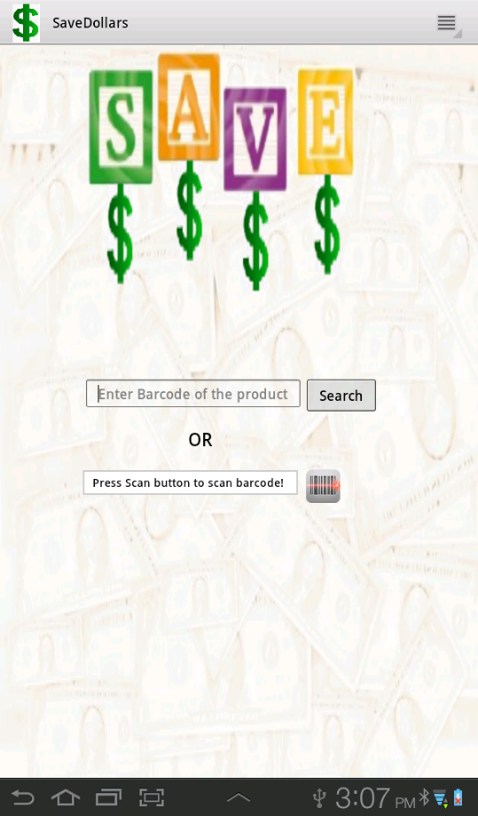
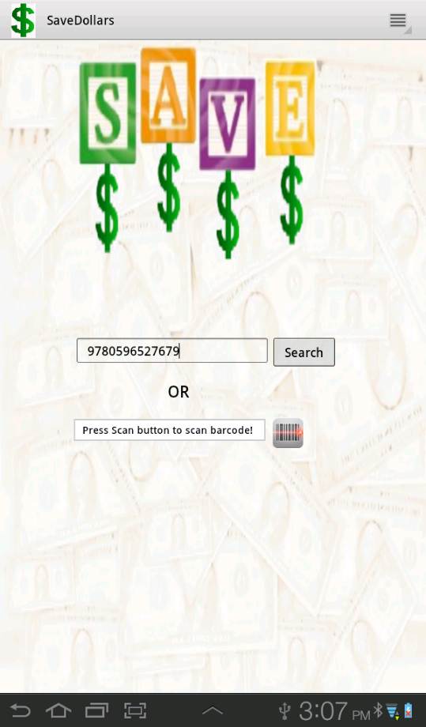

Slide 6
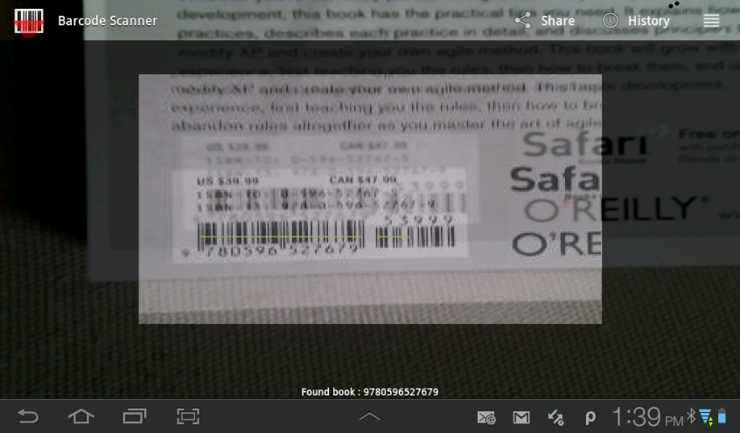

Slide 7
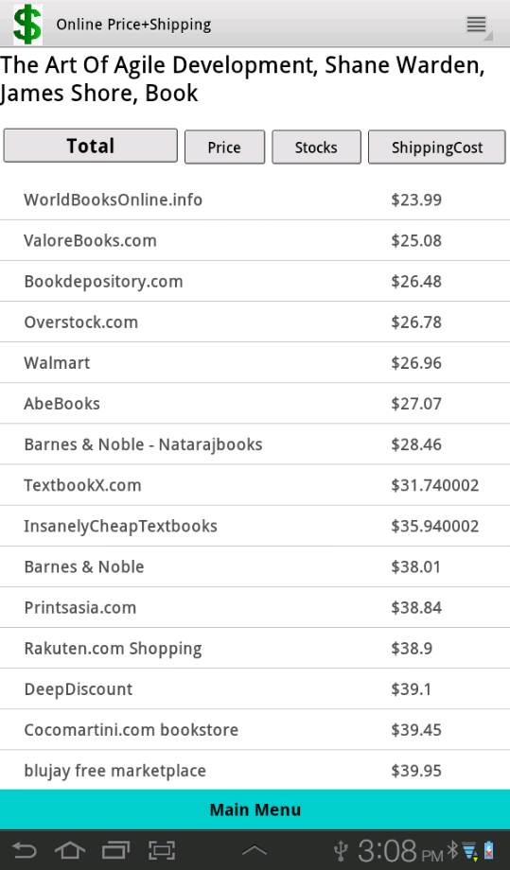

Slide 8
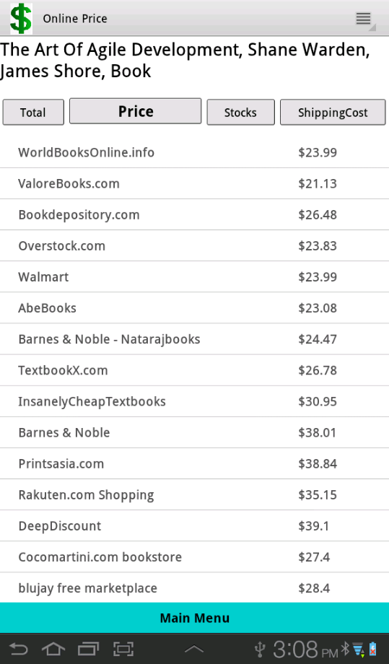

Slide 9
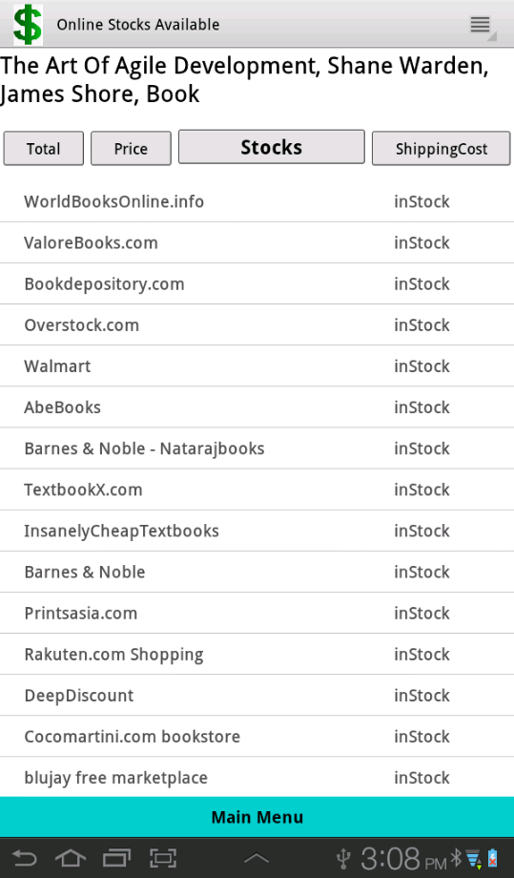

Slide 10
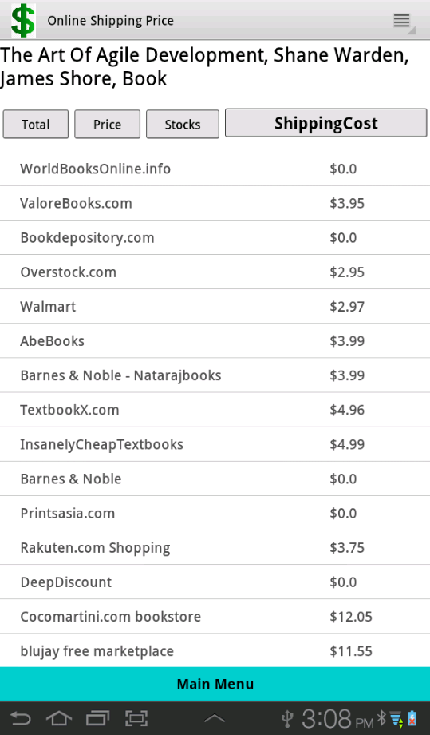

Slide 11
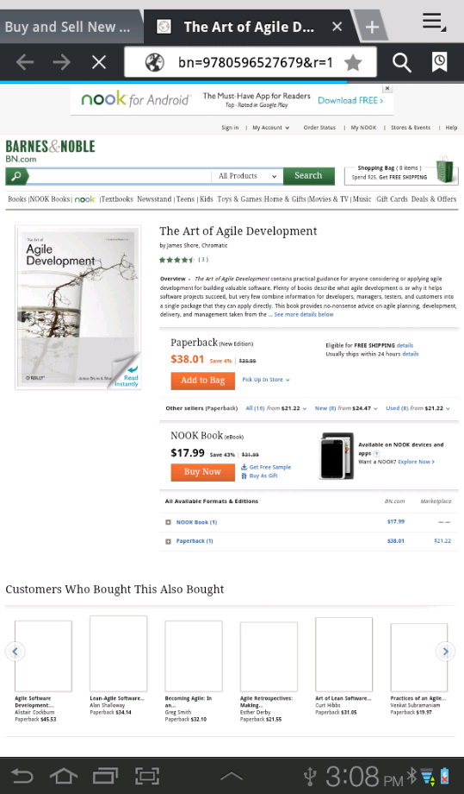

Slide 12
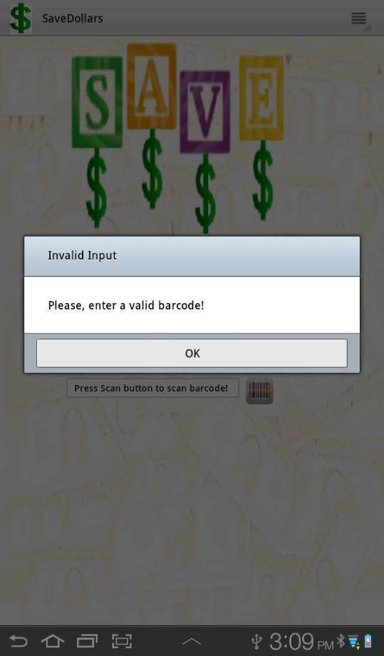

Slide 13
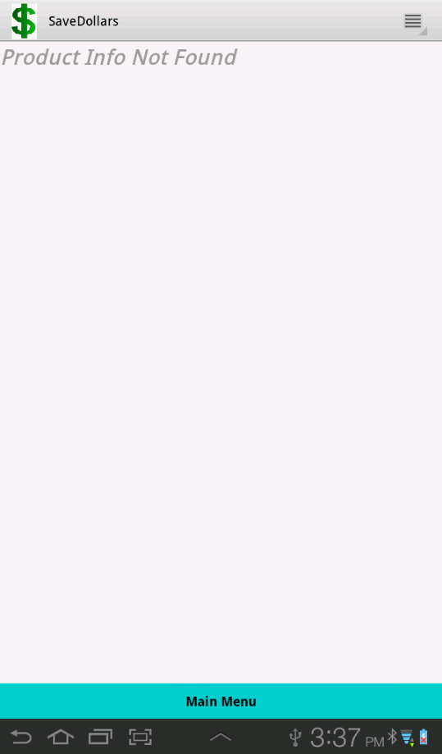

Slide 14
Pre-requistes
Internet Connection
Android device
Google API Key required for developers
Barcode scanner application to be installed(though our app will take you to install one, if you don’t have one)

Slide 15
Future Enhancements
Recognize image of the product instead of barcode to fetch product information.
Multiple API usage, ex: Ebay, Amazon etc.
Order product using our Application.
Show related products.
More information about the product

Slide 16
Thank you!
Any Questions ?

