Slide 1
Cards Against How Might We?

Slide 2
Challenge: What skills can we teach that would help shift mindsets and make space for new ideas?
Notes:
This activity was created after we conducted discovery research with a dozen or so NS public servants who had taken a design thinking course and completed project using design thinking approaches in their workplace. We asked them of all the skills they learned in their course, which ones had the biggest impact on them? Which one’s could they apply in their own setting? In almost every interview, “How Might We” came up. From ADM to operational staff, this way of framing challenges came up time and time again as something people could use. It’s a powerful tool in our context.

Slide 3
Hypothesis: A lot of opportunities get “blocked” before they even get started.
Notes:
How often have you had a suggestion or idea shot down by someone? How often have you shut something down because you didn’t think it was possible?

Slide 4
We often block ourselves.
In government we have patterns & narratives that block everything.

Slide 5
How Might We? is a tool that unblocks our thinking and opens us to possibilities.

Slide 6
What is a How Might We?
Problems reframed as a question
Are a response to an insight or a theme
Open to opportunities (no can’s or should’s)
Supports collaboration
Are broad enough to support a wide range of solutions, but narrow enough to provide helpful constraint
Notes:
How might we comes from design thinking… it’s a technique used to reframe a problem statement.
In our design process we often create how might we questions after we’ve synthesized our research with users… to help us frame what we will do next.
They are:
Problems reframed as a question
Are a response to an insight or a theme
Open to opportunities (no can’s or should’s)
Supports collaboration
Are broad enough to support a wide range of solutions, but narrow enough to provide helpful constraint

Slide 7

How Might We Example
Too Broad Too Specific Just Right
HMW redesign dessert?
HMW create a cone to eat ice cream without dripping?
HMW redesign ice cream to be more portable?
Doesn’t provide a starting point or enough direction
The solution is already implied by the question
Allows for brainstorming multiple solutions
Notes:
In this example…. Let’s say every time we stop for ice cream on the way to the cottage, my kids are dripping a sticky mess all over the back seat of my mini van.
The first example “HMW redesign desert?” is too broad. It doesn’t provide a starting point or any helpful constraints… are my kids now having cheesecake? Fondue?
The second example “HMW create a cone to eat ice cream without dripping?” is a little too narrow. Yes it might solve the specific and immediate issue, but it wouldn’t allow for a broad range of possible solutions. We’re constrained to ONLY work with cones.
The third example, “HMW redesign ice cream to be more portable” is just about right. We can imagine multiple possible ways that we might answer this question, but we’re still focused on ice cream (which is what my kids are interested in). This is what you’re aiming for in a good HWM… the goldilocks zone.
Creating a good HMW is a bit like going to the gym. It’s a muscle… and the more you use it, the stronger you will get.

Slide 8
Activity Time!
Cards Against HMW
Notes:
This is an actual card game that we’ve created. We crowd sourced the content from public servants around the globe. (UK, New Zealand, Australia, USA and many others) It turns out that the kinds of situations and blockers we face is pretty universal. We’ve tested it several times and iterated the content and know that it works well to help build up your “muscles”.

Slide 9
Before we start…
This is NOT the same game play as Cards Against Humanity.
Nobody “wins” the game. (well, we all do…)
Brainstorm and collaborate in groups to get practice at creating “How Might We” questions.
The cheat sheet has some help but as you get warmed up you’ll get the hang of it.
Notes:
Sometimes when playing this game, many people follow the same premise of Cards Against Humanity. It’s not quite the same game play.
You’ll be working together to try to unblock using HMW.

Slide 10
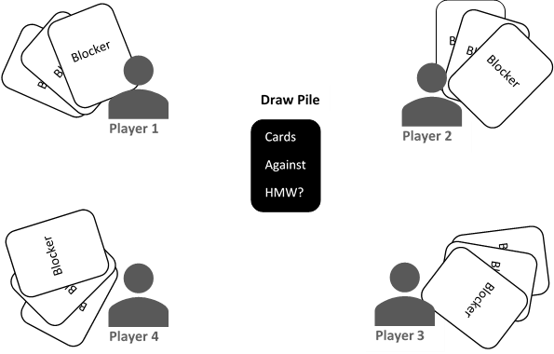
Game set up.
Notes:
You’ll get into groups of 4-6 people.
Deal all the blocker (white) cards to everyone.
Place the “Cards against how might we” (black) situation cards in the center.

Slide 11
Game play (choose)
Notes:
One person flips a situation card and reads it out.
Everyone else plays a blocker cad from their hand that feels like it fits the situation.
The person who flipped the situation card picks the blocker they feel is the most realistic, common, or they think is the best.

Slide 12



Game play (collaborate)
Situation … someone says…
Blocker
Notes:
The entire group then tries to create a How Might we question that will “unblock” the conversation…
essentially make the blocker no longer stop forward progress or the opportunity to move an idea forward or solve a problem.
Remember try not to be too narrow or broad. Try not to include the “solution” in the HMW.

Slide 13
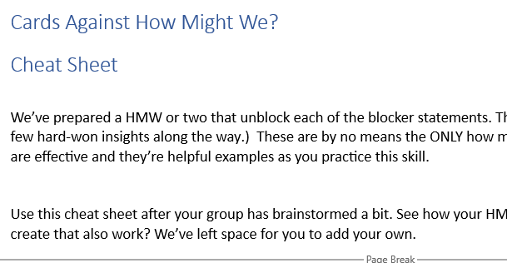
Game play (compare)
Notes:
Once the group feels they have a good how might we, look in the Cheat Sheet handout to see what the crowdsourced how might we was.
Cheats are based on our experience (and a few hard-won insights along the way.) These are by no means the ONLY how might we questions that work… but they are effective and they’re helpful examples as you practice this skill.
See how your HMWs compare. What other HWMs did you create that also work? We’ve left space for you to add your own.

Slide 14
If you’re stuck:
Look at the blocker and try to identify any underlying assumptions that might not be true.
How could you phrase a HMW question to offer an alternative to that assumption?
Remember that this is like a “muscle” and it will get easier with practice.

