Slide 1
Tanzania Markets

Slide 2
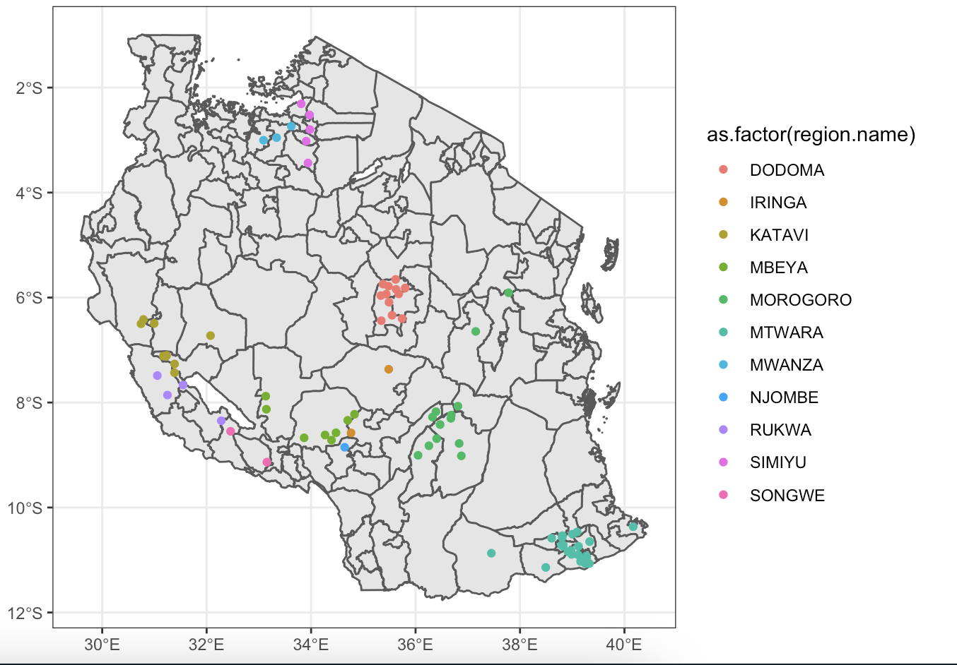

Slide 3
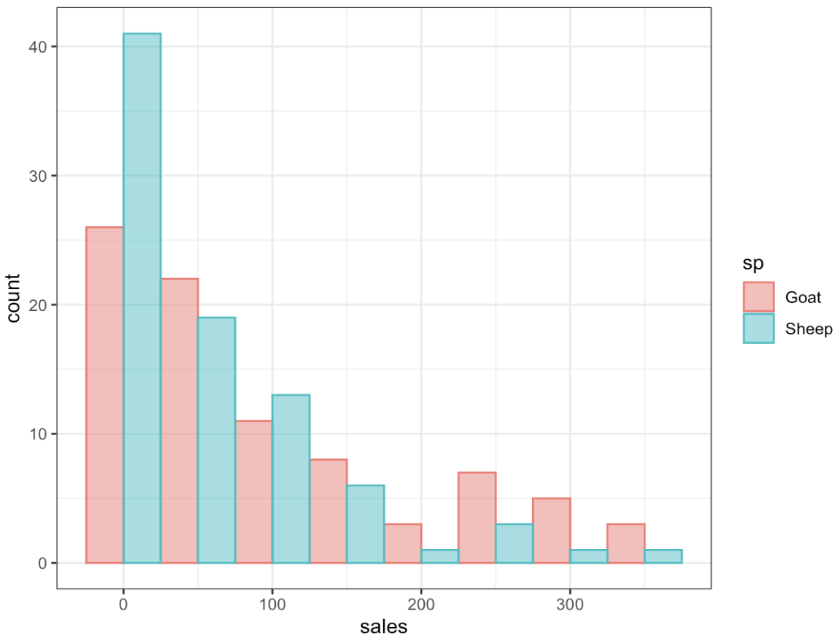
Sheep and goat sales per day

