Slide 1
Tanzania Markets
Notes:
NB See .Rmd file for mrkta survey - PDF

Slide 2
Market Survey A: General Info
NB See .Rmd file for mrkta survey - PDF
Notes:
NB See .Rmd file for mrkta survey - PDF

Slide 3
Market Survey A:
Market survey A is the key informant interview
From the EcoPPR Field Guide:
Key informant interview with the market manager or other key person who is knowledgeable about the market, focusing on the general characteristics of the market. (1 survey per market) –
At each market, the field team will identify and arrange to meet with the market manager/person in-charge to introduce the project and obtain permission to collect data, and then conduct a short interview
Total number of surveys: 85

Slide 4
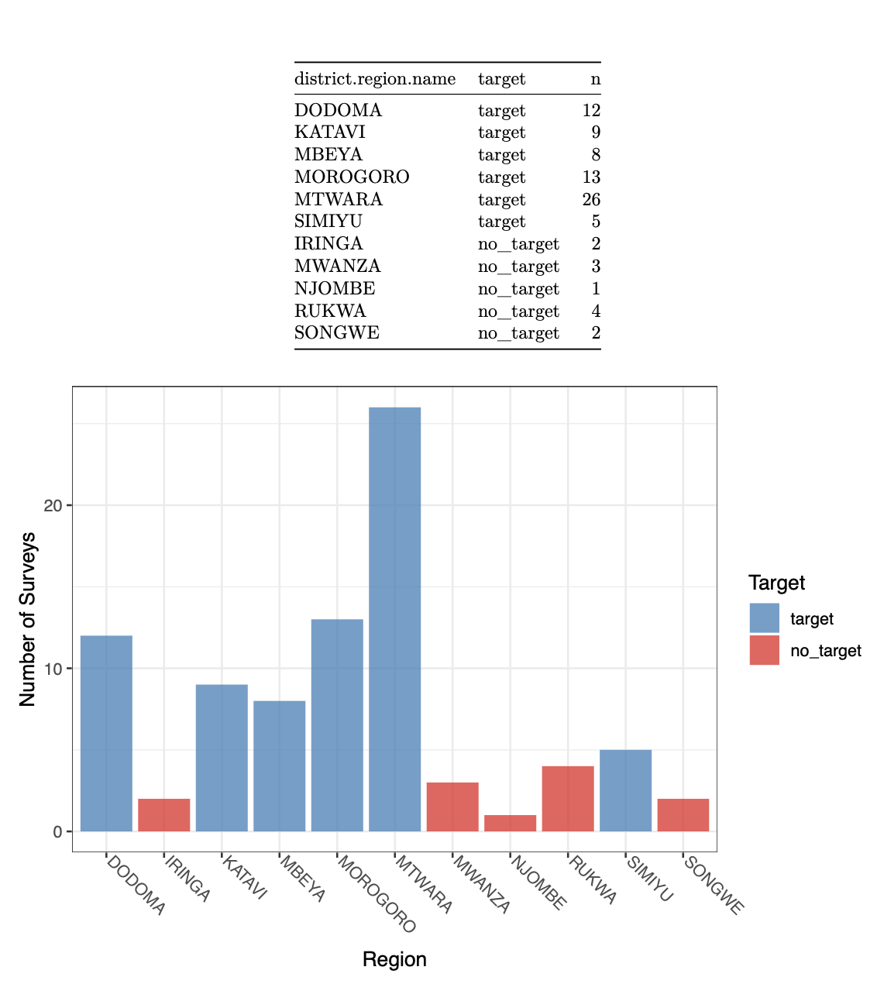
Overview: Regions Targeted & Surveys per Region
Why are the number of surveys in each region so different? – Simiyu = 5, Mtwara = 26
Why are there surveys in non-target regions?
Notes:
These are the regions I found in the Tanzania survey with a key informant interview.
Questions:
Why is the number of surveys in each region so different?
I.e. simiyu = 5 surveys, Mtwara = 26
Why are there a number of surveys in “non-target” regions?
Because if another market was mentioned then interviewers would follow up at that market even if outside region.

Slide 5
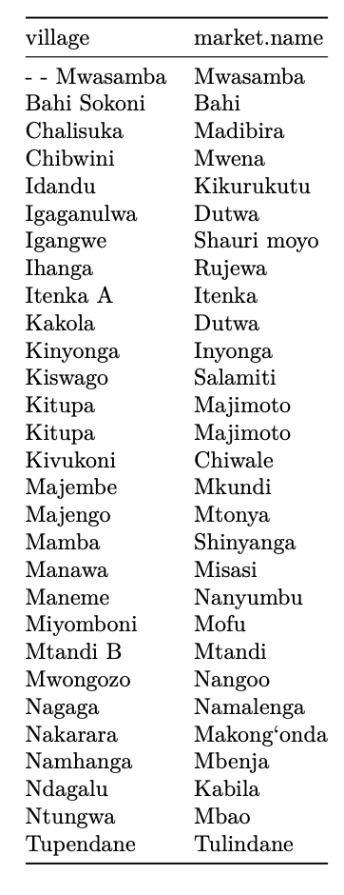
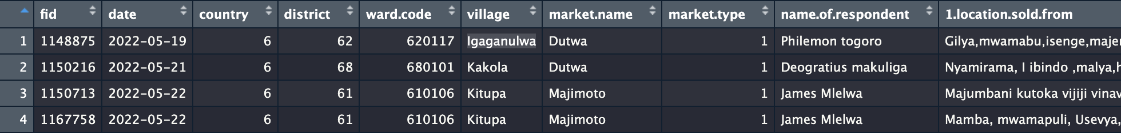
Market Names: Duplicates etc
2 market names duplicated: “Dutwa” and “Majimoto
Dutwa market appears to be 2 distinct markets?
Majimoto appears to be a duplicate survey (two surveys in the same market)?
Village-market names are very similar/the same, is there anyone available who knows the study area to do checking of the place names etc?
Notes:
Questions:
Can we confirm that the two markets named “Dutwa” are in fact two distinct market surveys
Why are there two entries for Majimoto that are seemingly the same?
Wanted to check market name variable to see if it is always the same as the village name, and if not whether the differences are typos or true differences.
List of markets which have names distinct to the village name (29 examples)
In some cases the market & village names appear to be the same except for a typo, in others they
appear genuinely distinct
- For typos (relevant later on) is there likely to be someone who could check the data to see if the text does contain typos or if they are correct (but different) spellings/

Slide 6
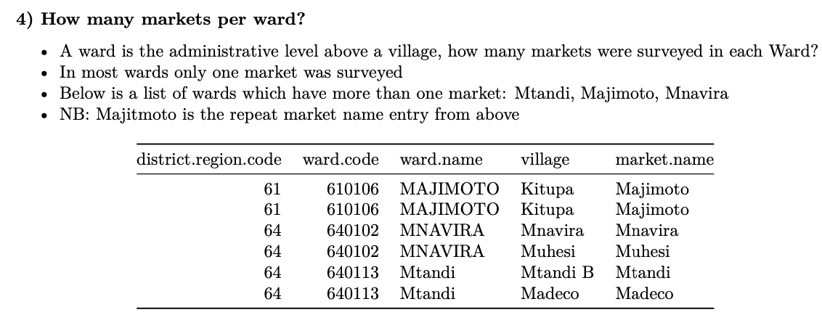
Markets & surveys per ward?

Slide 7
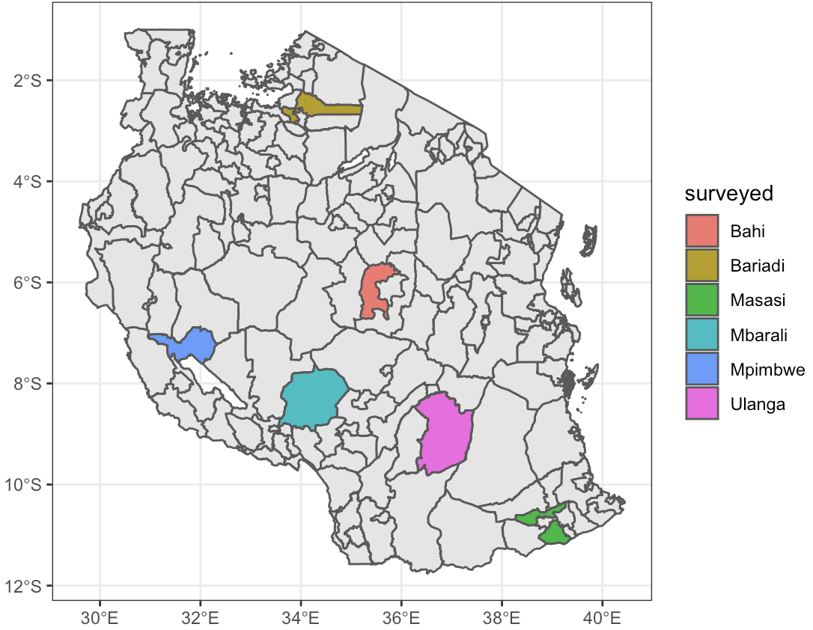
The districts identified in the survey as targeted regions
Region | Location (study site)
KATAVI | West. Mpimbwe district in this region
SIMIYU | North. Bariadi is the regional capital.
MBEYA | West/South-West. Mbarali District in this region.
MTWARA | South (South-East). Masasi district in this region
MOROGORO | Centre (Centre-East). Ulanga district in this region.
DODOMA | Centre (Centre-East). Bahi district in this region.
MWANZA | North
NJOMBE | South (South-West).
RUKWA | East (South-East).
SONGWE | East (South-East).
IRINGA | Centre
Updated: 02/03/23

Slide 8
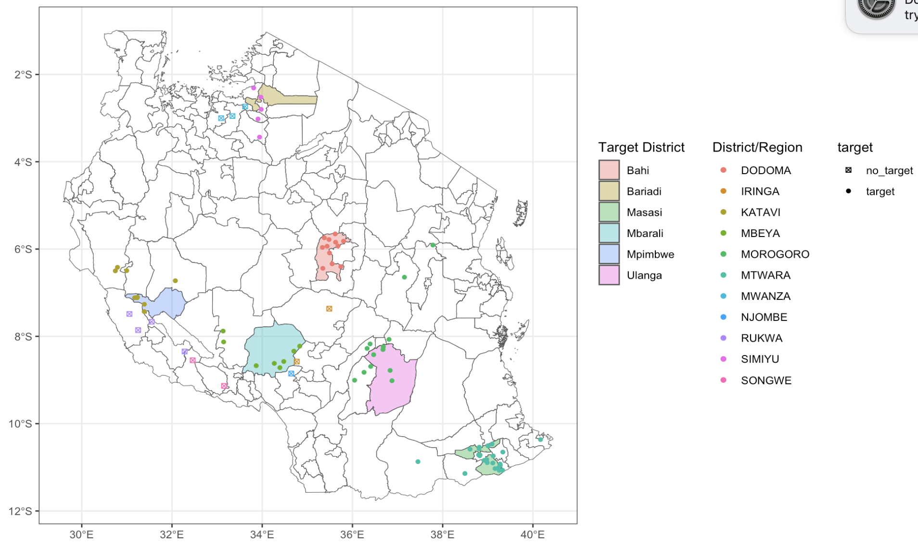
Districts targeted with markets surveyed indicated
Region | Location (study site)
KATAVI | West. Mpimbwe district in this region
SIMIYU | North. Bariadi is the regional capital.
MBEYA | West/South-West. Mbarali District in this region.
MTWARA | South (South-East). Masasi district in this region
MOROGORO | Centre (Centre-East). Ulanga district in this region.
DODOMA | Centre (Centre-East). Bahi district in this region.
MWANZA | North
NJOMBE | South (South-West).
RUKWA | East (South-East).
SONGWE | East (South-East).
IRINGA | Centre
Not targeted district
Updated: 02/03/23

Slide 9


Ulanga District is one of the six districts of the Morogoro Region of Tanzania. the administrative seat is in Mahenge.
Bahi District is one of the seven districts of the Dodoma Region of Tanzania. Bahi District is bordered to the north by Chemba District, to the east by Dodoma District and Chamwino District, and to the west by Singida Region.
Masasi is one of the six districts of the Mtwara Region of Tanzania.
Region | Location (study site)
KATAVI | West. Mpimbwe district in this region
SIMIYU | North. Bariadi is the regional capital.
MBEYA | West/South-West. Mbarali District in this region.
MTWARA | South (South-East). Masasi district in this region
MOROGORO | Centre (Centre-East). Ulanga district in this region.
DODOMA | Centre (Centre-East). Bahi district in this region.
MWANZA | North
NJOMBE | South (South-West).
RUKWA | East (South-East).
SONGWE | East (South-East).
IRINGA | Centre
Bariadi is a Tanzanian town and regional capital of Simiyu Region, and the is also administrative seat of Bariadi District.
Mpimbwe District is a district council in the Katavi Region of Tanzania's Southern Highlands established in 2012. T
Mbarali District is one of the seven districts of Mbeya Region, Tanzania. It is bordered to the north by Iringa region and east by Njombe region.

Slide 10
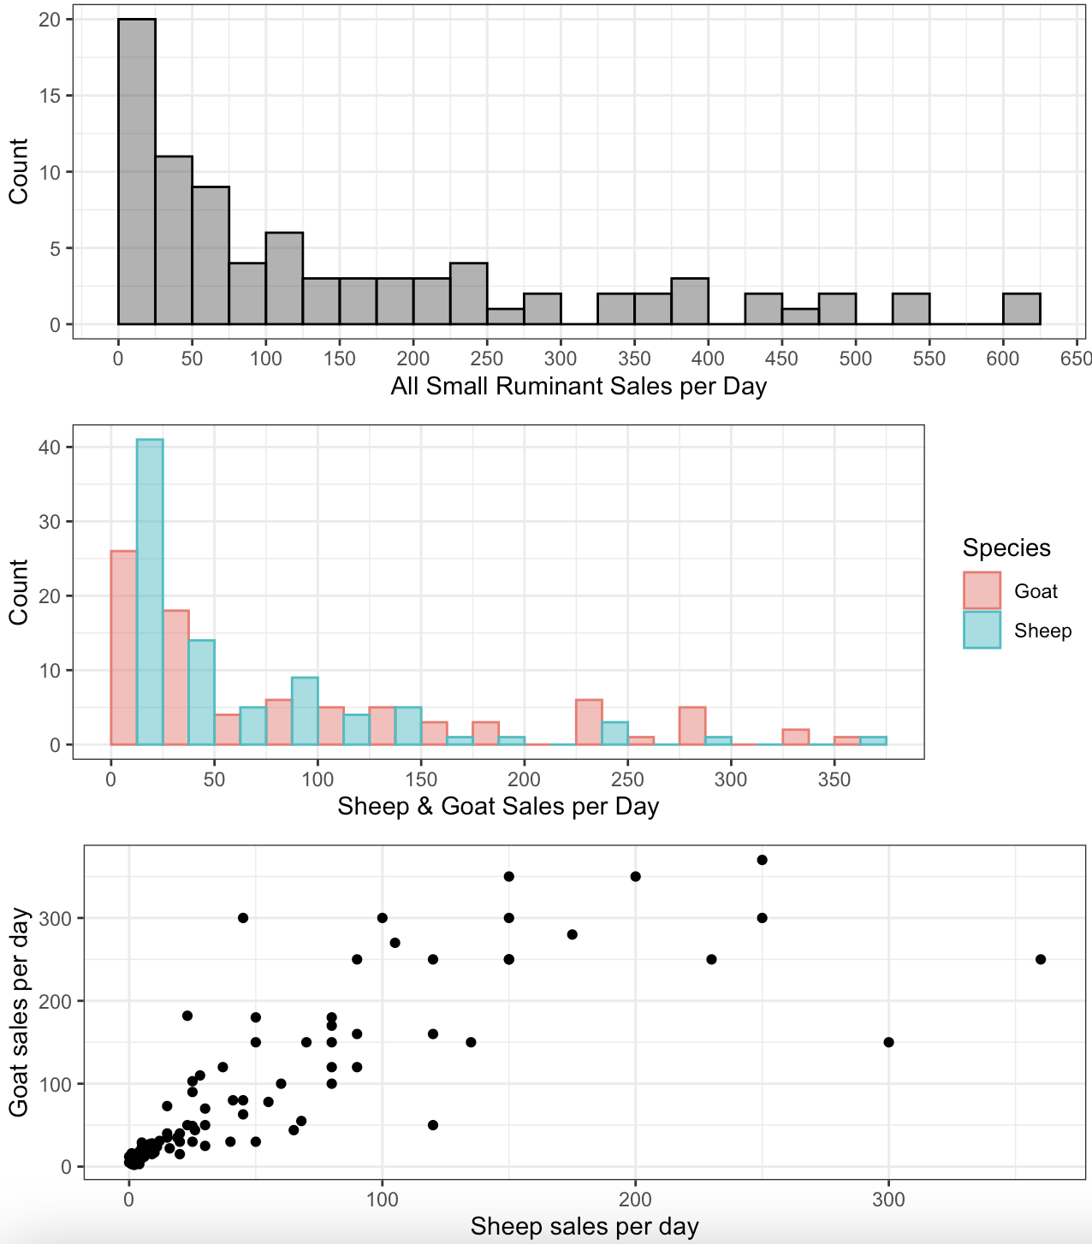
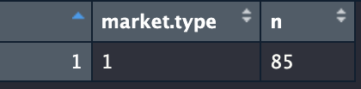
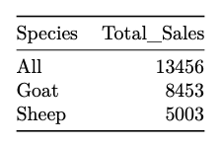
Type of market: all primary markets
Sheep and goat sales per day
Notes:
Mostly 0-50 sales per day
Generally sheep and goat sales are correlated with a few outliers with bias towards one species

Slide 11
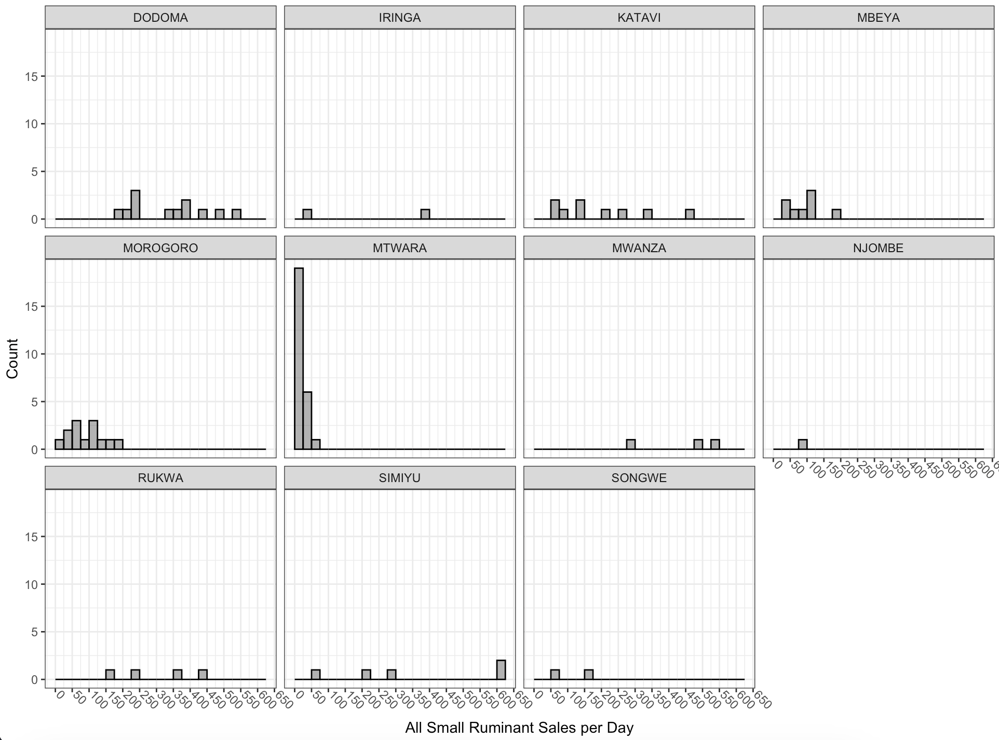
Small ruminant sales by region:
Notes:
Quite different distributions – probably because sample size in each region is too small

Slide 12
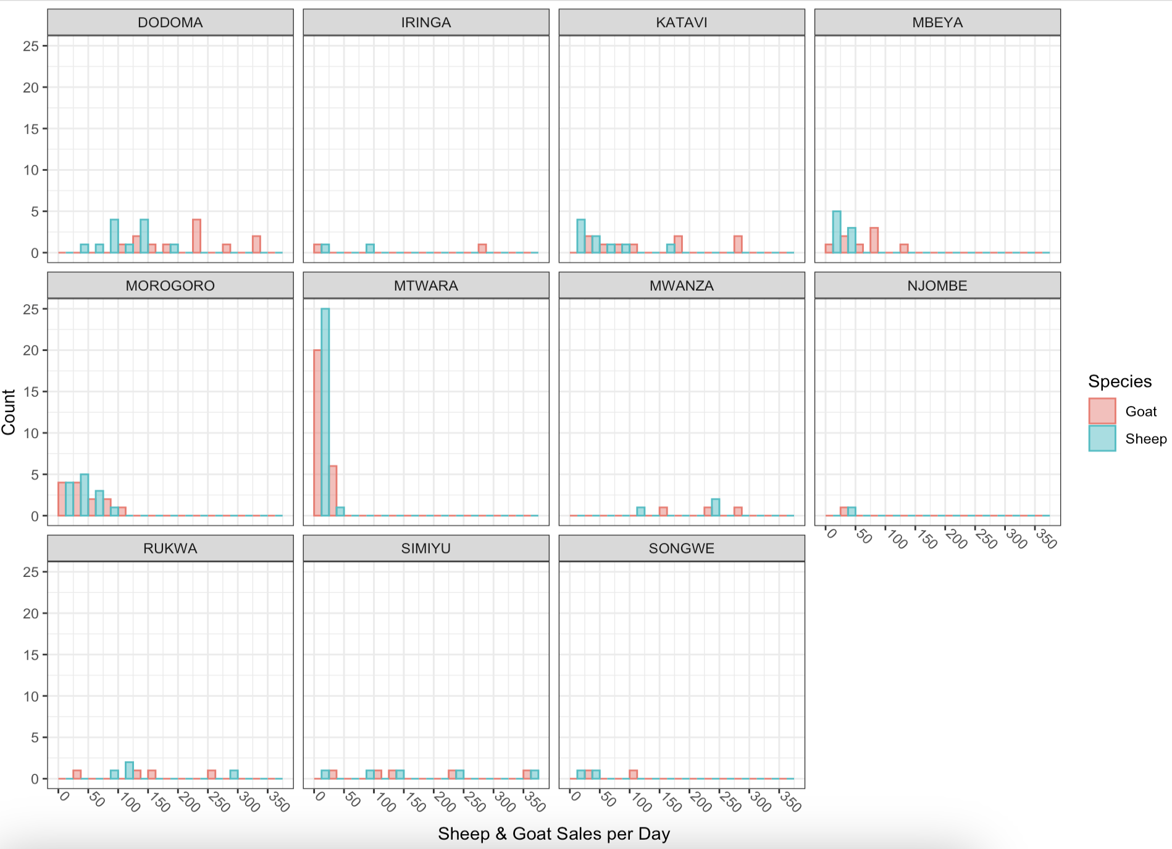
Sheep & goat sales by region:

Slide 13
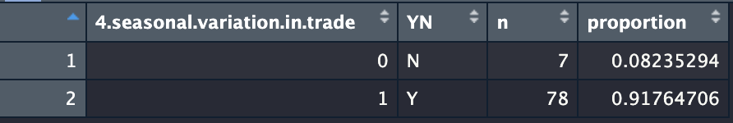
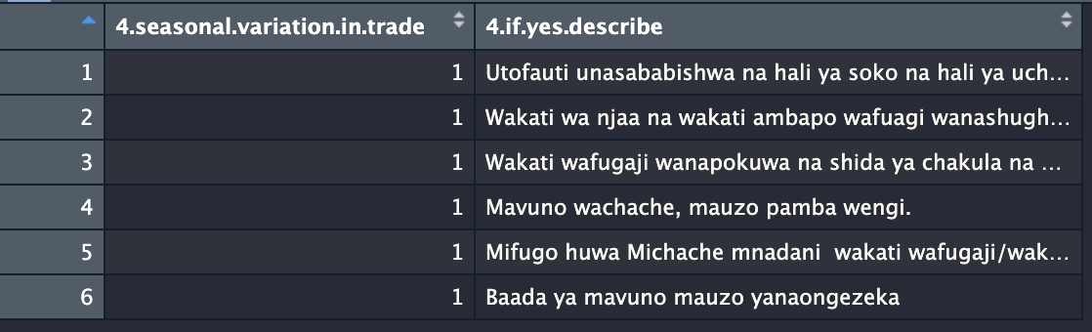
Seasonal Variation in Trade?
“ The difference is caused by the state of the market and the state of the economy of the people. Also, conflicting auction schedules lead to a decrease or increase in goats and sheep brought to this auction. Livestock are usually abundant during famine and decrease when people have food.”
If yes, describe (top 6 responses)

Slide 14
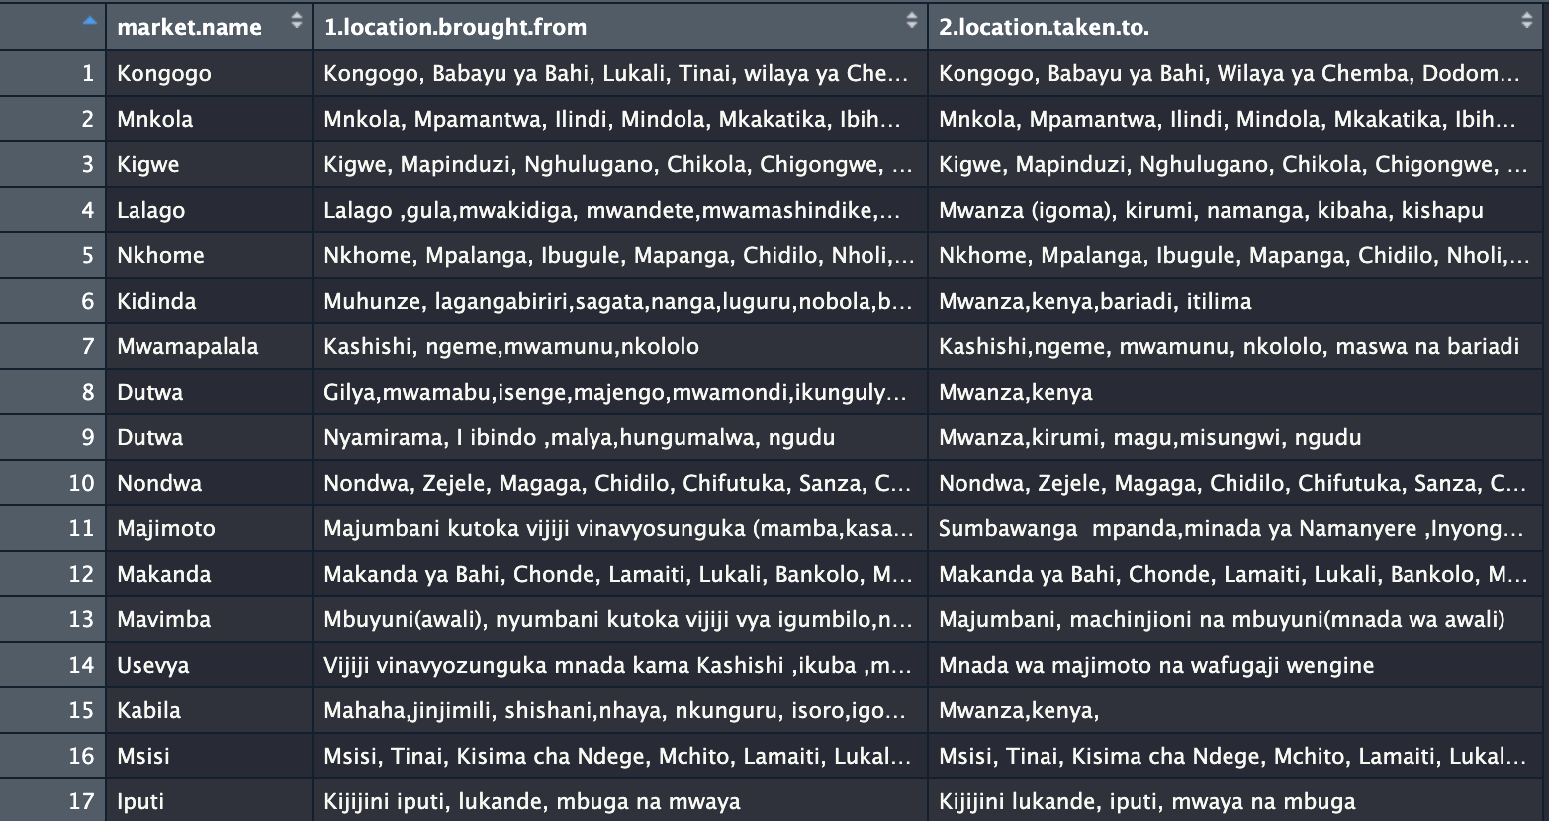
For Sheep and Goats sold in this market where are they brought from & where are they taken to ?
Key Informant provides general overview of trends where animals travel from/to… Not for network analysis
Question:
Are the locations market names, district names, region names?
Is there someone who could be on hand for translation help?
Notes:
Question:
Are the locations market names, district names, region names?
Is there someone who could be on hand for translation help?

Slide 15
Market Survey C: Buyer/Seller

Slide 16
Overview: Market Survey C: buyer&seller questionnaire
The tool aims to collect individual data on trading practices and market networks
Participants: In each market a minimum of 20 people need to be interview, or 10% of people buying and/or selling, depending on the size of the market
Interviews takes 5-10 minutes and need to be carried out in the marketplace
Data collection in the market: The transect walk method:
The people to be interviewed should be selected randomly or systematically to obtain a representative sample of all types of buyer and sellers and to avoid bias. The research team for each country should discuss how their markets are laid out and make a plan of how to obtain an unbiased sample. If the markets are laid out in a rectangular enclosure, then the field team should walk a transect from one corner of the market, diagonally across the market area to the opposite corner, interviewing every person buying and selling that they meet along the transect. Having completed one transect, if more interviews are required, a second transect can be made starting in a different corner. However, if the market is circular with all the people buying and selling arranged around the edge with very few in the middle, then the team can start at one point and move around the edge of the circle, interviewing everyone that they meet. Having completed the transects or circle, it may become clear that some key types of buyers or sellers have been missed e.g. sometimes the commercial traders are very busy and moving quickly in the market place so the team has not managed to meet many during the transect. In this case, they can be purposively tracked down for interview in addition to the 20 people/10% people interviewed in the main market area.
Total observations: 3310

Slide 17
Market Survey C: General Info

Slide 18
Variable | Use?
fid.see.mrktc.idtable. | for linking datasets
unique.row.id | for linking datasets
end.time
deviceid
date
country.see.mrkta.lkpcountry. | all tanzania (keep for checking)
enumerator.name.see.mrkta.lkpenum.
enter.password
get.selected.staff.current.password
district.region.see.mrkta.lkpregion. | for mapping and cross-referencing with other surveys
ward.see.mrkta.lkpward. | for mapping and cross-referencing with other surveys
village | for mapping and cross-referencing with other surveys
date.of.interview
interview.code
name.of.market | for mapping and cross-referencing with other surveys
type.of.market.see.mrktc.lkpmrkt.type. | summary stat
respondent.role
gender.of.respondent.see.mrktc.lkpresp.gender.
respondent.age.see.mrktc.lkpresp.age.
13.have.you.visited.other.markets.to.sell.or.buy.sheep.and.goats.in.the.past.one.month. | summary stat
number.of.other.markets.you.have.visited.to.sell.or.buy.sheep.and.goats.in.the.past.one.month | summary stat
researcher.is.this.person.a.trader.meaning.they.buy.and.sell.animals.as.a.business. | contextual information (edge attribute?)
14.what.is.your.usual.pattern.of.trading.sheep.and.or.goats. | contextual information
15.what.are.the.main.disease.problems.that.you.observe.in.the.sheep.and.or.goats.at.this.time.
16.have.you.seen.a.disease.with.signs.of.nasal.discharge.coughing.diarrhoea.eye.discharge.sores.in.the.mouth.in.your.own.animals.or.someone.else.s.flock.
if.yes.what.is.the.local.name.of.the.disease.
where.did.you.see.it.
when.did.you.see.it.
did.any.animals.die.
how.many.animals.died.
what.species.died.see.mrktc.lkpdse.deathsspecies.
other.information.
any.other.remarks.
gps.coordinates.of.the.market | main data for mapping market interactions
unique.row.identifier.uuid.

Slide 19
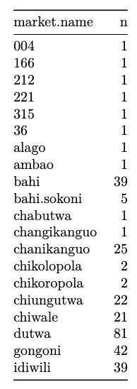
Market name cleaning:
Top 20 (alphabetical) markets surveyed with counts on number of surveys conducted
1) Why are there some markets with <20 surveys conducted
Some could be typos
2) Some markets appear to be typos
e.g. “chikolopola” and ”chikoropola” / bahi, bahi sokoni / changikanguo, chanikanguo
Is there someone who could check these?

Slide 20
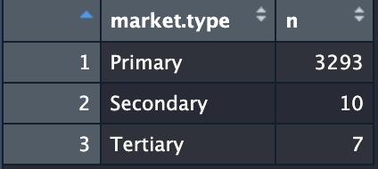
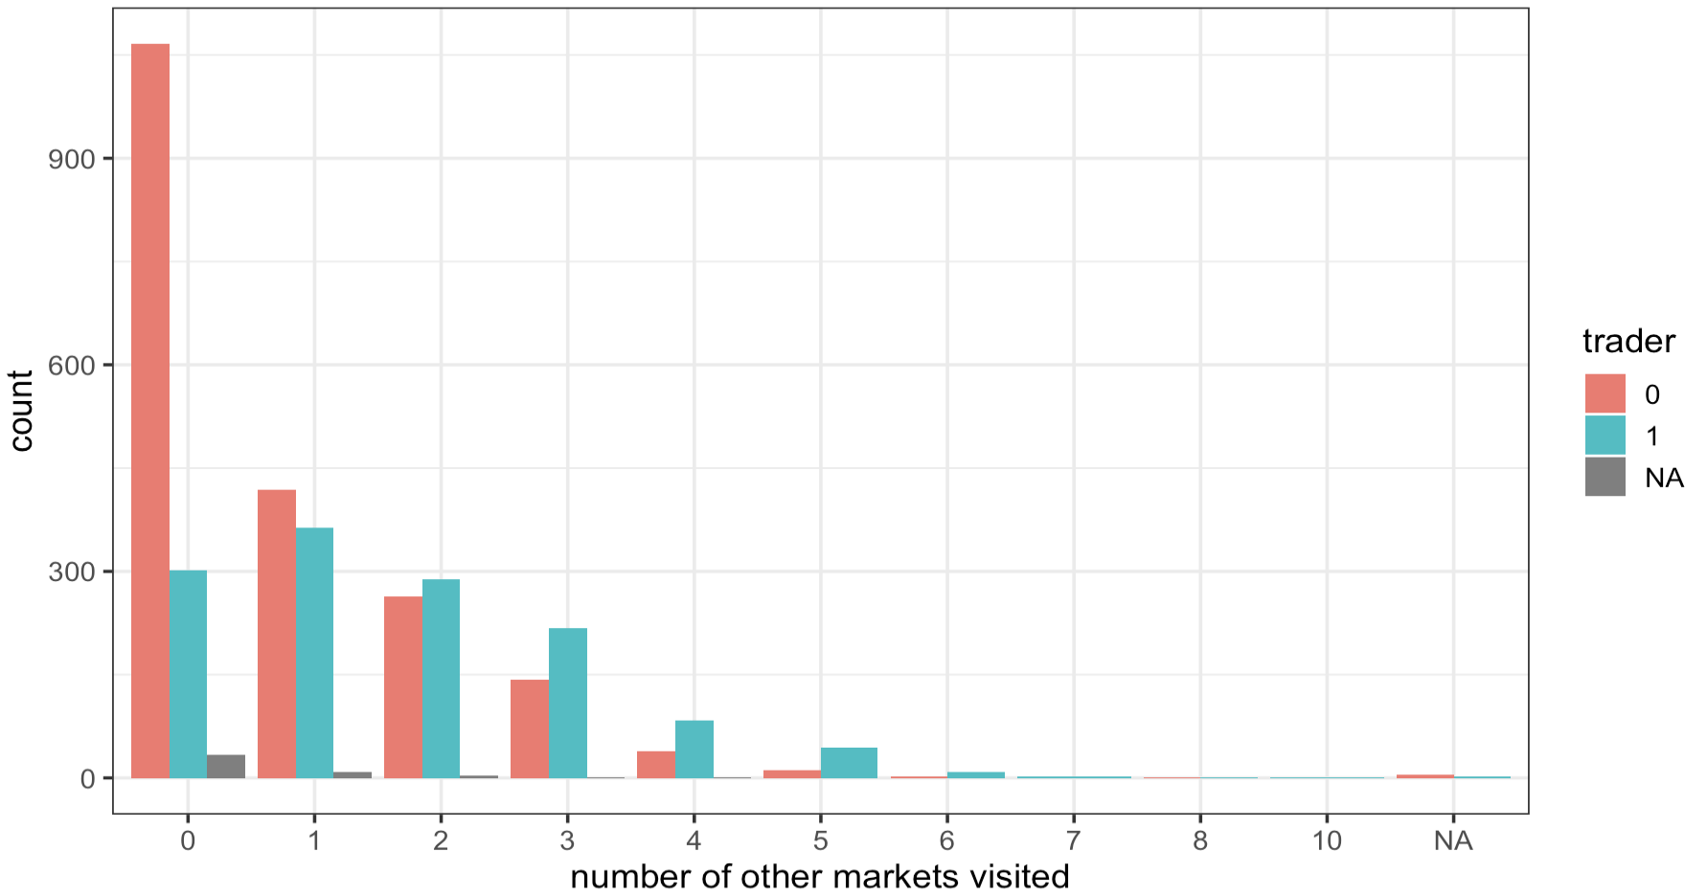
Type of Market:
Number of markets visited to buy or sell sheep or goats in last 1 month, with trader as group.

Slide 21
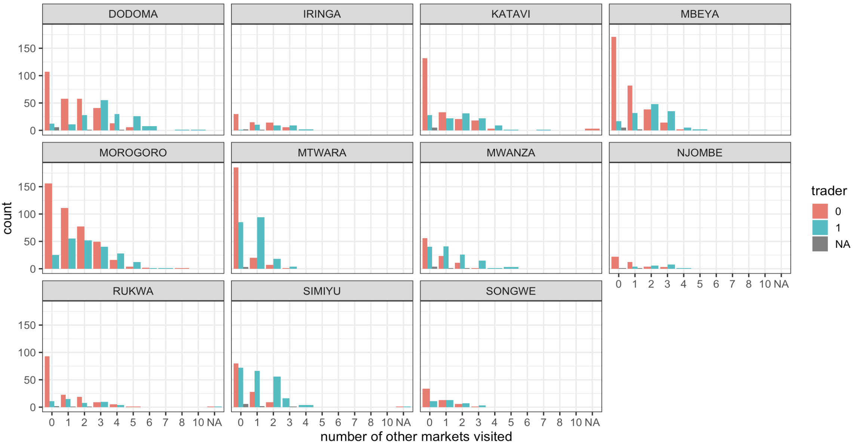
Number markets visited by region

Slide 22
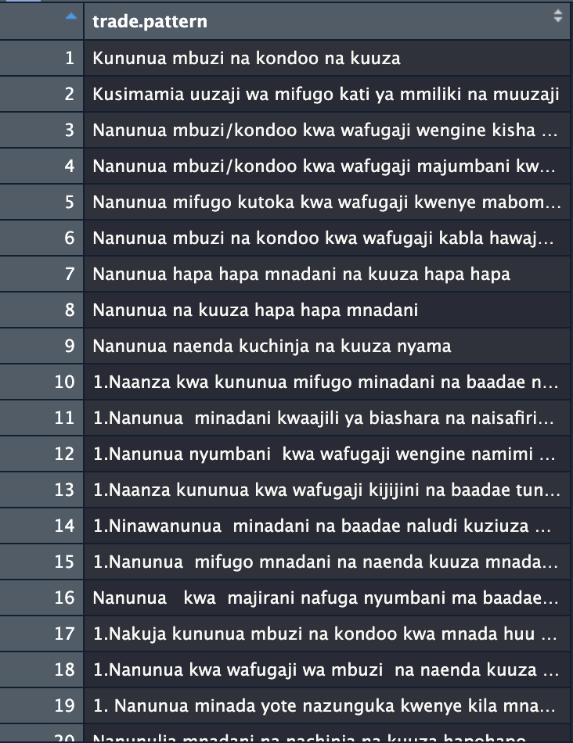
What is your usual pattern of trading?
Buy goats and sheep and sell
Managing the sale of livestock between the owner and the seller
I buy goats/sheep from other breeders and then I give them to people who ask me to take them to the auction to sell them
I buy goats/sheep from breeders at their homes or before they arrive at the auction and then I take them to the auction that day and sell them at a profitable price

Slide 23
Market activities data

Slide 24
raw-data | interpretation
fid.see.mrktc.generalinfo. | fid.see.mrktc.generalinfo.
unique.row.id.see.mrktc.generalinfo. | unique.row.id.see.mrktc.generalinfo.
unique.row.id | unique.row.id
1.what.are.the.activities.that.you.are.doing.in.this.market.today. | 1.what.are.the.activities.that.you.are.doing.in.this.market.today.
if.other.specify.5 | 1.if.other.specify
type.of.place.see.mrktc.lkpsell.placetype. | 2.for.sheep.and.or.goats.that.you.are.selling.where.have.they.been.brought.from.sell.placetype
if.other.specify | 2.sell.placetype.if.other.specify
name.of.place.8 | 2.name.of.sell.place
ward.9 | 2.ward.of.sell.place
district.10 | 2.district.of.sell.place
3.what.is.your.main.reason.for.selling.these.sheep.and.or.goats. | 3.what.is.your.main.reason.for.selling.these.sheep.and.or.goats.
if.other.specify.12 | 3.what.is.your.main.reason.for.selling.these.sheep.and.or.goats.if.other.specify
4.how.were.sheep.goats.transported.to.the.market.see.mrktc.lkpsell.trans. | 4.how.were.sheep.goats.transported.to.the.market.see.mrktc.lkpsell.trans.
if.other.specify.14 | 4.sell.trans.if.other.specify
5.do.you.also.sell.other.animal.species.apart.from.sheep.and.goats. | 5.do.you.also.sell.other.animal.species.apart.from.sheep.and.goats.
if.yes.out.of.all.the.species.that.you.sell.which.species.do.you.sell.the.most. | 5.if.yes.out.of.all.the.species.that.you.sell.which.species.do.you.sell.the.most.
if.other.specify.17 | 5.if.other.specify
will.you.transport.the.sheep.goats.you.are.buying.today. | 6.will.you.transport.the.sheep.goats.you.are.buying.today.
type.of.place.see.mrktc.lkpplacetype. | 6.for.sheep.and.or.goats.that.you.are.buying.where.will.they.be.taken.to.buy.placetype
if.other.specify.20 | 6.buy.placetype.if.other.specify
name.of.place.21 | 6.name.of.buy.place
ward.22 | 6.ward.of.buy.place
district.23 | 6.district.of.buy.place
7.what.is.your.main.reason.for.buying.these.small.ruminants. | 7.what.is.your.main.reason.for.buying.these.small.ruminants.
if.other.specify.25 | 7.if.other.specify
8.how.will.you.transport.these.small.ruminants.that.you.are.buying.see.mrktc.lkpsell.trans. | 8.how.will.you.transport.these.small.ruminants.that.you.are.buying.see.mrktc.lkpsell.trans.
if.other.specify.27 | 8.if.other.specify
9.what.criteria.do.you.use.to.decide.which.small.ruminants.to.buy. | 9.what.criteria.do.you.use.to.decide.which.small.ruminants.to.buy.
if.other.specify.29 | 9.if.other.specify
10.what.other.species.of.animals.do.you.buy.apart.from.sheep.and.goats. | 10.what.other.species.of.animals.do.you.buy.apart.from.sheep.and.goats.
if.other.specify.31 | 10.if.other.specify
11.if.the.prices.of.sheep.and.goats.increase.for.some.reason.e.g.a.shortage.of.animals.due.to.disease.will.you.still.buy.them. | 11.if.the.prices.of.sheep.and.goats.increase.for.some.reason.e.g.a.shortage.of.animals.due.to.disease.will.you.still.buy.them.
if.no.which.other.species.will.you.consider.instead. | 11.if.no.which.other.species.will.you.consider.instead.
if.other.specify.34 | 11.if.other.specify.34
if.yes.how.much.of.an.increase.in.the.current.price.of.sheep.and.goat.unit.price.of.live.animal.will.cause.you.to.change.your.purchasing.behaviour.to.another.animal.species | 11.if.yes.how.much.of.an.increase.in.the.current.price.of.sheep.and.goat.unit.price.of.live.animal.will.cause.you.to.change.your.purchasing.behaviour.to.another.animal.species
12.how.many.times.in.a.month.do.you.buy.or.sell.sheep.and.or.goats.in.this.market. | 12.how.many.times.in.a.month.do.you.buy.or.sell.sheep.and.or.goats.in.this.market.
unique.row.identifier.uuid. | unique.row.identifier.uuid.

Slide 25
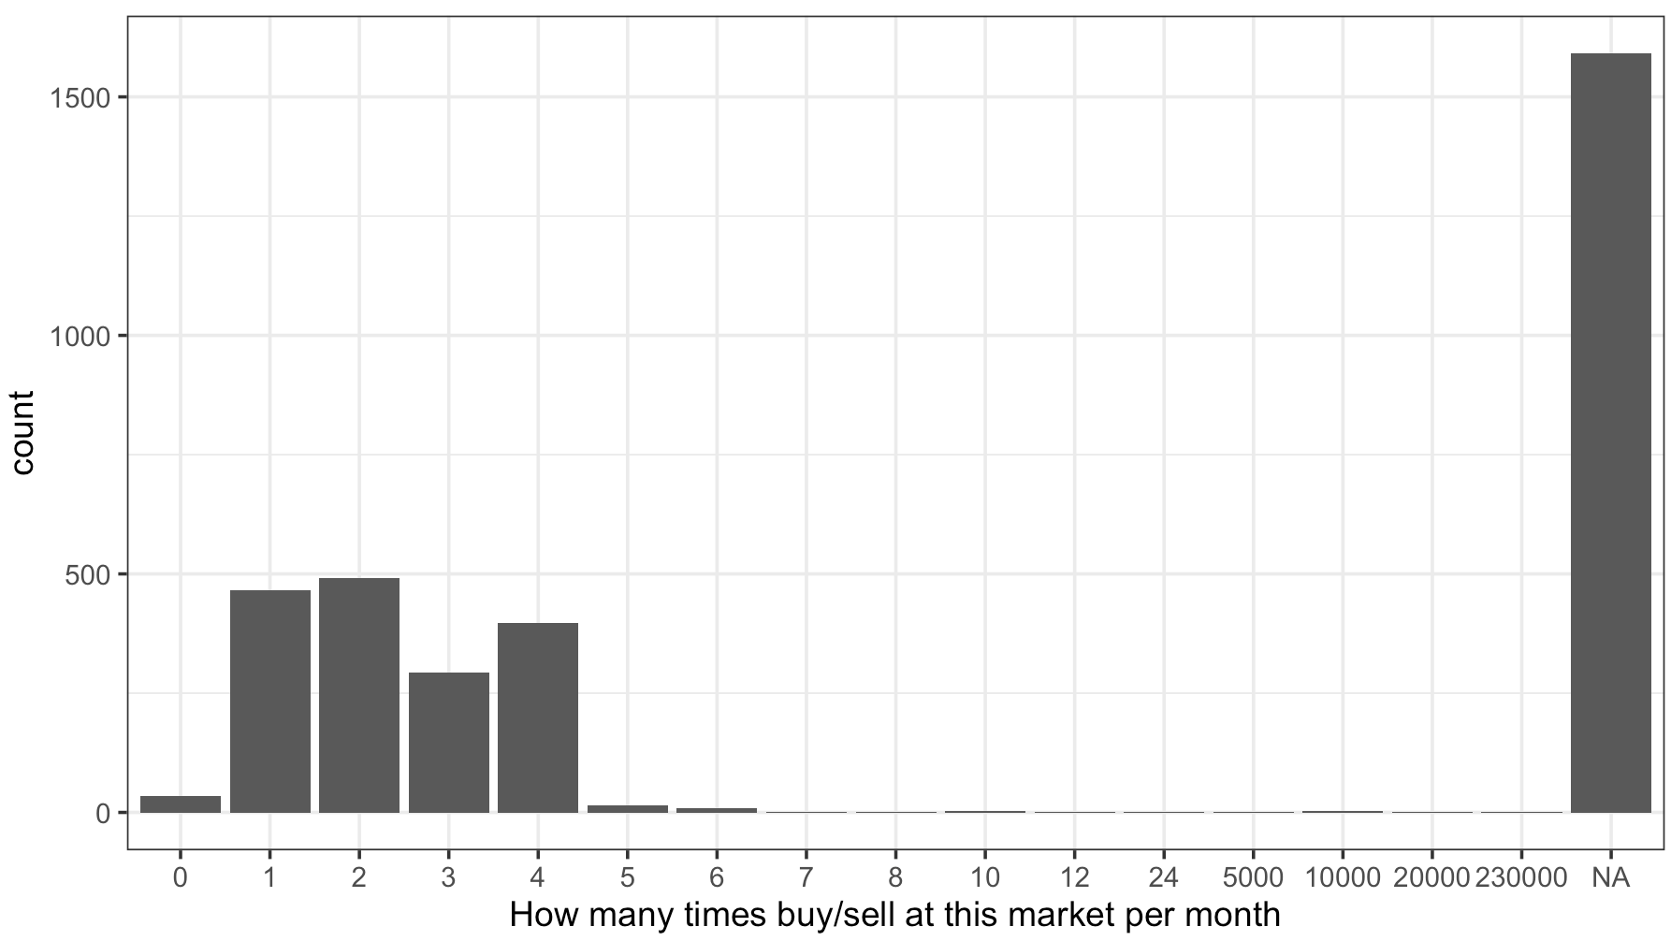
12.how.many.times.in.a.month.do.you.buy.or.sell.sheep.and.or.goats.in.this.market.

Slide 26
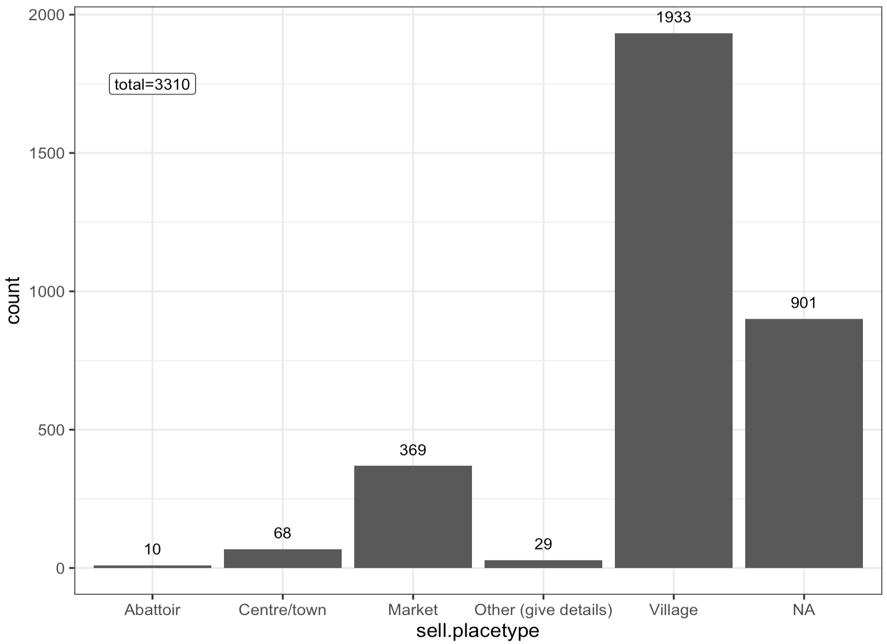
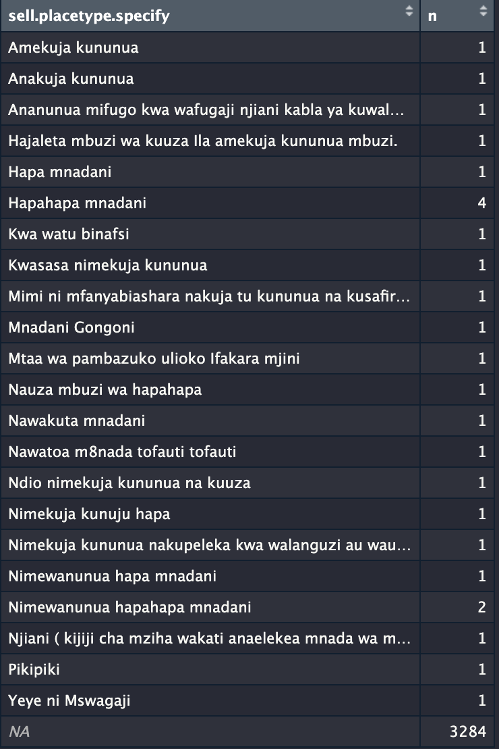
2. For sheep and/or goats that you are selling where have they been brought from? (place type)
Notes:
Table = if placetype is “other” please specify.
e.g. “he comes to buy”, “He buys livestock from breeders on the way before bringing them to the auction”

Slide 27
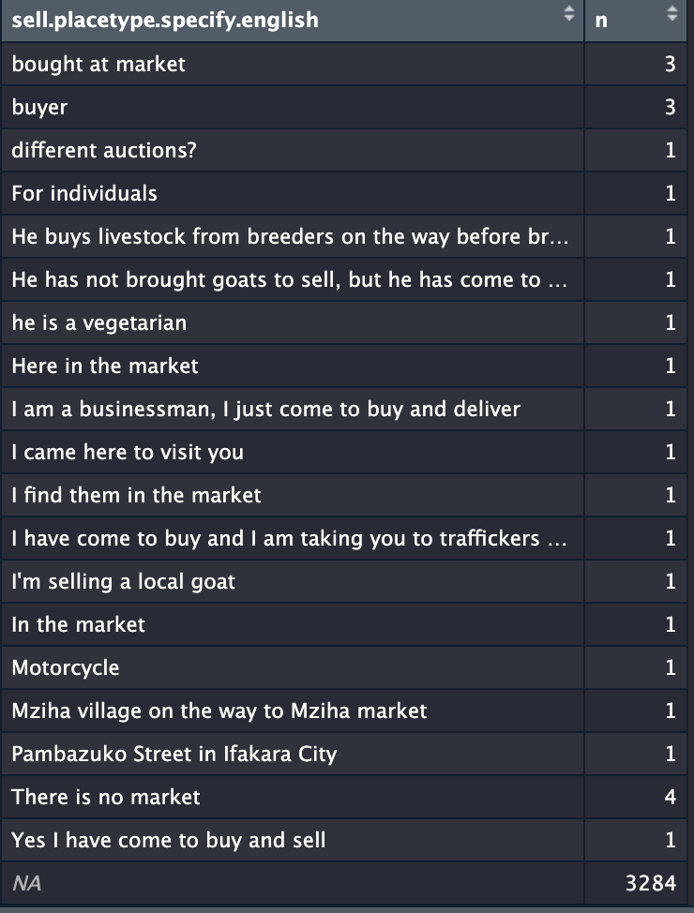
2. For sheep and/or goats that you are selling where have they been brought from? (place type)
Notes:
Table = if placetype is “other” please specify.
e.g. “he comes to buy”, “He buys livestock from breeders on the way before bringing them to the auction”

Slide 28
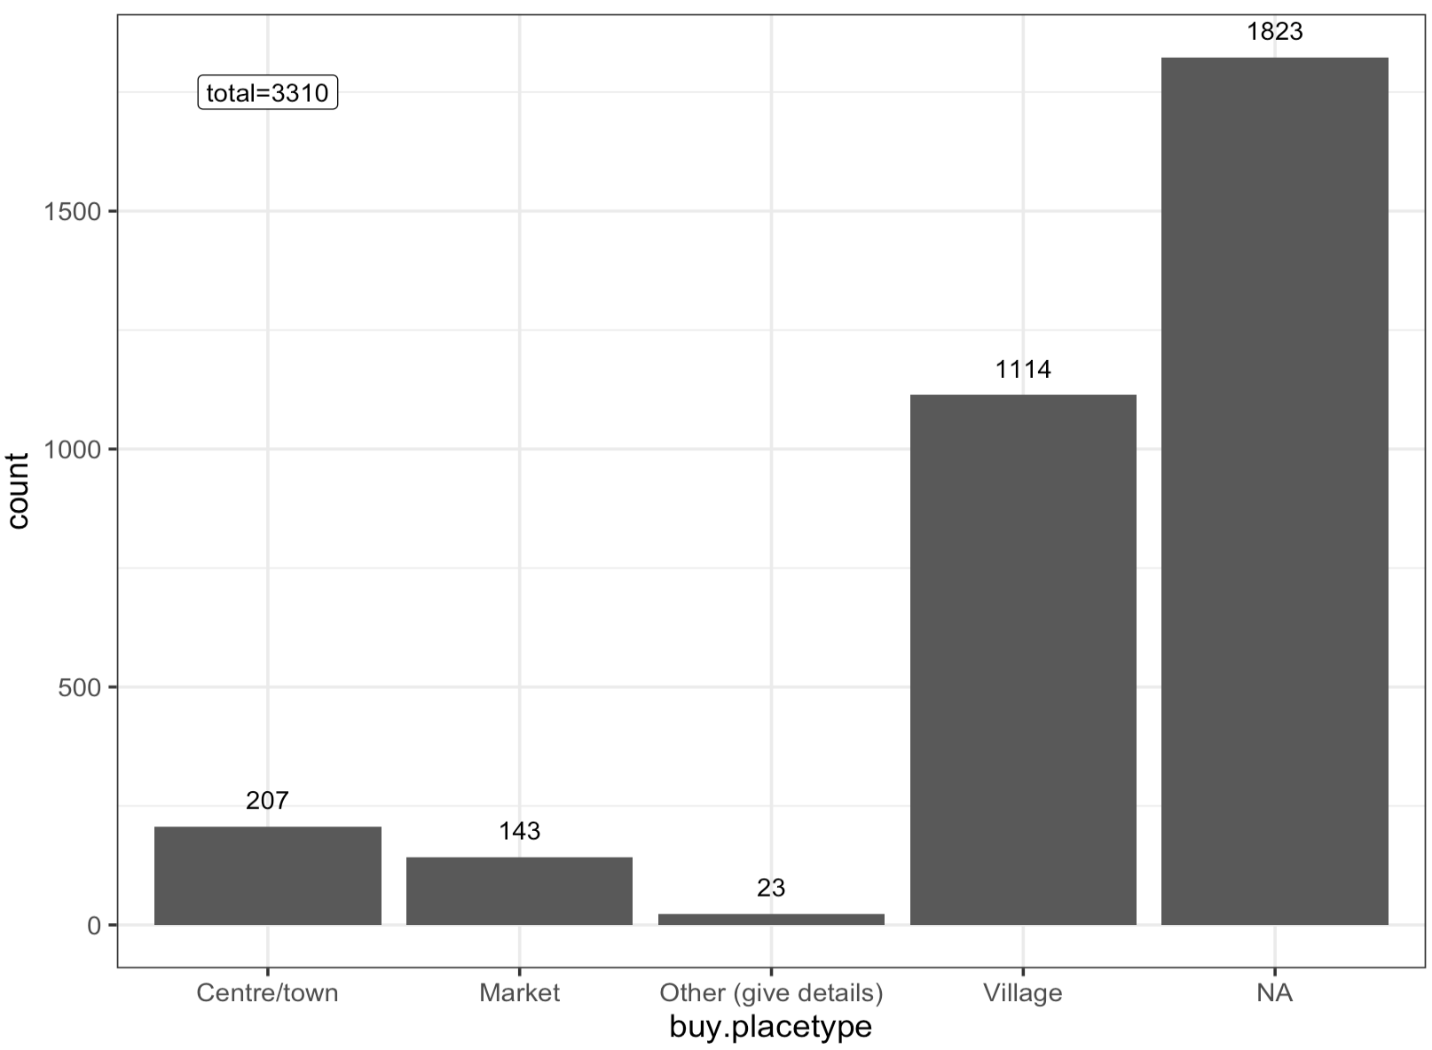
6.for.sheep.and.or.goats.that.you.are.buying.where.will.they.be.taken.to.buy.placetype

Slide 29
Further Questions

Slide 30
Is there typically one market per village? Or can there be more than one?
When markets in other regions were followed up were the same number of surveys (min. 20) conducted?
Should I be building my network at the village level or market level (probably no gps data for markets though)

