Slide 1
Flock Dynamics Model

Slide 2
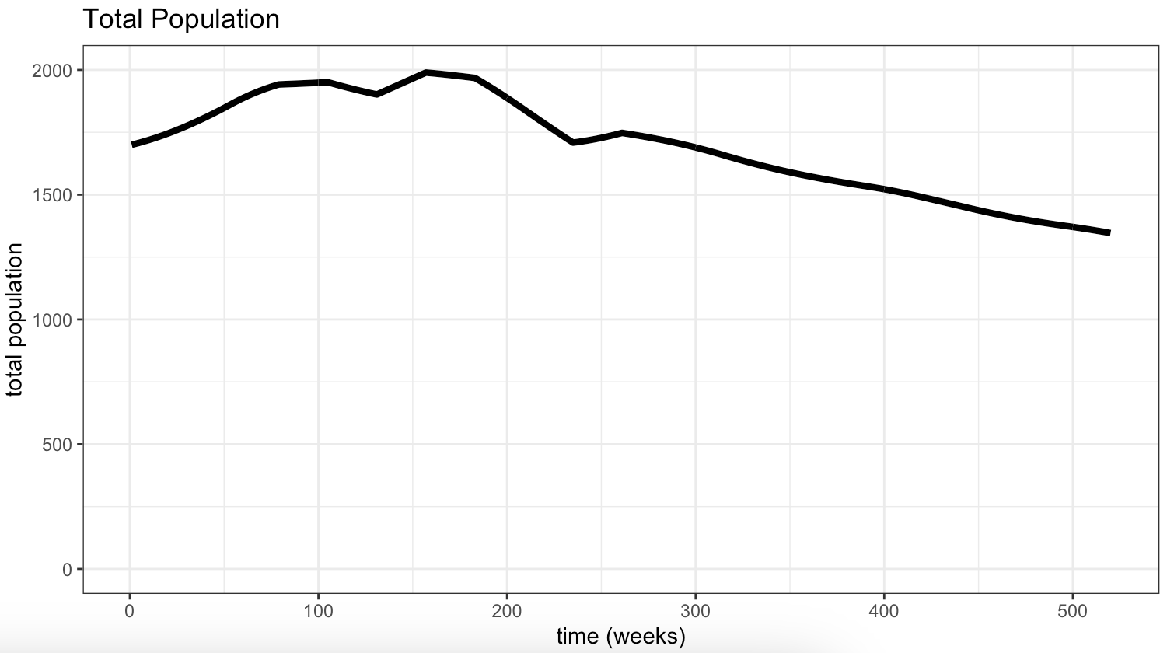
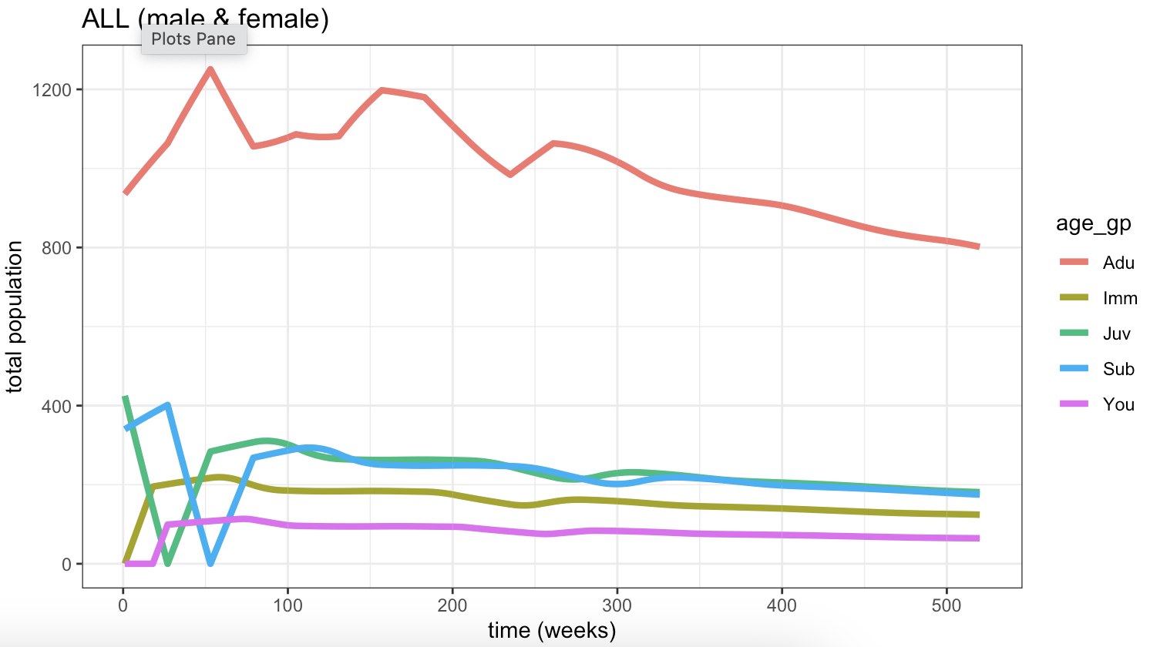
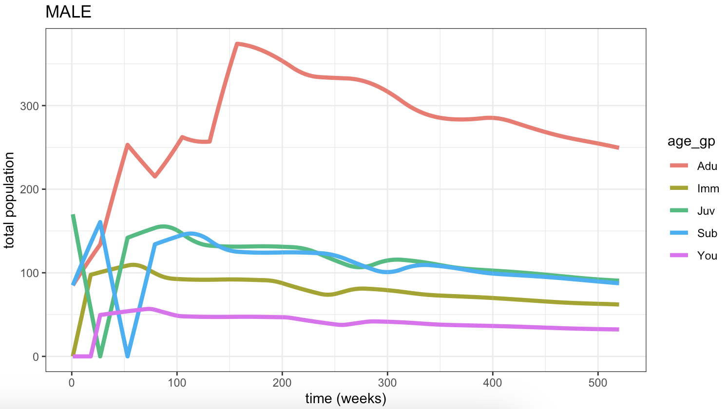
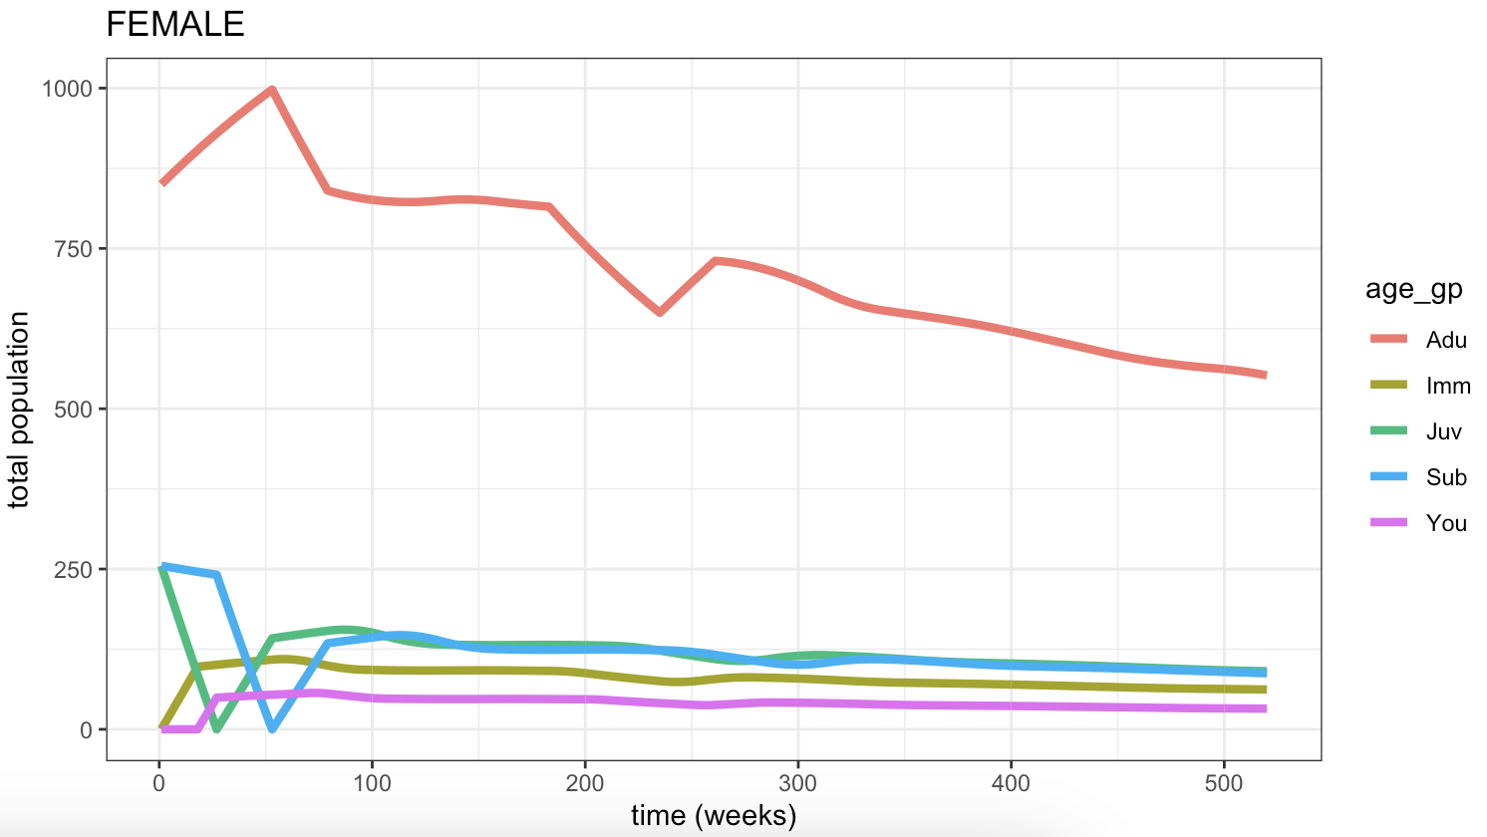
Notes:
BAOBAB data
Downward trend – probably due to misinterpreting parameters (especially reproductive rate)
BAOBAB data doesn’t differentiate male and female rates
Nb. NET offtake is 0

Slide 3
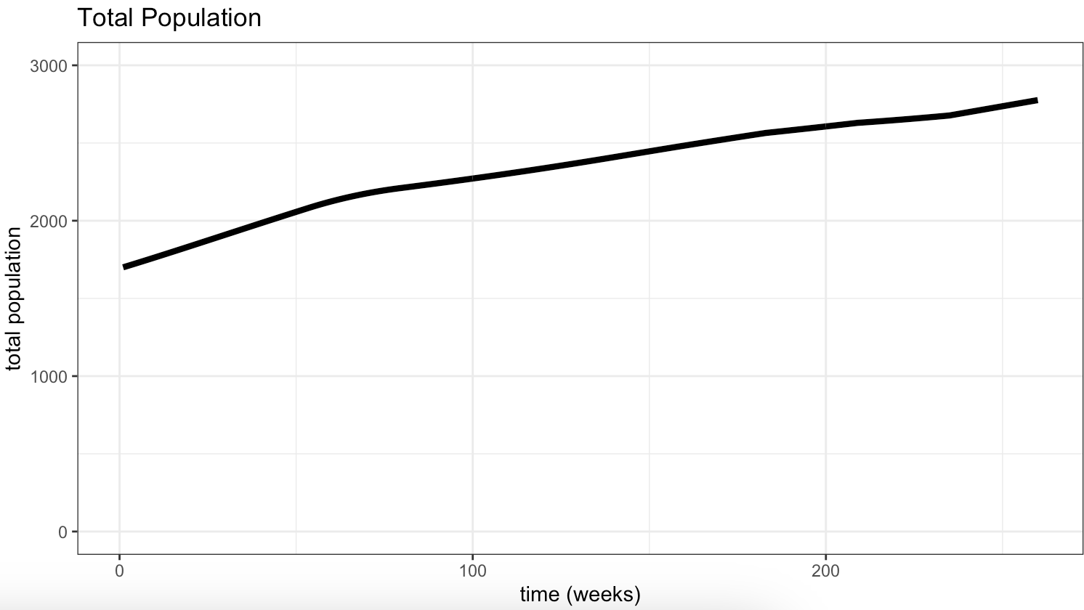
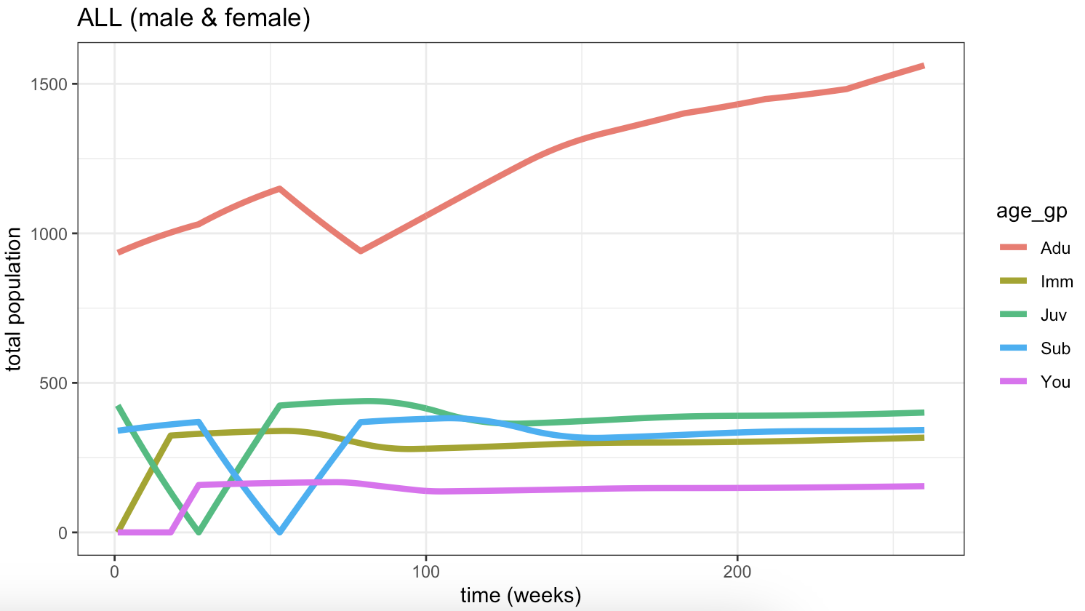
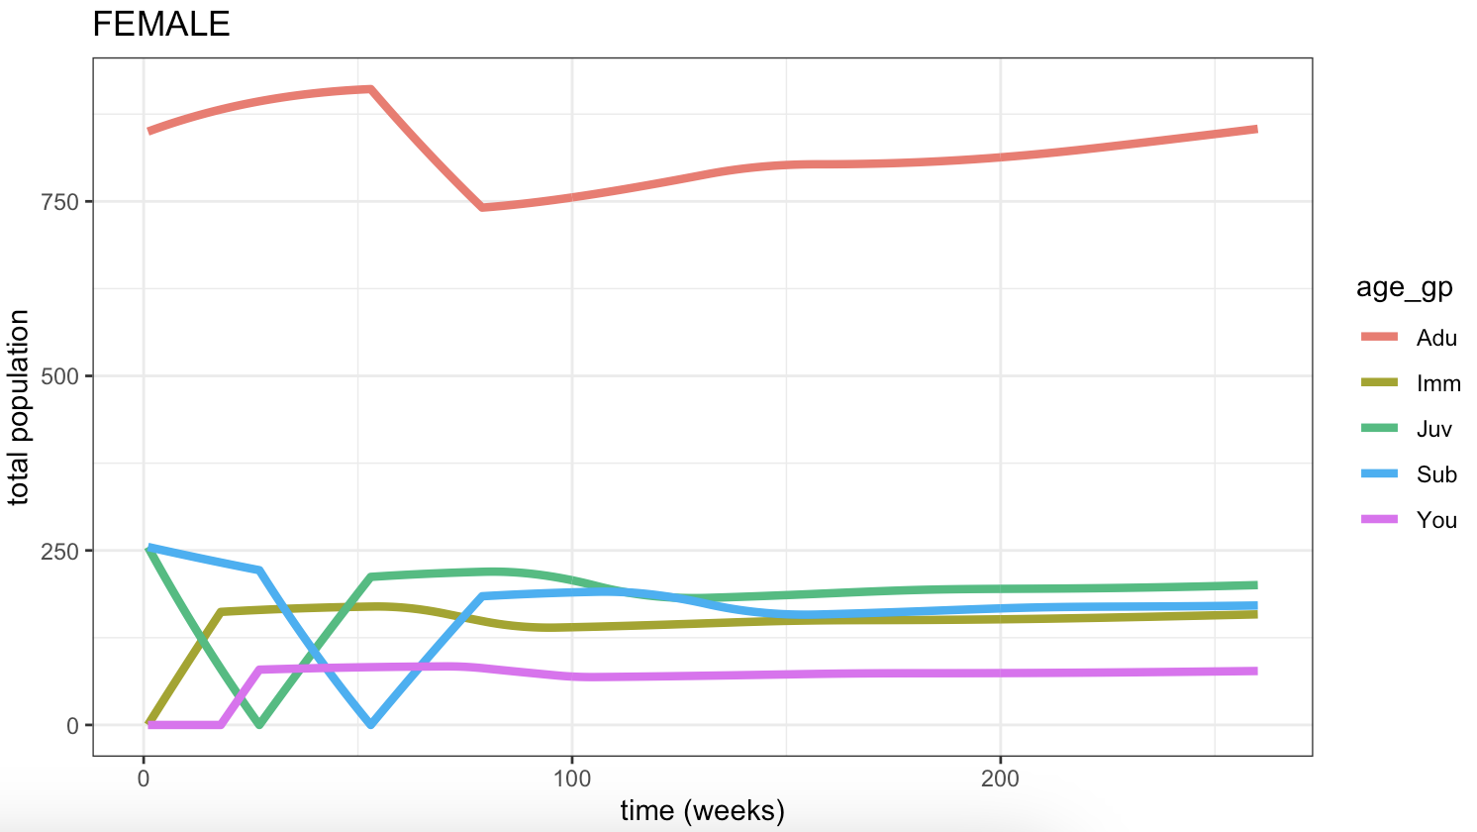
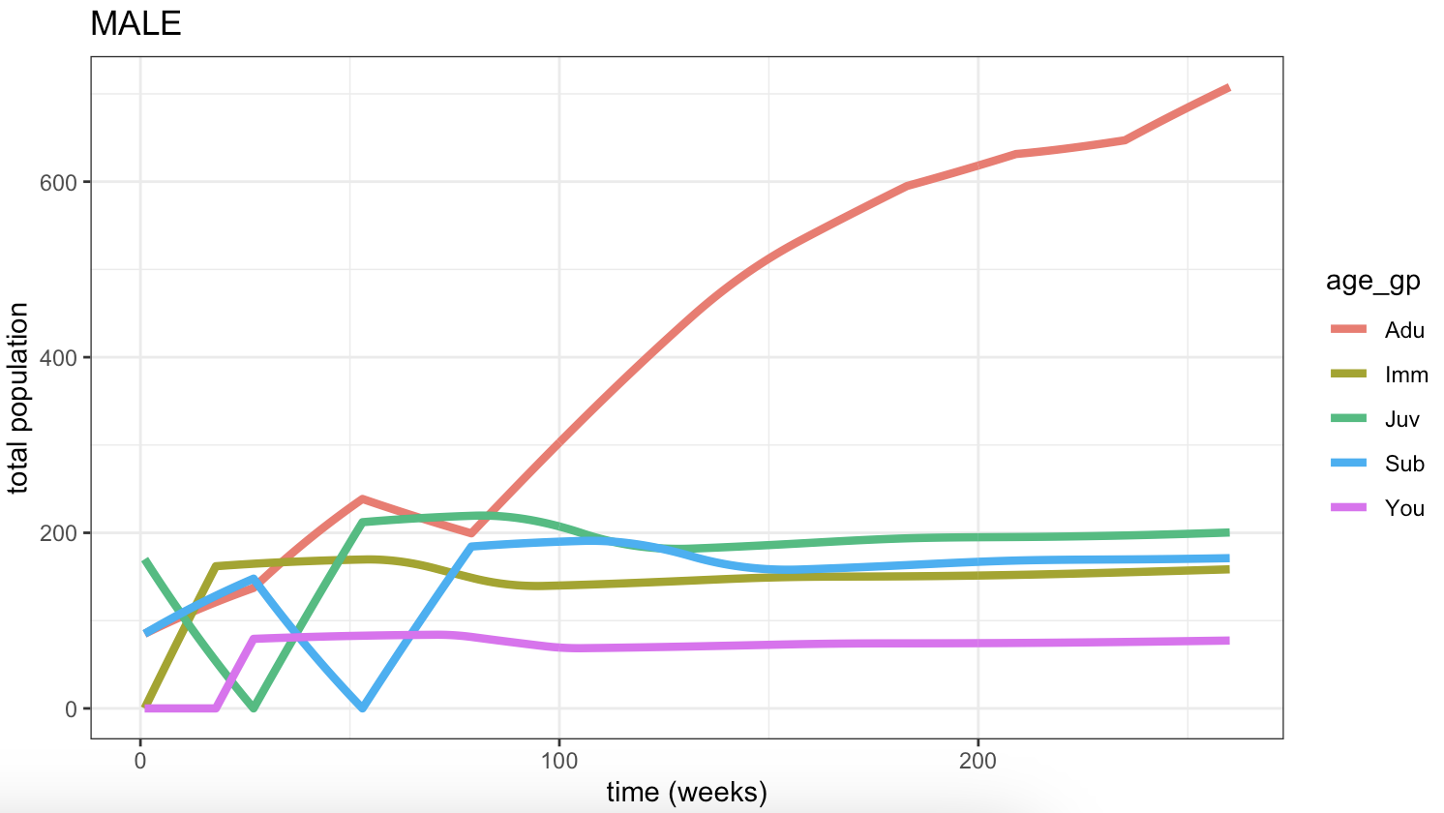
Notes:
As previous but with upper age limes of 5(male) and 7(female)
- Changed from 3 (male) and 5 (female)

