Slide 1
Flock Dynamics: Applied Examples – Data validation

Slide 2
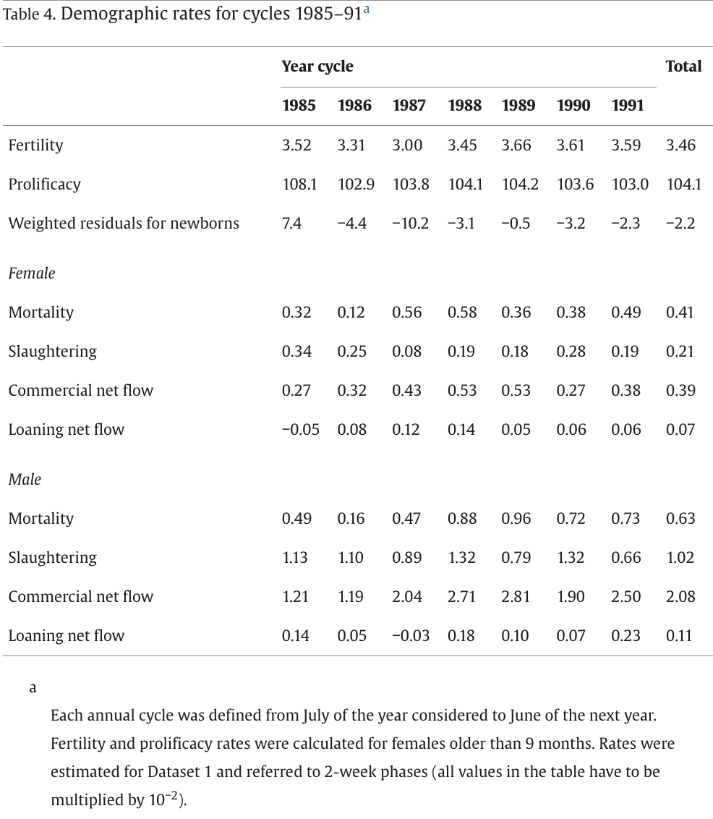
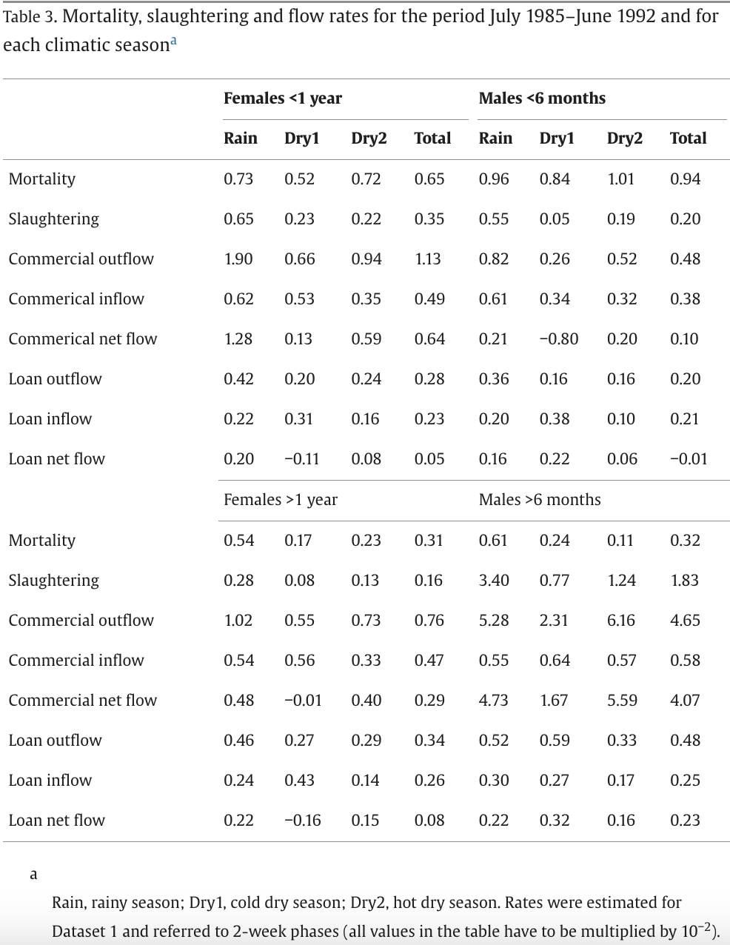
Lesnoff 1999 – Raw Data
Data from Lesnoff 1999.
Table 4:
Fortnightly rates for each year of study, and overall fortnightly average.
Parameters given by sex (not age)
Table 3:
Fortnightly rates for each season and overall over the full 7 year period
Parameters by age and sex (F<12m, F>12m, M<6m, M>6m)

Slide 3
Calculate ALL Offtake (slaughter+commercial net flow + loan net flow)
Lesnoff 1999 – Raw Data
Demographic rates for cycles 1985–91
Each annual cycle was defined from July of the year considered to June of the next year. Fertility and prolificacy rates were calculated for females older than 9 months. Rates were estimated for Dataset 1 and referred to 2-week phases (all values in the table have to be multiplied by 10−2).
 | Year-Cycle
 | 1985 | 1986 | 1987 | 1988 | 1989 | 1990 | 1991 | Total
Fertility | 3.52 | 3.31 | 3 | 3.45 | 3.66 | 3.61 | 3.59 | 3.46
Prolificacy | 108.1 | 102.9 | 103.8 | 104.1 | 104.2 | 103.6 | 103 | 104.1
Weighted residuals for newborns | 7.4 | −4.4 | −10.2 | −3.1 | −0.5 | −3.2 | −2.3 | −2.2
Fecundity | 380.512 | 340.599 | 311.4 | 359.145 | 381.372 | 373.996 | 369.77 | 360.186
Female |  |  |  |  |  |  |  | Total
Mortality | 0.32 | 0.12 | 0.56 | 0.58 | 0.36 | 0.38 | 0.49 | 0.41
Slaughtering | 0.34 | 0.25 | 0.08 | 0.19 | 0.18 | 0.28 | 0.19 | 0.21
Commercial net flow | 0.27 | 0.32 | 0.43 | 0.53 | 0.53 | 0.27 | 0.38 | 0.39
Loaning net flow | -0.05 | 0.08 | 0.12 | 0.14 | 0.05 | 0.06 | 0.06 | 0.07
ALL OFFTAKE = (Sl+CommercialNetFlow+LoanNetFlow) | 0.56 | 0.65 | 0.63 | 0.86 | 0.76 | 0.61 | 0.63 | 0.67
Male |  |  |  |  |  |  |  | Total
Mortality | 0.49 | 0.16 | 0.47 | 0.88 | 0.96 | 0.72 | 0.73 | 0.63
Slaughtering | 1.13 | 1.1 | 0.89 | 1.32 | 0.79 | 1.32 | 0.66 | 1.02
Commercial net flow | 1.21 | 1.19 | 2.04 | 2.71 | 2.81 | 1.9 | 2.5 | 2.08
Loaning net flow | 0.14 | 0.05 | -0.03 | 0.18 | 0.1 | 0.07 | 0.23 | 0.11
ALL OFFTAKE = (Sl+CommercialNetFlow+LoanNetFlow) | 2.48 | 2.34 | 2.9 | 4.21 | 3.7 | 3.29 | 3.39 | 3.21
Table 3. Mortality, slaughtering and flow rates for the period July 1985–June 1992 and for each climatic seasona
Rain, rainy season; Dry1, cold dry season; Dry2, hot dry season. Rates were estimated for Dataset 1 and referred to 2-week phases (all values in the table have to be multiplied by 10−2).
 | Rain | Dry1 | Dry2 | Total | Rain | Dry1 | Dry2 | Total
 | Females <1 year |  |  |  | Males <6 months
Mortality | 0.73 | 0.52 | 0.72 | 0.65 | 0.96 | 0.84 | 1.01 | 0.94
Slaughtering | 0.65 | 0.23 | 0.22 | 0.35 | 0.55 | 0.05 | 0.19 | 0.2
Commercial outflow | 1.9 | 0.66 | 0.94 | 1.13 | 0.82 | 0.26 | 0.52 | 0.48
Commerical inflow | 0.62 | 0.53 | 0.35 | 0.49 | 0.61 | 0.34 | 0.32 | 0.38
Commerical net flow | 1.28 | 0.13 | 0.59 | 0.64 | 0.21 | -0.8 | 0.2 | 0.1
Loan outflow | 0.42 | 0.2 | 0.24 | 0.28 | 0.36 | 0.16 | 0.16 | 0.2
Loan inflow | 0.22 | 0.31 | 0.16 | 0.23 | 0.2 | 0.38 | 0.1 | 0.21
Loan net flow | 0.2 | -0.11 | 0.08 | 0.05 | 0.16 | 0.22 | 0.06 | -0.01
ALL OFFTAKE = (Sl+CommercialNetFlow+LoanNetFlow) | 2.13 | 0.25 | 0.89 | 1.04 | 0.92 | -0.53 | 0.45 | 0.29
 | Females >1 year |  |  |  | Males >6 months
Mortality | 0.54 | 0.17 | 0.23 | 0.31 | 0.61 | 0.24 | 0.11 | 0.32
Slaughtering | 0.28 | 0.08 | 0.13 | 0.16 | 3.4 | 0.77 | 1.24 | 1.83
Commercial outflow | 1.02 | 0.55 | 0.73 | 0.76 | 5.28 | 2.31 | 6.16 | 4.65
Commercial inflow | 0.54 | 0.56 | 0.33 | 0.47 | 0.55 | 0.64 | 0.57 | 0.58
Commercial net flow | 0.48 | -0.01 | 0.4 | 0.29 | 4.73 | 1.67 | 5.59 | 4.07
Loan outflow | 0.46 | 0.27 | 0.29 | 0.34 | 0.52 | 0.59 | 0.33 | 0.48
Loan inflow | 0.24 | 0.43 | 0.14 | 0.26 | 0.3 | 0.27 | 0.17 | 0.25
Loan net flow | 0.22 | -0.16 | 0.15 | 0.08 | 0.22 | 0.32 | 0.16 | 0.23
ALL OFFTAKE = (Sl+CommercialNetFlow+LoanNetFlow) | 0.98 | -0.09 | 0.68 | 0.53 | 8.35 | 2.76 | 6.99 | 6.13

Slide 4
Lesnoff 1999 – Data Transformation
- Compute the min and max for each parameter & age-sex group:
- based on minimum and maximum fortnightly rates across seasons (offtake/mortality - table 4)
- based on reported fortnightly rates over all years (reproduction - table 3)
- Convert raw data into true fortnightly rates (*0.01)
- Convert fortnightly rates to annual rates (see below)
- mortality & offtake: 1-(1-X)^26
- birth rate: birth_r*26
TRANSFORMED DATA - Annual Rates
Transformation Formulas: Fortnightly to Annual
Mortality | mort_Y = 1-(1-mort_F)^26
Offtake | off_Y = 1-(1-mort_F)^26
ANNUAL RATES
F<1y | 0.23800547 | 0.0630088 | 0.42866702
F>1y | 0.1290463 | -0.0236652 | 0.22590195
M<6m | 0.07272912 | -0.1473284 | 0.21361369
M>6m | 0.80693779 | 0.51697601 | 0.89637985
Total Mortality (by age-sex group)
F<1y | 0.15595683 | 0.1267669 | 0.17345107
F>1y | 0.07755284 | 0.0432734 | 0.13131999
M<6m | 0.21773047 | 0.19693727 | 0.23197664
M>6m | 0.07995565 | 0.02821019 | 0.14707674
 | Min age exchange
M | 6 | NA | NA
F | 12 | NA | NA
TRUE RATES | TRUE (All Offtake) | TRUE Min | TRUE Max
Female | 0.16036348 | 0.13585025 | 0.20113797
Male | 0.57185317 | 0.45970031 | 0.67316805
Female | 0.1013118 | 0.03073646 | 0.1403578
Male | 0.15152796 | 0.04077855 | 0.22182652
 | Min age exchange
M | 6 | NA | NA
F | 12 | NA | NA
Birthrate | birth_Y = birth_F*26
 | True Fortnightly Rates: * 0.01
TRUE RATES | TRUE (All Offtake) | TRUE Min | TRUE Max
F>9m | 0.9365096 | 0.80964 | 0.9915672
RAW DATA - Fortnightly Rates
TABLE 3: Offtake & Mortality by Age&Sex |  |  |  |  | True Fortnightly Rates
Total Offtake = Slaughter + Commercial Net Flow + Loan Net Flow |  |  |  |  | True Fortnightly Rates: * 0.01
All Offtake (by age-sex group) |  | Min | Max |  | All Offtake (by age-sex group) |  | Min | TMax
F<1y | 1.04 | 0.25 | 2.13 |  | F<1y | 0.0104 | 0.0025 | 0.0213
F>1y | 0.53 | -0.09 | 0.98 |  | F>1y | 0.0053 | -0.0009 | 0.0098
M<6m | 0.29 | -0.53 | 0.92 |  | M<6m | 0.0029 | -0.0053 | 0.0092
M>6m | 6.13 | 2.76 | 8.35 |  | M>6m | 0.0613 | 0.0276 | 0.0835
Total Mortality (by age-sex group) |  | Min | Max |  | Total Mortality (by age-sex group) |  | Min | TMax
F<1y | 0.65 | 0.52 | 0.73 |  | F<1y | 0.0065 | 0.0052 | 0.0073
F>1y | 0.31 | 0.17 | 0.54 |  | F>1y | 0.0031 | 0.0017 | 0.0054
M<6m | 0.94 | 0.84 | 1.01 |  | M<6m | 0.0094 | 0.0084 | 0.0101
M>6m | 0.32 | 0.11 | 0.61 |  | M>6m | 0.0032 | 0.0011 | 0.0061
Min age exchange |  |  |  |  | Min age exchange | Min age exchange
M | 6 | NA | NA |  | M | 6 | NA | NA
F | 12 | NA | NA |  | F | 12 | NA | NA
TABLE 4: Offtake & Mortality by Sex |  |  |  |  | True Fortnightly Rates
Total Offtake = Slaughter + Commercial Net Flow + Loan Net Flow |  |  |  |  | True Fortnightly Rates: * 0.01
All Offtake (by sex) |  | Min | Max |  | All Offtake (by sex) |  | Min | Max
Female | 0.67 | 0.56 | 0.86 |  | Female | 0.0067 | 0.0056 | 0.0086
Male | 3.21 | 2.34 | 4.21 |  | Male | 0.0321 | 0.0234 | 0.0421
All Mortality (by sex) |  | Min | Max |  | All Mortality (by sex) |  | Min | Max
Female | 0.41 | 0.12 | 0.58 |  | Female | 0.0041 | 0.0012 | 0.0058
Male | 0.63 | 0.16 | 0.96 |  | Male | 0.0063 | 0.0016 | 0.0096
Min age exchange (by sex) |  | Min | Max |  | Min age exchange (by sex) |  | Min | Max
M | 6 | NA | NA |  | M
F | 12 | NA | NA |  | F
TABLE 4: Fecundity for F>9m |  |  |  |  | TABLE 4: Fecundity for F>9m
Fecundity = Prolificacy * Fertility |  |  |  |  | True Fortnightly Rates: *( 0.01)^2 = 1*10^-4
 | Fecundity | Min | Max |  |  | Fecundity | TRUE Min | TRUE Max
F>9m | 360.196 | 311.4 | 381.372 |  | F>9m | 0.0360196 | 0.03114 | 0.0381372

Slide 5
Lesnoff 1999 – LHS model parameter ranges
Add minimum and maximum for each parameter required in the model:
- Based on minimum and maximum of all possible values ofr each parameter e.g.
- NET_offtake_y
FRTNTLY MIN-MAX
parameter | lesnoff.ft.min | lesnoff.ft.max
NET_offtake_y | -0.0053 | 0.0213 | range based on min-max F<12m and M<6m
NET_offtake_m | -0.0053 | 0.0092 | range based on M>6m
NET_offtake_m2 | -0.0053 | 0.0092 | range based on M>6m
NET_offtake_f | -0.0009 | 0.0213 | range based on F>12m
mortality_y | 0.0052 | 0.0101 | range based on min-max of F>12m & M>6m
mortality_a | 0.0011 | 0.0061 | range based on min-max of F<12m & M<6m
mortality_end | 1 | 1
birth_rate | 0.03114 | 0.0381372
ppr_mortality_y | 0 | 0
ppr_mortality_a | 0 | 0
adu_f_max_yrs | 3 | 3
adu_m_max_yrs | 3 | 3
min_age_offtake | 6 | 6
min_age_repro | 9 | 9
YEARLY MIN-MAX
parameter | lesnoff.yr.min | lesnoff.yr.max
NET_offtake_y | -0.1473284 | 0.42866702 | range based on min-max F<12m and M<6m
NET_offtake_m | 0.51697601 | 0.89637985 | range based on M>6m
NET_offtake_m2 | 0.51697601 | 0.89637985 | range based on M>6m
NET_offtake_f | -0.0236652 | 0.42866702 | range based on min - max of F<12m, F>12m
mortality_y | 0.1267669 | 0.23197664 | range based on min-max of F<12m & M<6m
mortality_a | 0.02821019 | 0.14707674 | range based on min-max of F>12m & M>6m
mortality_end | 1 | 1
birth_rate | 0.80964 | 0.9915672
ppr_mortality_y | 0 | 0
ppr_mortality_a | 0 | 0
adu_f_max_yrs | 3 | 3
adu_m_max_yrs | 3 | 3
min_age_offtake | 6 | 6
min_age_repro | 9 | 9

Slide 6
Lesnoff 1999 – LHS model parameter ranges
fortnightly
FRTNTLY MIN-MAX
parameter | lesnoff.ft.min | lesnoff.ft.max
NET_offtake_y | -0.0053 | 0.0213 | range based on min-max F<12m and M<6m
NET_offtake_m | -0.0053 | 0.0092 | range based on M>6m
NET_offtake_m2 | -0.0053 | 0.0092 | range based on M>6m
NET_offtake_f | -0.0009 | 0.0213 | range based on F>12m
mortality_y | 0.0052 | 0.0101 | range based on min-max of F>12m & M>6m
mortality_a | 0.0011 | 0.0061 | range based on min-max of F<12m & M<6m
mortality_end | 1 | 1
birth_rate | 0.03114 | 0.0381372
ppr_mortality_y | 0 | 0
ppr_mortality_a | 0 | 0
adu_f_max_yrs | 3 | 3
adu_m_max_yrs | 3 | 3
min_age_offtake | 6 | 6
min_age_repro | 9 | 9

Slide 7
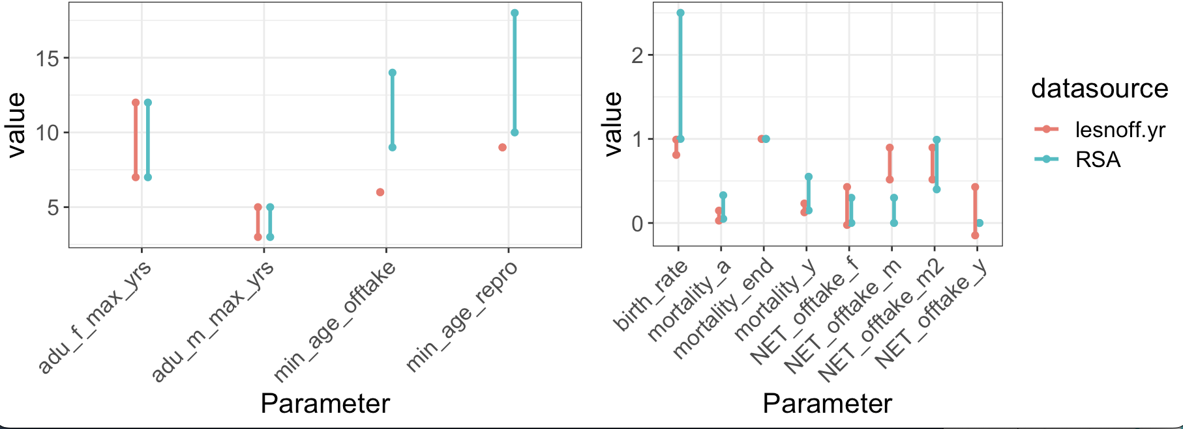
Lesnoff 1999 – Compare ranges to RSA
Points to note:
- min age offtake and min age of reproduction are both below the range used for RSA (based on E.Africa Pastoral flocks)
- min_age_offtake based on age-breaks used for males in paper.
Points to note:
- Birth rate is relatively low compared to RSA range
- NET_offtake_m is higher than RSA range – because we are grouping m>6m together (not splitting >24m)
- Much wider range for youth offtake (because upper limit includes F<12m range)

Slide 8
Model
20 years
1000 parameter combinations (time efficiency)
Sample of 10 used to explore complete population dynamics
Full 1000 sets used for population growth and age-sex summary statistics
Parameter outputs (age-sex & population growth) verified against:
(i) Original model conditions
(ii) Lesnoff reported annual growth rates

Slide 9
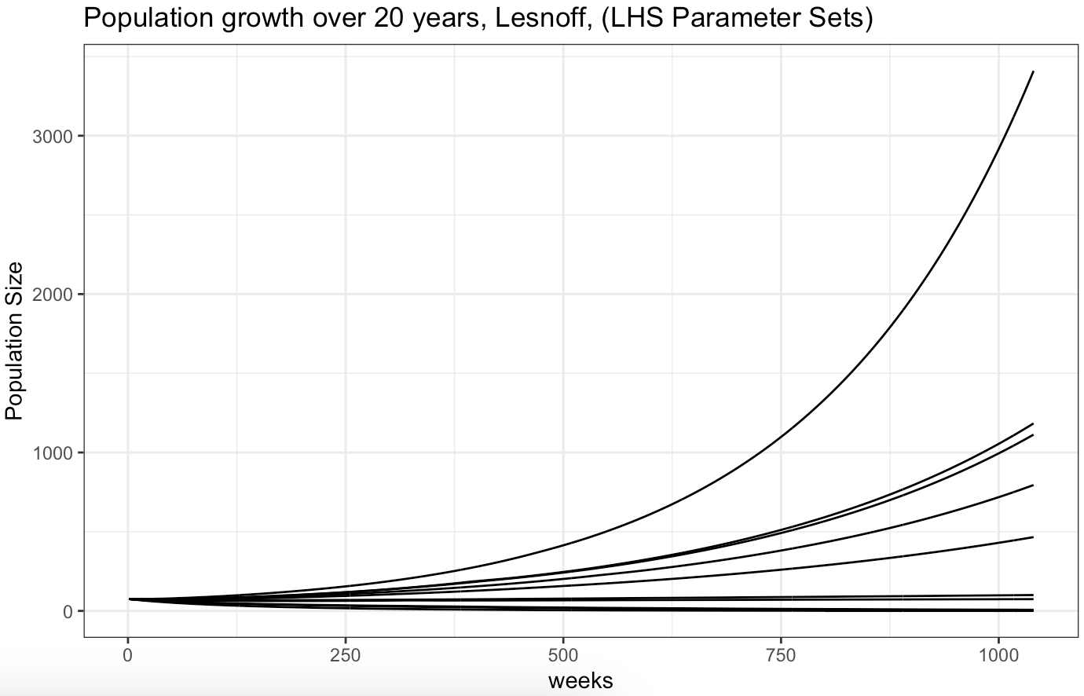
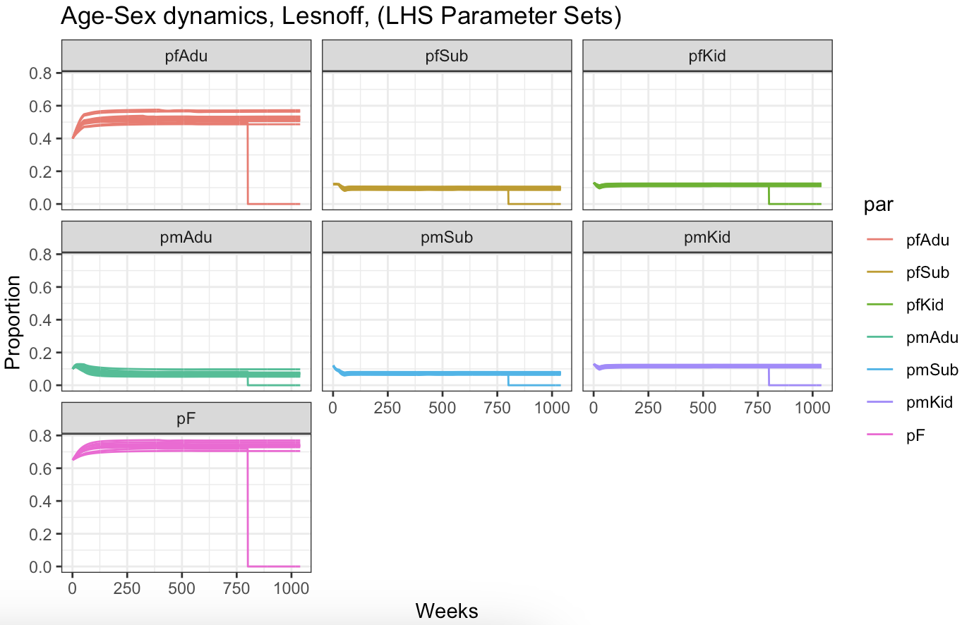
Population Growth & Age-Sex Dynamics
10 parameter sets sampled from 1000 sets (LHS)
Monotonic function (always increasing)
Age-Sex structure equilibrates within first year

Slide 10
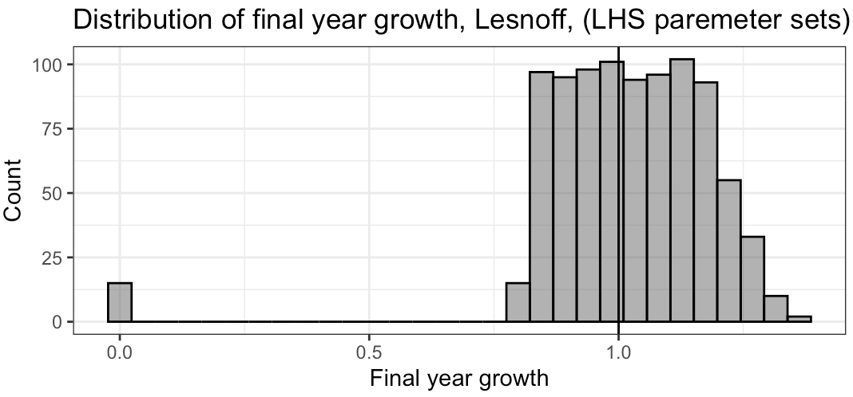
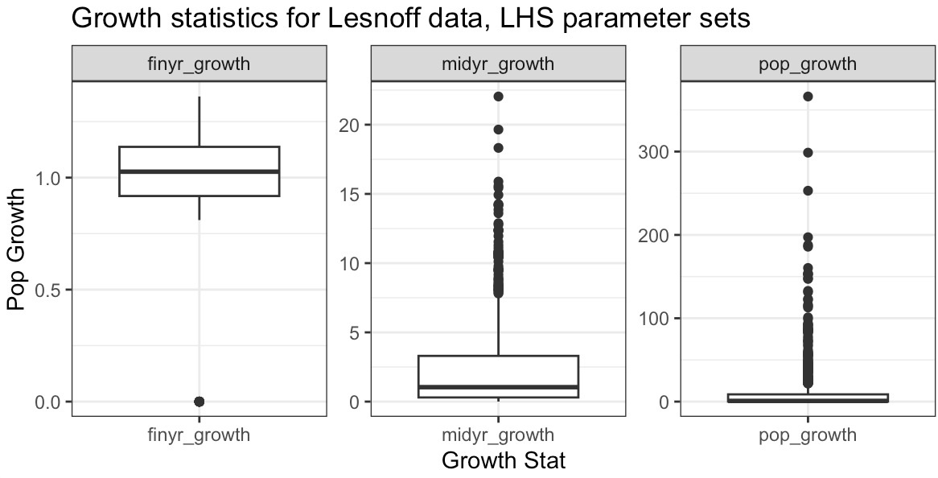
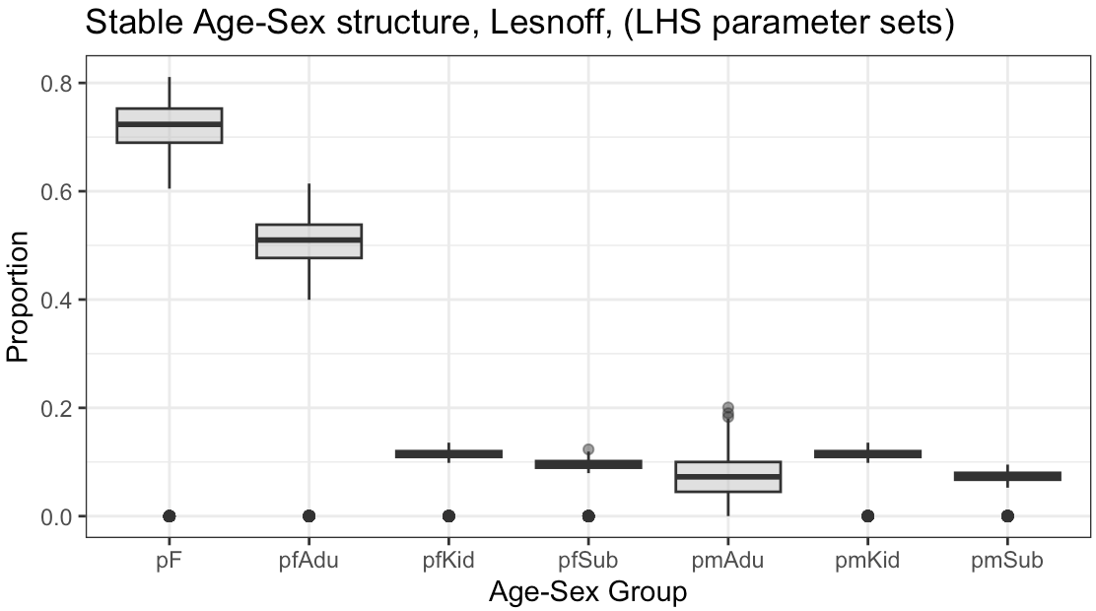
Population Growth & Age-Sex Summary stats
Growth rates: final year, midyr (10yr), and total (20y)
Distribution of final year growth
Stable age-sex structure
- approx. 50% Adu_F, approx. 10% Adu_M

Slide 11
“Valid” Parameter Sets (1)
Conditions for output population | Range
Population growth | +/- 15%
% female | 0.5-0.8
kid_m_prop | 5-16%
kid_f_prop | 5-19%
sub_m_prop | 4-15%
sub_f_prop | 6-19%
adu_m_prop | 1-15%
adu_f_prop | 21-62%
Do any Lesnoff parameter sets meet the growth and age-sex structure criteria used for RSA & GSA analysis?
Growth criteria: +/-15% for 10y period
Age-Sex Structure>>>
Results, tally >>>
35/1000 parameter sets are “valid”
midyr_15age | midyr_05age | n
0 | 0 | 940
1 | 0 | 35
1 | 1 | 25

Slide 12
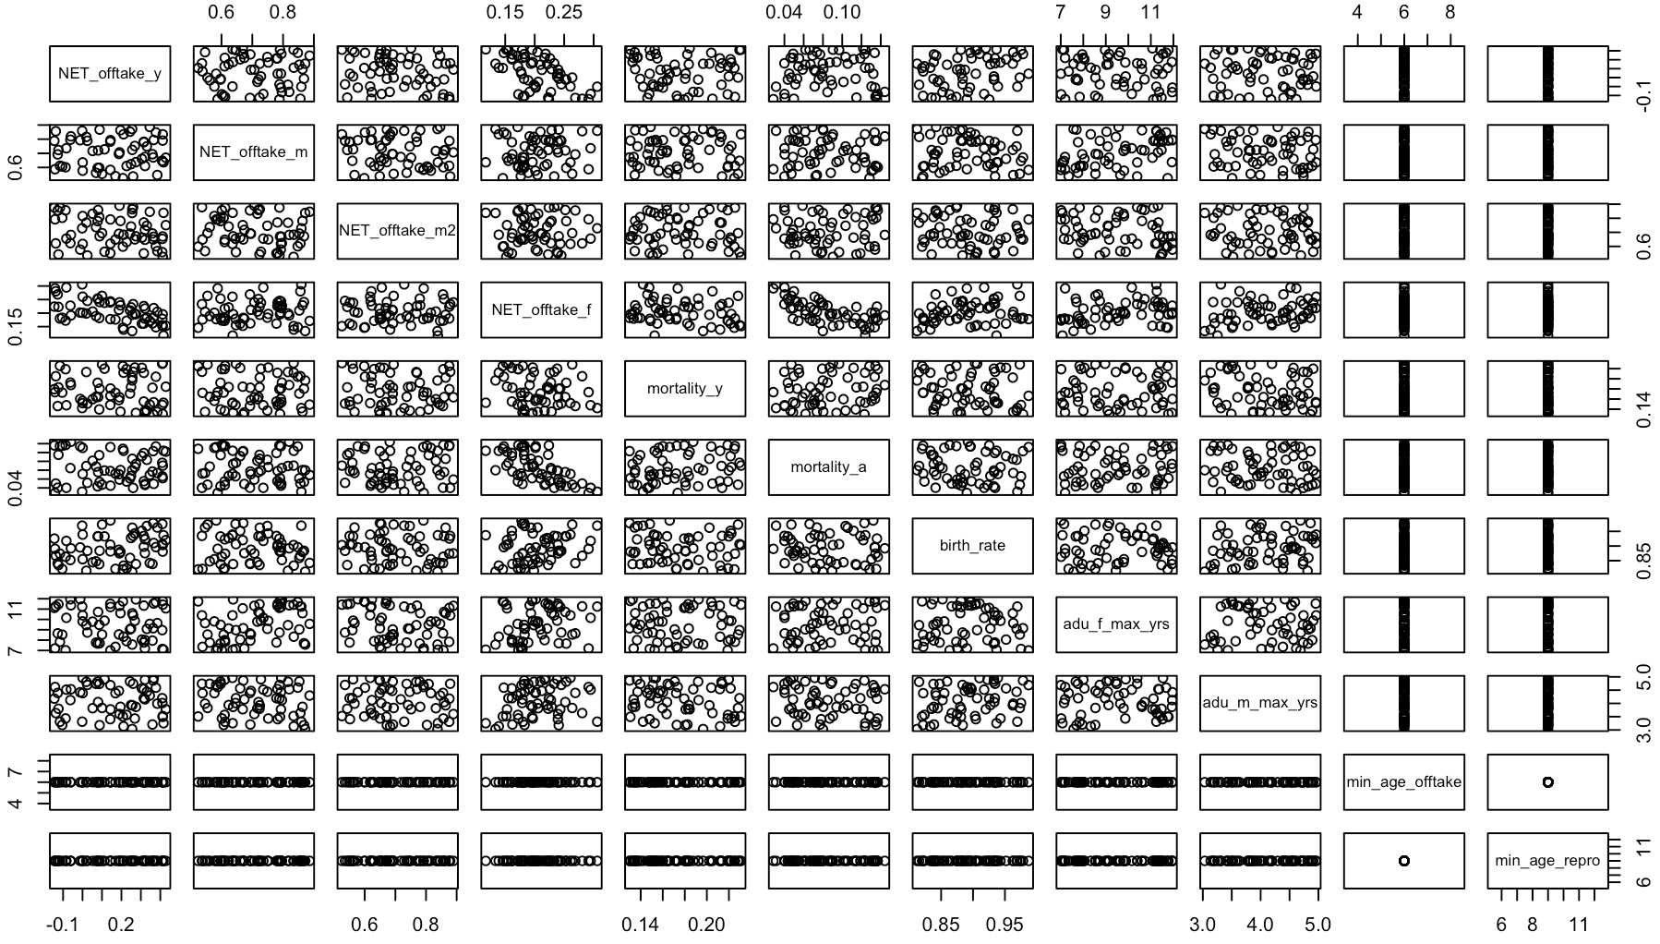
Valid Parameter Sets (1)
No clear parameter dependencies
- NET_offtake_y & NET_offtake_F negatively correlated?
- Mort_A and Net_off_F negatively correlated?
- Birth and net_off_F positively correlated?

Slide 13
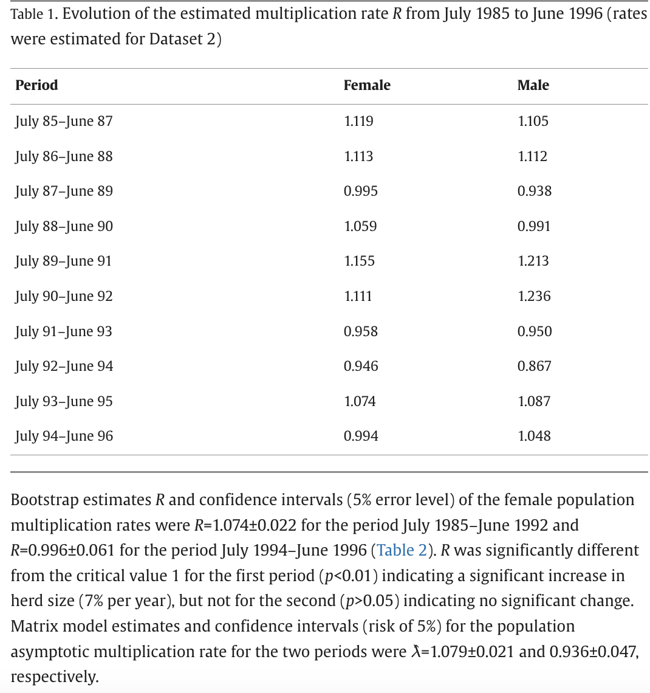
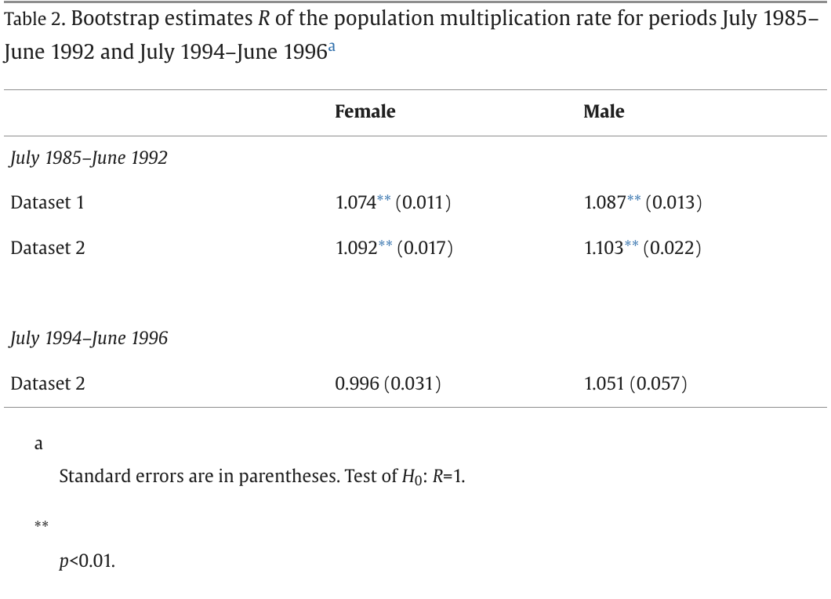
“Valid” Parameter Sets (2)
Are any parameter sets within the growth range reported in Lesnoff 1999 paper
Table 1: reported 2y multiplication rates for F and M for each period in 1985-1992
Table 2: Reported bootstrap estimates of population multiplication rate over whole period.

Slide 14
“Valid” Parameter Sets (2)
Table 1: 2y multiplication rate for F & M over 7y study period
Compute “total” growth: F_growth * pF, and M_growth * pM
- Assumed pF = 0.7 from stable age-sex structure (prev result)
Table 1. Evolution of the estimated multiplication rate R from July 1985 to June 1996 (rates were estimated for Dataset 2)
Period | Female | Male | TOTAL GROWTH (p*F_growth + p*M_growth)
July 85–June 87 | 1.119 | 1.105 | 1.1148
July 86–June 88 | 1.113 | 1.112 | 1.1127
July 87–June 89 | 0.995 | 0.938 | 0.9779
July 88–June 90 | 1.059 | 0.991 | 1.0386
July 89–June 91 | 1.155 | 1.213 | 1.1724
July 90–June 92 | 1.111 | 1.236 | 1.1485
July 91–June 93 | 0.958 | 0.95 | 0.9556
July 92–June 94 | 0.946 | 0.867 | 0.9223
July 93–June 95 | 1.074 | 1.087 | 1.0779
July 94–June 96 | 0.994 | 1.048 | 1.0102
Min | 0.946 | 0.867 | 0.9223
Max | 1.155 | 1.236 | 1.1724
Mean | 1.0524 | 1.0547 | 1.05309
Also reported F multiplication rate for 7y: R = 1.074 (+/- 0.022)
Asymptotic multiplication rate for 7y: 1.079 (+/-0.021)
~ 7 % growth over 7 years

Slide 15
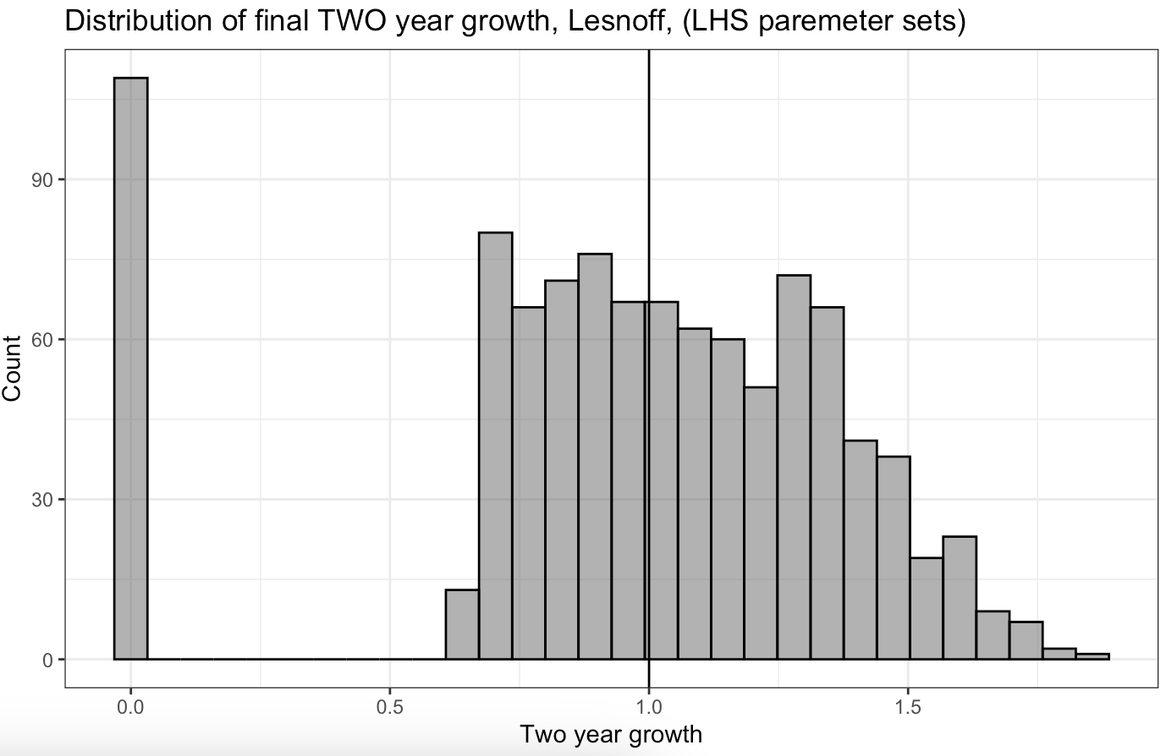
Valid Parameter Sets (2)
Note: Haven’t had time to see how many parameter sets are within growth range but histogram overlaps the valid range
Model Est. 2y Growth
Min. | 0.6568
1st | 0.8603
Median | 1.0626
Mean | 1.085
3rd | 1.2952
Max. | 1.8557
Table 1. Evolution of the estimated multiplication rate R from July 1985 to June 1996 (rates were estimated for Dataset 2)
Period | Female | Male | TOTAL GROWTH (p*F_growth + p*M_growth)
July 85–June 87 | 1.119 | 1.105 | 1.1148
July 86–June 88 | 1.113 | 1.112 | 1.1127
July 87–June 89 | 0.995 | 0.938 | 0.9779
July 88–June 90 | 1.059 | 0.991 | 1.0386
July 89–June 91 | 1.155 | 1.213 | 1.1724
July 90–June 92 | 1.111 | 1.236 | 1.1485
July 91–June 93 | 0.958 | 0.95 | 0.9556
July 92–June 94 | 0.946 | 0.867 | 0.9223
July 93–June 95 | 1.074 | 1.087 | 1.0779
July 94–June 96 | 0.994 | 1.048 | 1.0102
Min | 0.946 | 0.867 | 0.9223
Max | 1.155 | 1.236 | 1.1724
Mean | 1.0524 | 1.0547 | 1.05309
Overview:
Lesnoff paper reports multiplication rate over 2y intervals ranging from:
0.92 – 1.17 (Total Growth),
0.86-1.236 (M & F growth),
mean of 1.05.
Model outputs (excluding fadeout) indicate 2y growth (final year) ranging from:
0.65 – 1.85 (Total population)
median of 1.06 (total population)
mean of 1.08 (total population)
Female, R = 1.074 (+/- 0.022) for 7y period
Asymptotic multiplication rate: 1.079 (+/-0.021) for 7y period

Slide 16
Check Parameter Rates

Slide 17
Lesnoff 1999 – Raw Data
Data from Lesnoff 1999.
Table 4:
Fortnightly rates for each year of study, and overall fortnightly average.
Parameters given by sex (not age)
Table 3:
Fortnightly rates for each season and overall over the full 7 year period
Parameters by age and sex (F<12m, F>12m, M<6m, M>6m)

Slide 18
Lesnoff 1999 – Parameter Targets
Table 3. Mortality, slaughtering and flow rates for the period July 1985–June 1992 and for each climatic seasona
Rain, rainy season; Dry1, cold dry season; Dry2, hot dry season. Rates were estimated for Dataset 1 and referred to 2-week phases (all values in the table have to be multiplied by 10−2).
 | Rain | Dry1 | Dry2 | Total | Rain | Dry1 | Dry2 | Total
 | Females <1 year |  |  |  | Males <6 months
Mortality | 0.73 | 0.52 | 0.72 | 0.65 | 0.96 | 0.84 | 1.01 | 0.94
Slaughtering | 0.65 | 0.23 | 0.22 | 0.35 | 0.55 | 0.05 | 0.19 | 0.2
Commercial outflow | 1.9 | 0.66 | 0.94 | 1.13 | 0.82 | 0.26 | 0.52 | 0.48
Commerical inflow | 0.62 | 0.53 | 0.35 | 0.49 | 0.61 | 0.34 | 0.32 | 0.38
Commerical net flow | 1.28 | 0.13 | 0.59 | 0.64 | 0.21 | -0.8 | 0.2 | 0.1
Loan outflow | 0.42 | 0.2 | 0.24 | 0.28 | 0.36 | 0.16 | 0.16 | 0.2
Loan inflow | 0.22 | 0.31 | 0.16 | 0.23 | 0.2 | 0.38 | 0.1 | 0.21
Loan net flow | 0.2 | -0.11 | 0.08 | 0.05 | 0.16 | 0.22 | 0.06 | -0.01
ALL OFFTAKE = (Sl+CommercialNetFlow+LoanNetFlow) | 2.13 | 0.25 | 0.89 | 1.04 | 0.92 | -0.53 | 0.45 | 0.29
 | Females >1 year |  |  |  | Males >6 months
Mortality | 0.54 | 0.17 | 0.23 | 0.31 | 0.61 | 0.24 | 0.11 | 0.32
Slaughtering | 0.28 | 0.08 | 0.13 | 0.16 | 3.4 | 0.77 | 1.24 | 1.83
Commercial outflow | 1.02 | 0.55 | 0.73 | 0.76 | 5.28 | 2.31 | 6.16 | 4.65
Commercial inflow | 0.54 | 0.56 | 0.33 | 0.47 | 0.55 | 0.64 | 0.57 | 0.58
Commercial net flow | 0.48 | -0.01 | 0.4 | 0.29 | 4.73 | 1.67 | 5.59 | 4.07
Loan outflow | 0.46 | 0.27 | 0.29 | 0.34 | 0.52 | 0.59 | 0.33 | 0.48
Loan inflow | 0.24 | 0.43 | 0.14 | 0.26 | 0.3 | 0.27 | 0.17 | 0.25
Loan net flow | 0.22 | -0.16 | 0.15 | 0.08 | 0.22 | 0.32 | 0.16 | 0.23
ALL OFFTAKE = (Sl+CommercialNetFlow+LoanNetFlow) | 0.98 | -0.09 | 0.68 | 0.53 | 8.35 | 2.76 | 6.99 | 6.13
Define parameter age-sex target, with target range calculated as +/-10%
TARGET, Fortnightly rates
parameter | lesnoff.ft | targ.min | targ.max | +/- 10%
F_off <12m | 0.0104 | 0.00936 | 0.01144 | What values of off_y and off_F produce a F<12m offtake of 1.04
F_off >12m | 0.0053 | 0.00477 | 0.00583 | What values of off_y and off_F produce a F>12m offtake of 0.53
M_off <6m | 0.0029 | 0.00261 | 0.00319 | If min_offtake is set to 6m then this aligns with age-categories, no target needed
M_off >6m | 0.0613 | 0.05517 | 0.06743 | If min_offtake is set to 6m then this aligns with age-categories, no target needed
F_mort <12m | 0.0065 | 0.00585 | 0.00715 | What values of mort_y and mort_A produce a F<12m mortality of 0.65
F_mort >12m | 0.0031 | 0.00279 | 0.00341 | What values of mort_y and mort_A produce a F>12m mortality of 0.31
M_mort <6m | 0.0094 | 0.00846 | 0.01034 | What values of mort_y and mort_A produce a F>12m mortality of 0.31
M_mort >6m | 0.0032 | 0.00288 | 0.00352 | What values of mort_y and mort_A produce a F>12m mortality of 0.31
Calculate ALL Offtake (slaughter+commercial net flow + loan net flow)

Slide 19
Lesnoff 1999 – Parameter Targets and Input
parameter | lesnoff.ft | targ.min | targ.max | +/- 10%
F_off <12m | 0.0104 | 0.00936 | 0.01144 | What values of off_y and off_F produce a F<12m offtake of 1.04
F_off >12m | 0.0053 | 0.00477 | 0.00583 | What values of off_y and off_F produce a F>12m offtake of 0.53
M_off <6m | 0.0029 | 0.00261 | 0.00319 | If min_offtake is set to 6m then this aligns with age-categories, no target needed
M_off >6m | 0.0613 | 0.05517 | 0.06743 | If min_offtake is set to 6m then this aligns with age-categories, no target needed
F_mort <12m | 0.0065 | 0.00585 | 0.00715 | What values of mort_y and mort_A produce a F<12m mortality of 0.65
F_mort >12m | 0.0031 | 0.00279 | 0.00341 | What values of mort_y and mort_A produce a F>12m mortality of 0.31
M_mort <6m | 0.0094 | 0.00846 | 0.01034 | What values of mort_y and mort_A produce a F>12m mortality of 0.31
M_mort >6m | 0.0032 | 0.00288 | 0.00352 | What values of mort_y and mort_A produce a F>12m mortality of 0.31
Define parameter range for Model LHS (see prev):
- Add minimum and maximum for each parameter required in the model:
- Based on minimum and maximum of all possible values for each parameter e.g.
- NET_offtake_y = min-max of F<12m & M<6m,
Parameter | Definition | Input
Off_y | All Off <6m | -0.0053 – 0.0213 | Range: min-max (F<12m, M<6m)
Off_F | F Off > min. age (6m) | -0.0009 – 0.0213 | Range: min-max (F<12m, F>12m)
Off_M | M Off > 24m | 0.0276-0.0835 | Range: min-max (M>6m)
Off_M2 | M Off >min.age (6m-24m) | 0.0276-0.0835 | Range: min-max (M>6m)
mortality_y | 0.0052 | 0.0101 | range based on min-max of F>12m & M>6m
mortality_a | 0.0011 | 0.0061 | range based on min-max of F<12m & M<6m

Slide 20
Lesnoff 1999 – Mortality Rate
Run Model with LHS on target parameters:
Targets: F_mort<12m, F_mort>12m,M_mort<6m,M_mort>6m
Input: mortality_y, mortality_a
Assume no other demographic processes occur during the period (only mortality)
Compute annual mortality for each age-sex category:
F<12m, F>12m
M<6m, M<12m
Review whether model output for mortality stats is within range of reported mortality rates
TARGET Mortality
F_mort <12m | 0.0065 | 0.00585 | 0.00715 | What values of mort_y and mort_A produce a F<12m mortality of 0.65
F_mort >12m | 0.0031 | 0.00279 | 0.00341 | What values of mort_y and mort_A produce a F>12m mortality of 0.31
M_mort <6m | 0.0094 | 0.00846 | 0.01034 | What values of mort_y and mort_A produce a F>12m mortality of 0.31
M_mort >6m | 0.0032 | 0.00288 | 0.00352 | What values of mort_y and mort_A produce a F>12m mortality of 0.31

Slide 21
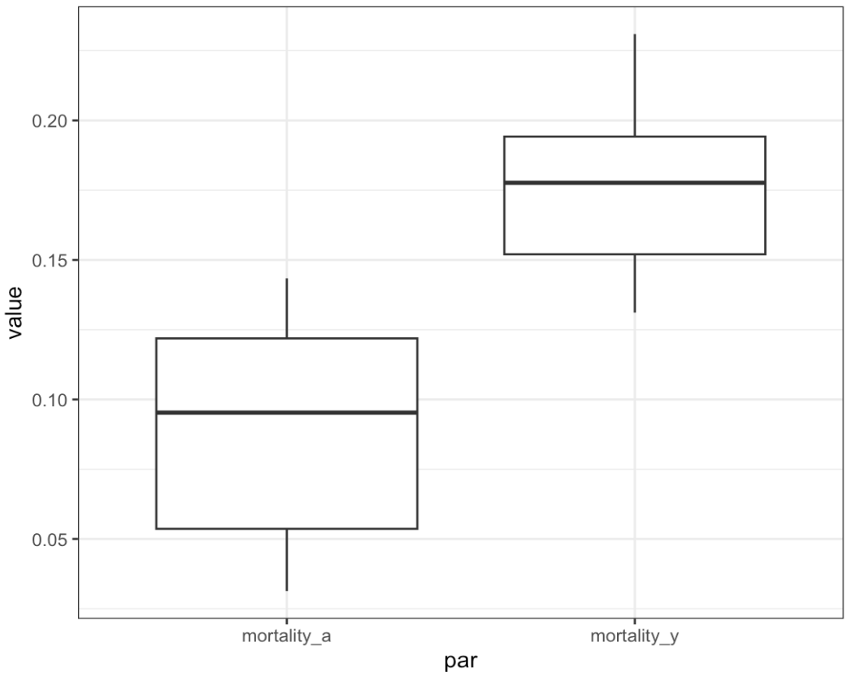
Mortality Rate - Output
INPUT Mortality
Parameter | Definition | Input
mortality_y | 0.0052 | 0.0101 | range based on min-max of F>12m & M>6m
mortality_a | 0.0011 | 0.0061 | range based on min-max of F<12m & M<6m
10,000 parameter sets
Of which 41 parameter sets were within range of reported stats for all age-sex groups
TARGET Mortality
F_mort <12m | 0.0065 | 0.00585 | 0.00715 | What values of mort_y and mort_A produce a F<12m mortality of 0.65
F_mort >12m | 0.0031 | 0.00279 | 0.00341 | What values of mort_y and mort_A produce a F>12m mortality of 0.31
M_mort <6m | 0.0094 | 0.00846 | 0.01034 | What values of mort_y and mort_A produce a F>12m mortality of 0.31
M_mort >6m | 0.0032 | 0.00288 | 0.00352 | What values of mort_y and mort_A produce a F>12m mortality of 0.31

Slide 22
Lesnoff 1999 – Offtake Rate
Run Model with LHS on target parameters:
Targets: F_off<12m, F_off>12m,M_off<6m,M_off>6m
Input: off_y, off_f, off_m, off_m2
Assume no other demographic processes occur during the period (only offtake)
Compute offtake for each age-sex category:
F<12m, F>12m
M<6m, M<12m
Review whether model offtake stats are within range of reported offtake rates
TARGET Offtake
F_off <12m | 0.0104 | 0.00936 | 0.01144 | F_off <12m
F_off >12m | 0.0053 | 0.00477 | 0.00583 | F_off >12m
M_off <6m | 0.0029 | 0.00261 | 0.00319 | M_off <6m
M_off >6m | 0.0613 | 0.05517 | 0.06743 | M_off >6m

Slide 23
Offtake Rate - Output
INPUT Offtake (fortnightly)
Parameter | Definition | Input
NET_offtake_y | -0.0053 | 0.0213 | range based on min-max F<12m and M<6m
NET_offtake_m | 0.0276 | 0.0835 | range based on M>6m
NET_offtake_m2 | 0.0276 | 0.0835 | range based on M>6m
NET_offtake_f | -0.0009 | 0.0213 | range based on min - max of F<12m, F>12m
10,000 parameter sets
Of which 2 parameter sets were within range of reported stats for all age-sex groups
TARGET Offtake (fortnightly)
F_mort <12m | 0.0065 | 0.00585 | 0.00715 | What values of mort_y and mort_A produce a F<12m mortality of 0.65
F_mort >12m | 0.0031 | 0.00279 | 0.00341 | What values of mort_y and mort_A produce a F>12m mortality of 0.31
M_mort <6m | 0.0094 | 0.00846 | 0.01034 | What values of mort_y and mort_A produce a F>12m mortality of 0.31
M_mort >6m | 0.0032 | 0.00288 | 0.00352 | What values of mort_y and mort_A produce a F>12m mortality of 0.31
 | NET_offtake_y | NET_offtake_f | NET_offtake_m | NET_offtake_m2
27 | 0.4117296 | 0.1814705 | 0.5915481 | 0.7176708
39 | 0.0287726 | 0.1651086 | 0.6631247 | 0.6010686
Set 27: NET_off_y >> NET_off_F
In other literature young offtake is negligible
Set 39: NET_off_m >> NET_off_m2
M2 is the young male offtake rate
**Discard set 27 as off_y is too high?**

Slide 24
Offtake Rate – Output
INPUT Offtake
Parameter | Definition | Input
NET_offtake_y | -0.0053 | 0.0213 | range based on min-max F<12m and M<6m
NET_offtake_m | 0.0276 | 0.0835 | range based on M>6m
NET_offtake_m2 | 0.0276 | 0.0835 | range based on M>6m
NET_offtake_f | -0.0009 | 0.0213 | range based on min - max of F<12m, F>12m
10,000 parameter sets
Female offtake only: 62 valid sets
Male offtake only: 45 valid sets
(filter for off_y << off_F & off_m << off_m2)?
TARGET Offtake
F_mort <12m | 0.0065 | 0.00585 | 0.00715 | What values of mort_y and mort_A produce a F<12m mortality of 0.65
F_mort >12m | 0.0031 | 0.00279 | 0.00341 | What values of mort_y and mort_A produce a F>12m mortality of 0.31
M_mort <6m | 0.0094 | 0.00846 | 0.01034 | What values of mort_y and mort_A produce a F>12m mortality of 0.31
M_mort >6m | 0.0032 | 0.00288 | 0.00352 | What values of mort_y and mort_A produce a F>12m mortality of 0.31

Slide 25
Lesnoff – Parameter Validation Test
Use mortality and offtake output to parameterize model and review population dynamics.
Mortality: 41 valid parameter combinations for mort_A and mort_Y
Offtake: 1 valid parameter set for off_y, off_f, off_m, off_m2.
Combine valid offtake and mortality for 41 parameter sets
Set birth rate to the mean reported birth rate
Set min_age_repro and min_age_exchange to 6m & 9m (based on age categories in the model).
Set max_age_F and max_age_M to 9 and 4, as approximate midpoints of original range
mortality_y | mortality_a | NET_offtake_y | NET_offtake_f | NET_offtake_m | NET_offtake_m2 | F_max | M_max | Min_off | Min_repro | birth_rate
0.1691054 | 0.1264694 | 0.0287726 | 0.1651086 | 0.6631247 | 0.6010686 | 9 | 4 | 6 | 9 | 0.9365096
0.1817255 | 0.0313126 | 0.0287726 | 0.1651086 | 0.6631247 | 0.6010686 | 9 | 4 | 6 | 9 | 0.9365096
0.213232 | 0.0642168 | 0.0287726 | 0.1651086 | 0.6631247 | 0.6010686 | 9 | 4 | 6 | 9 | 0.9365096

Slide 26
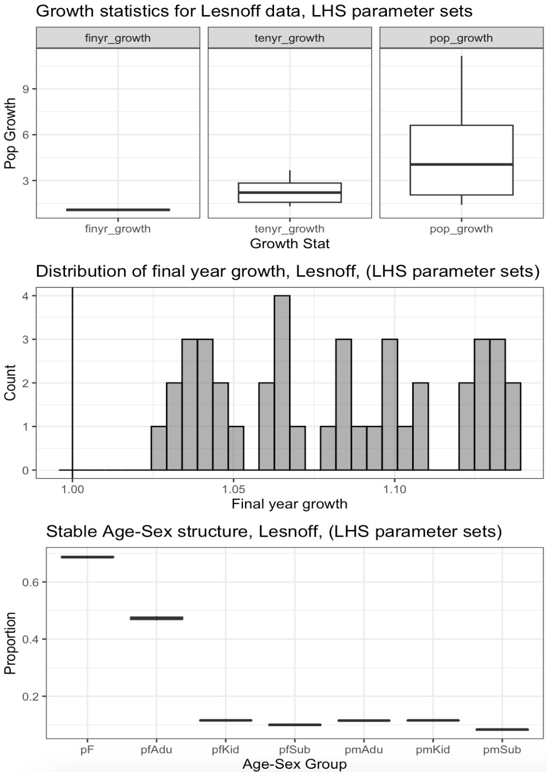
Lesnoff-Validation_Output
Finyr growth within 1 – 1.15
10y growth between 1.3 – 3.6 which is much higher than reported 7y growth rates
No results are consistent with age-sex structure and +/- 15% growth conditions used for RSA & GSA
par | meanProp
:----- | ---------:
pfAdu | 0.4812468
pfSub | 0.098537
pfKid | 0.1160342
pmAdu | 0.1058999
pmSub | 0.082248
pmKid | 0.1160342
pF | 0.695818
 | pop_growth | tenyr_growth | finyr_growth
Min. | 1.41 | 1.304 | 1.026
1st | 2.053 | 1.574 | 1.046
Median | 4.052 | 2.210 | 1.082
Mean | 4.828 | 2.300 | 1.081
3rd | 6.61 | 2.834 | 1.109
Max. | 11.153 | 3.674 | 1.139

Slide 27
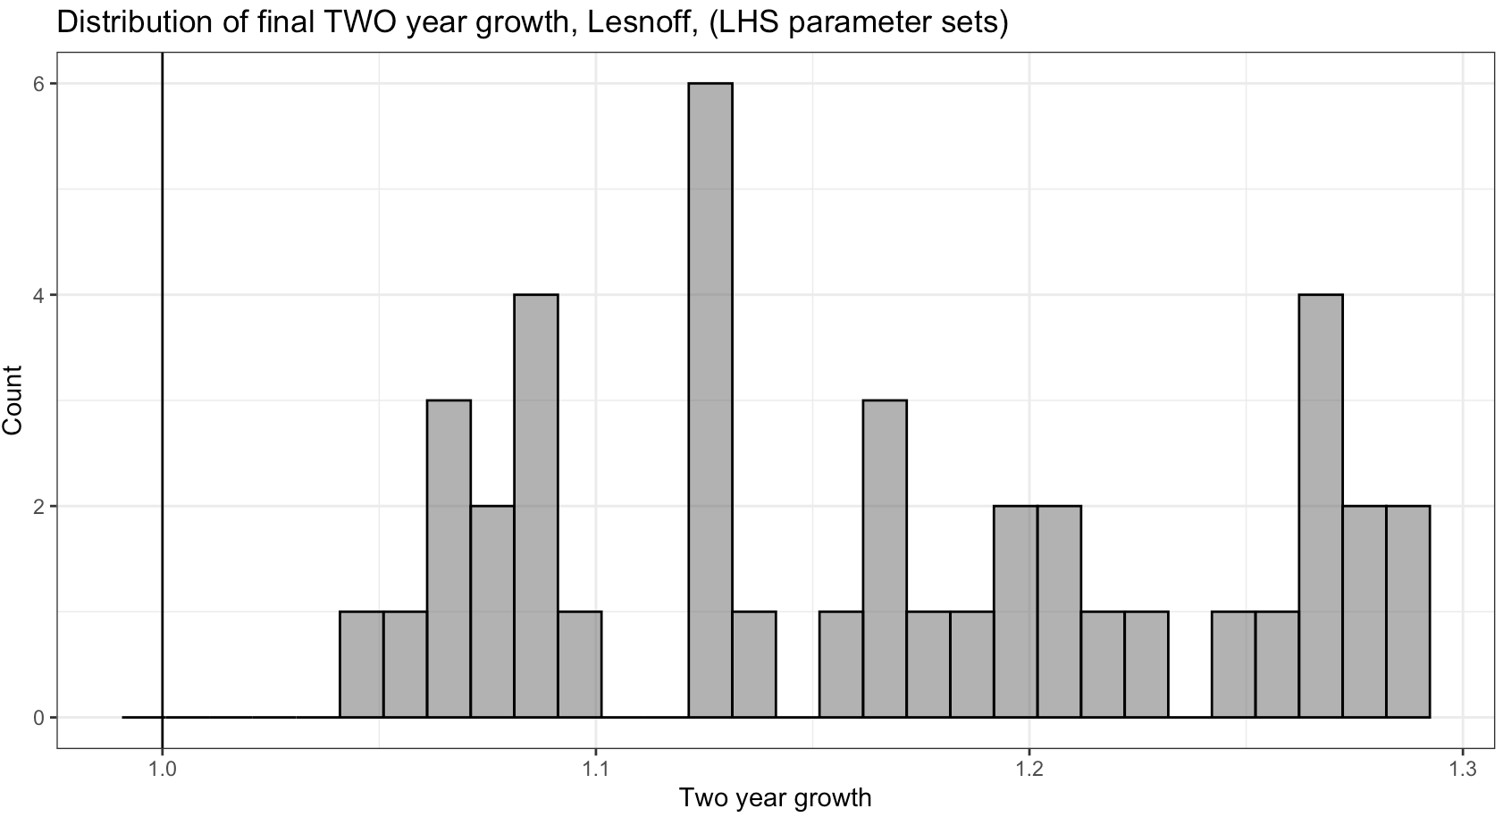
Valid Parameter Sets (2)
Model Est. 2y Growth
 | twoyr_growth
Min. | 1.051
1st | 1.091
Median | 1.168
Mean | 1.166
3rd | 1.226
Max. | 1.292
Table 1. Evolution of the estimated multiplication rate R from July 1985 to June 1996 (rates were estimated for Dataset 2)
Period | Female | Male | TOTAL GROWTH (p*F_growth + p*M_growth)
July 85–June 87 | 1.119 | 1.105 | 1.1148
July 86–June 88 | 1.113 | 1.112 | 1.1127
July 87–June 89 | 0.995 | 0.938 | 0.9779
July 88–June 90 | 1.059 | 0.991 | 1.0386
July 89–June 91 | 1.155 | 1.213 | 1.1724
July 90–June 92 | 1.111 | 1.236 | 1.1485
July 91–June 93 | 0.958 | 0.95 | 0.9556
July 92–June 94 | 0.946 | 0.867 | 0.9223
July 93–June 95 | 1.074 | 1.087 | 1.0779
July 94–June 96 | 0.994 | 1.048 | 1.0102
Min | 0.946 | 0.867 | 0.9223
Max | 1.155 | 1.236 | 1.1724
Mean | 1.0524 | 1.0547 | 1.05309
Overview:
Lesnoff paper reports multiplication rate over 2y intervals ranging from:
0.92 – 1.17 (Total Growth),
0.86-1.236 (M & F growth),
mean of 1.05.
Model outputs (excluding fadeout) indicate 2y growth (final year) ranging from:
1.05 – 1.29 (Total population)
median of 1.168 (total population)
mean of 1.166 (total population)
23/41 parameters are within the reported range for 2y multiplication rate

Slide 28
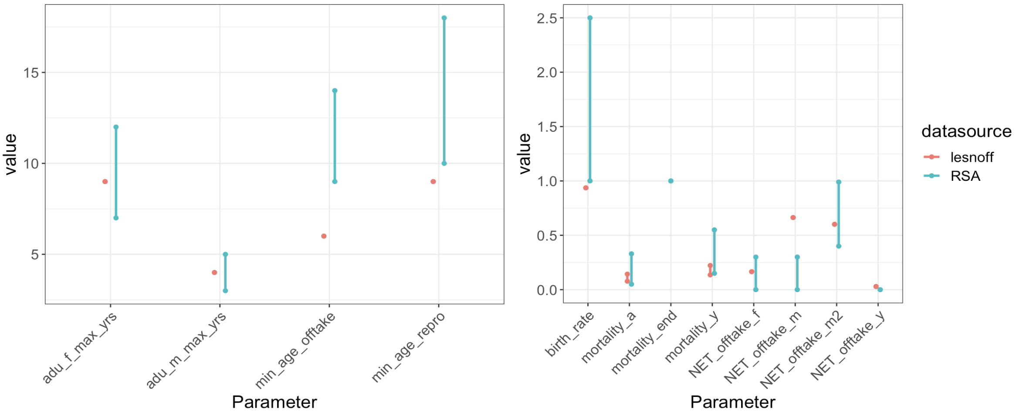
Valid Lesnoff vs RSA range:

Slide 29
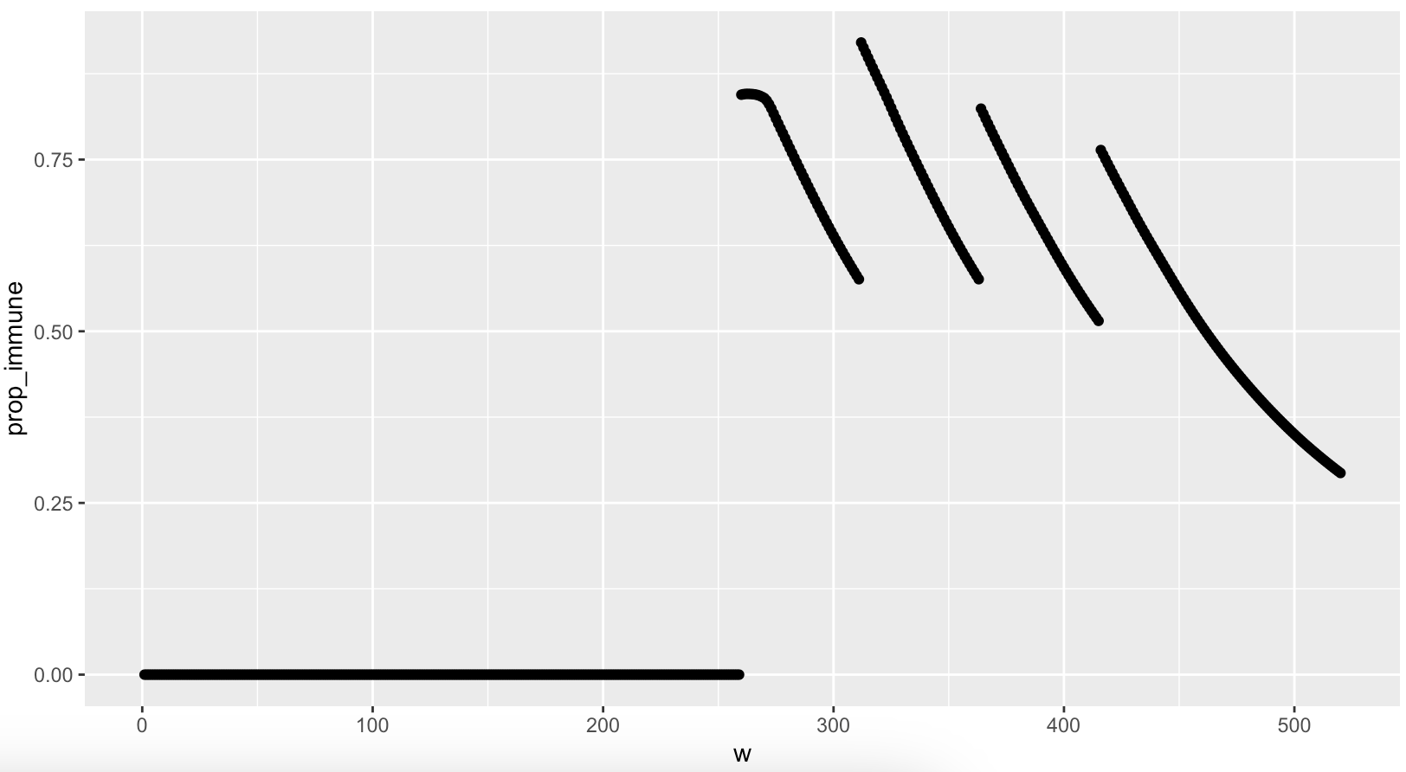
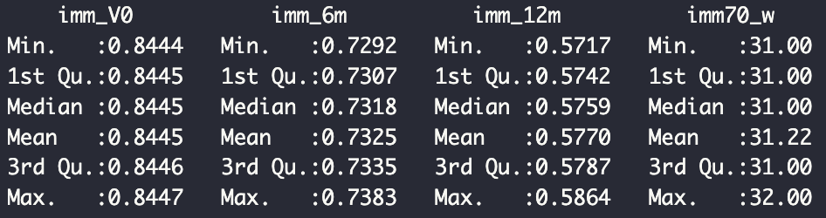

Slide 30
