Slide 1
Flock Dynamics: Applied Examples – Data validation

Slide 2
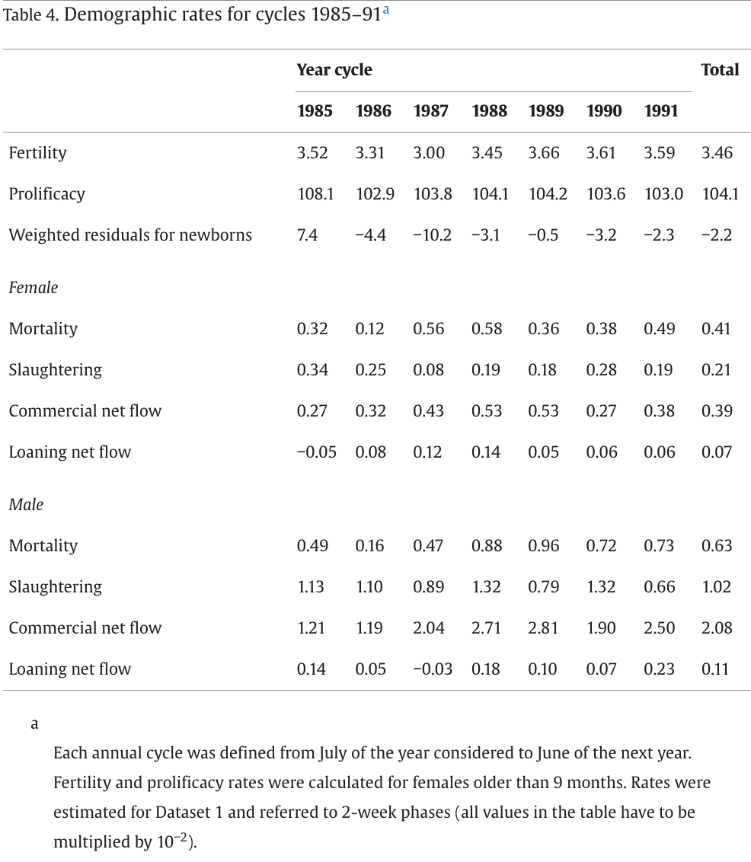
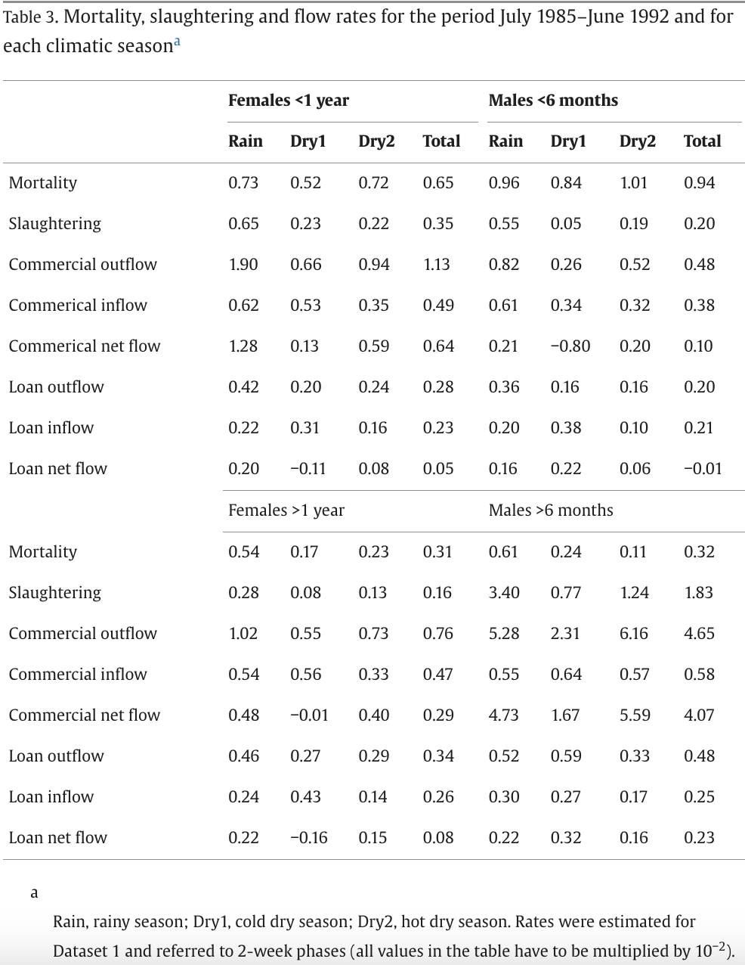
Lesnoff 1999 – Raw Data
Data from Lesnoff 1999.
Table 4:
Fortnightly rates for each year of study, and overall fortnightly average.
Parameters given by sex (not age)
Table 3:
Fortnightly rates for each season and overall over the full 7 year period
Parameters by age and sex (F<12m, F>12m, M<6m, M>6m)

Slide 3
Calculate ALL Offtake (slaughter+commercial net flow + loan net flow)
Lesnoff 1999 – Raw Data
Demographic rates for cycles 1985–91
Each annual cycle was defined from July of the year considered to June of the next year. Fertility and prolificacy rates were calculated for females older than 9 months. Rates were estimated for Dataset 1 and referred to 2-week phases (all values in the table have to be multiplied by 10−2).
 | Year-Cycle
 | 1985 | 1986 | 1987 | 1988 | 1989 | 1990 | 1991 | Total
Fertility | 3.52 | 3.31 | 3 | 3.45 | 3.66 | 3.61 | 3.59 | 3.46
Prolificacy | 108.1 | 102.9 | 103.8 | 104.1 | 104.2 | 103.6 | 103 | 104.1
Weighted residuals for newborns | 7.4 | −4.4 | −10.2 | −3.1 | −0.5 | −3.2 | −2.3 | −2.2
Fecundity | 380.512 | 340.599 | 311.4 | 359.145 | 381.372 | 373.996 | 369.77 | 360.186
Female |  |  |  |  |  |  |  | Total
Mortality | 0.32 | 0.12 | 0.56 | 0.58 | 0.36 | 0.38 | 0.49 | 0.41
Slaughtering | 0.34 | 0.25 | 0.08 | 0.19 | 0.18 | 0.28 | 0.19 | 0.21
Commercial net flow | 0.27 | 0.32 | 0.43 | 0.53 | 0.53 | 0.27 | 0.38 | 0.39
Loaning net flow | -0.05 | 0.08 | 0.12 | 0.14 | 0.05 | 0.06 | 0.06 | 0.07
ALL OFFTAKE = (Sl+CommercialNetFlow+LoanNetFlow) | 0.56 | 0.65 | 0.63 | 0.86 | 0.76 | 0.61 | 0.63 | 0.67
Male |  |  |  |  |  |  |  | Total
Mortality | 0.49 | 0.16 | 0.47 | 0.88 | 0.96 | 0.72 | 0.73 | 0.63
Slaughtering | 1.13 | 1.1 | 0.89 | 1.32 | 0.79 | 1.32 | 0.66 | 1.02
Commercial net flow | 1.21 | 1.19 | 2.04 | 2.71 | 2.81 | 1.9 | 2.5 | 2.08
Loaning net flow | 0.14 | 0.05 | -0.03 | 0.18 | 0.1 | 0.07 | 0.23 | 0.11
ALL OFFTAKE = (Sl+CommercialNetFlow+LoanNetFlow) | 2.48 | 2.34 | 2.9 | 4.21 | 3.7 | 3.29 | 3.39 | 3.21
Table 3. Mortality, slaughtering and flow rates for the period July 1985–June 1992 and for each climatic seasona
Rain, rainy season; Dry1, cold dry season; Dry2, hot dry season. Rates were estimated for Dataset 1 and referred to 2-week phases (all values in the table have to be multiplied by 10−2).
 | Rain | Dry1 | Dry2 | Total | Rain | Dry1 | Dry2 | Total
 | Females <1 year |  |  |  | Males <6 months
Mortality | 0.73 | 0.52 | 0.72 | 0.65 | 0.96 | 0.84 | 1.01 | 0.94
Slaughtering | 0.65 | 0.23 | 0.22 | 0.35 | 0.55 | 0.05 | 0.19 | 0.2
Commercial outflow | 1.9 | 0.66 | 0.94 | 1.13 | 0.82 | 0.26 | 0.52 | 0.48
Commerical inflow | 0.62 | 0.53 | 0.35 | 0.49 | 0.61 | 0.34 | 0.32 | 0.38
Commerical net flow | 1.28 | 0.13 | 0.59 | 0.64 | 0.21 | -0.8 | 0.2 | 0.1
Loan outflow | 0.42 | 0.2 | 0.24 | 0.28 | 0.36 | 0.16 | 0.16 | 0.2
Loan inflow | 0.22 | 0.31 | 0.16 | 0.23 | 0.2 | 0.38 | 0.1 | 0.21
Loan net flow | 0.2 | -0.11 | 0.08 | 0.05 | 0.16 | 0.22 | 0.06 | -0.01
ALL OFFTAKE = (Sl+CommercialNetFlow+LoanNetFlow) | 2.13 | 0.25 | 0.89 | 1.04 | 0.92 | -0.53 | 0.45 | 0.29
 | Females >1 year |  |  |  | Males >6 months
Mortality | 0.54 | 0.17 | 0.23 | 0.31 | 0.61 | 0.24 | 0.11 | 0.32
Slaughtering | 0.28 | 0.08 | 0.13 | 0.16 | 3.4 | 0.77 | 1.24 | 1.83
Commercial outflow | 1.02 | 0.55 | 0.73 | 0.76 | 5.28 | 2.31 | 6.16 | 4.65
Commercial inflow | 0.54 | 0.56 | 0.33 | 0.47 | 0.55 | 0.64 | 0.57 | 0.58
Commercial net flow | 0.48 | -0.01 | 0.4 | 0.29 | 4.73 | 1.67 | 5.59 | 4.07
Loan outflow | 0.46 | 0.27 | 0.29 | 0.34 | 0.52 | 0.59 | 0.33 | 0.48
Loan inflow | 0.24 | 0.43 | 0.14 | 0.26 | 0.3 | 0.27 | 0.17 | 0.25
Loan net flow | 0.22 | -0.16 | 0.15 | 0.08 | 0.22 | 0.32 | 0.16 | 0.23
ALL OFFTAKE = (Sl+CommercialNetFlow+LoanNetFlow) | 0.98 | -0.09 | 0.68 | 0.53 | 8.35 | 2.76 | 6.99 | 6.13

Slide 4
RAW DATA - Fortnightly Rates
TABLE 3: Offtake & Mortality by Age&Sex
Total Offtake = Slaughter + Commercial Net Flow + Loan Net Flow |  |  |  | TRUE RATES | True Fortnightly Rates: * 0.01
Table 3: | All Offtake (by age-sex group) | Min | Max | All Offtake (by age-sex group) | TRUE (All Offtake) | TRUE Min | TRUE Max
F<1y | 1.04 | 0.25 | 2.13 | F<1y | 0.0104 | 0.0025 | 0.0213
F>1y | 0.53 | -0.09 | 0.98 | F>1y | 0.0053 | -0.0009 | 0.0098
M<6m | 0.29 | -0.53 | 0.92 | M<6m | 0.0029 | -0.0053 | 0.0092
M>6m | 6.13 | 2.76 | 8.35 | M>6m | 0.0613 | 0.0276 | 0.0835
 | Total Mortality (by age-sex group) | Min | Max | Total Mortality (by age-sex group)
F<1y | 0.65 | 0.52 | 0.73 | F<1y | 0.0065 | 0.0052 | 0.0073
F>1y | 0.31 | 0.17 | 0.54 | F>1y | 0.0031 | 0.0017 | 0.0054
M<6m | 0.94 | 0.84 | 1.01 | M<6m | 0.0094 | 0.0084 | 0.0101
M>6m | 0.32 | 0.11 | 0.61 | M>6m | 0.0032 | 0.0011 | 0.0061
 | Min age exchange |  |  |  | Min age exchange
M | 6 | NA | NA | M | 6 | NA | NA
F | 12 | NA | NA | F | 12 | NA | NA
TABLE 4: Offtake & Mortality by Sex
Total Offtake = Slaughter + Commercial Net Flow + Loan Net Flow |  |  |  |  | True Fortnightly Rates: * 0.01
 | All Offtake | Min | Max | TRUE RATES | TRUE (All Offtake) | TRUE Min | TRUE Max
Female | 0.67 | 0.56 | 0.86 | Female | 0.0067 | 0.0056 | 0.0086
Male | 3.21 | 2.34 | 4.21 | Male | 0.0321 | 0.0234 | 0.0421
 | All Mortality
Female | 0.41 | 0.12 | 0.58 | Female | 0.0041 | 0.0012 | 0.0058
Male | 0.63 | 0.16 | 0.96 | Male | 0.0063 | 0.0016 | 0.0096
 | Min age exchange
M | 6 | NA | NA | M
F | 12 | NA | NA | F
TABLE 4: Fecundity for F>9m
Fecundity = Prolificacy * Fertility |  |  |  |  | True Fortnightly Rates: *( 0.01)^2 = 1*10^-4
 | Fecundity | Min | Max | TRUE RATES | TRUE (All Offtake) | TRUE Min | TRUE Max
F>9m | 360.196 | 311.4 | 381.372 | F>9m | 0.0360196 | 0.03114 | 0.0381372
TRANSFORMED DATA - Annual Rates
Transformation Formulas: Fortnightly to Annual
Mortality | mort_Y = 1-(1-mort_F)^26
Offtake | off_Y = 1-(1-mort_F)^26
ANNUAL RATES
F<1y | 0.23800547 | 0.0630088 | 0.42866702
F>1y | 0.1290463 | -0.0236652 | 0.22590195
M<6m | 0.07272912 | -0.1473284 | 0.21361369
M>6m | 0.80693779 | 0.51697601 | 0.89637985
Total Mortality (by age-sex group)
F<1y | 0.15595683 | 0.1267669 | 0.17345107
F>1y | 0.07755284 | 0.0432734 | 0.13131999
M<6m | 0.21773047 | 0.19693727 | 0.23197664
M>6m | 0.07995565 | 0.02821019 | 0.14707674
 | Min age exchange
M | 6 | NA | NA
F | 12 | NA | NA
TRUE RATES | TRUE (All Offtake) | TRUE Min | TRUE Max
Female | 0.16036348 | 0.13585025 | 0.20113797
Male | 0.57185317 | 0.45970031 | 0.67316805
Female | 0.1013118 | 0.03073646 | 0.1403578
Male | 0.15152796 | 0.04077855 | 0.22182652
 | Min age exchange
M | 6 | NA | NA
F | 12 | NA | NA
Birthrate | birth_Y = birth_F*26
 | True Fortnightly Rates: * 0.01
TRUE RATES | TRUE (All Offtake) | TRUE Min | TRUE Max
F>9m | 0.9365096 | 0.80964 | 0.9915672

Slide 5
Lesnoff 1999 – Ranges for LHS
YEARLY MIN-MAX
parameter | lesnoff.yr.min | lesnoff.yr.max
NET_offtake_y | -0.1473284 | 0.42866702 | range based on min-max F<12m and M<6m
NET_offtake_m | 0.51697601 | 0.89637985 | range based on M>6m
NET_offtake_m2 | 0.51697601 | 0.89637985 | range based on M>6m
NET_offtake_f | -0.0236652 | 0.42866702 | range based on min - max of F<12m, F>12m
mortality_y | 0.1267669 | 0.23197664 | range based on min-max of F<12m & M<6m
mortality_a | 0.02821019 | 0.14707674 | range based on min-max of F>12m & M>6m
mortality_end | 1 | 1
birth_rate | 0.80964 | 0.9915672
ppr_mortality_y | 0 | 0
ppr_mortality_a | 0 | 0
adu_f_max_yrs | 3 | 3
adu_m_max_yrs | 3 | 3
min_age_offtake | 6 | 6
min_age_repro | 9 | 9
FRTNTLY MIN-MAX
parameter | lesnoff.ft.min | lesnoff.ft.max
NET_offtake_y | -0.0053 | 0.0213 | range based on min-max F<12m and M<6m
NET_offtake_m | -0.0053 | 0.0092 | range based on M>6m
NET_offtake_m2 | -0.0053 | 0.0092 | range based on M>6m
NET_offtake_f | -0.0009 | 0.0213 | range based on F>12m
mortality_y | 0.0052 | 0.0101 | range based on min-max of F>12m & M>6m
mortality_a | 0.0011 | 0.0061 | range based on min-max of F<12m & M<6m
mortality_end | 1 | 1
birth_rate | 0.03114 | 0.0381372
ppr_mortality_y | 0 | 0
ppr_mortality_a | 0 | 0
adu_f_max_yrs | 3 | 3
adu_m_max_yrs | 3 | 3
min_age_offtake | 6 | 6
min_age_repro | 9 | 9

Slide 6
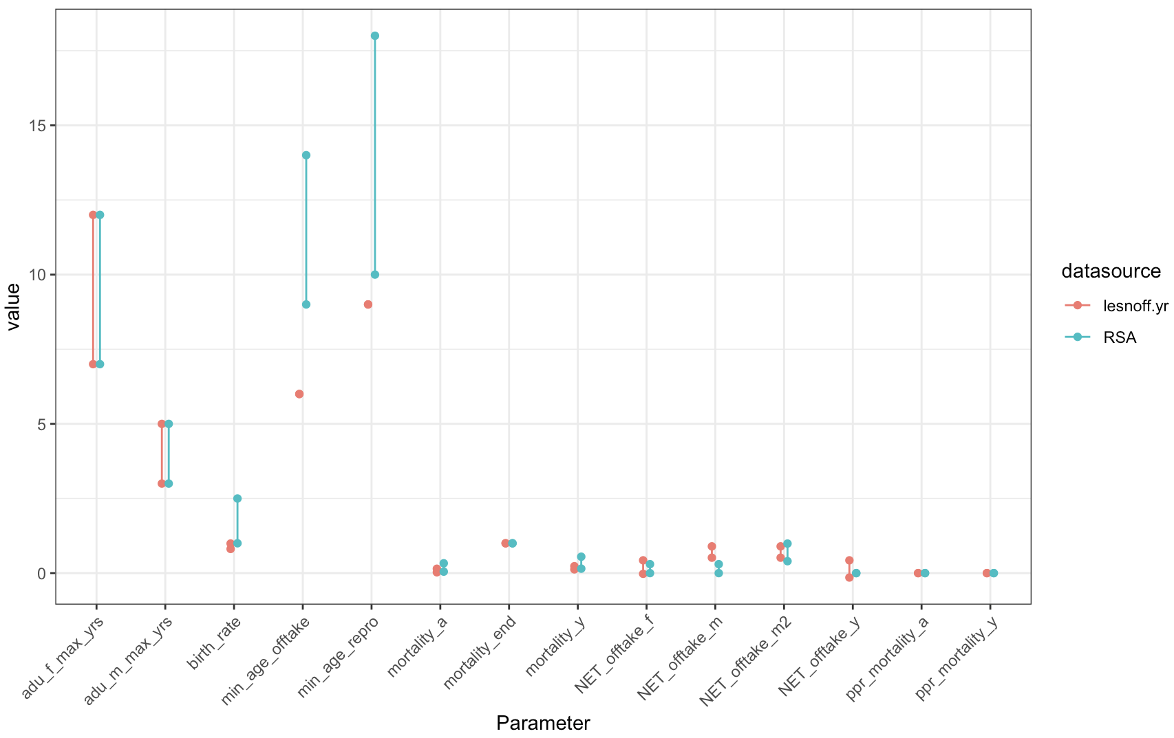
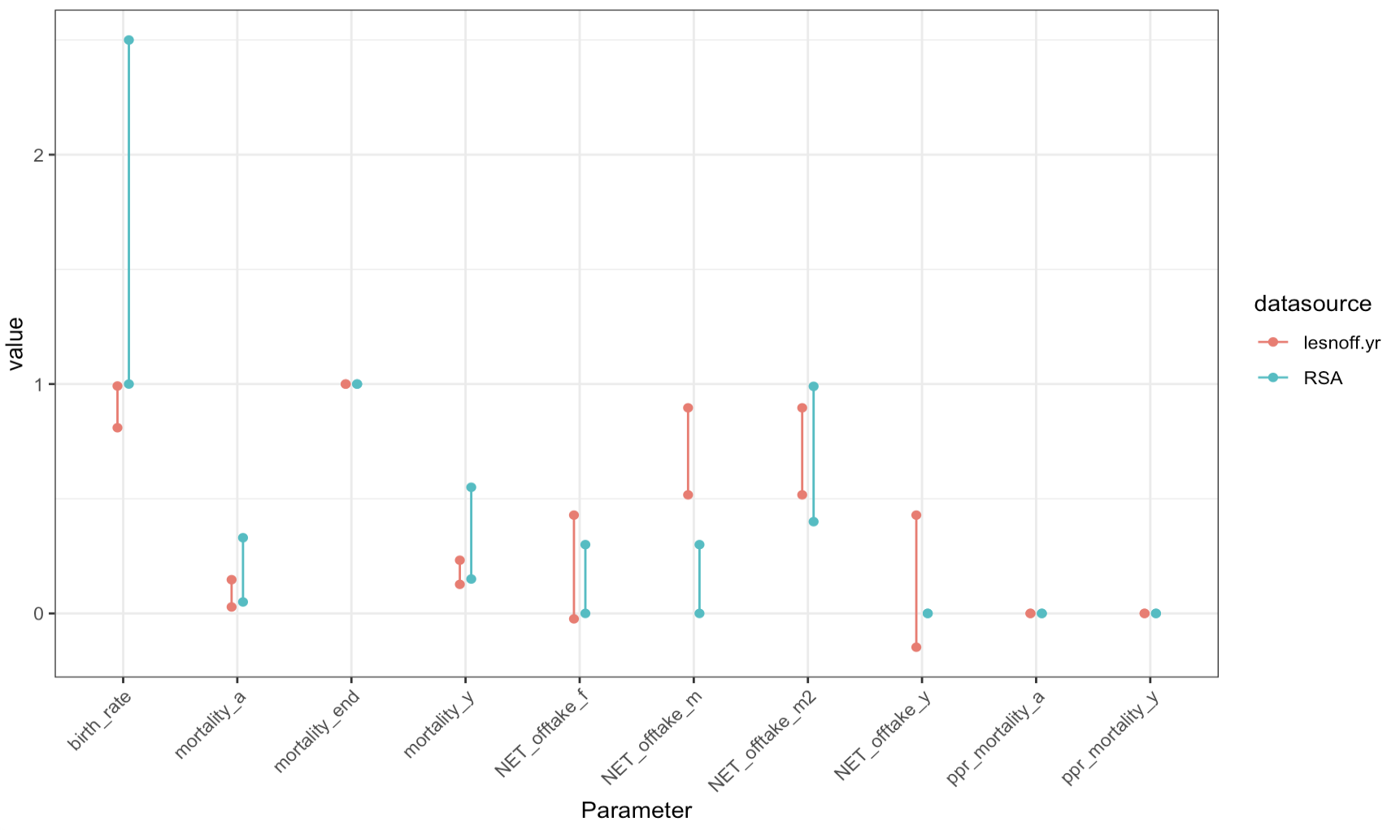
Lesnoff 1999 – Compare ranges to RSA

Slide 7
Model
20 years
1000 parameter combinations (time efficiency)
Sample of 10 used to explore complete population dynamics
Full 1000 sets used for population growth and age-sex summary statistics
Parameter outputs (age-sex & population growth) verified against:
(i) Original model conditions
(ii) Lesnoff reported annual growth rates

Slide 8
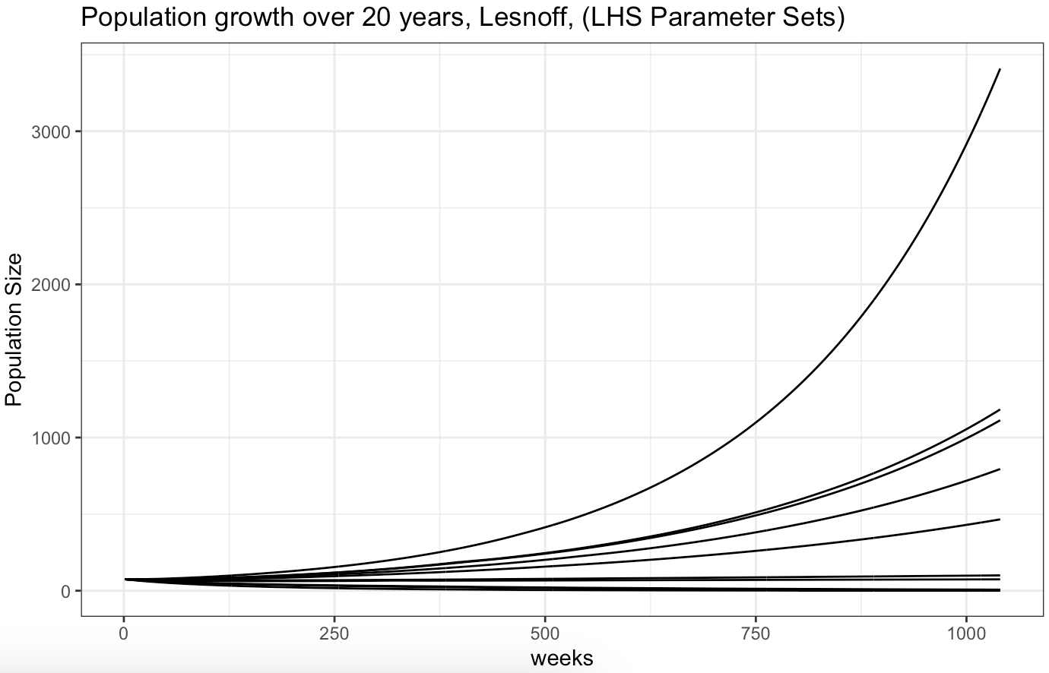
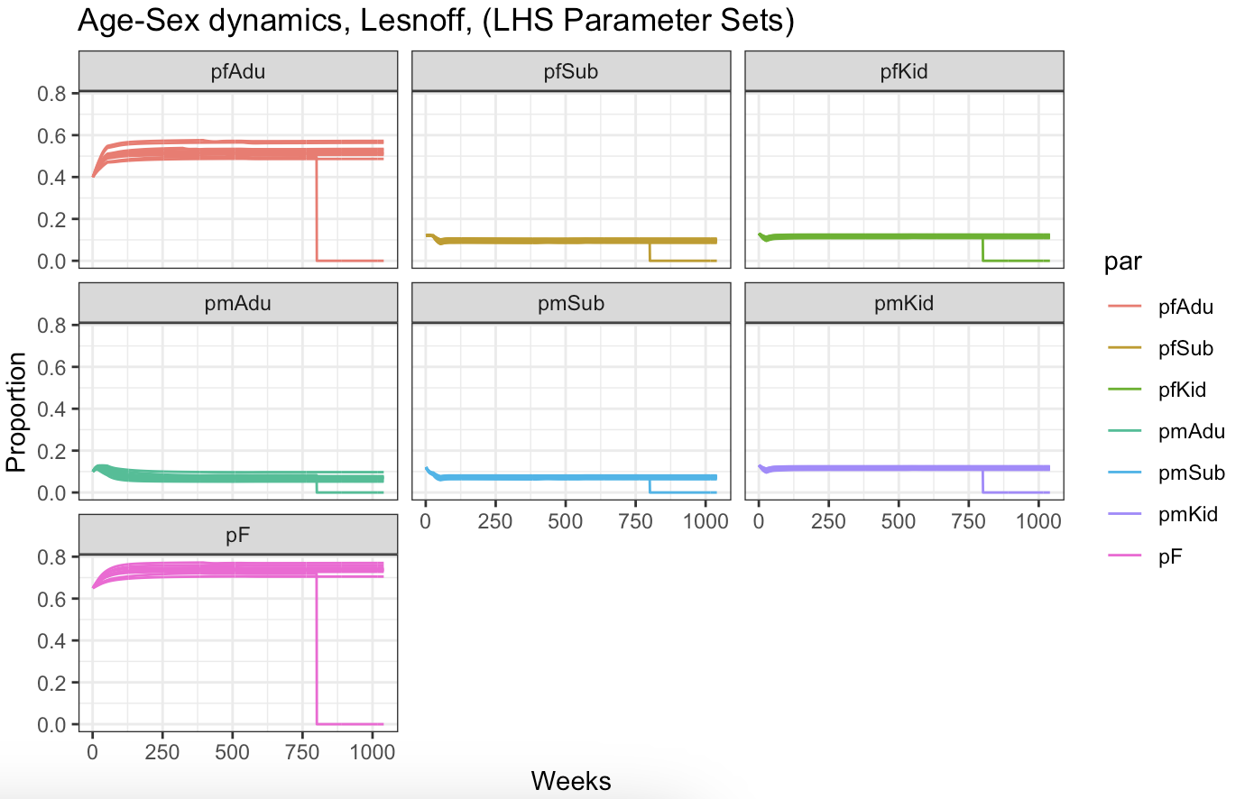
Population Growth & Age-Sex Dynamics
10 parameter sets sampled from 1000 sets (LHS)
Monotonic function (always increasing)
Age-Sex structure equilibrates

Slide 9
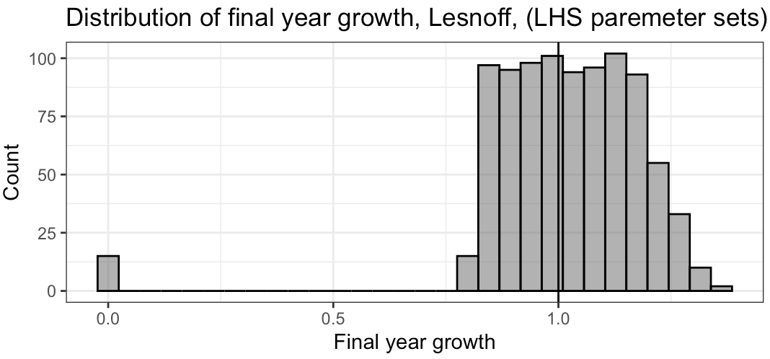
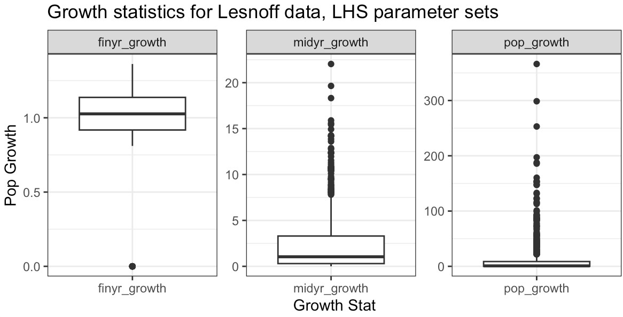
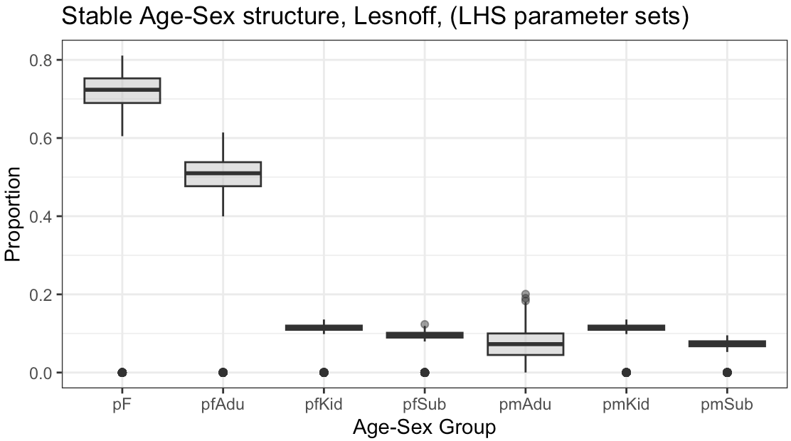
Population Growth & Age-Sex Dynamics
Summary: Population Growth (1000 LHS parameter sets).
Simulation period = 20y
Midyr = 10years.

Slide 10
“Valid” Parameter Sets (1)
Conditions for output population | Range
Population growth | +/- 15%
% female | 0.5-0.8
kid_m_prop | 5-16%
kid_f_prop | 5-19%
sub_m_prop | 4-15%
sub_f_prop | 6-19%
adu_m_prop | 1-15%
adu_f_prop | 21-62%
Do any Lesnoff parameter sets meet the growth and age-sex structure criteria used for RSA & GSA analysis?
Growth criteria: +/-15% for 10 year growth period
Age-Sex Structure>>>
Results, tally:
midyr_15age | midyr_05age | n
0 | 0 | 940
1 | 0 | 35
1 | 1 | 25

Slide 11
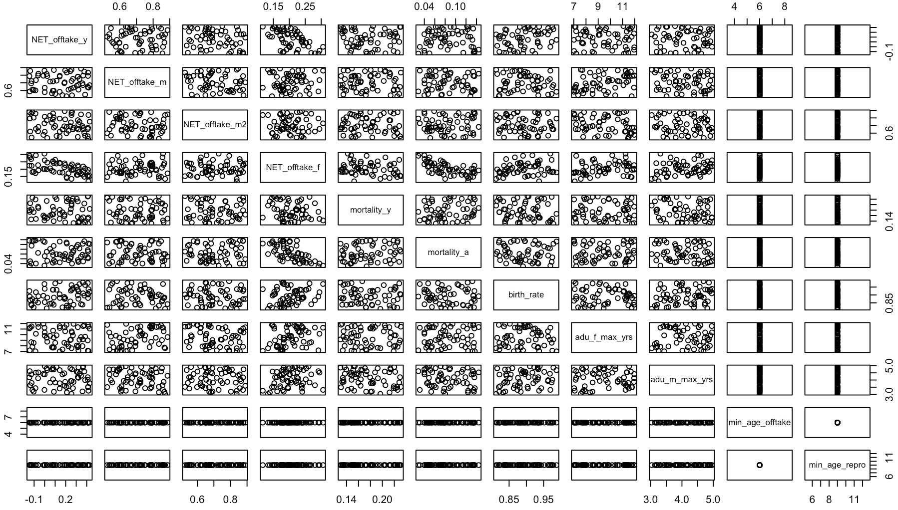
Valid Parameter Sets (1)

Slide 12
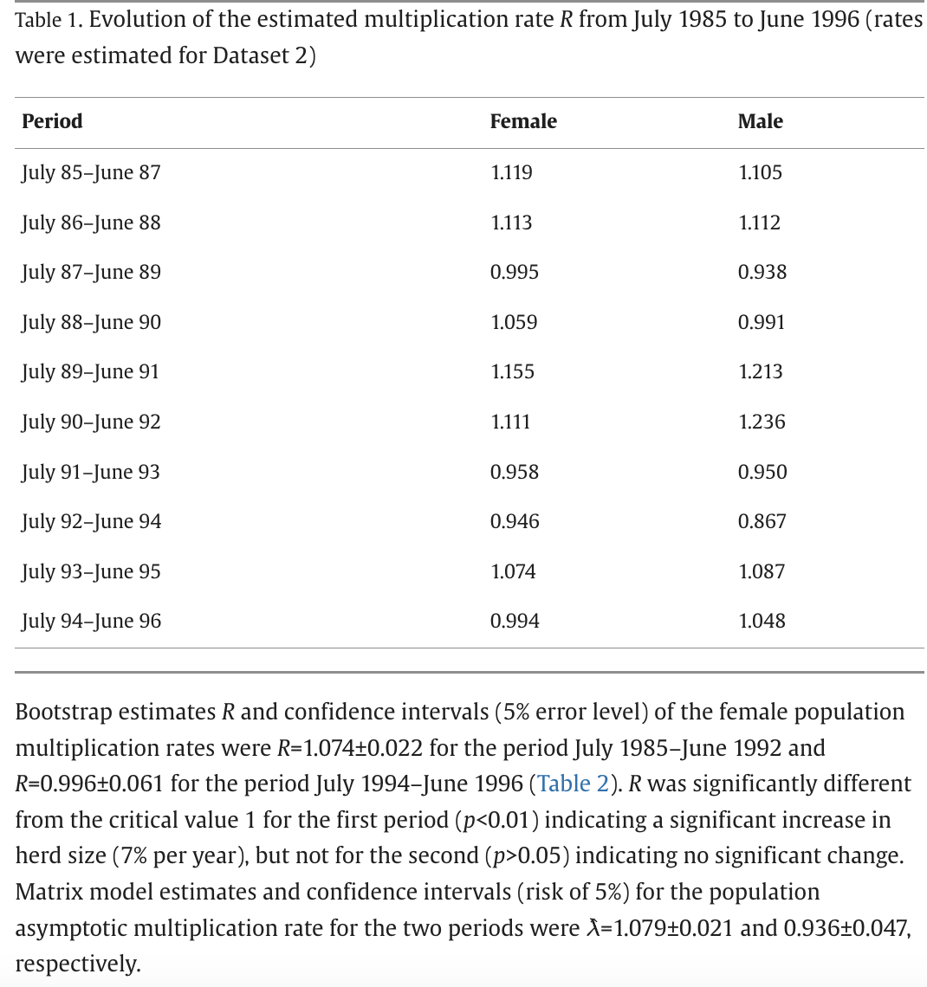
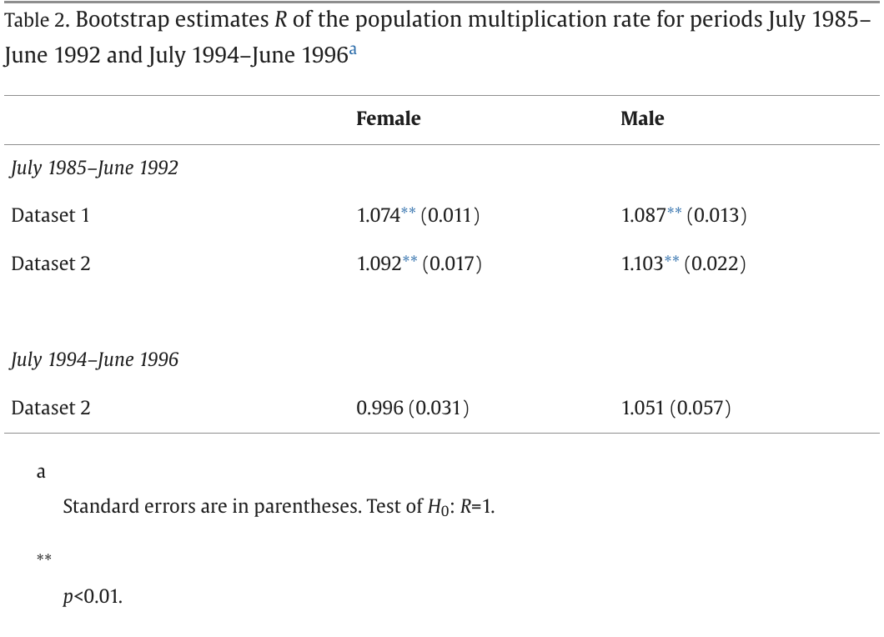
“Valid” Parameter Sets (2)

Slide 13
“Valid” Parameter Sets (2)
Estimated multiplication rate for 2 year intervals
Compute total growth as F_growth * pF, and M_growth * pM
Assume pF = 0.7 from stable age-sex structure
Table 1. Evolution of the estimated multiplication rate R from July 1985 to June 1996 (rates were estimated for Dataset 2)
Period | Female | Male | TOTAL GROWTH (p*F_growth + p*M_growth)
July 85–June 87 | 1.119 | 1.105 | 1.1148
July 86–June 88 | 1.113 | 1.112 | 1.1127
July 87–June 89 | 0.995 | 0.938 | 0.9779
July 88–June 90 | 1.059 | 0.991 | 1.0386
July 89–June 91 | 1.155 | 1.213 | 1.1724
July 90–June 92 | 1.111 | 1.236 | 1.1485
July 91–June 93 | 0.958 | 0.95 | 0.9556
July 92–June 94 | 0.946 | 0.867 | 0.9223
July 93–June 95 | 1.074 | 1.087 | 1.0779
July 94–June 96 | 0.994 | 1.048 | 1.0102
Min | 0.946 | 0.867 | 0.9223
Max | 1.155 | 1.236 | 1.1724
Mean | 1.0524 | 1.0547 | 1.05309
Female, R = 1.074 (+/- 0.022) for 7y period
Asymptotic multiplication rate: 1.079 (+/-0.021) for 7y period

Slide 14
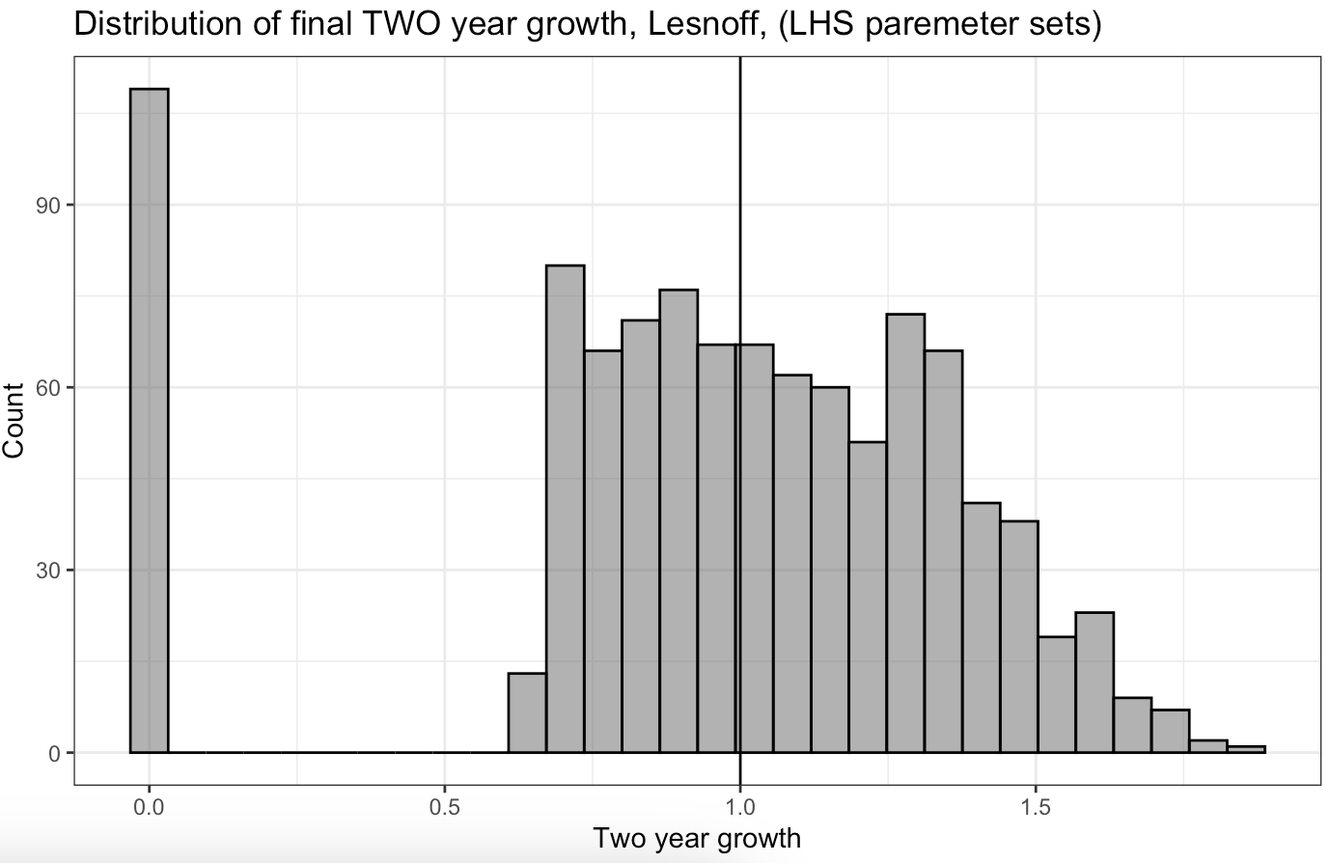
Valid Parameter Sets (2)
Model Est. 2y Growth
Min. | 0.6568
1st | 0.8603
Median | 1.0626
Mean | 1.085
3rd | 1.2952
Max. | 1.8557
Table 1. Evolution of the estimated multiplication rate R from July 1985 to June 1996 (rates were estimated for Dataset 2)
Period | Female | Male | TOTAL GROWTH (p*F_growth + p*M_growth)
July 85–June 87 | 1.119 | 1.105 | 1.1148
July 86–June 88 | 1.113 | 1.112 | 1.1127
July 87–June 89 | 0.995 | 0.938 | 0.9779
July 88–June 90 | 1.059 | 0.991 | 1.0386
July 89–June 91 | 1.155 | 1.213 | 1.1724
July 90–June 92 | 1.111 | 1.236 | 1.1485
July 91–June 93 | 0.958 | 0.95 | 0.9556
July 92–June 94 | 0.946 | 0.867 | 0.9223
July 93–June 95 | 1.074 | 1.087 | 1.0779
July 94–June 96 | 0.994 | 1.048 | 1.0102
Min | 0.946 | 0.867 | 0.9223
Max | 1.155 | 1.236 | 1.1724
Mean | 1.0524 | 1.0547 | 1.05309
Overview:
Lesnoff paper reports multiplication rate over 2y intervals ranging from:
0.92 – 1.17 (Total Growth),
0.86-1.236 (M & F growth),
mean of 1.05.
Model outputs (excluding fadeout) indicate 2y growth ranging from
0.65 – 1.85 (Total population)
median of 1.06 (total population)
mean of 1.08 (total population)
Female, R = 1.074 (+/- 0.022) for 7y period
Asymptotic multiplication rate: 1.079 (+/-0.021) for 7y period

Slide 15
Check Parameter Rates

Slide 16
Lesnoff 1999 – Raw Data
Data from Lesnoff 1999.
Table 4:
Fortnightly rates for each year of study, and overall fortnightly average.
Parameters given by sex (not age)
Table 3:
Fortnightly rates for each season and overall over the full 7 year period
Parameters by age and sex (F<12m, F>12m, M<6m, M>6m)

Slide 17
Calculate ALL Offtake (slaughter+commercial net flow + loan net flow)
Lesnoff 1999 – Raw Data
Table 3. Mortality, slaughtering and flow rates for the period July 1985–June 1992 and for each climatic seasona
Rain, rainy season; Dry1, cold dry season; Dry2, hot dry season. Rates were estimated for Dataset 1 and referred to 2-week phases (all values in the table have to be multiplied by 10−2).
 | Rain | Dry1 | Dry2 | Total | Rain | Dry1 | Dry2 | Total
 | Females <1 year |  |  |  | Males <6 months
Mortality | 0.73 | 0.52 | 0.72 | 0.65 | 0.96 | 0.84 | 1.01 | 0.94
Slaughtering | 0.65 | 0.23 | 0.22 | 0.35 | 0.55 | 0.05 | 0.19 | 0.2
Commercial outflow | 1.9 | 0.66 | 0.94 | 1.13 | 0.82 | 0.26 | 0.52 | 0.48
Commerical inflow | 0.62 | 0.53 | 0.35 | 0.49 | 0.61 | 0.34 | 0.32 | 0.38
Commerical net flow | 1.28 | 0.13 | 0.59 | 0.64 | 0.21 | -0.8 | 0.2 | 0.1
Loan outflow | 0.42 | 0.2 | 0.24 | 0.28 | 0.36 | 0.16 | 0.16 | 0.2
Loan inflow | 0.22 | 0.31 | 0.16 | 0.23 | 0.2 | 0.38 | 0.1 | 0.21
Loan net flow | 0.2 | -0.11 | 0.08 | 0.05 | 0.16 | 0.22 | 0.06 | -0.01
ALL OFFTAKE = (Sl+CommercialNetFlow+LoanNetFlow) | 2.13 | 0.25 | 0.89 | 1.04 | 0.92 | -0.53 | 0.45 | 0.29
 | Females >1 year |  |  |  | Males >6 months
Mortality | 0.54 | 0.17 | 0.23 | 0.31 | 0.61 | 0.24 | 0.11 | 0.32
Slaughtering | 0.28 | 0.08 | 0.13 | 0.16 | 3.4 | 0.77 | 1.24 | 1.83
Commercial outflow | 1.02 | 0.55 | 0.73 | 0.76 | 5.28 | 2.31 | 6.16 | 4.65
Commercial inflow | 0.54 | 0.56 | 0.33 | 0.47 | 0.55 | 0.64 | 0.57 | 0.58
Commercial net flow | 0.48 | -0.01 | 0.4 | 0.29 | 4.73 | 1.67 | 5.59 | 4.07
Loan outflow | 0.46 | 0.27 | 0.29 | 0.34 | 0.52 | 0.59 | 0.33 | 0.48
Loan inflow | 0.24 | 0.43 | 0.14 | 0.26 | 0.3 | 0.27 | 0.17 | 0.25
Loan net flow | 0.22 | -0.16 | 0.15 | 0.08 | 0.22 | 0.32 | 0.16 | 0.23
ALL OFFTAKE = (Sl+CommercialNetFlow+LoanNetFlow) | 0.98 | -0.09 | 0.68 | 0.53 | 8.35 | 2.76 | 6.99 | 6.13
Parameter | Target
F_off <12m | 1.04 (0.0095-0.0115) | What values of off_y and off_F produce a F<12m offtake of 1.04
F_off >12m | 0.53 (0.0045-0.006) | What values of off_y and off_F produce a F>12m offtake of 0.53
M_off <6m | 0.29 | If min_offtake is set to 6m then this aligns with age-categories, no target needed
M_off >6m | 6.13 | If min_offtake is set to 6m then this aligns with age-categories, no target needed
F_mort <12m | 0.65 (0.006-0.007) | What values of mort_y and mort_A produce a F<12m mortality of 0.65
F_mort >12m | 0.31 (0.0025-0.0035) | What values of mort_y and mort_A produce a F>12m mortality of 0.31
M_mort <6m | 0.94 | What values of mort_y and mort_A produce a F>12m mortality of 0.31
M_mort >6m | 0.32 | What values of mort_y and mort_A produce a F>12m mortality of 0.31

Slide 18
Offtake
parameter | lesnoff.ft | targ.min | targ.max | +/- 10%
F_off <12m | 0.0104 | 0.00936 | 0.01144 | What values of off_y and off_F produce a F<12m offtake of 1.04
F_off >12m | 0.0053 | 0.00477 | 0.00583 | What values of off_y and off_F produce a F>12m offtake of 0.53
M_off <6m | 0.0029 | 0.00261 | 0.00319 | If min_offtake is set to 6m then this aligns with age-categories, no target needed
M_off >6m | 0.0613 | 0.05517 | 0.06743 | If min_offtake is set to 6m then this aligns with age-categories, no target needed
F_mort <12m | 0.0065 | 0.00585 | 0.00715 | What values of mort_y and mort_A produce a F<12m mortality of 0.65
F_mort >12m | 0.0031 | 0.00279 | 0.00341 | What values of mort_y and mort_A produce a F>12m mortality of 0.31
M_mort <6m | 0.0094 | 0.00846 | 0.01034 | What values of mort_y and mort_A produce a F>12m mortality of 0.31
M_mort >6m | 0.0032 | 0.00288 | 0.00352 | What values of mort_y and mort_A produce a F>12m mortality of 0.31
Parameter | Definition | Input
Off_y | All Off <6m | -0.0053 – 0.0213 | Range: min-max (F<12m, M<6m)
Off_F | F Off > min. age (6m) | -0.0009 – 0.0213 | Range: min-max (F<12m, F>12m)
Off_M | M Off > 24m | -0.0278-0.0835 | Range: min-max (M>6m)
Off_M2 | M Off >min.age (6m-24m) | -0.0278-0.0835 | Range: min-max (M>6m)

