Slide 1
Seasonal Births

Slide 2
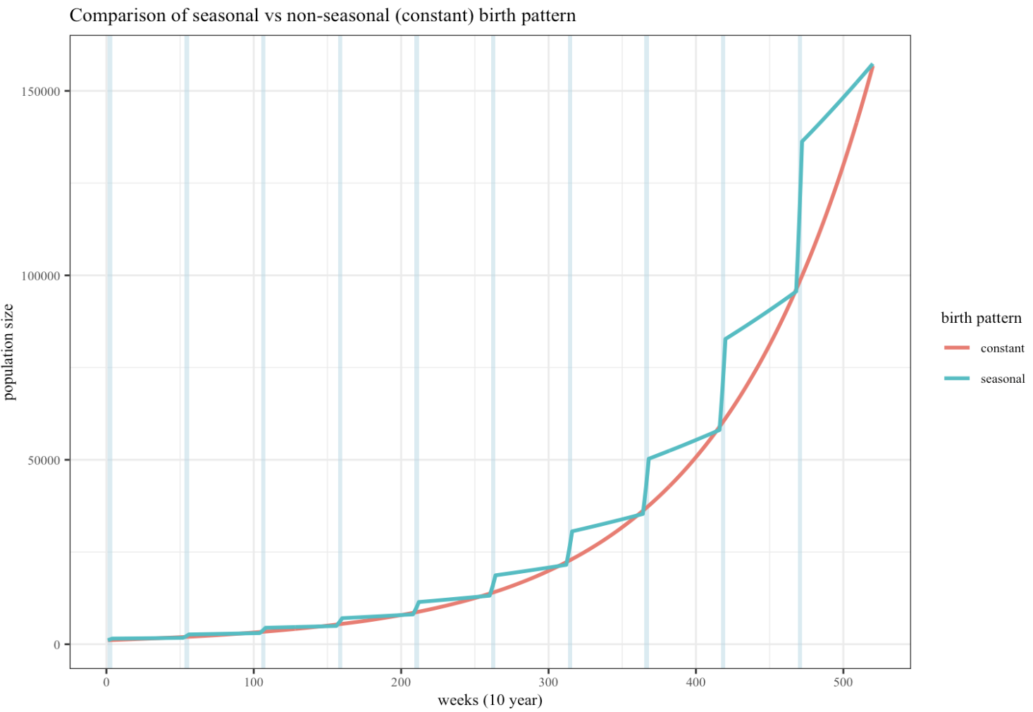
A crude test of the model :seasonal vs non seasonal
A = seasonal
70% all births occur in first 4 weeks of the year
30% in the remaining 48 weeks
B = non-seasonal
Input:
Starting pop of 1000
ONLY births (no offtake)
10 year simulation period

Slide 3
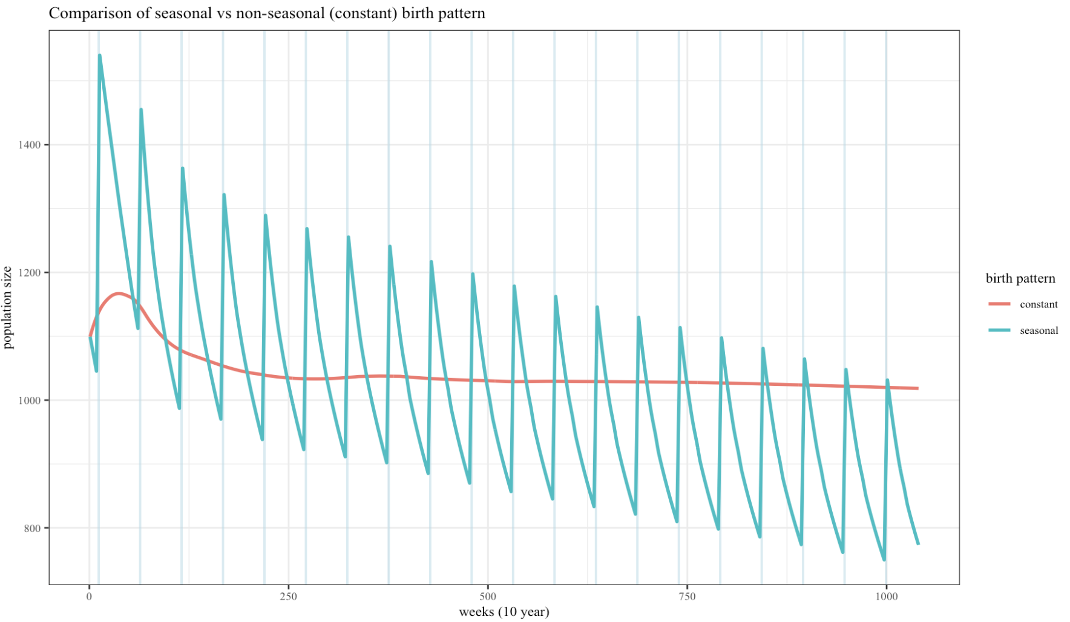
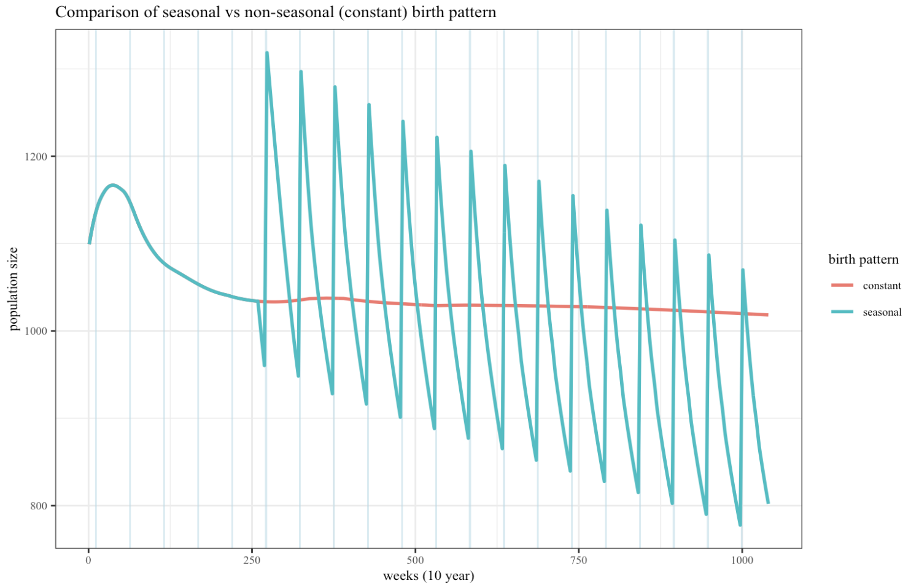
Otte & Chilonda – arid, pastoral, goat
Birth peaks at month 3 each year, lasting 4 weeks .
Weeks 10-13
OC Data – less good
Because proportions of animals fluctuate the actual numbers being removed from the population are larger?
Maybe also due to the model not being at stable state when initiated (NO >>>)

Slide 4
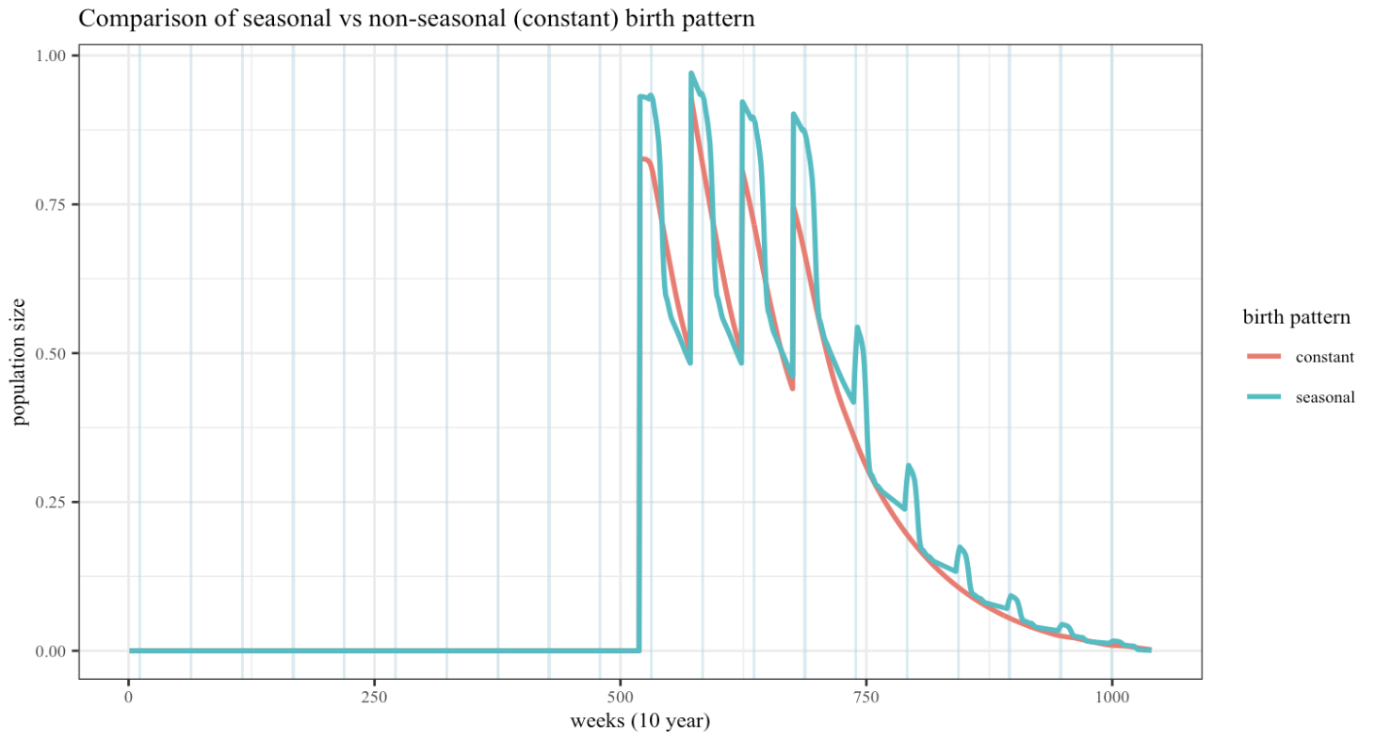
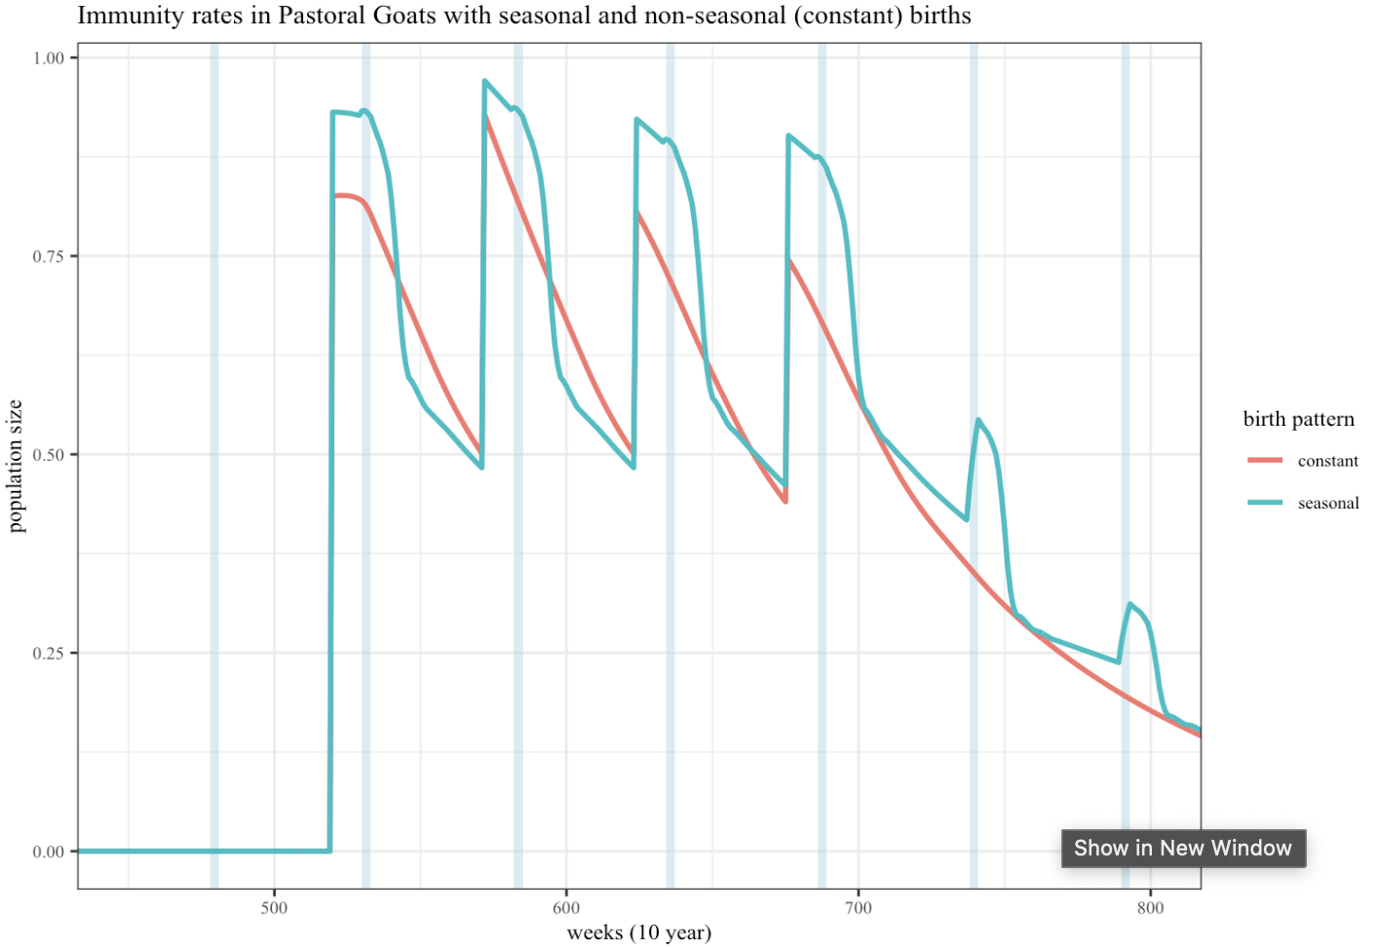
Otte & Chilonda – Immunity Dynamics
Vaccination begins at year 10
4 annual campaigns: y1-2: animals>4m, y3-4: animals 4-12m
Vaccination occurs in 1st month of year (weeks 520, 572, 624, 676) & within 1 timestep (week)
Birth peak occurs at 3 months (week 10) ~ 9 weeks post vaccination (weeks 530,582,634,686)

