Slide 1
Seasonal Births

Slide 2
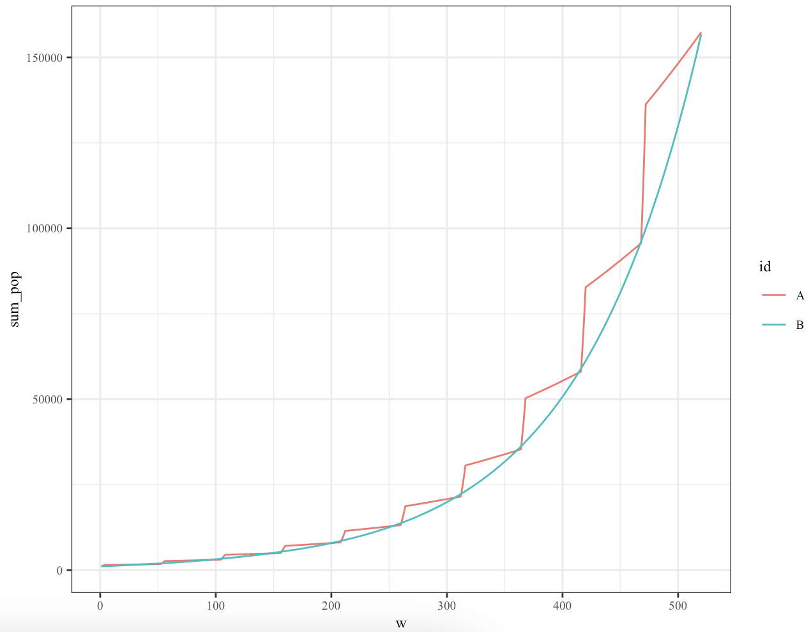
A crude test of the model :seasonal vs non seasonal
A = seasonal
70% all births occur in first 4 weeks of the year
30% in the remaining 48 weeks
B = non-seasonal
Input:
Starting pop of 1000
ONLY births (no offtake)
10 year simulation period

