Slide 1
Flock Dynamics Model
02/03/2023

Slide 2
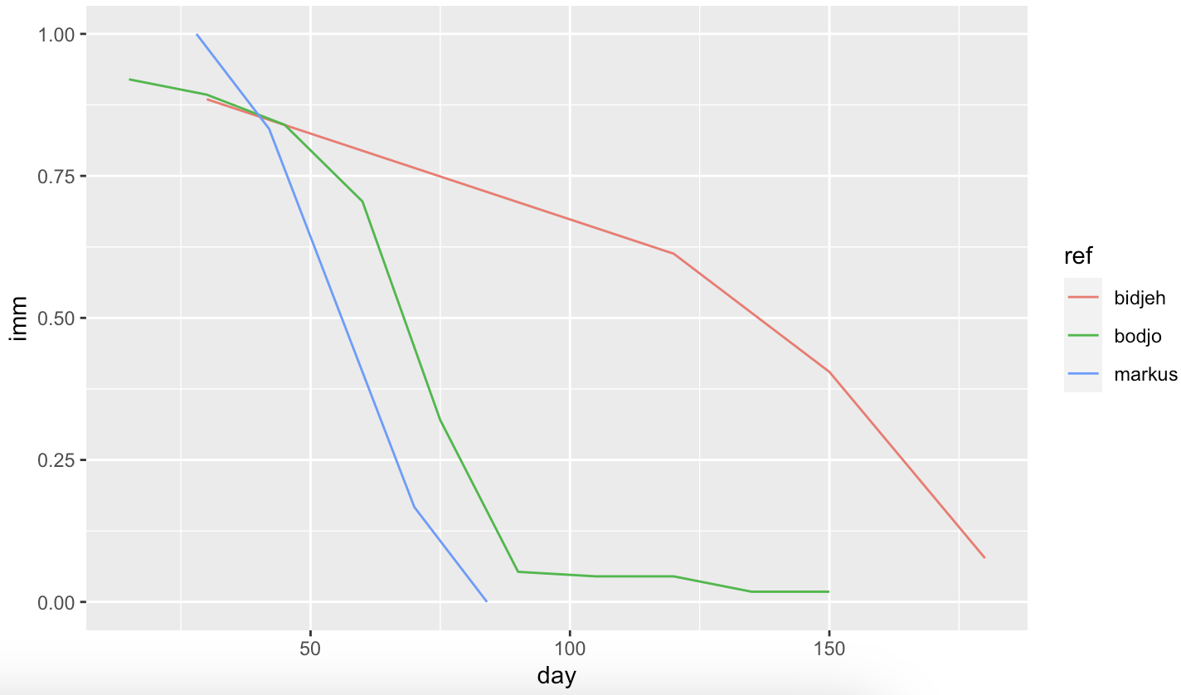
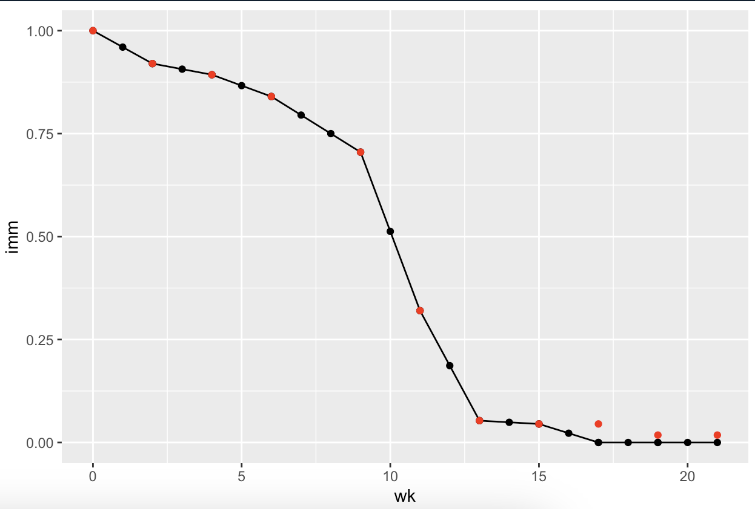
Immune decay
Data from papers:
Bodjo data + modelled decay
Set maternal immunity to last until 4th month (week 17 = 0 immunity)
Supported by Bodjo, Markus, Awa
Notes:
Bodjo et al.
Tested duration of maternal immunity in 112 lambs up to 150 days after birth, born to ewes vaccinated with the homologous PPR vaccine “Nigeria 75/1" at day 90 and day 120 of pregnancy.
Results (seropositivity):
Day 15 = 92%, Day 30 = 89.3%, day 45 = 84%, day 60 = 70.5%, day 75 = 32%, day 90 = 5.3% , day 105 = 4.5%, day 120 – 4.5%, day 135 = 1.8%, Day 150 = 1.8%
Decision:
Follow trend of Bodjo (supported by markus) with datapoints every 2 weeks (14days) - can fill in the midpoints for weekly decay
Set maternal immunity to last until 4th month, day 119, week 17 (week 17 = 0 immunity)
Supported by Bodjo, Markus, Awa
Bodjo data provides proportion of all lambs that are immune at each timepoint, we need the decay rate (or proportion of lambs at previous timestep)

Slide 3


BAOBAB Test Data
parameter rate rate_wk
<fct> <dbl> <dbl>
1 hdea 0.0234 0.00537
2 hint 0.0527 0.0121
3 hoff 0.0527 0.0121
4 hpar 0.0680 0.0157
5 netpro 1.48 0.341
6 reprod 0.0997 0.0230
Intake = Offtake, NET offtake = 0
No age-sex differences for intake/offtake
Only animals >=12m could be exchanged
Only females >=18m could give birth
1:1 sex ratio at birth
Starting population: 1700 (arbitrary)
Female (80%):
15% 6-12m,
15% 12-18m,
50% 18m+
- Similar to reported proportions in field
Male (20%):
10% 6-12m,
5% 12-18m,
5% 18m+
Notes:
Rate = median monthly rate
Week is computed weekly rate
Hdea = mortality
Hint = intake
Hoff = offtake
Hpar = parturition risk
Netpro = prolificacy (minus stillbirths)
Reprod = parturition * prolificac

Slide 4
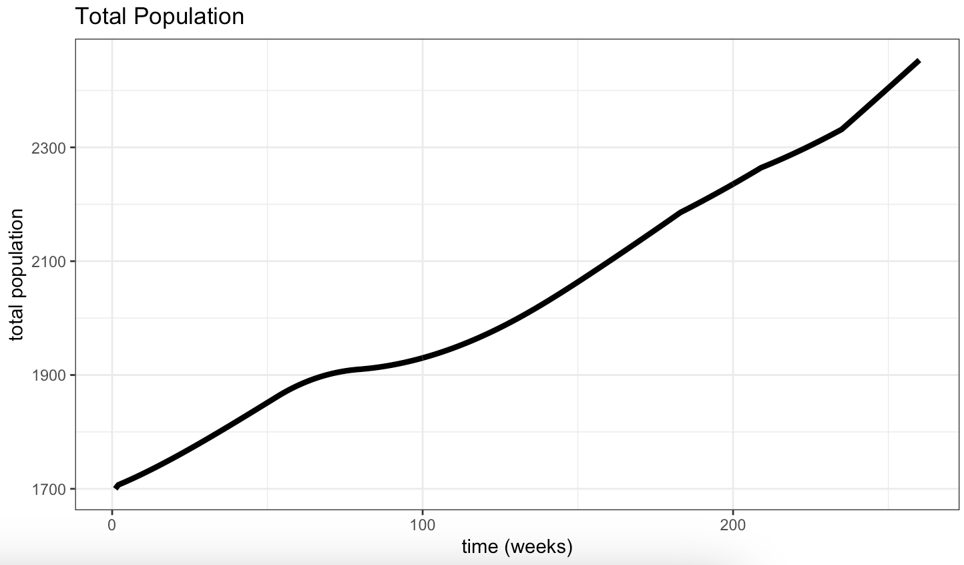
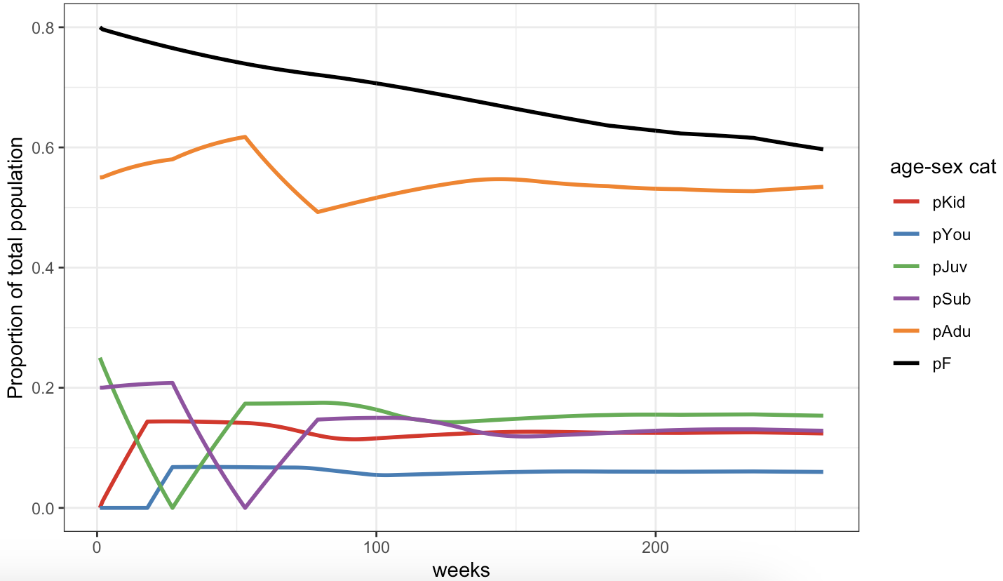
Exponential growth of population
Age-sex structure of population not maintained (no age-sex differences for trade, deaths)
i.e. expect higher male offtake (should help maintain proportion F)
Notes:
BAOBAB data
Pop size: 1700
Max age F: 7y, M: 5y
Age cats: 4m/6m/12m/18m/18m+
No transmission

Slide 5
Developments:
Transmission - BS working on this but not quite right
Stabilising population size + structure
Seasonality: how to incorporate this
Options: 2 seasons, 1 peak season and 1 'off' season, could compare this and model with no seasonality
Seasons differ between regions so may be too hard to generalise?
Timestep of model
Weekly demographic rates are hard to come by
Would monthly demographic timestep be too big
Data may be more accurately reflected
Data for model:
BS needs to focus time on this, still not confirmed flock profiles (was hoping RP2 would help but not enough time)

Slide 6
Sensitivity analysis
file:///Users/bethsavagar/Library/CloudStorage/OneDrive-RoyalVeterinaryCollege/Population_Dynamics_Model/writing/methods/notes/Parameters.docx

Slide 7
Testing Model Functionality

Slide 8
Immunity Decay Test
See Imm-test.R (08/03/23)
# Run model with conditions to replicate Bodjo et al paper where offspring immunity dynamics are drawn from.
Tested duration of maternal immunity in 112 lambs up to 150 days after birth, born to ewes vaccinated with the homologous PPR vaccine “Nigeria 75/1" at day 90 and day 120 of pregnancy.
# Parameters:
# - set 112 lambs to immune compartment
# - set rest of population to 0
# - set mortality, offtake, and all demographic rates (except immune decay) to 0
# - plot proportion immune for first 6 months of simulation
# - plot should mirror the immune decay from Bodjo raw data

Slide 9
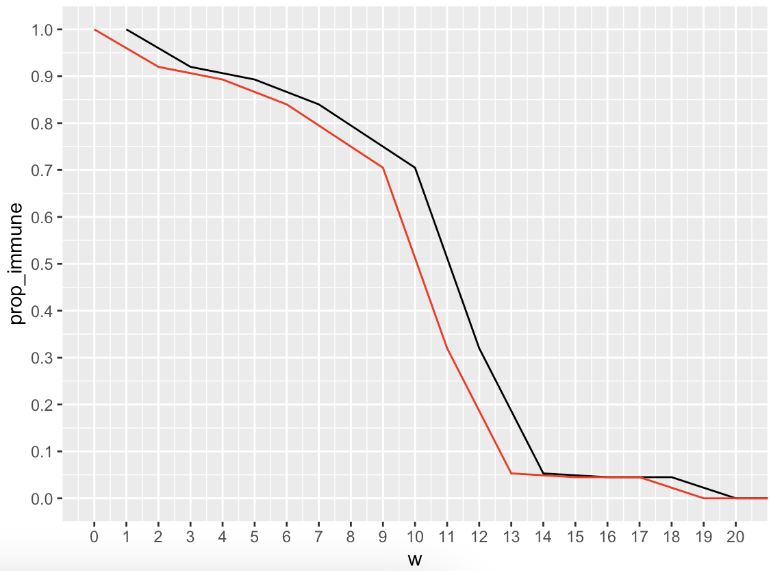
Model output

