Slide 1
Flock Dynamics Model

Slide 2
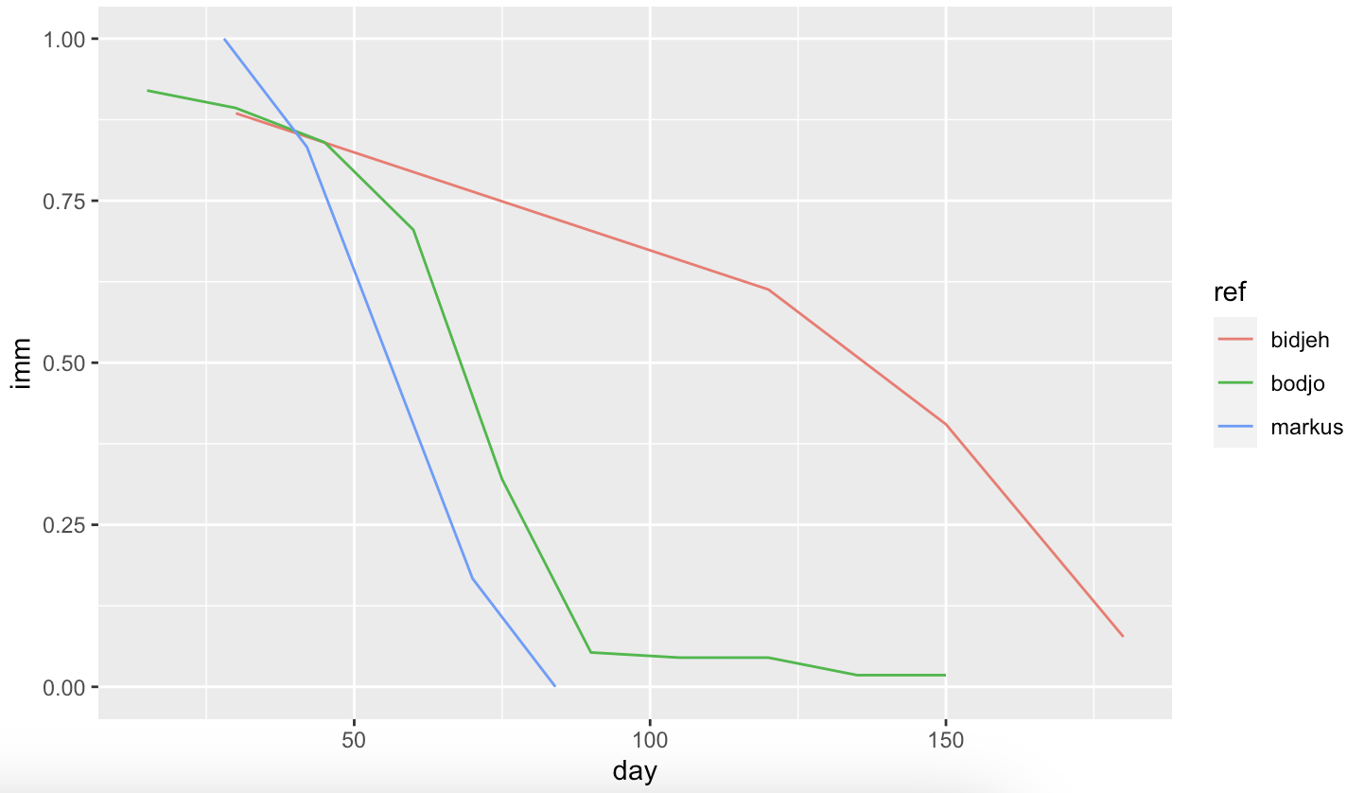
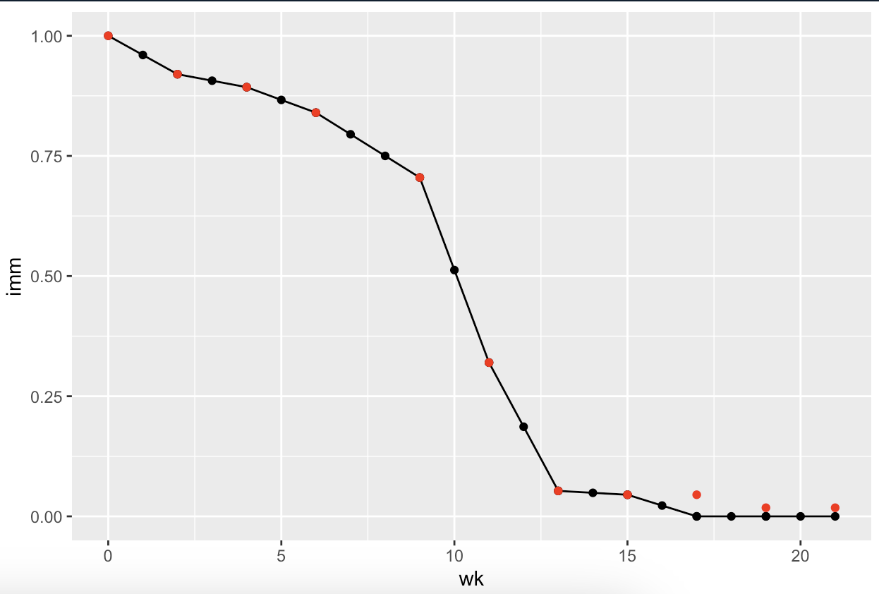
Immune decay
Set maternal immunity to last until 4th month (week 17 = 0 immunity)
Supported by Bodjo, Markus, Awa
Notes:
Bodjo et al.
Tested duration of maternal immunity in 112 lambs up to 150 days after birth, born to ewes vaccinated with the homologous PPR vaccine “Nigeria 75/1" at day 90 and day 120 of pregnancy.
Results (seropositivity):
Day 15 = 92%, Day 30 = 89.3%, day 45 = 84%, day 60 = 70.5%, day 75 = 32%, day 90 = 5.3% , day 105 = 4.5%, day 120 – 4.5%, day 135 = 1.8%, Day 150 = 1.8%
Decision:
Follow trend of Bodjo (supported by markus) with datapoints every 2 weeks (14days) - can fill in the midpoints for weekly decay
Set maternal immunity to last until 4th month, day 119, week 17 (week 17 = 0 immunity)
Supported by Bodjo, Markus, Awa

Slide 3
BAOBAB Test
parameter rate rate_wk
<fct> <dbl> <dbl>
1 hdea 0.0234 0.00537
2 hint 0.0527 0.0121
3 hoff 0.0527 0.0121
4 hpar 0.0680 0.0157
5 netpro 1.48 0.341
6 reprod 0.0997 0.0230
Notes:
Rate = median monthly rate
Week is computed weekly rate
Hdea = mortality
Hint = intake
Hoff = offtake
Hpar = parturition risk
Netpro = prolificacy (minus stillbirths)
Reprod = parturition * prolificac

Slide 4
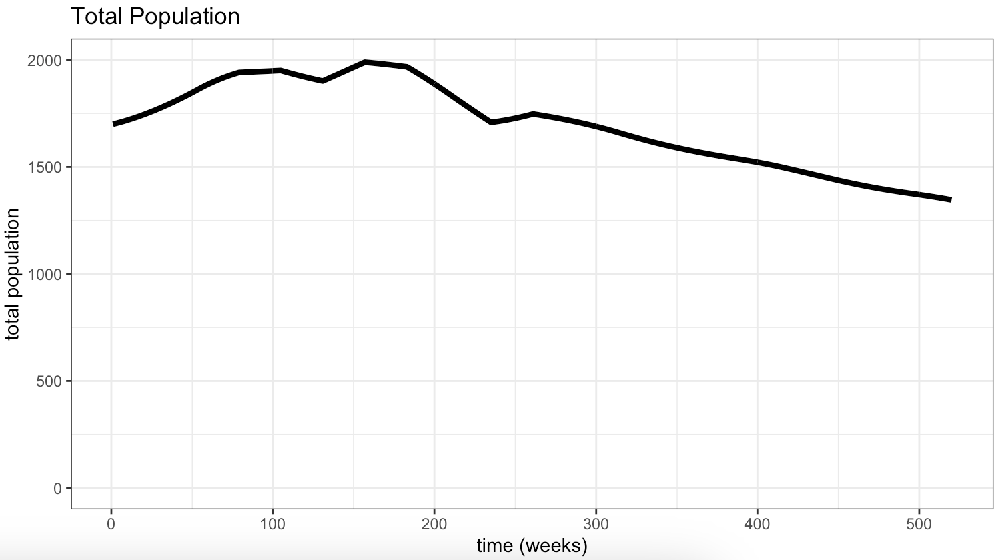
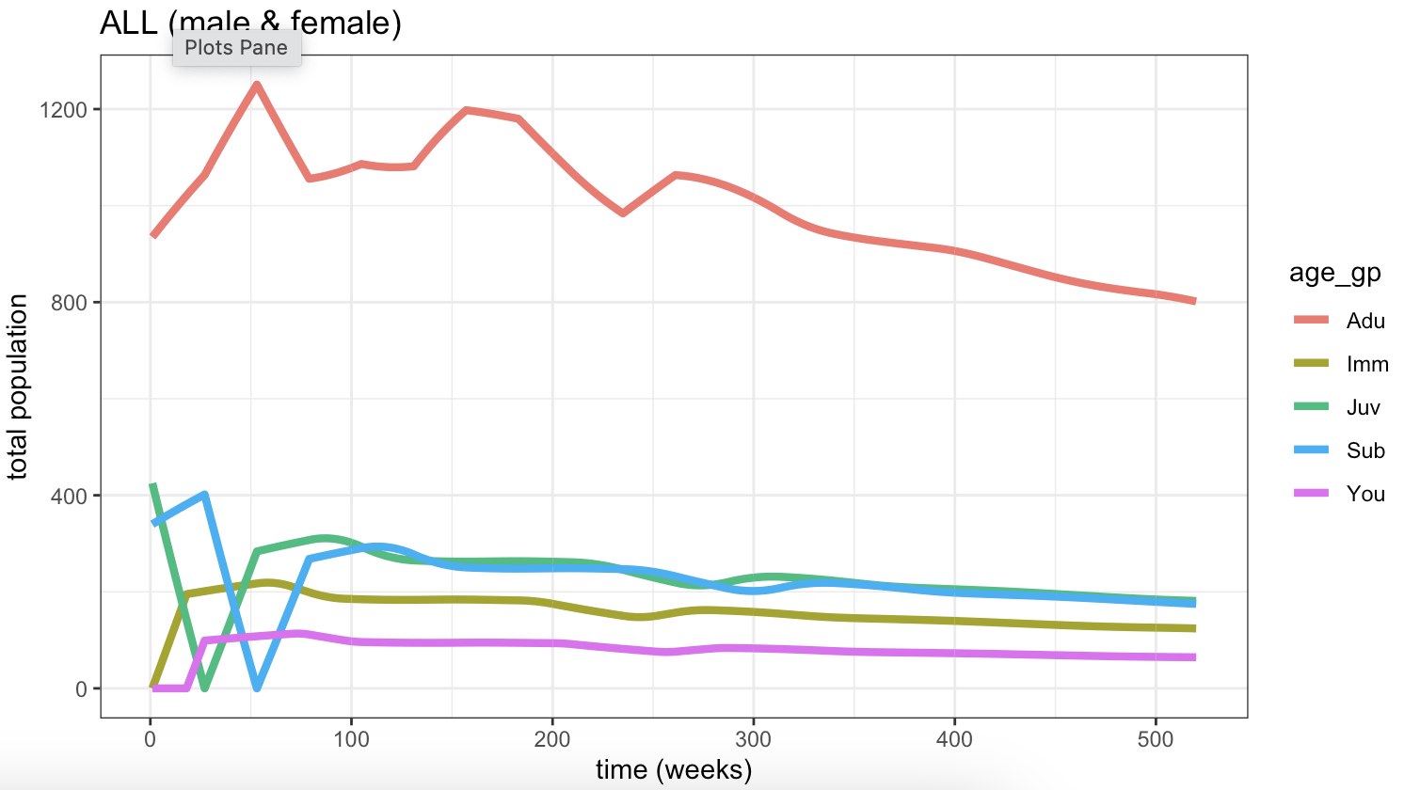
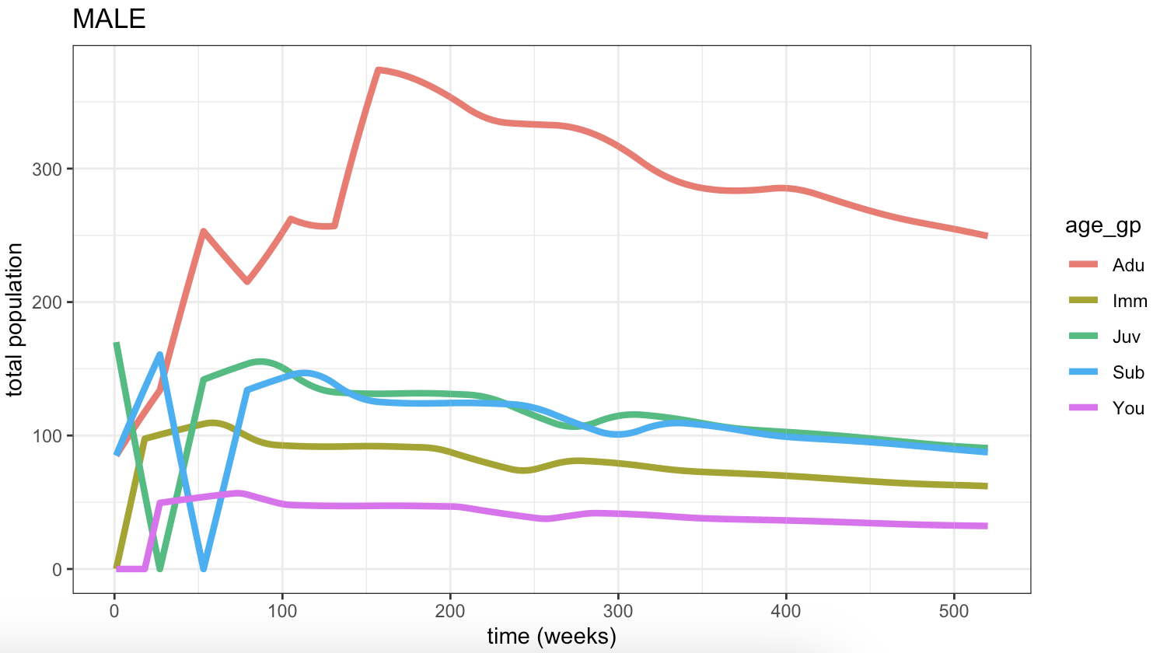
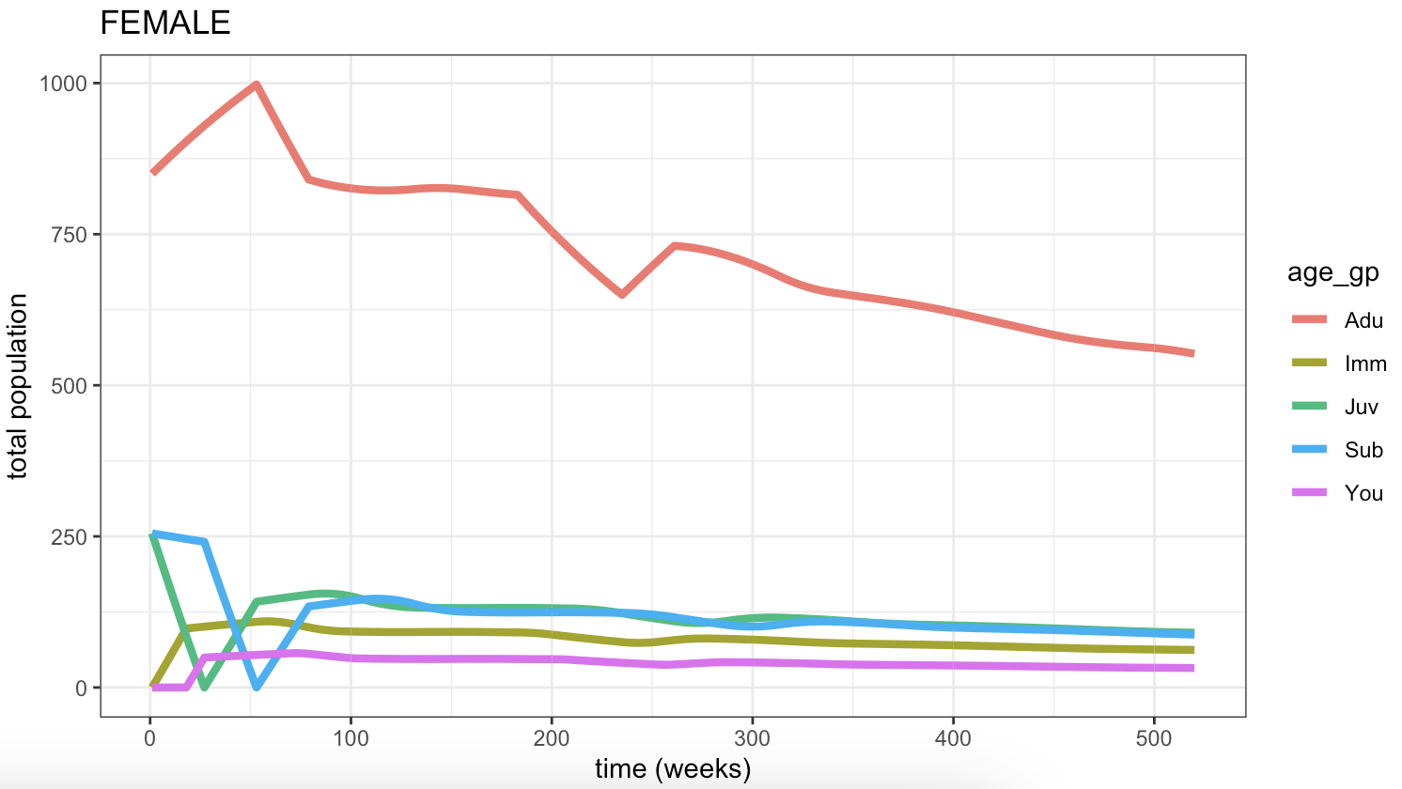
Notes:
BAOBAB data
Pop size: 1700
Max age F: 7y, M: 5y
Age cats: 4m/6m/12m/18m/18m+
No transmission

Slide 5
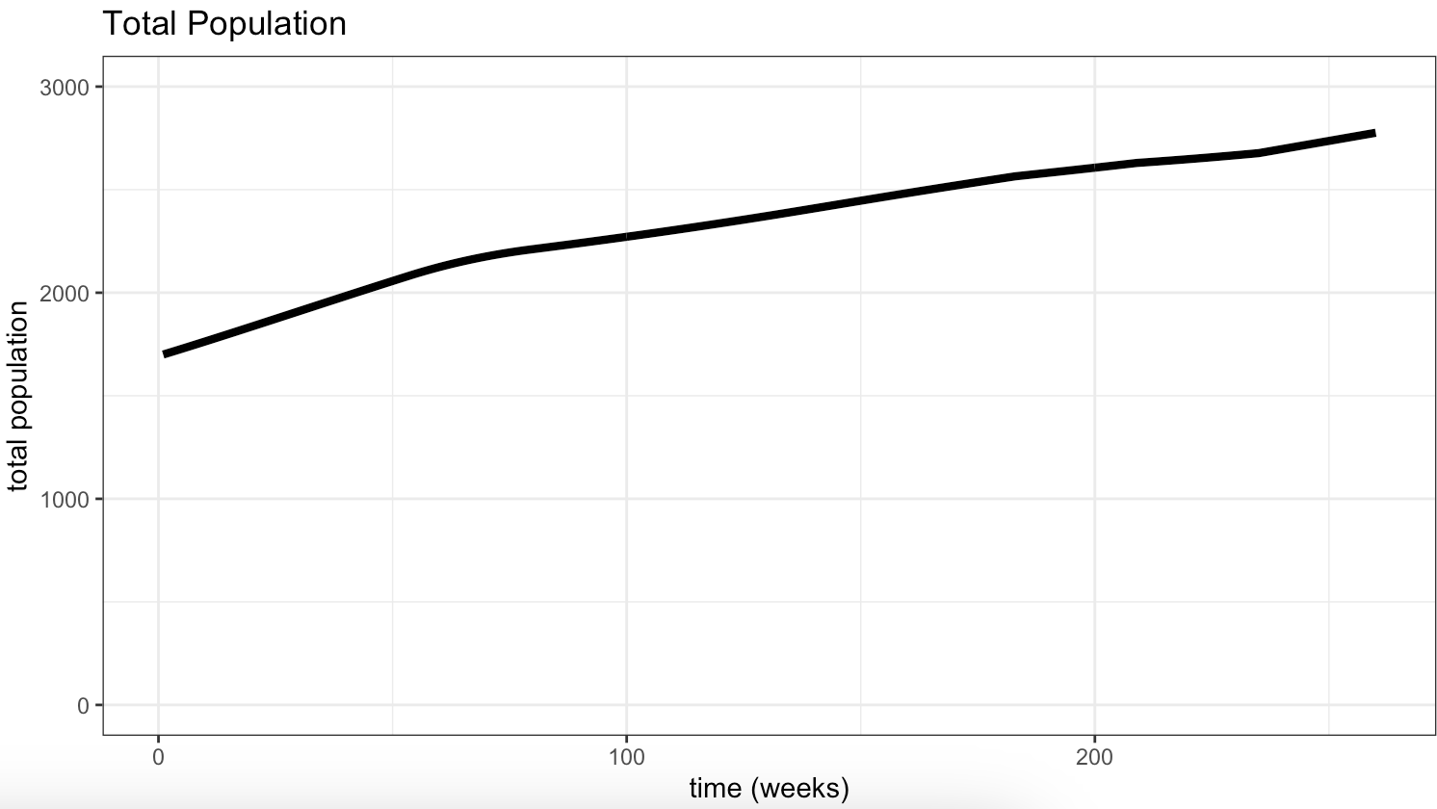
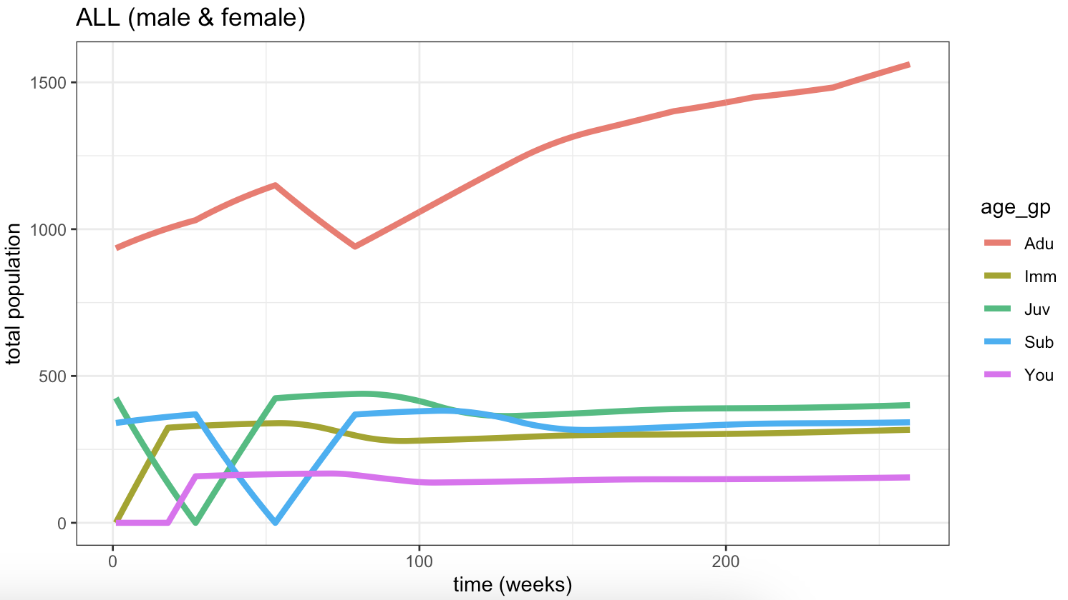
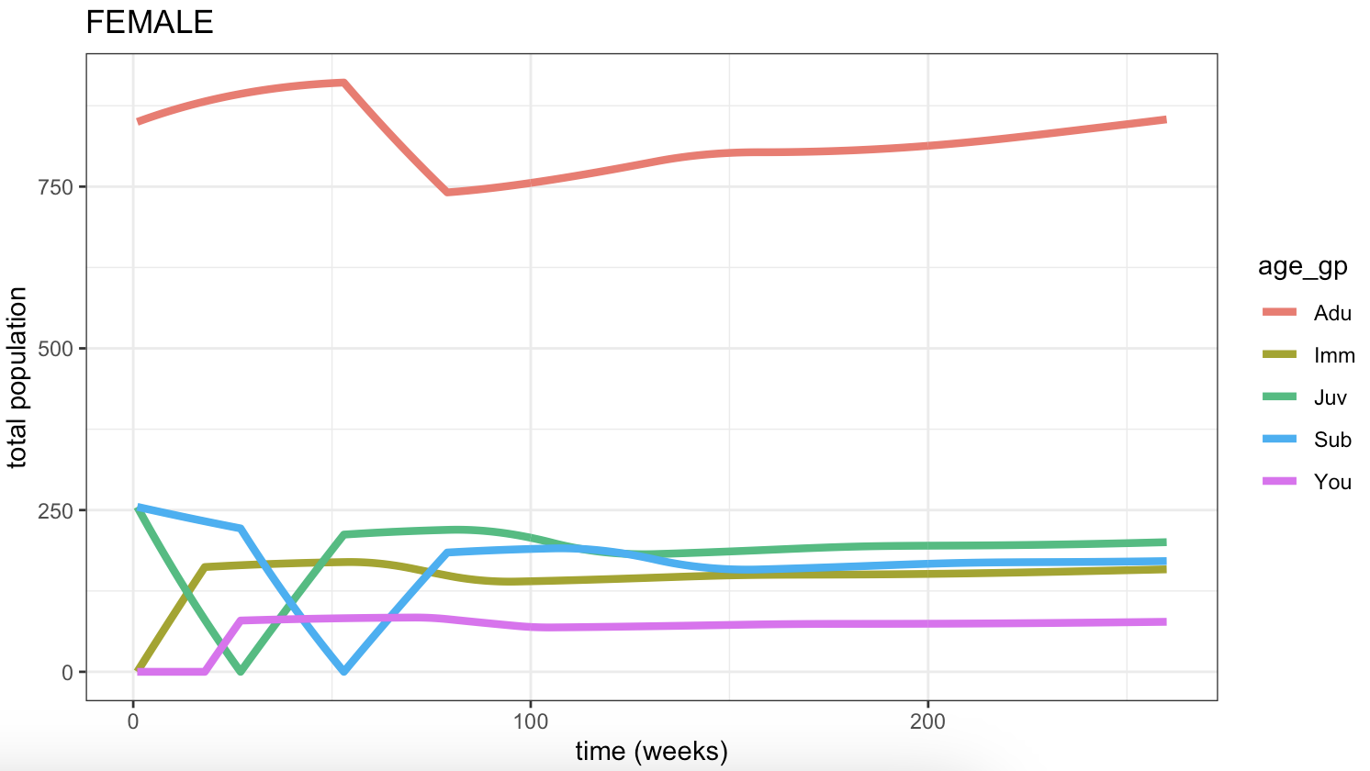
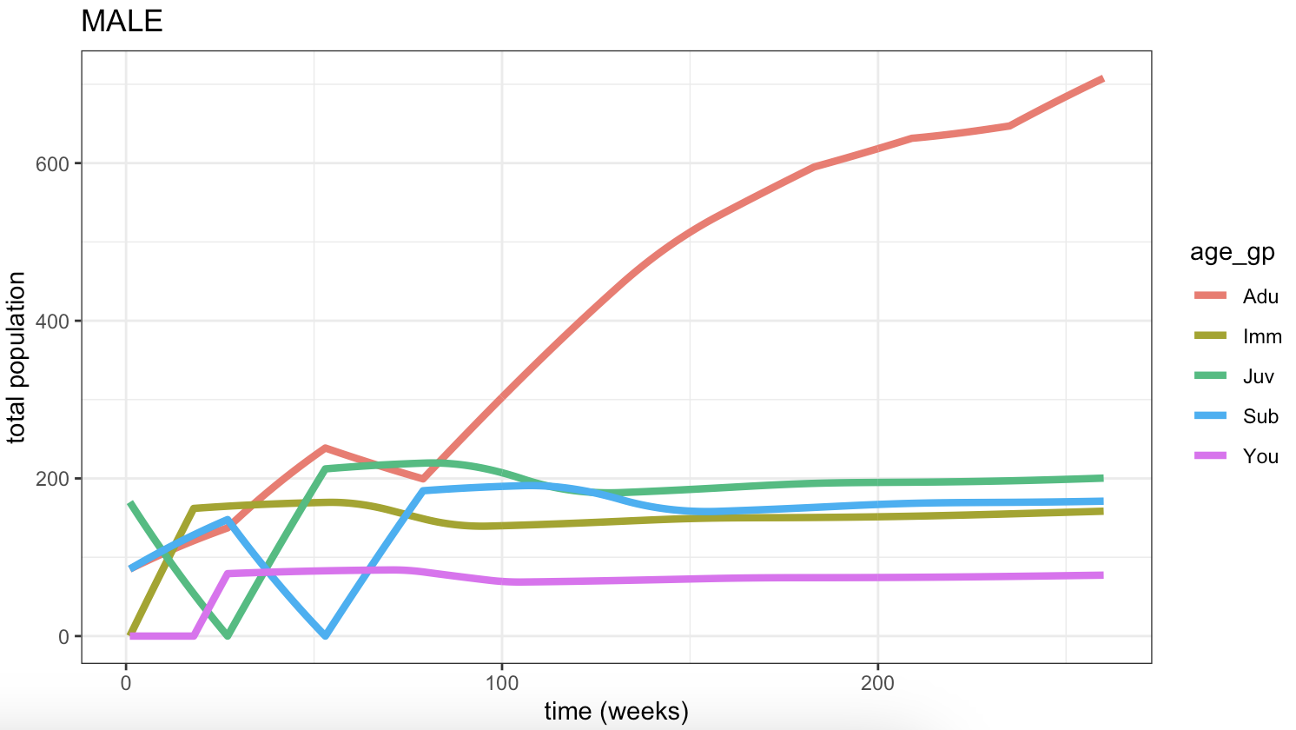
Notes:
As previous but with upper age limes of 5(male) and 7(female)
- Changed from 3 (male) and 5 (female)

Slide 6
Developments:
Controlling population size (tbc when more parameter sets fitted)
GF: Need to think about end population - stable / exponential / avoid collapse
Add in transmission
Seasonality of demographic rates (how?) - thinking just 2 seasons, 1 "peak", remainder "normal"
Timestep of model
Weekly demographic rates are hard to come by…

