Slide 1
Flock Dynamics Model

Slide 2
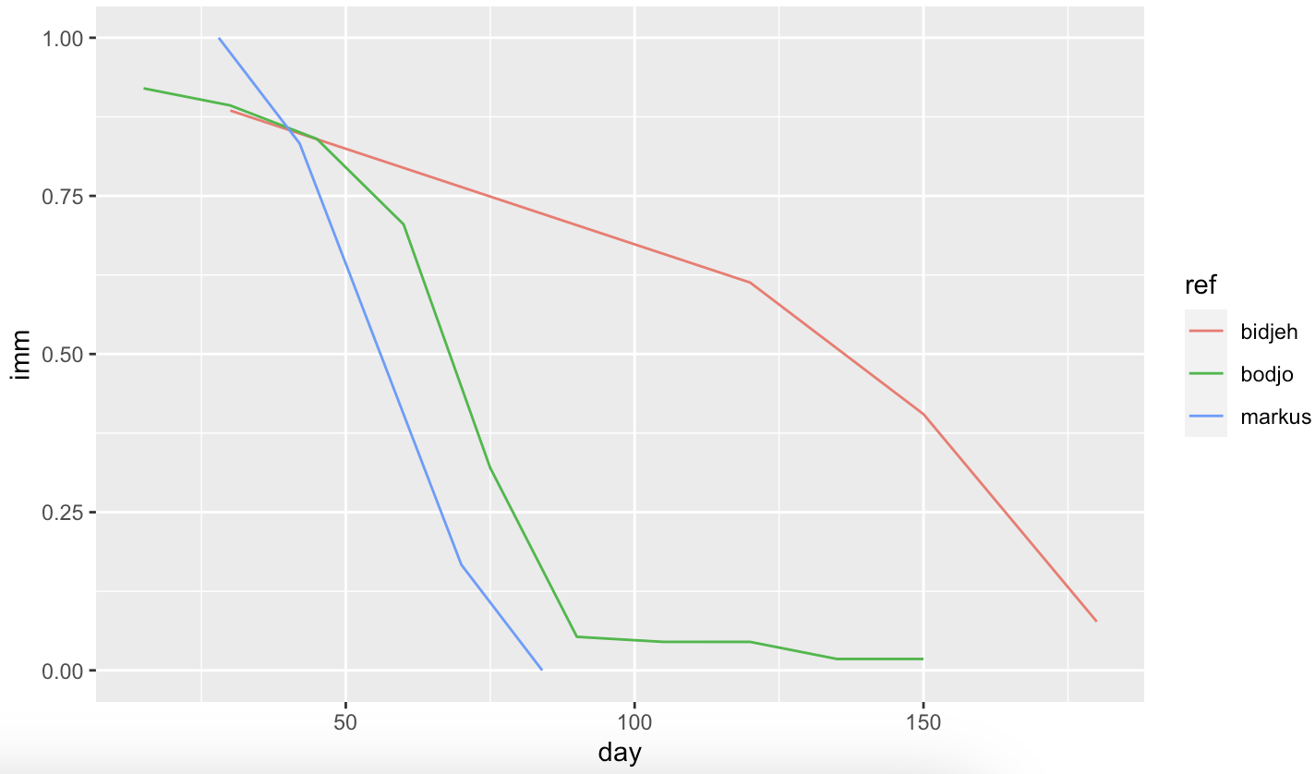
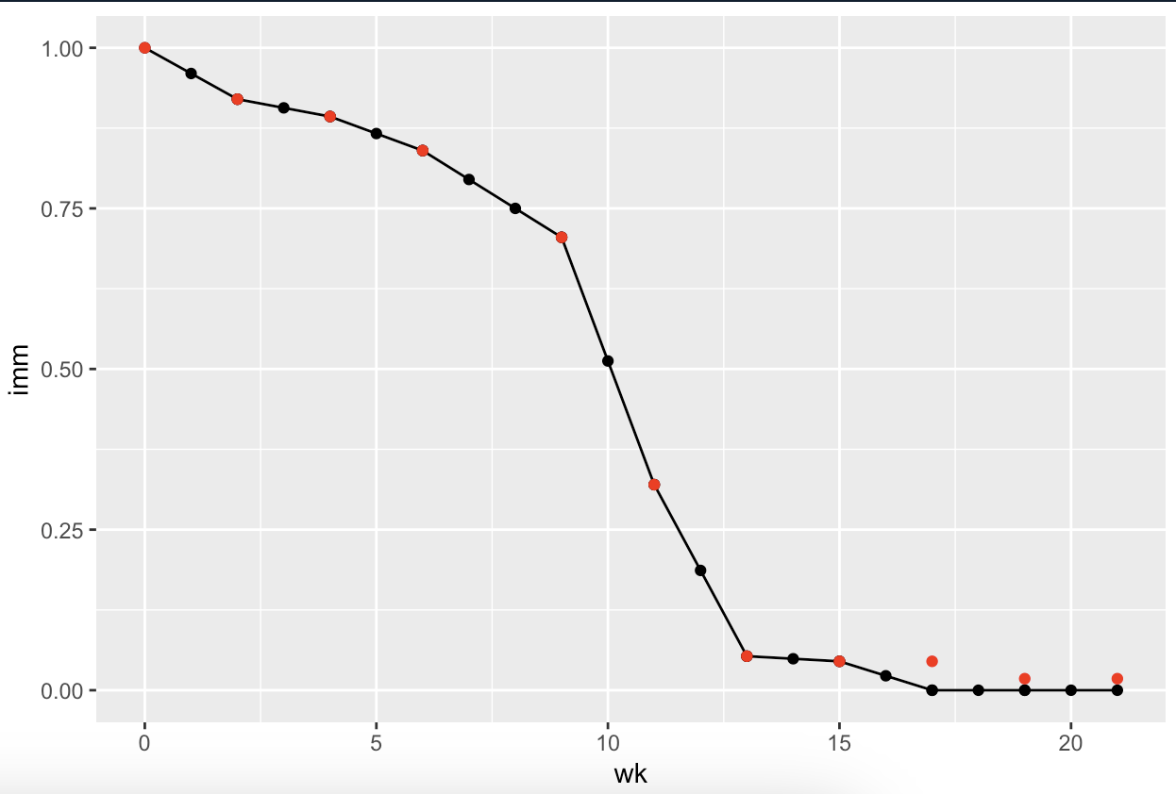
Immune decay
Set maternal immunity to last until 4th month (week 17 = 0 immunity)
Supported by Bodjo, Markus, Awa
Notes:
Bodjo et al.
Tested duration of maternal immunity in 112 lambs up to 150 days after birth, born to ewes vaccinated with the homologous PPR vaccine “Nigeria 75/1" at day 90 and day 120 of pregnancy.
Results (seropositivity):
Day 15 = 92%, Day 30 = 89.3%, day 45 = 84%, day 60 = 70.5%, day 75 = 32%, day 90 = 5.3% , day 105 = 4.5%, day 120 – 4.5%, day 135 = 1.8%, Day 150 = 1.8%
Decision:
Follow trend of Bodjo (supported by markus) with datapoints every 2 weeks (14days) - can fill in the midpoints for weekly decay
Set maternal immunity to last until 4th month, day 119, week 17 (week 17 = 0 immunity)
Supported by Bodjo, Markus, Awa

Slide 3


BAOBAB Test
parameter rate rate_wk
<fct> <dbl> <dbl>
1 hdea 0.0234 0.00537
2 hint 0.0527 0.0121
3 hoff 0.0527 0.0121
4 hpar 0.0680 0.0157
5 netpro 1.48 0.341
6 reprod 0.0997 0.0230
Intake = Offtake, NET offtake = 0
No age-sex differences for intake/offtake
Only animals >=12m could be exchanged
Only females >=18m could give birth
1:1 sex ratio at birth
Starting population: 1700
Female (80%):
15% 6-12m,
15% 12-18m,
50% 18m+
Male (20%):
10% 6-12m,
5% 12-18m,
5% 18m+
Notes:
Rate = median monthly rate
Week is computed weekly rate
Hdea = mortality
Hint = intake
Hoff = offtake
Hpar = parturition risk
Netpro = prolificacy (minus stillbirths)
Reprod = parturition * prolificac

Slide 4
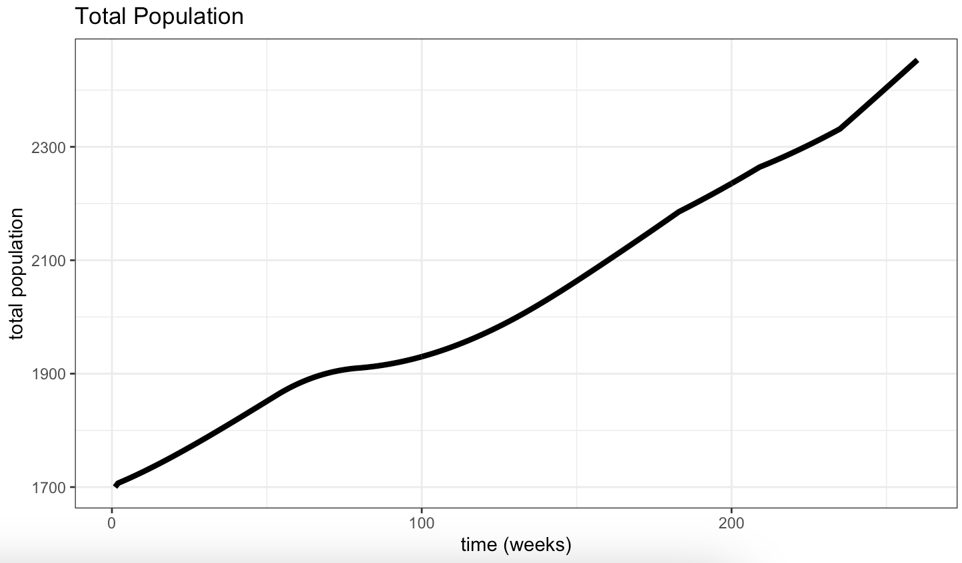
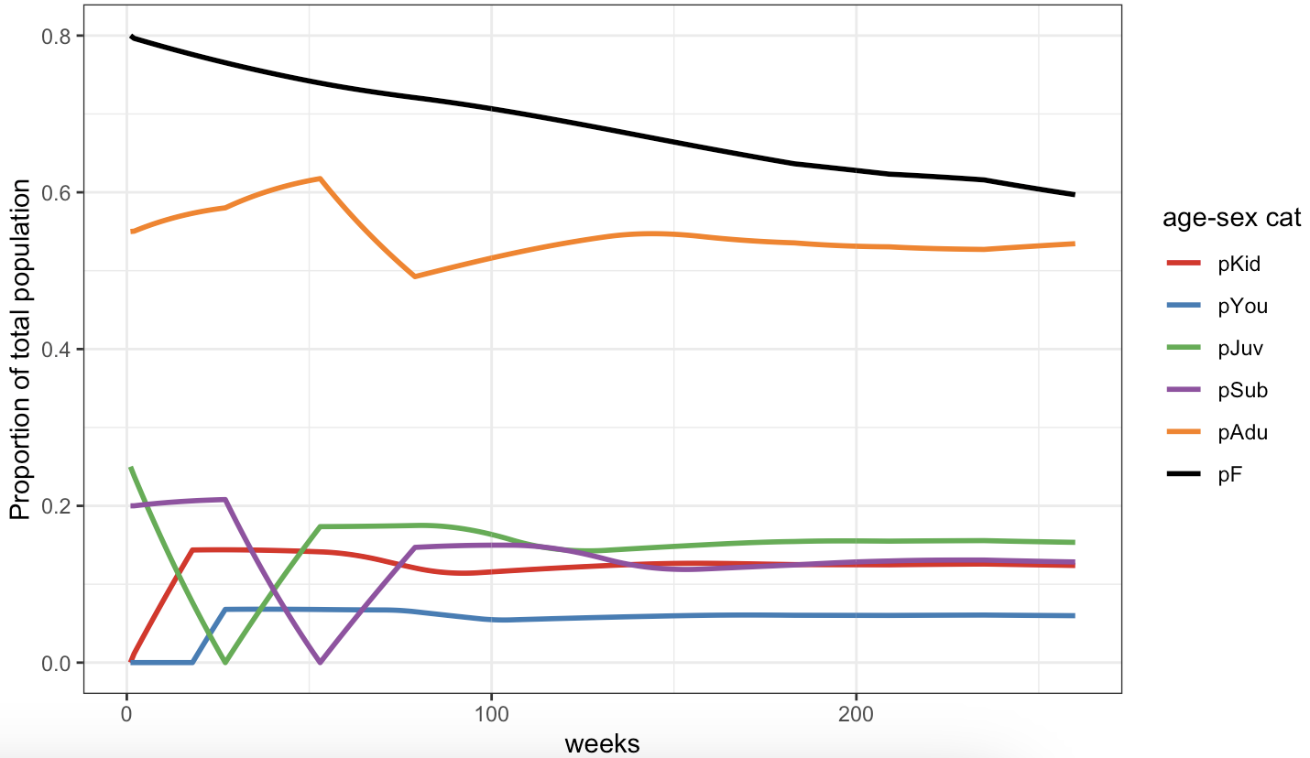
Exponential growth of population
Age-sex structure of population not maintained (no age-sex differences for trade, deaths)
Notes:
BAOBAB data
Pop size: 1700
Max age F: 7y, M: 5y
Age cats: 4m/6m/12m/18m/18m+
No transmission

Slide 5
Developments:
Transmission - BS working on this but not quite right
Stabilising population size + structure
Seasonality: how to incorporate this
Options: 2 seasons, 1 peak season and 1 'off' season, could compare this and model with no seasonality
Seasons differ between regions so may be too hard to generalise?
Timestep of model
Weekly demographic rates are hard to come by
Would monthly demographic timestep be too big
Data may be more accurately reflected
Data for model:
BS needs to focus time on this, still not confirmed flock profiles (was hoping RP2 would help but not enough time)

Slide 6
Sensitivity analysis
file:///Users/bethsavagar/Library/CloudStorage/OneDrive-RoyalVeterinaryCollege/Population_Dynamics_Model/writing/methods/notes/Parameters.docx

