Slide 1

VoiceRAG: talk to your data
Enrique Moreno Cano
Principal Software Engineer Manager – Azure AI Search
In partnership with

Slide 2
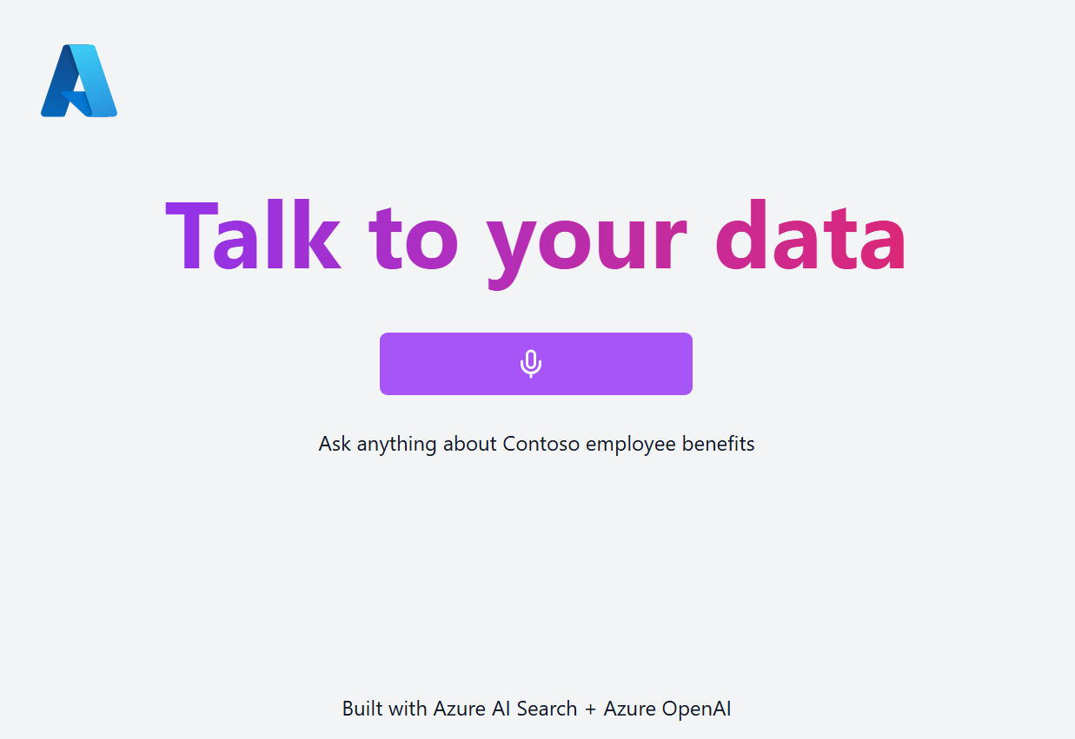
VoiceRAG
Azure OpenAI +
Azure AI Search +
GPT-4o Realtime API
Repo: aka.ms/voicerag/repo Demo video:
aka.ms/voicerag/video
Blog post: aka.ms/voicerag/blog

Slide 3
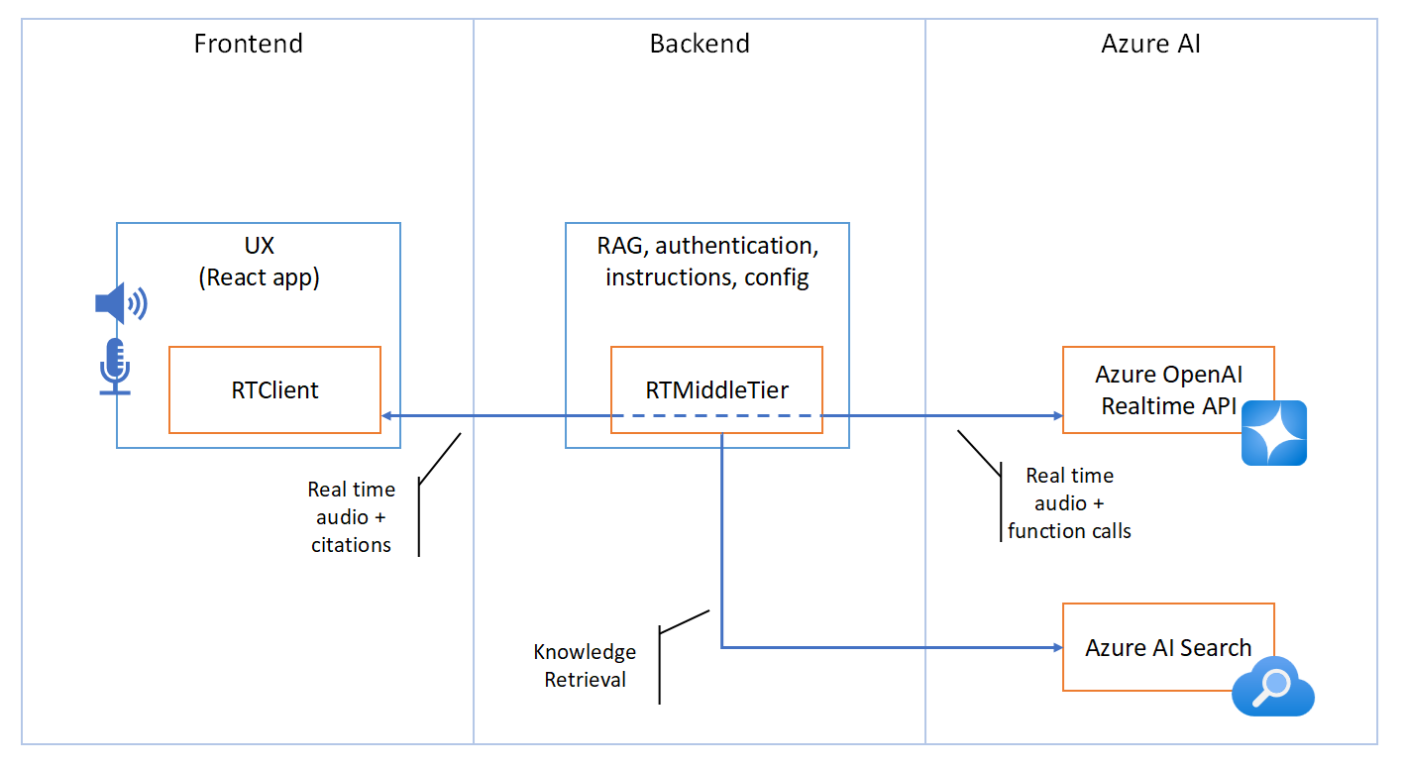
VoiceRAG

Slide 4
VoiceRAG - Frontend code
const { startSession, addUserAudio, inputAudioBufferClear } = useRealTime({
onReceivedResponseAudioDelta: message => {
isRecording && playAudio(message.delta);
},
onReceivedInputAudioBufferSpeechStarted: () => {
stopAudioPlayer();
},
onReceivedExtensionMiddleTierToolResponse: message => {
const result: ToolResult = JSON.parse(message.tool_result);
const files: GroundingFile[] = result.sources.map(x => {
return { id: x.chunk_id, name: x.title, content: x.chunk };
});
setGroundingFiles(prev => [...prev, ...files]);
}
});
app/frontend/src/App.tsx
Notes:
Enrique can browse GitHub and show code there as well

Slide 5
VoiceRAG - Prompt
app/backend/app.py
You are a helpful assistant. Only answer questions based on information you searched in the knowledge base, accessible with the 'search' tool.
The user is listening to answers with audio, so it's *super* important that answers are as short as possible, a single sentence if at all possible.
Never read file names or source names or keys out loud.
Always use the following step-by-step instructions to respond:
1. Always use the 'search' tool to check the knowledge base before answering a question.
2. Always use the 'report_grounding' tool to report the source of information from the knowledge base.
3. Produce an answer that's as short as possible. If the answer isn't in the knowledge base, say you don't know.

Slide 6
More real-time resources
AI Foundry Realtime audio playground
How to use the GPT-4o Realtime API for speech and audio (Preview)
GPT-4o Realtime API for speech and audio (Preview)
Realtime API (Preview) reference
Azure-Samples/aoai-realtime-audio-sdk
Notes:
This is when Enrique can answer questions

