Slide 1
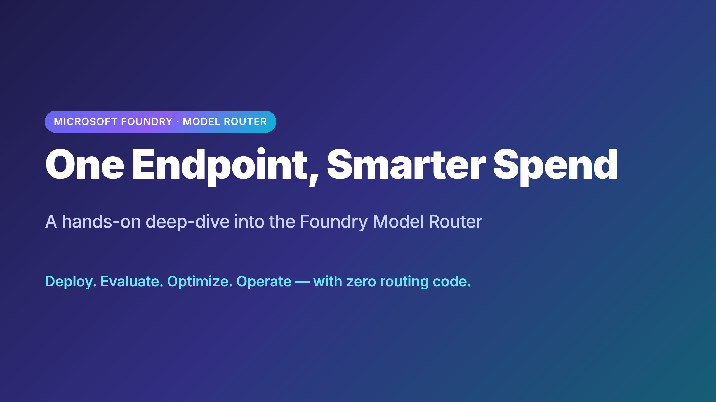
Notes:
═══════════════════════════════════════════════════════════════════════
One Endpoint, Smarter Spend — Model Router Deep-Dive
Workshop: workshops/model-router-demystified
~35 slides · ~45 min · ~1 min/slide
═══════════════════════════════════════════════════════════════════════
Opener. Frame the deck: this isn't a marketing pitch for Model Router,
it's an empirical workshop. We're going to *measure* whether the router
holds up on a real workload (Zava Travel Concierge), and learn how to
optimize it with config alone.

Slide 2
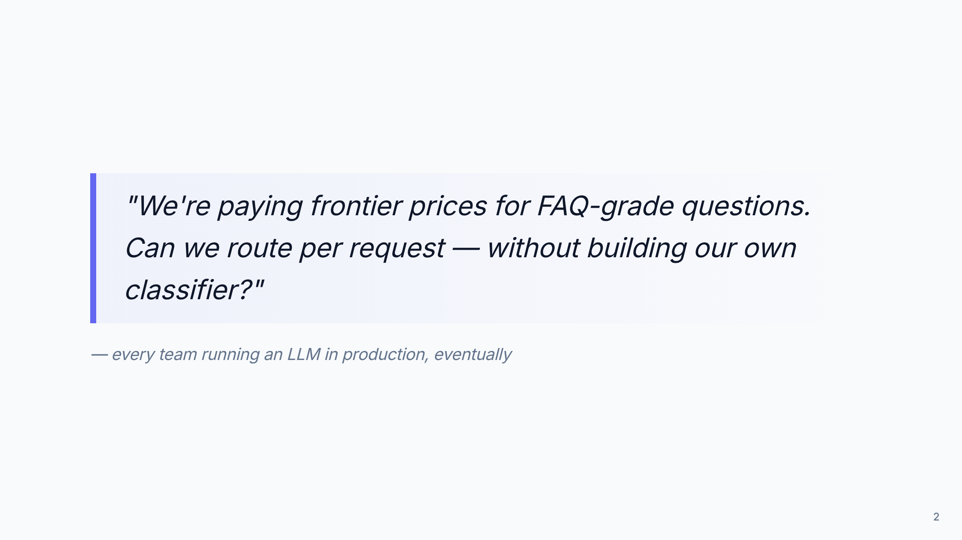
Notes:
The motivating problem. Most teams default to "one frontier model for
everything" because they don't want to maintain a custom routing layer.
That's exactly the gap Model Router fills.

Slide 3
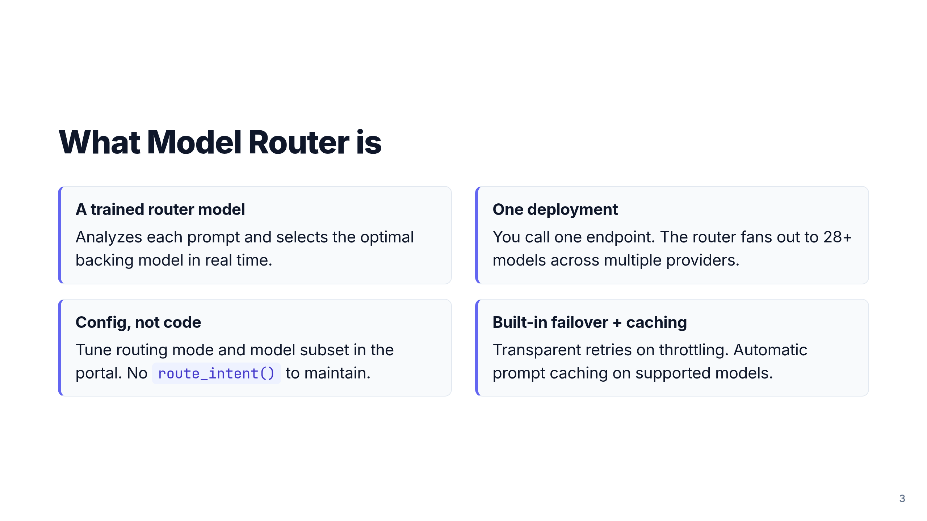
Notes:
Four-corner overview. Each tile becomes a deeper slide later, so keep
this short. Emphasis: Model Router *is* the router — you don't build
one on top of it.

Slide 4
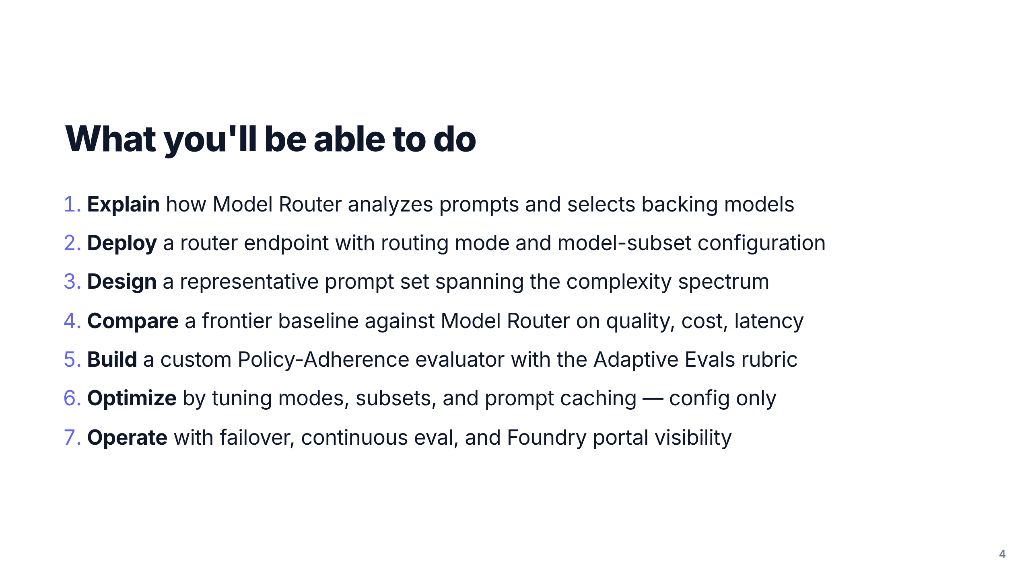
Notes:
The 7 learning objectives from README.md, condensed into action verbs.
This is the contract for the next 45 minutes.

Slide 5
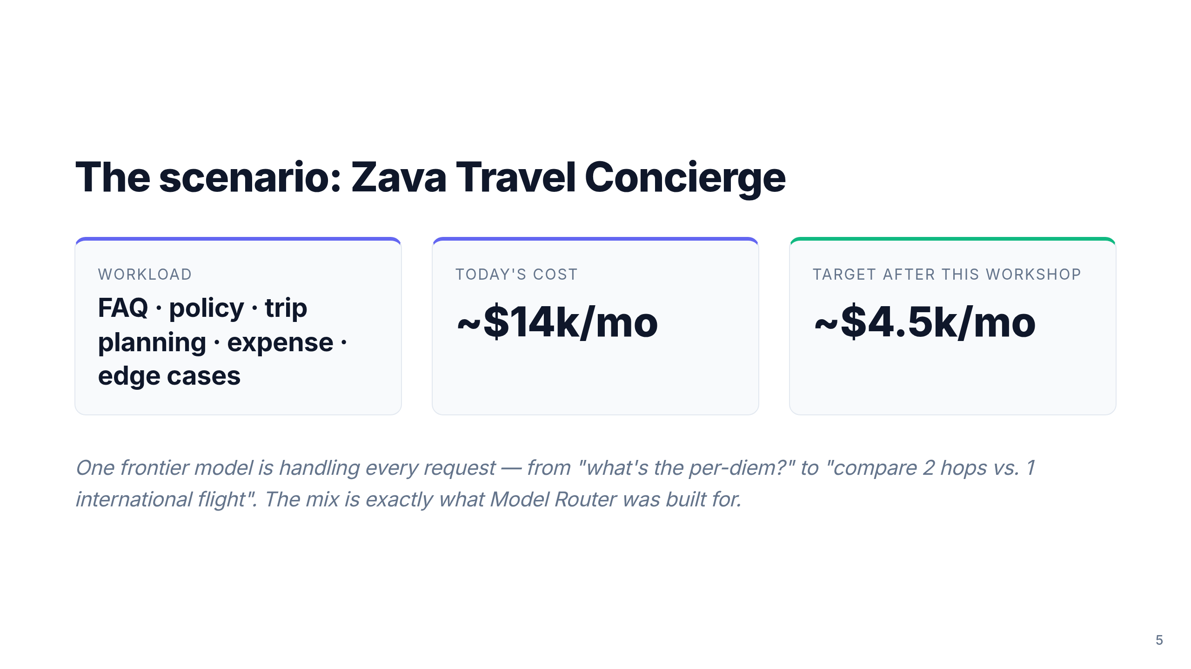
Notes:
Anchor the workshop in a concrete scenario. The same Zava Travel domain
is reused from foundry-models-e2e, so learners crossing over already
know the policy. The before/after numbers come from README.md.

Slide 6
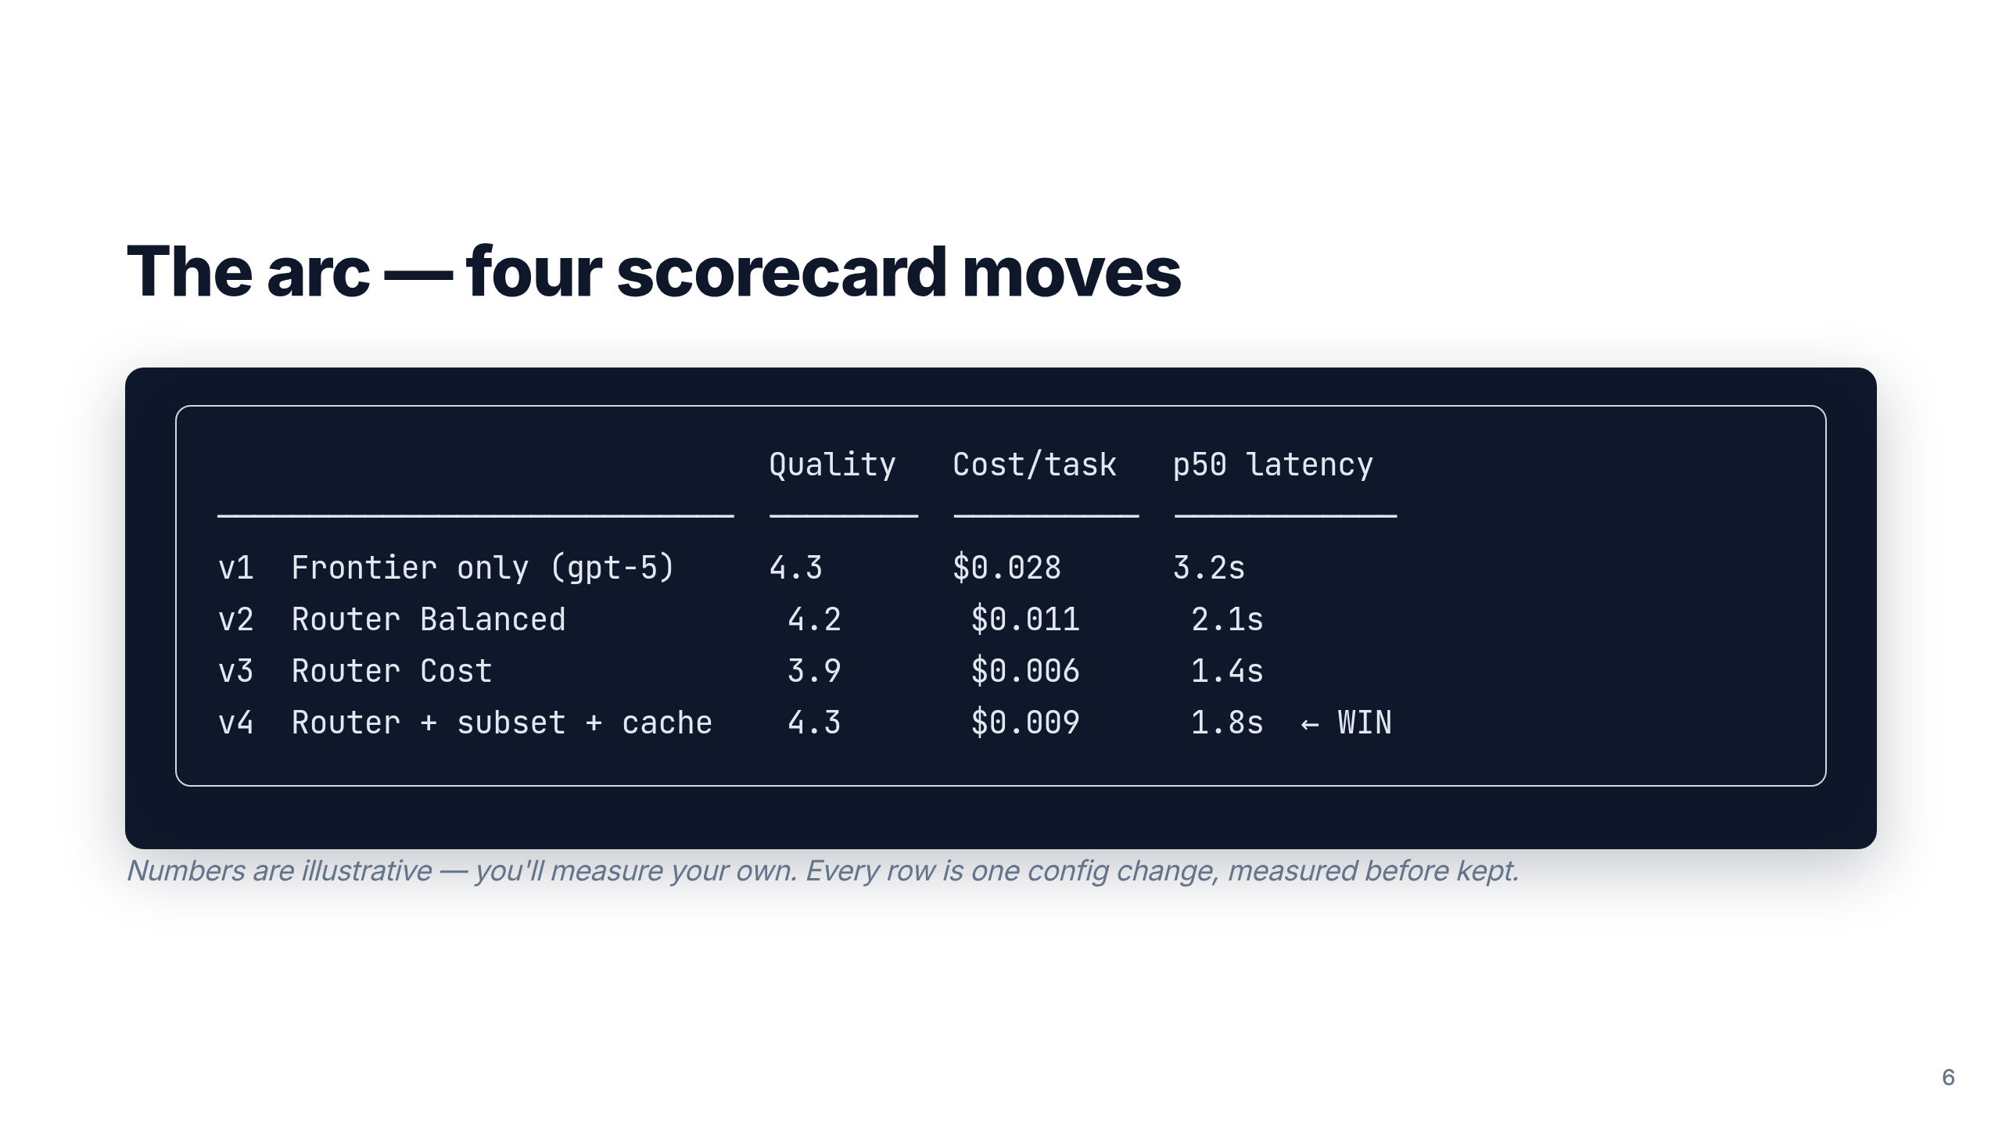
Notes:
This is the spine of the workshop. Each lab moves one row. By the end
we want the audience to internalize: "Same quality. ~68% less cost.
~44% less latency. Zero code changes."

Slide 7
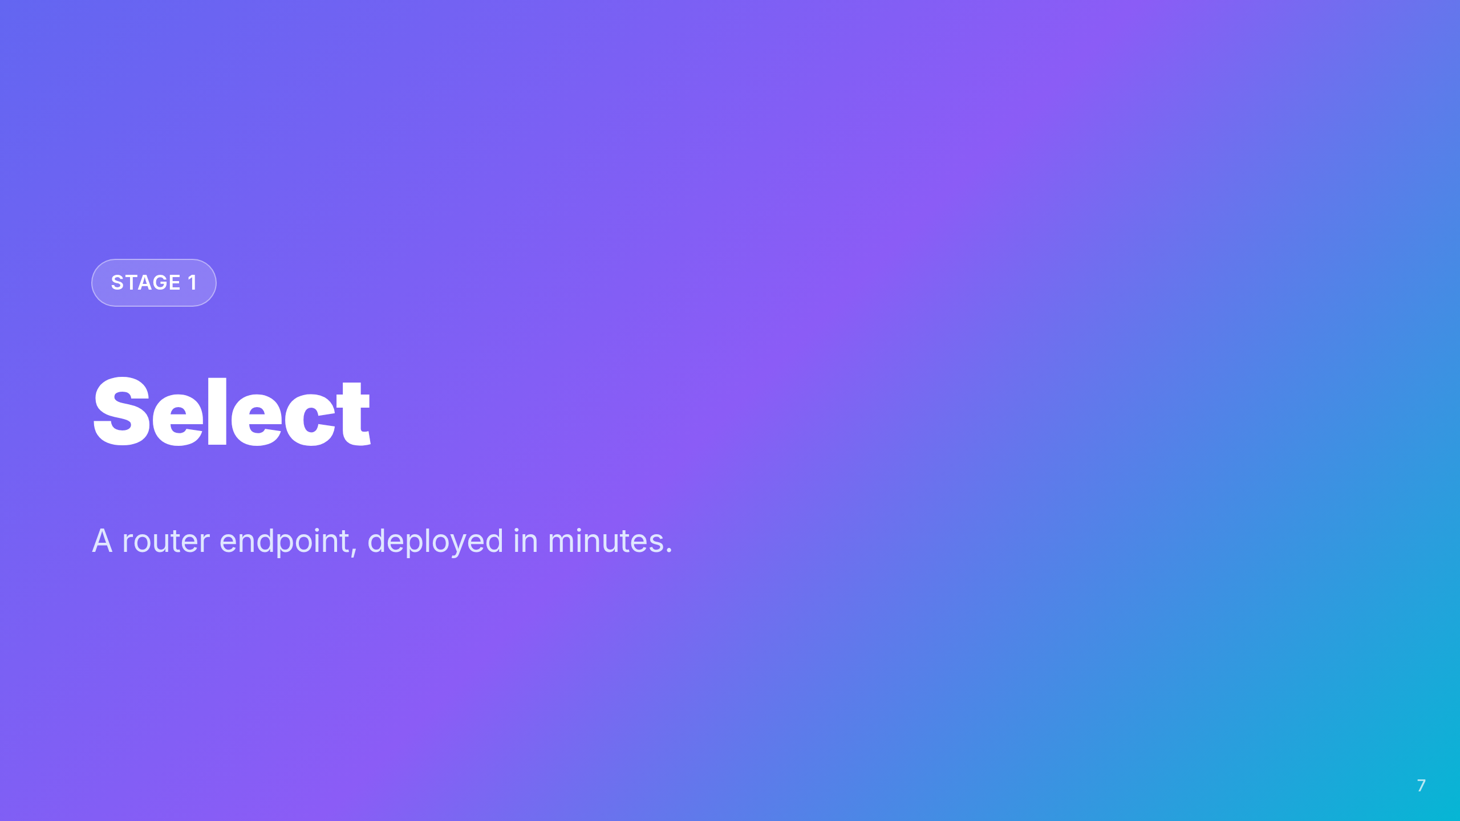
Notes:
Stage divider. The workshop uses the Select → Evaluate → Optimize →
Operate loop. We're entering Select.

Slide 8
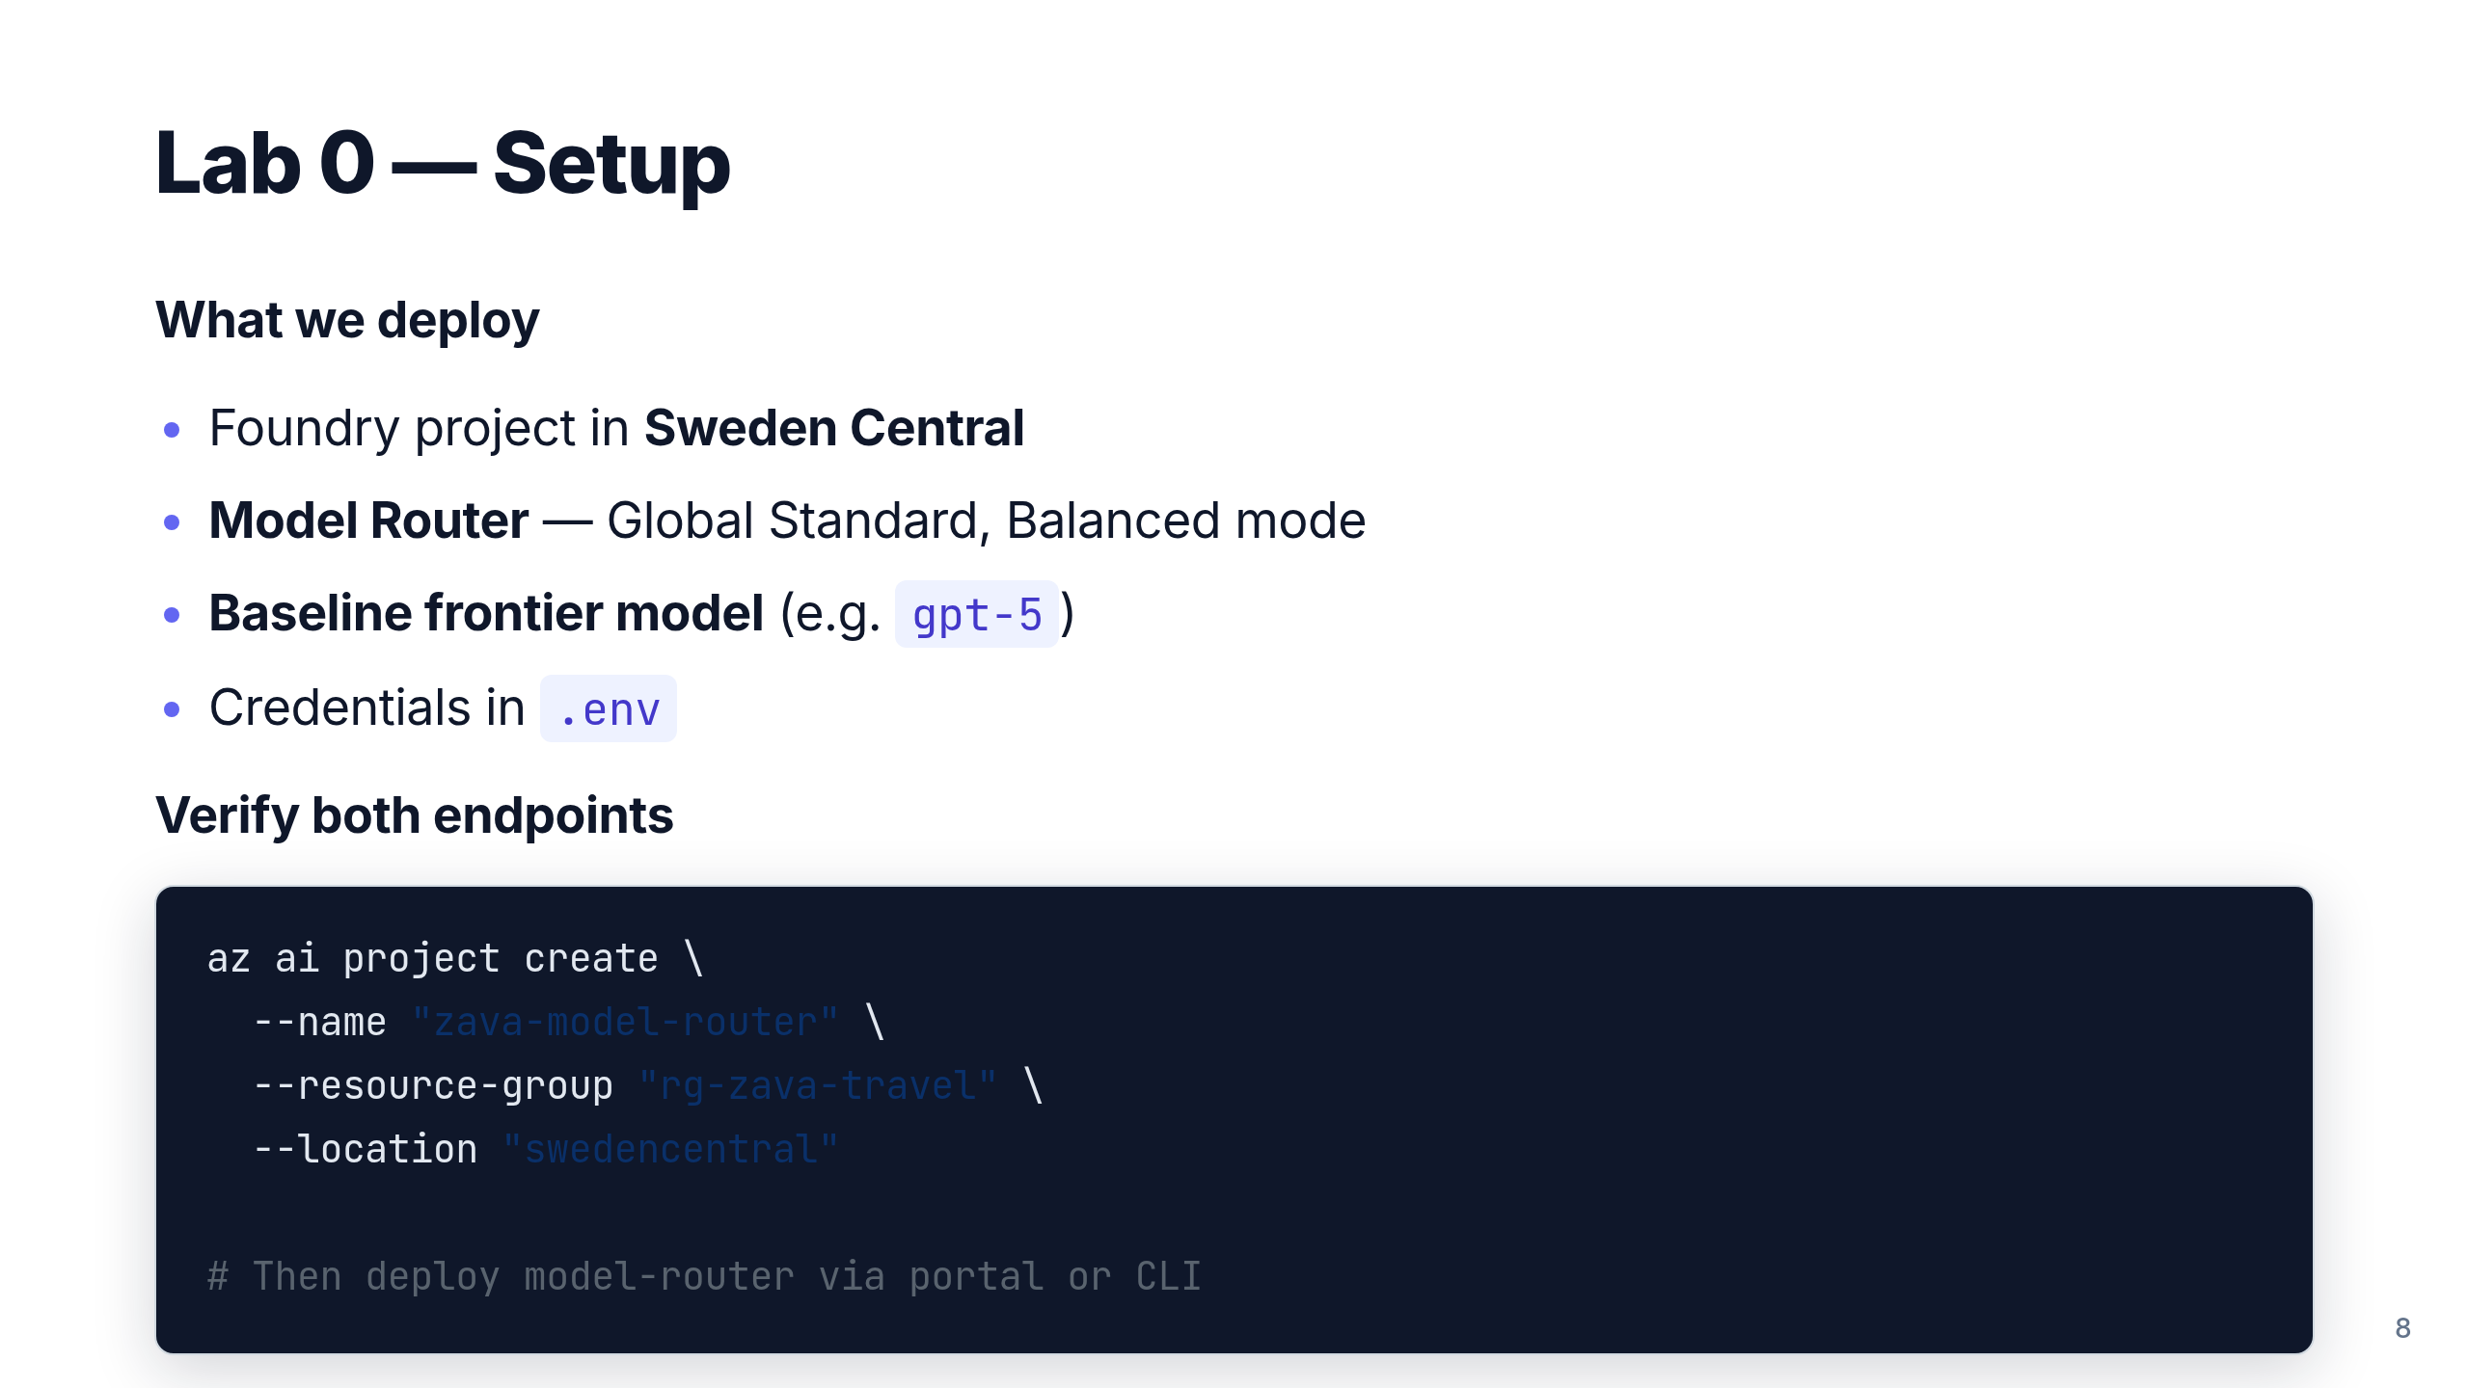
Notes:
~15 min lab. The point is: deploying Model Router is the same workflow
as any other model. No special infrastructure.

Slide 9
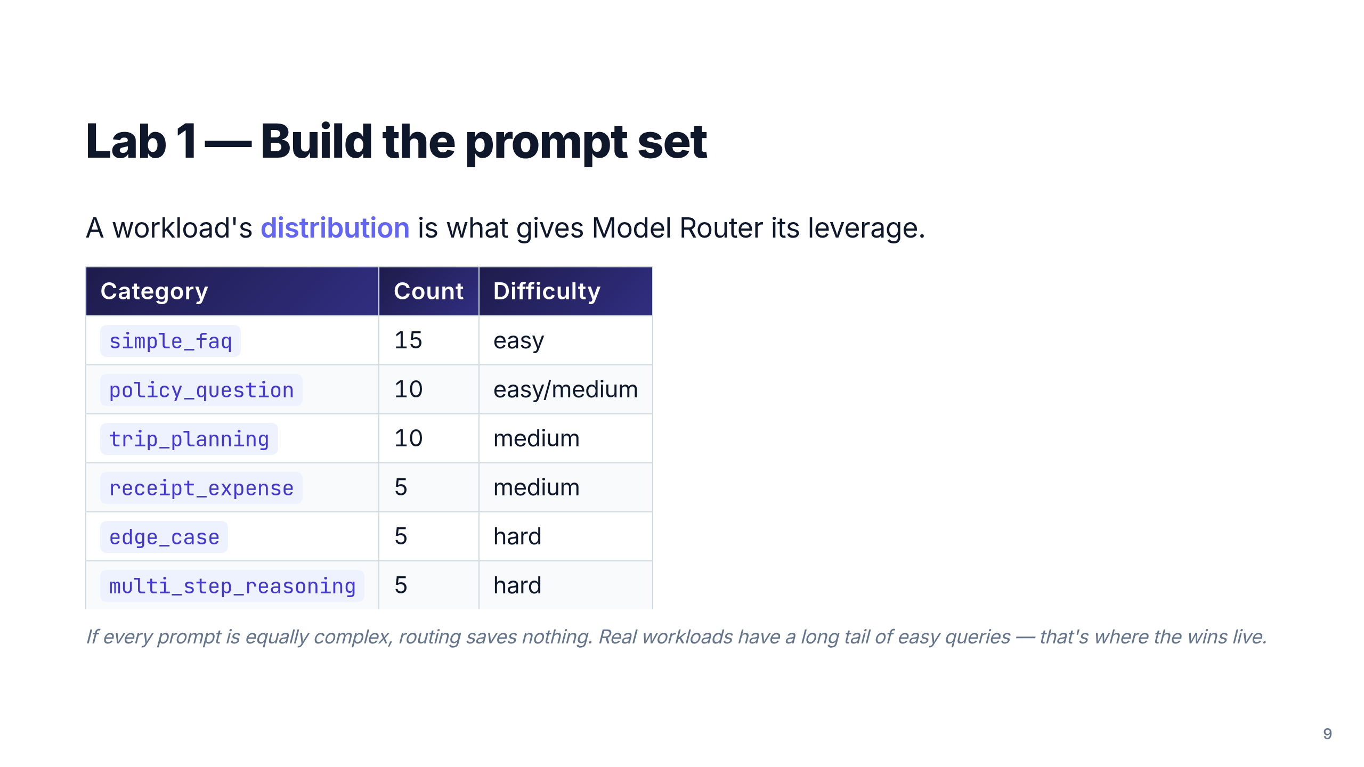
Notes:
50+ prompts in router-eval-prompts.jsonl. The category column matters
later for adaptive evaluator rules. Spend a moment on why mirroring
your real distribution is the whole game for honest measurement.

Slide 10
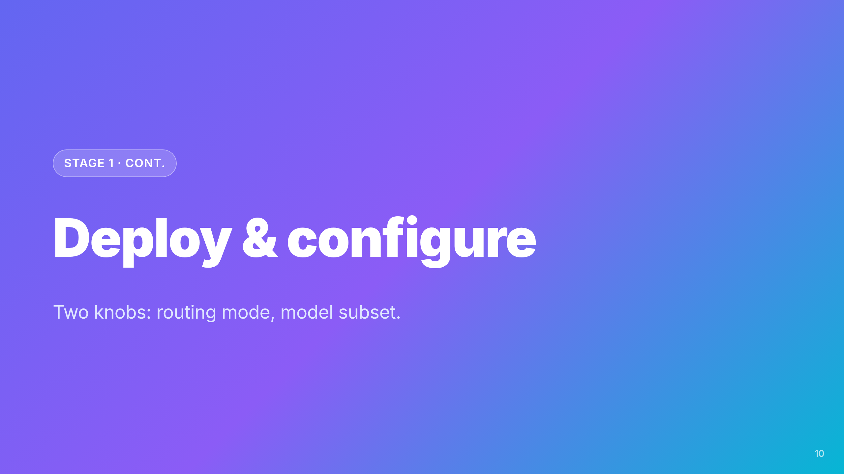

Slide 11
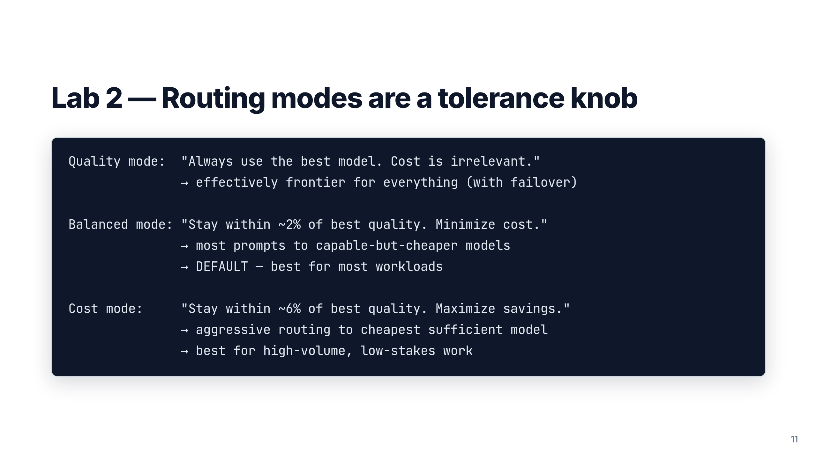
Notes:
This is the conceptual pivot of the workshop. Mode = quality tolerance
band. Subset = which models the router can choose from. Together they
give you fine control without code.

Slide 12
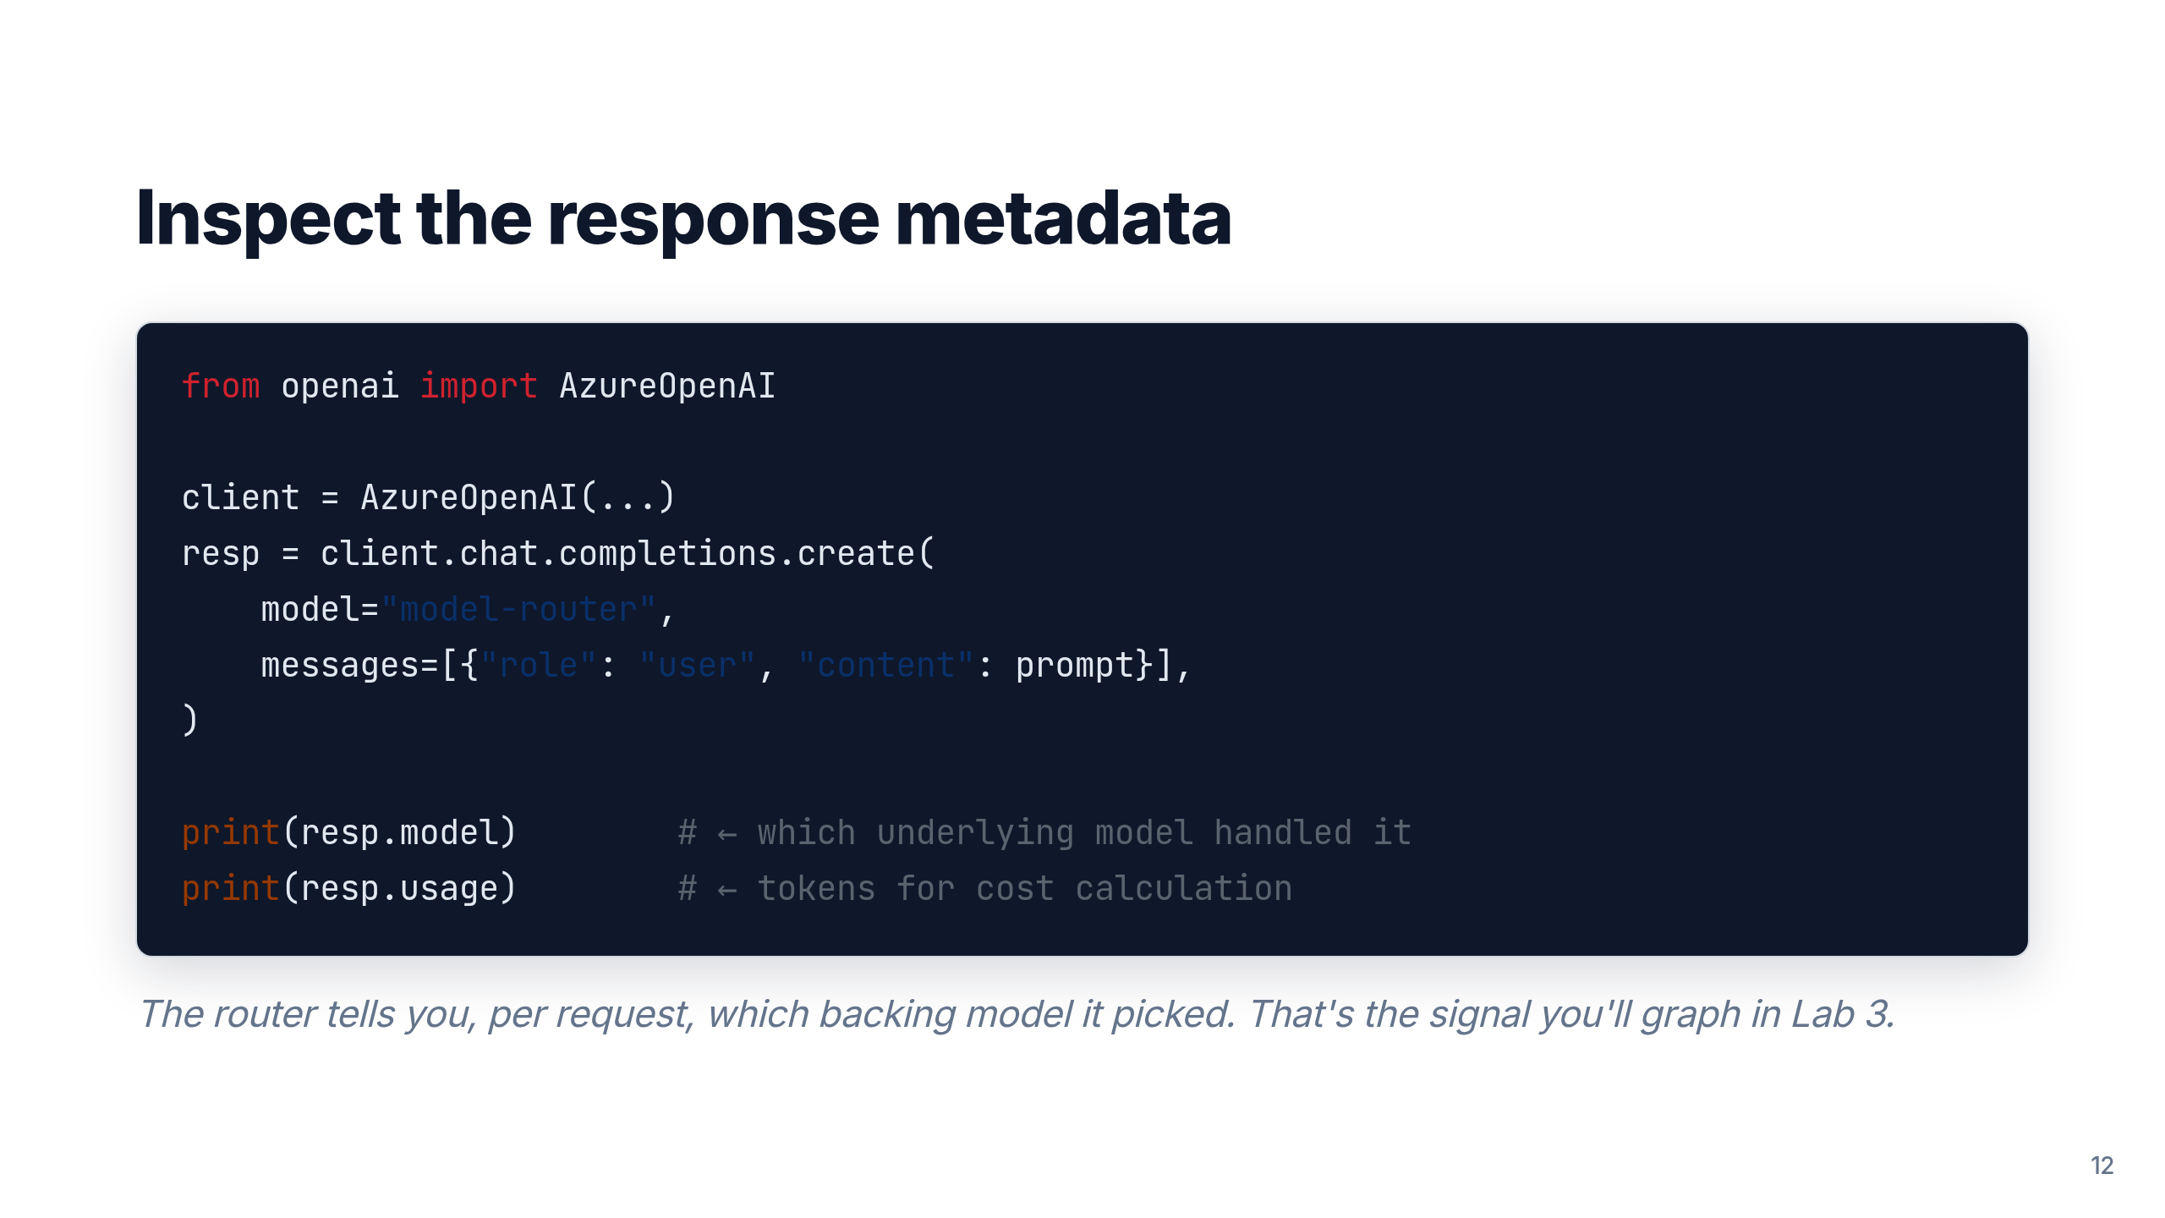
Notes:
Demo this live if time. The response.model field is the most useful
single piece of telemetry in the entire workshop.

Slide 13
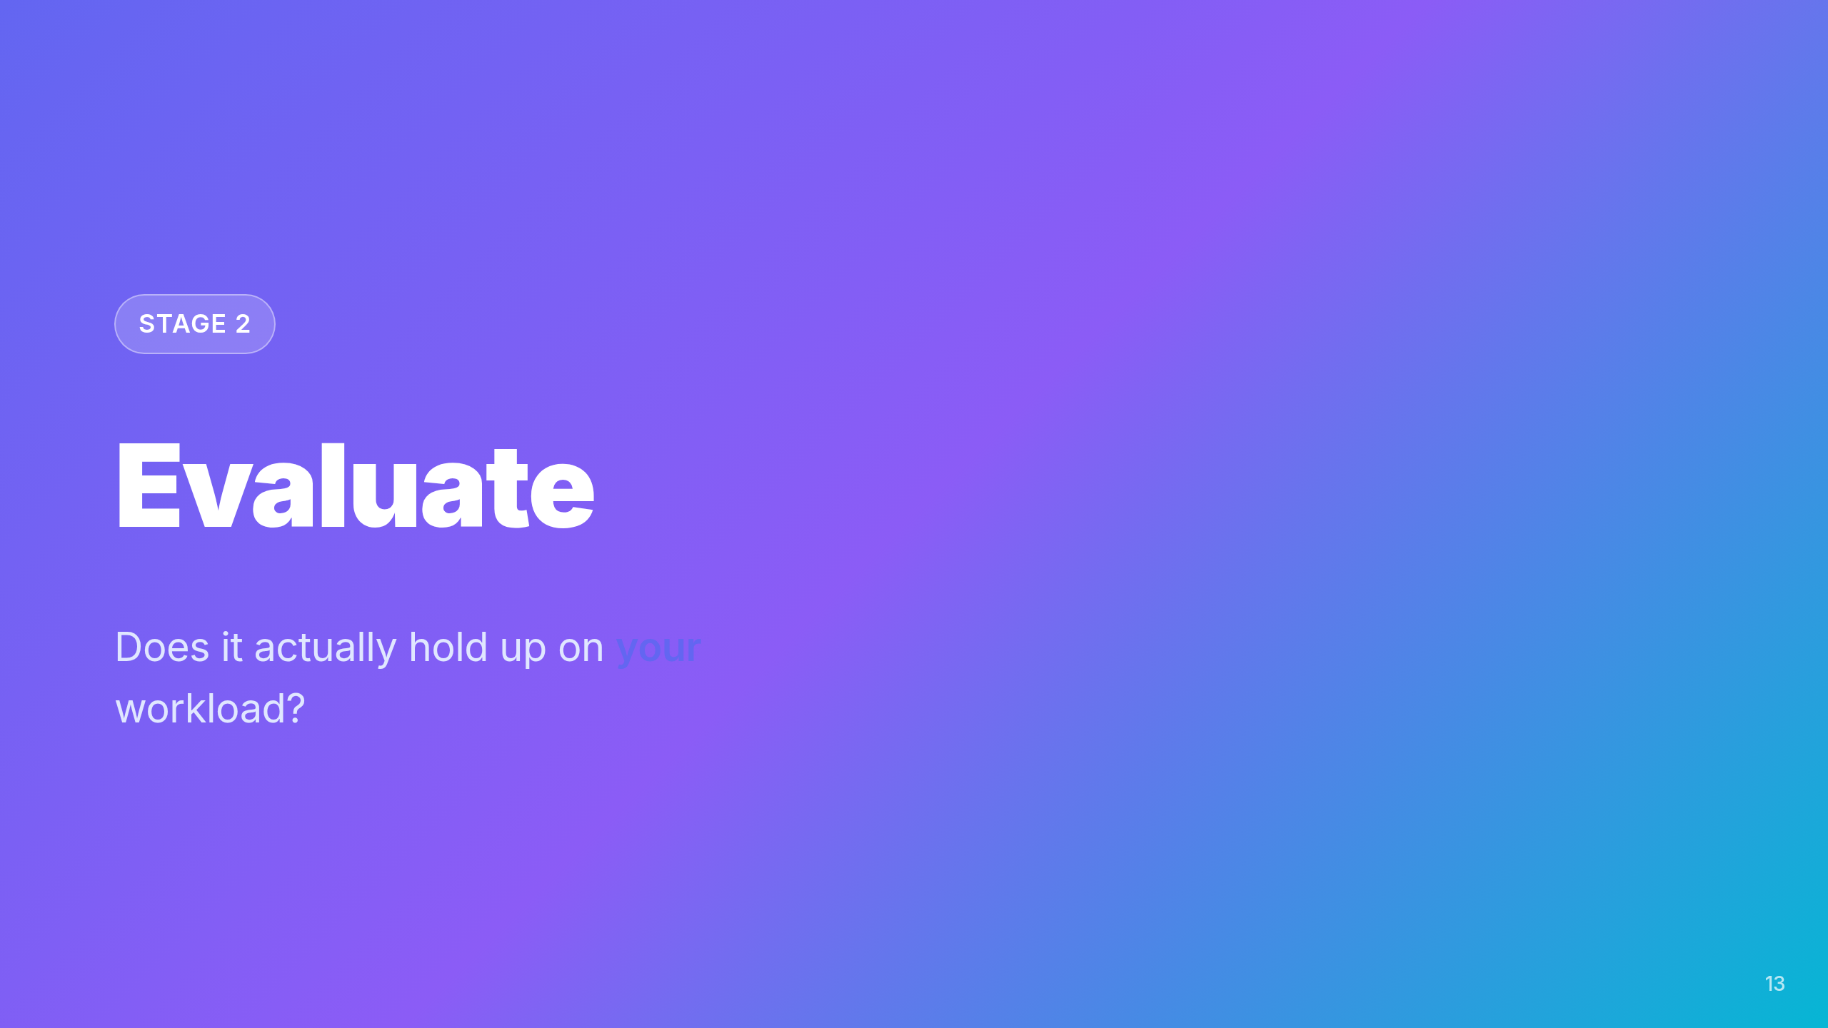

Slide 14
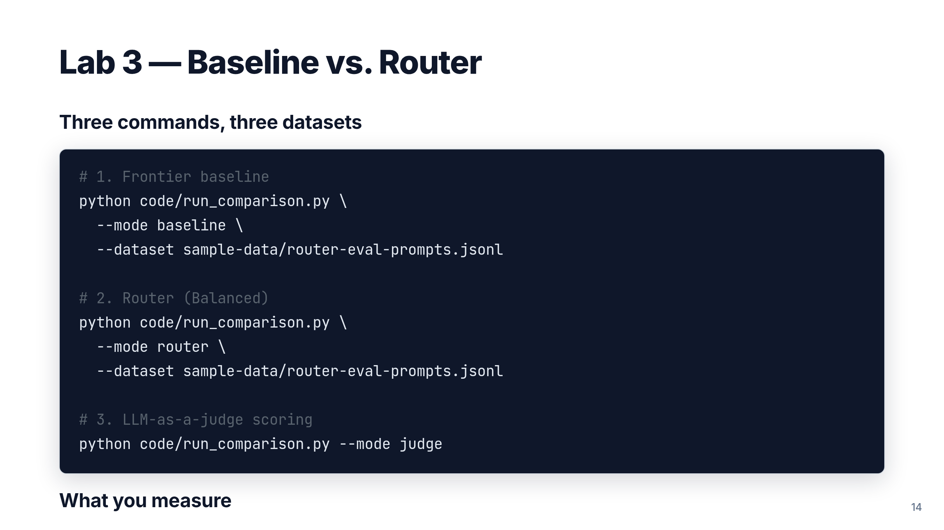
Notes:
~20 min lab. Pipeline is adapted from the public
Model-Router-Auto-Evaluation repo. Dual-ordered pairwise is the
non-obvious trick — without it, position bias contaminates results.

Slide 15
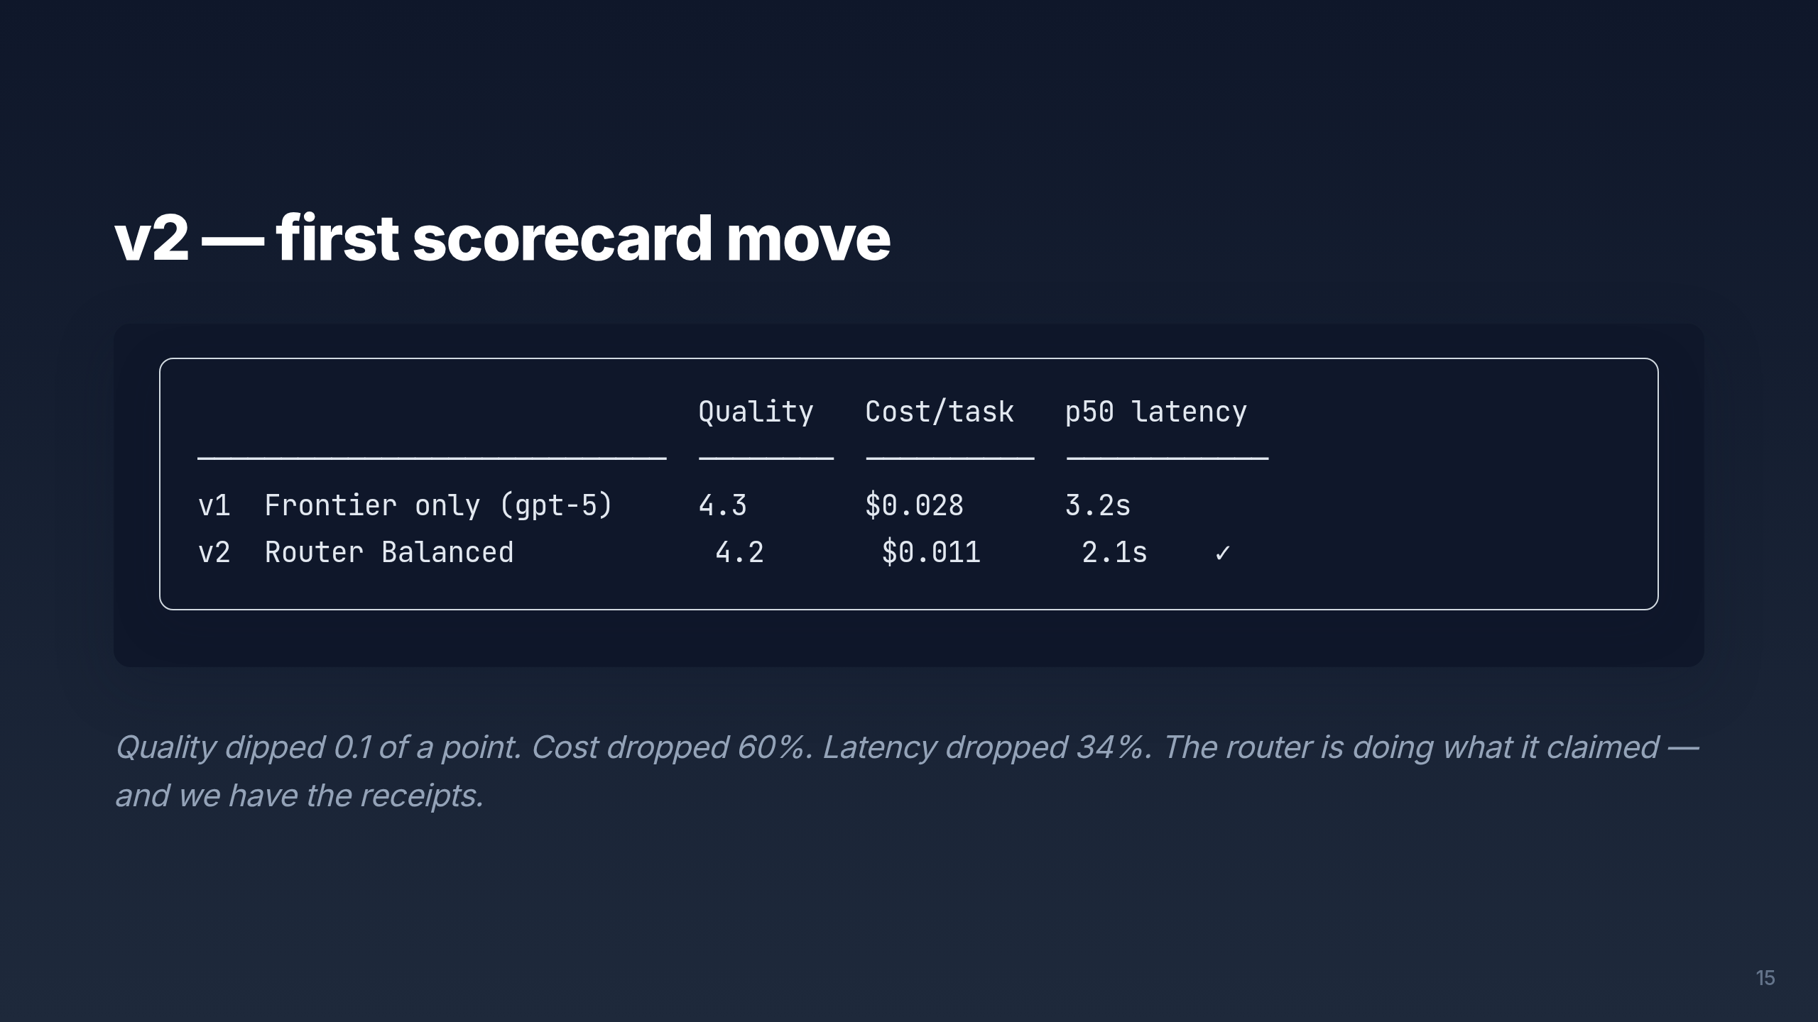
Notes:
Pause here. This is the "aha" moment for skeptics. The trade is real
and measurable, not theoretical. The next lab tightens the eval to
catch the domain-specific failures that generic scoring misses.

Slide 16
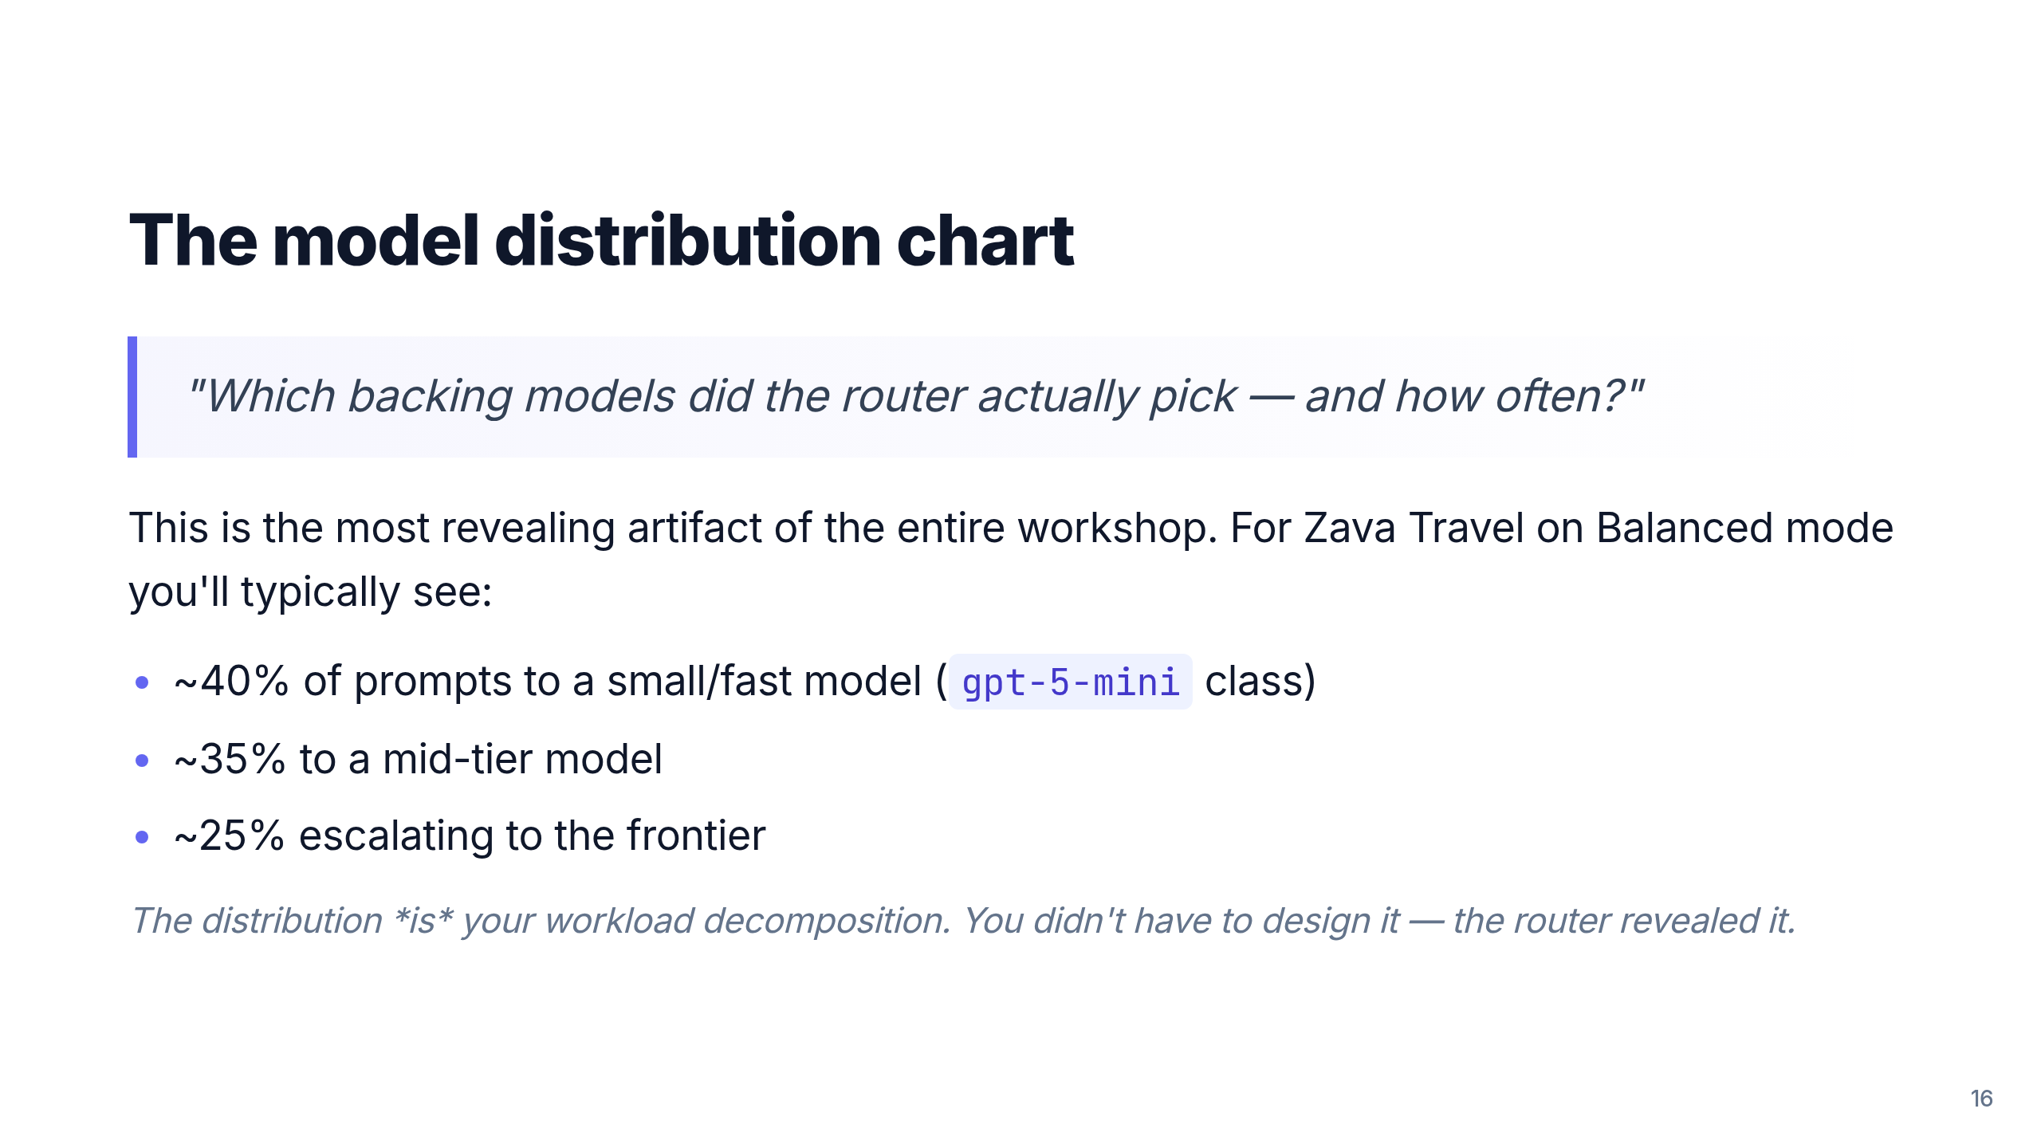
Notes:
Tie back to the core insight from README: "the router IS the
decomposition." If the distribution surprises you, that's data about
your workload, not a router bug.

Slide 17
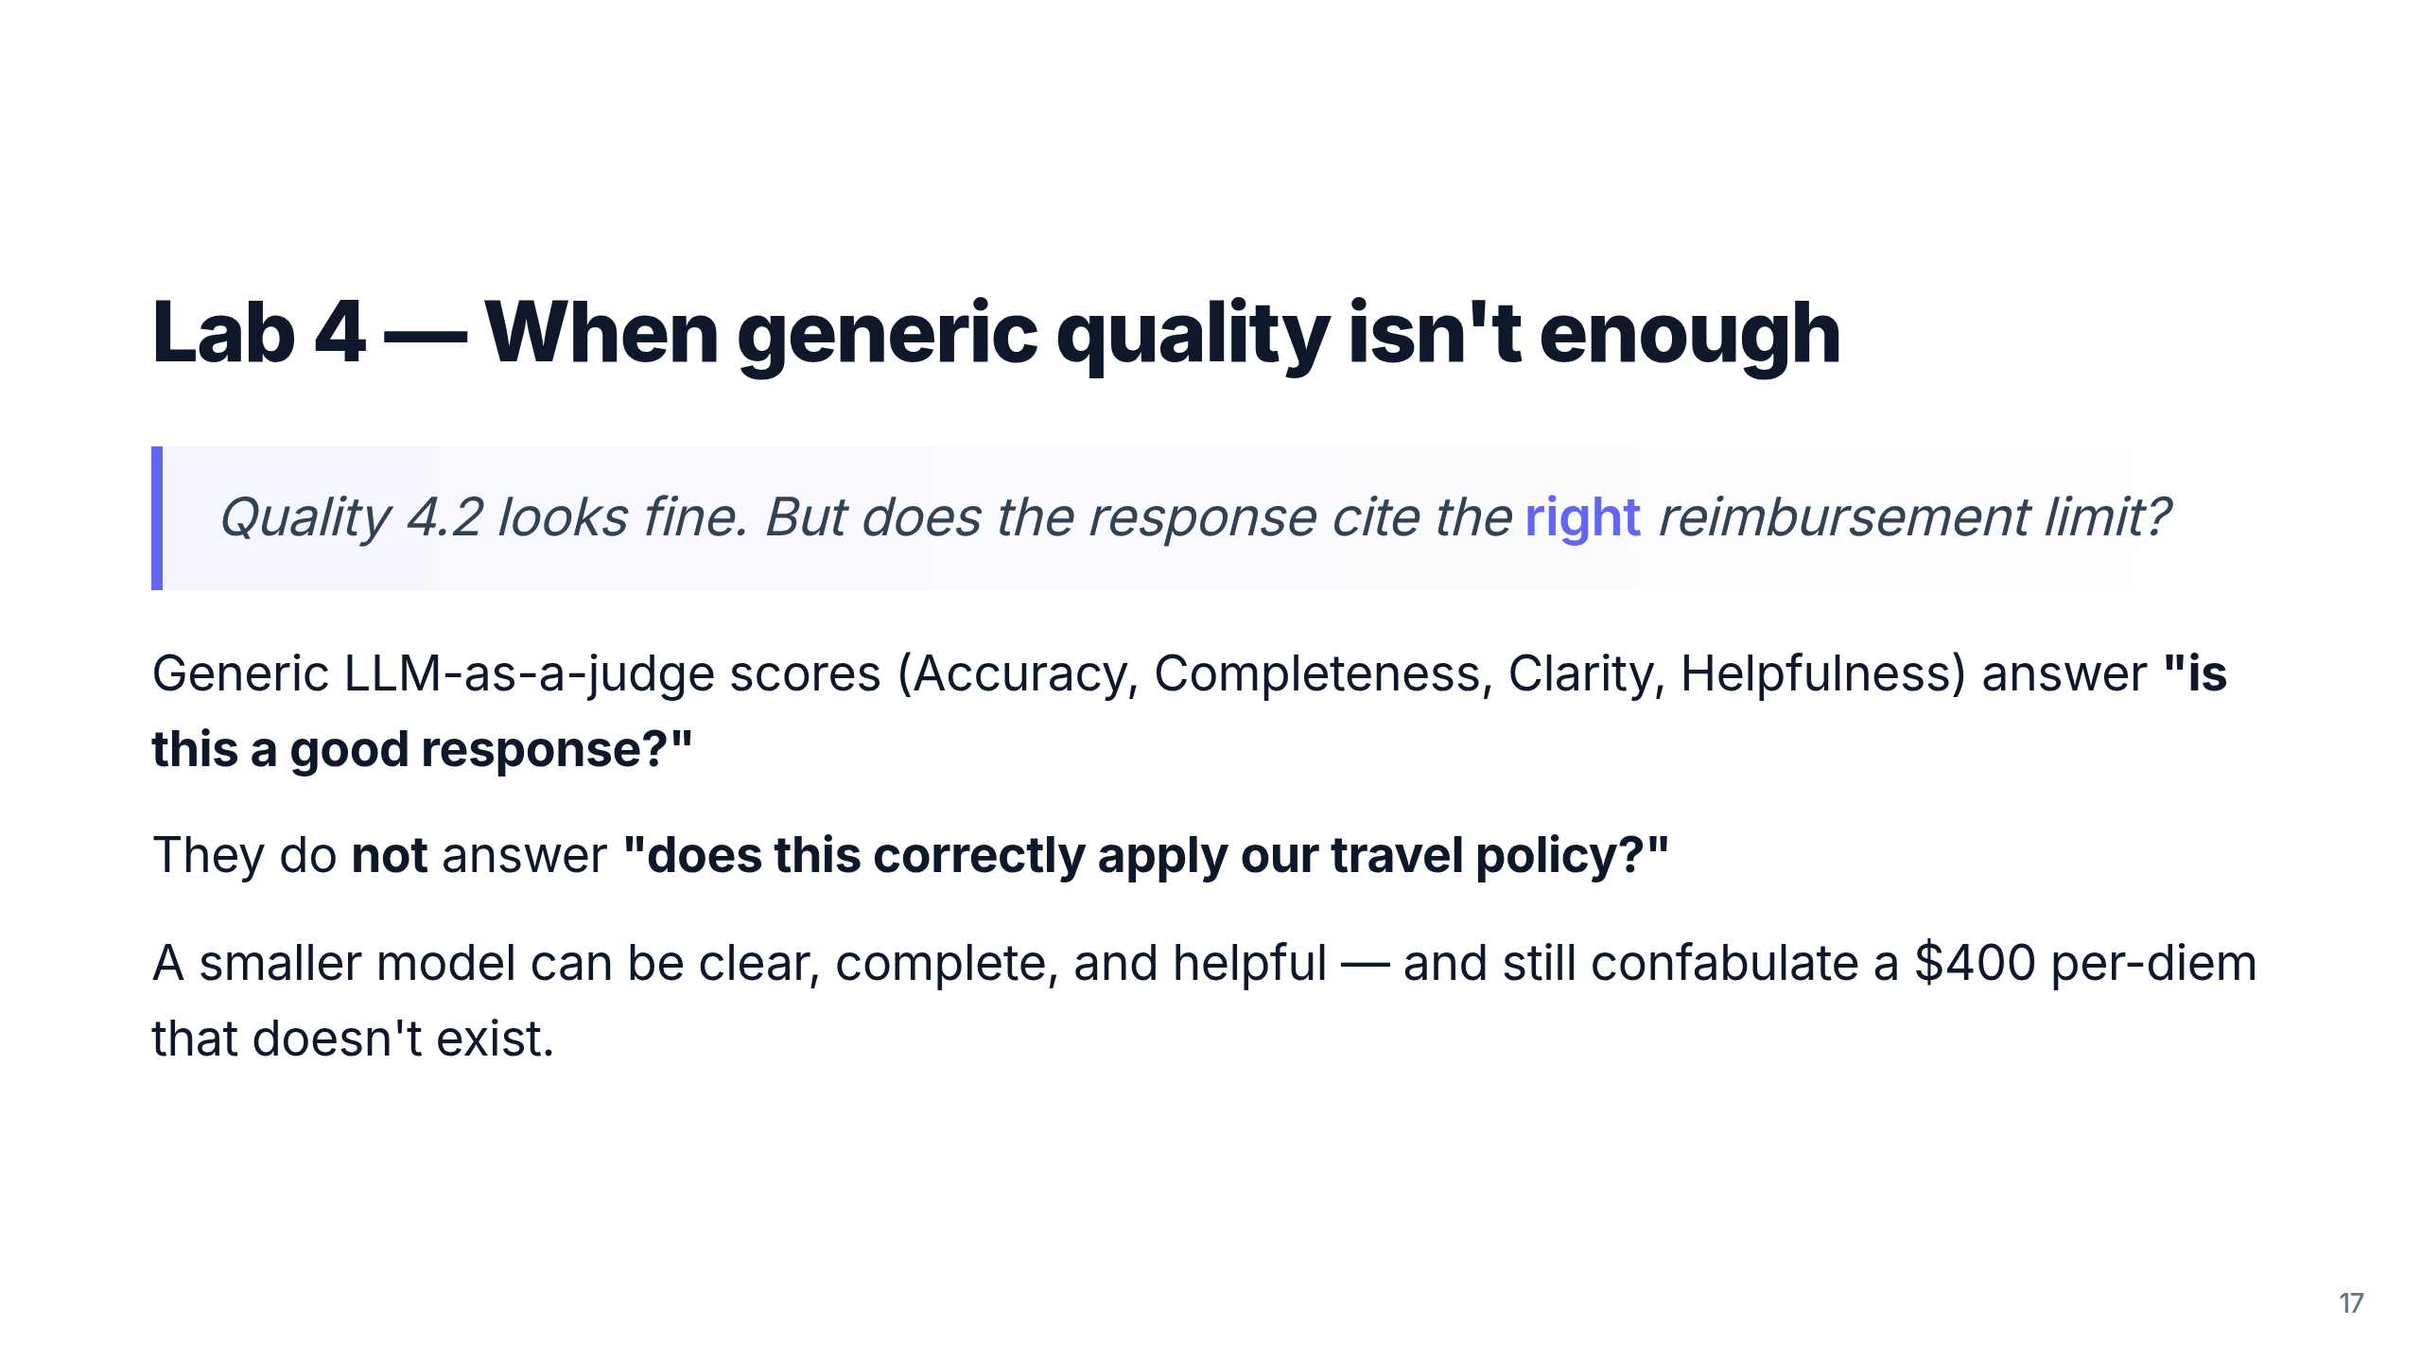
Notes:
The pivot to domain-specific evaluation. This is the lesson that
generalizes far beyond Model Router: generic evals are necessary, not
sufficient.

Slide 18
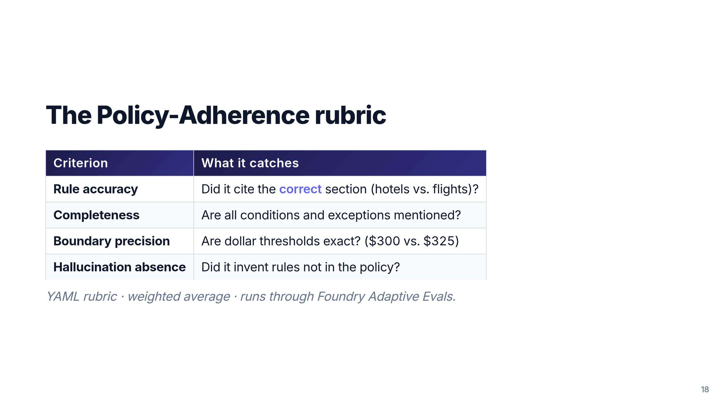
Notes:
Four criteria, all framed around failure modes we actually see with
smaller models. Boundary precision is the killer one — "reimbursable
vs. needs approval" hinges on $25.

Slide 19
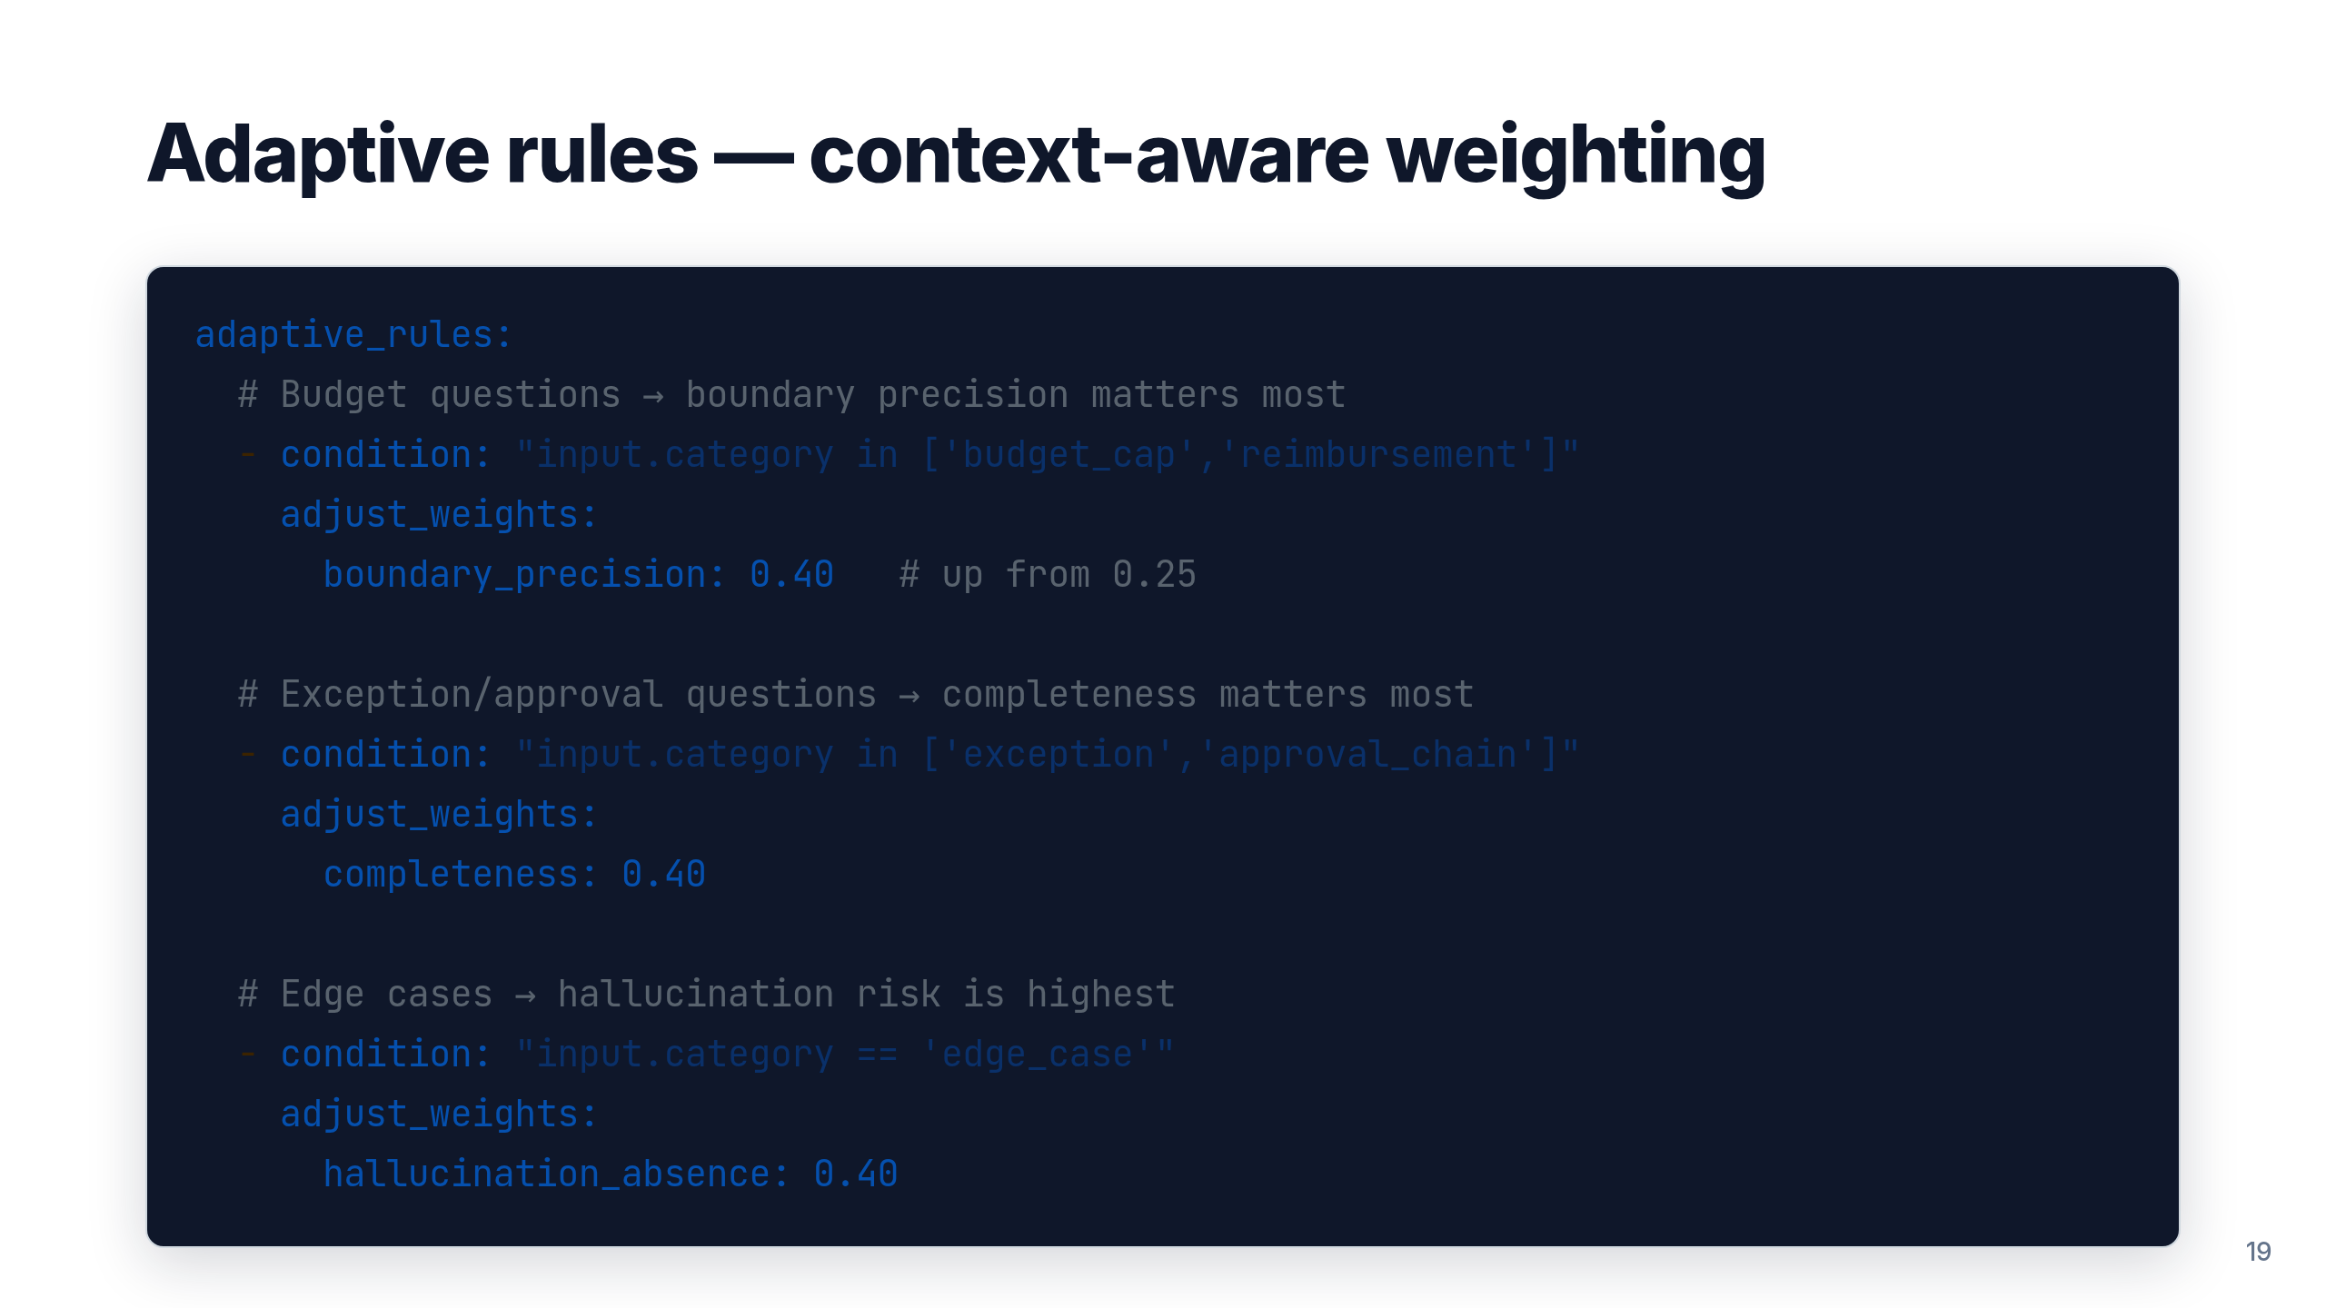
Notes:
The rubric shifts weight based on the *kind* of question. Edge cases
penalize hallucination harder; budget questions penalize wrong
numbers harder. This is what makes the evaluator usable beyond a toy.

Slide 20
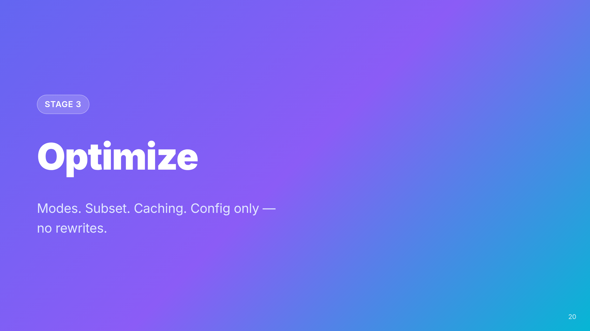

Slide 21
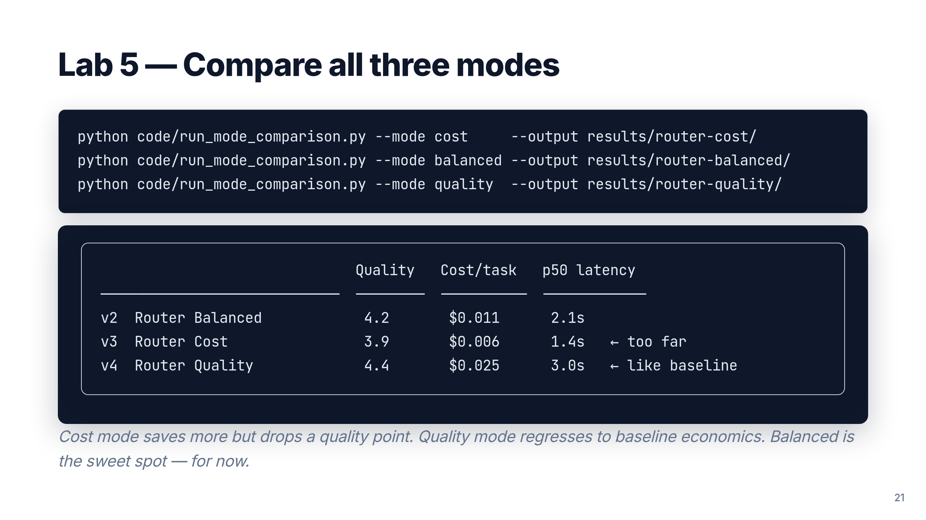
Notes:
Three runs, three data points. The lesson: don't pick a mode by name,
pick it by what the scorecard says about *your* workload. For Zava
Travel, Balanced wins. For a tier-2 chatbot, Cost might.

Slide 22
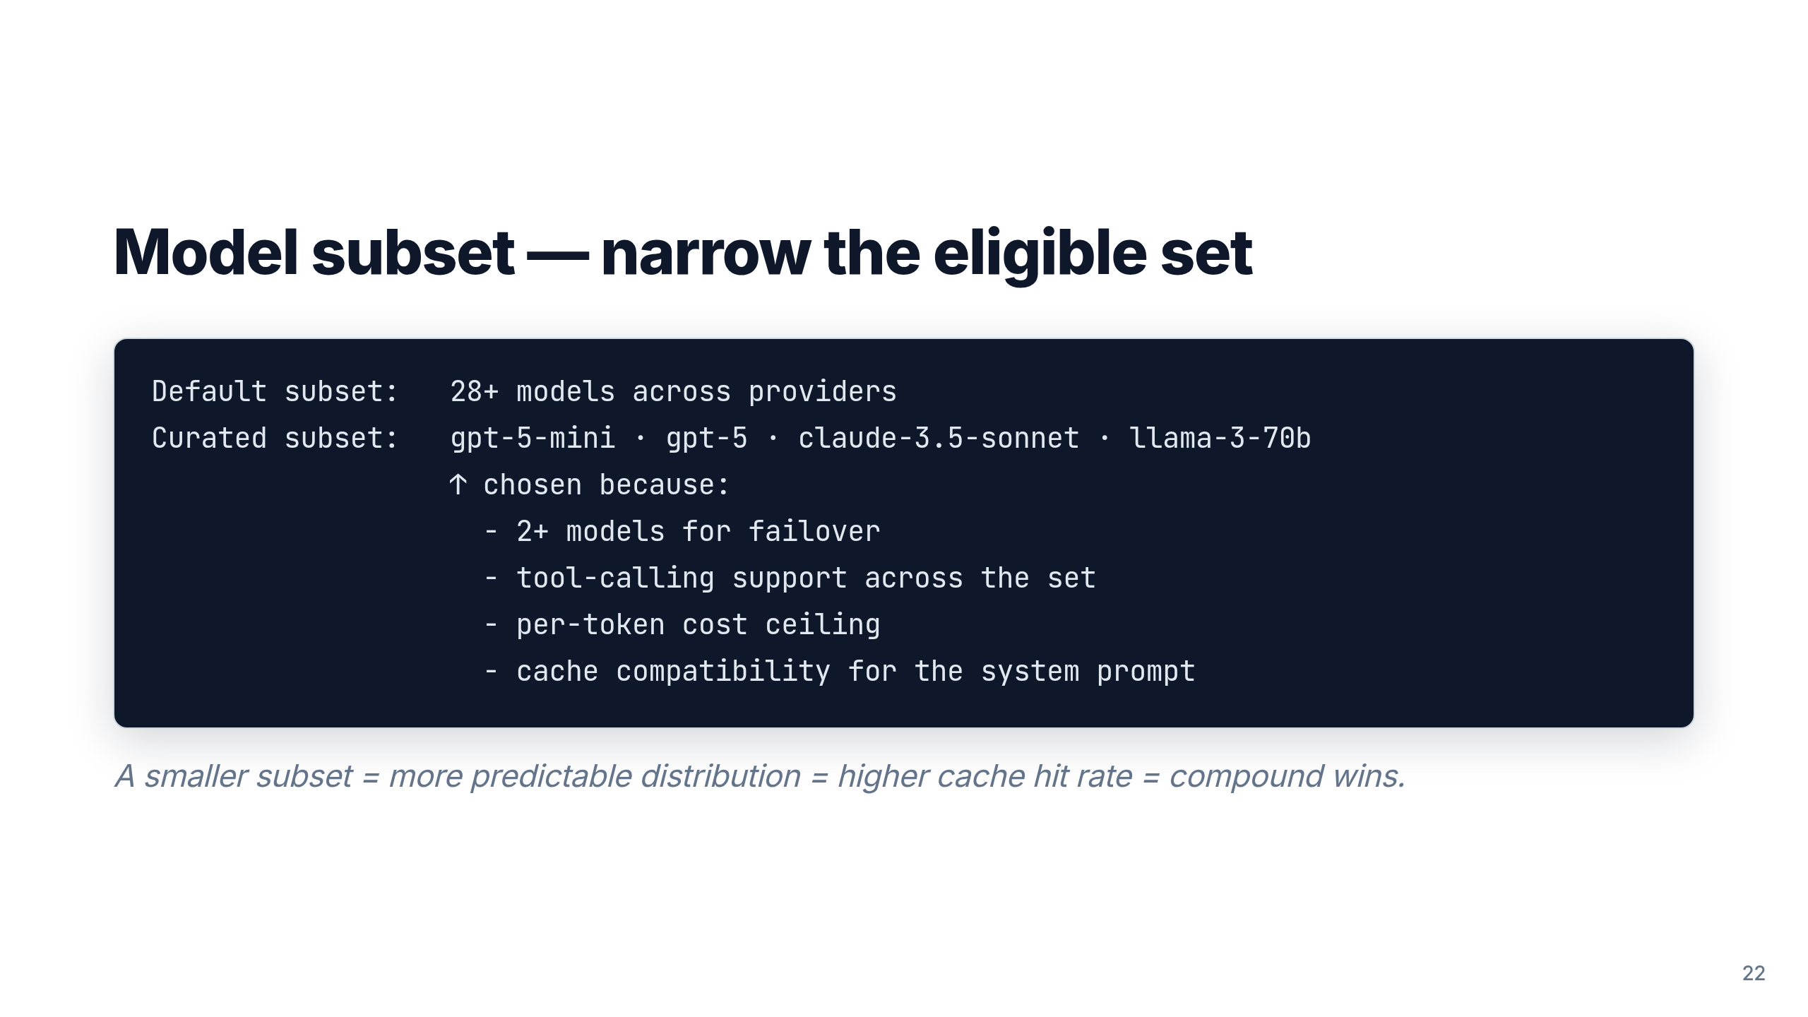
Notes:
This is where compliance, predictability, and caching all converge.
"Always include ≥2 models in your subset" is the one operational rule
to repeat twice.

Slide 23
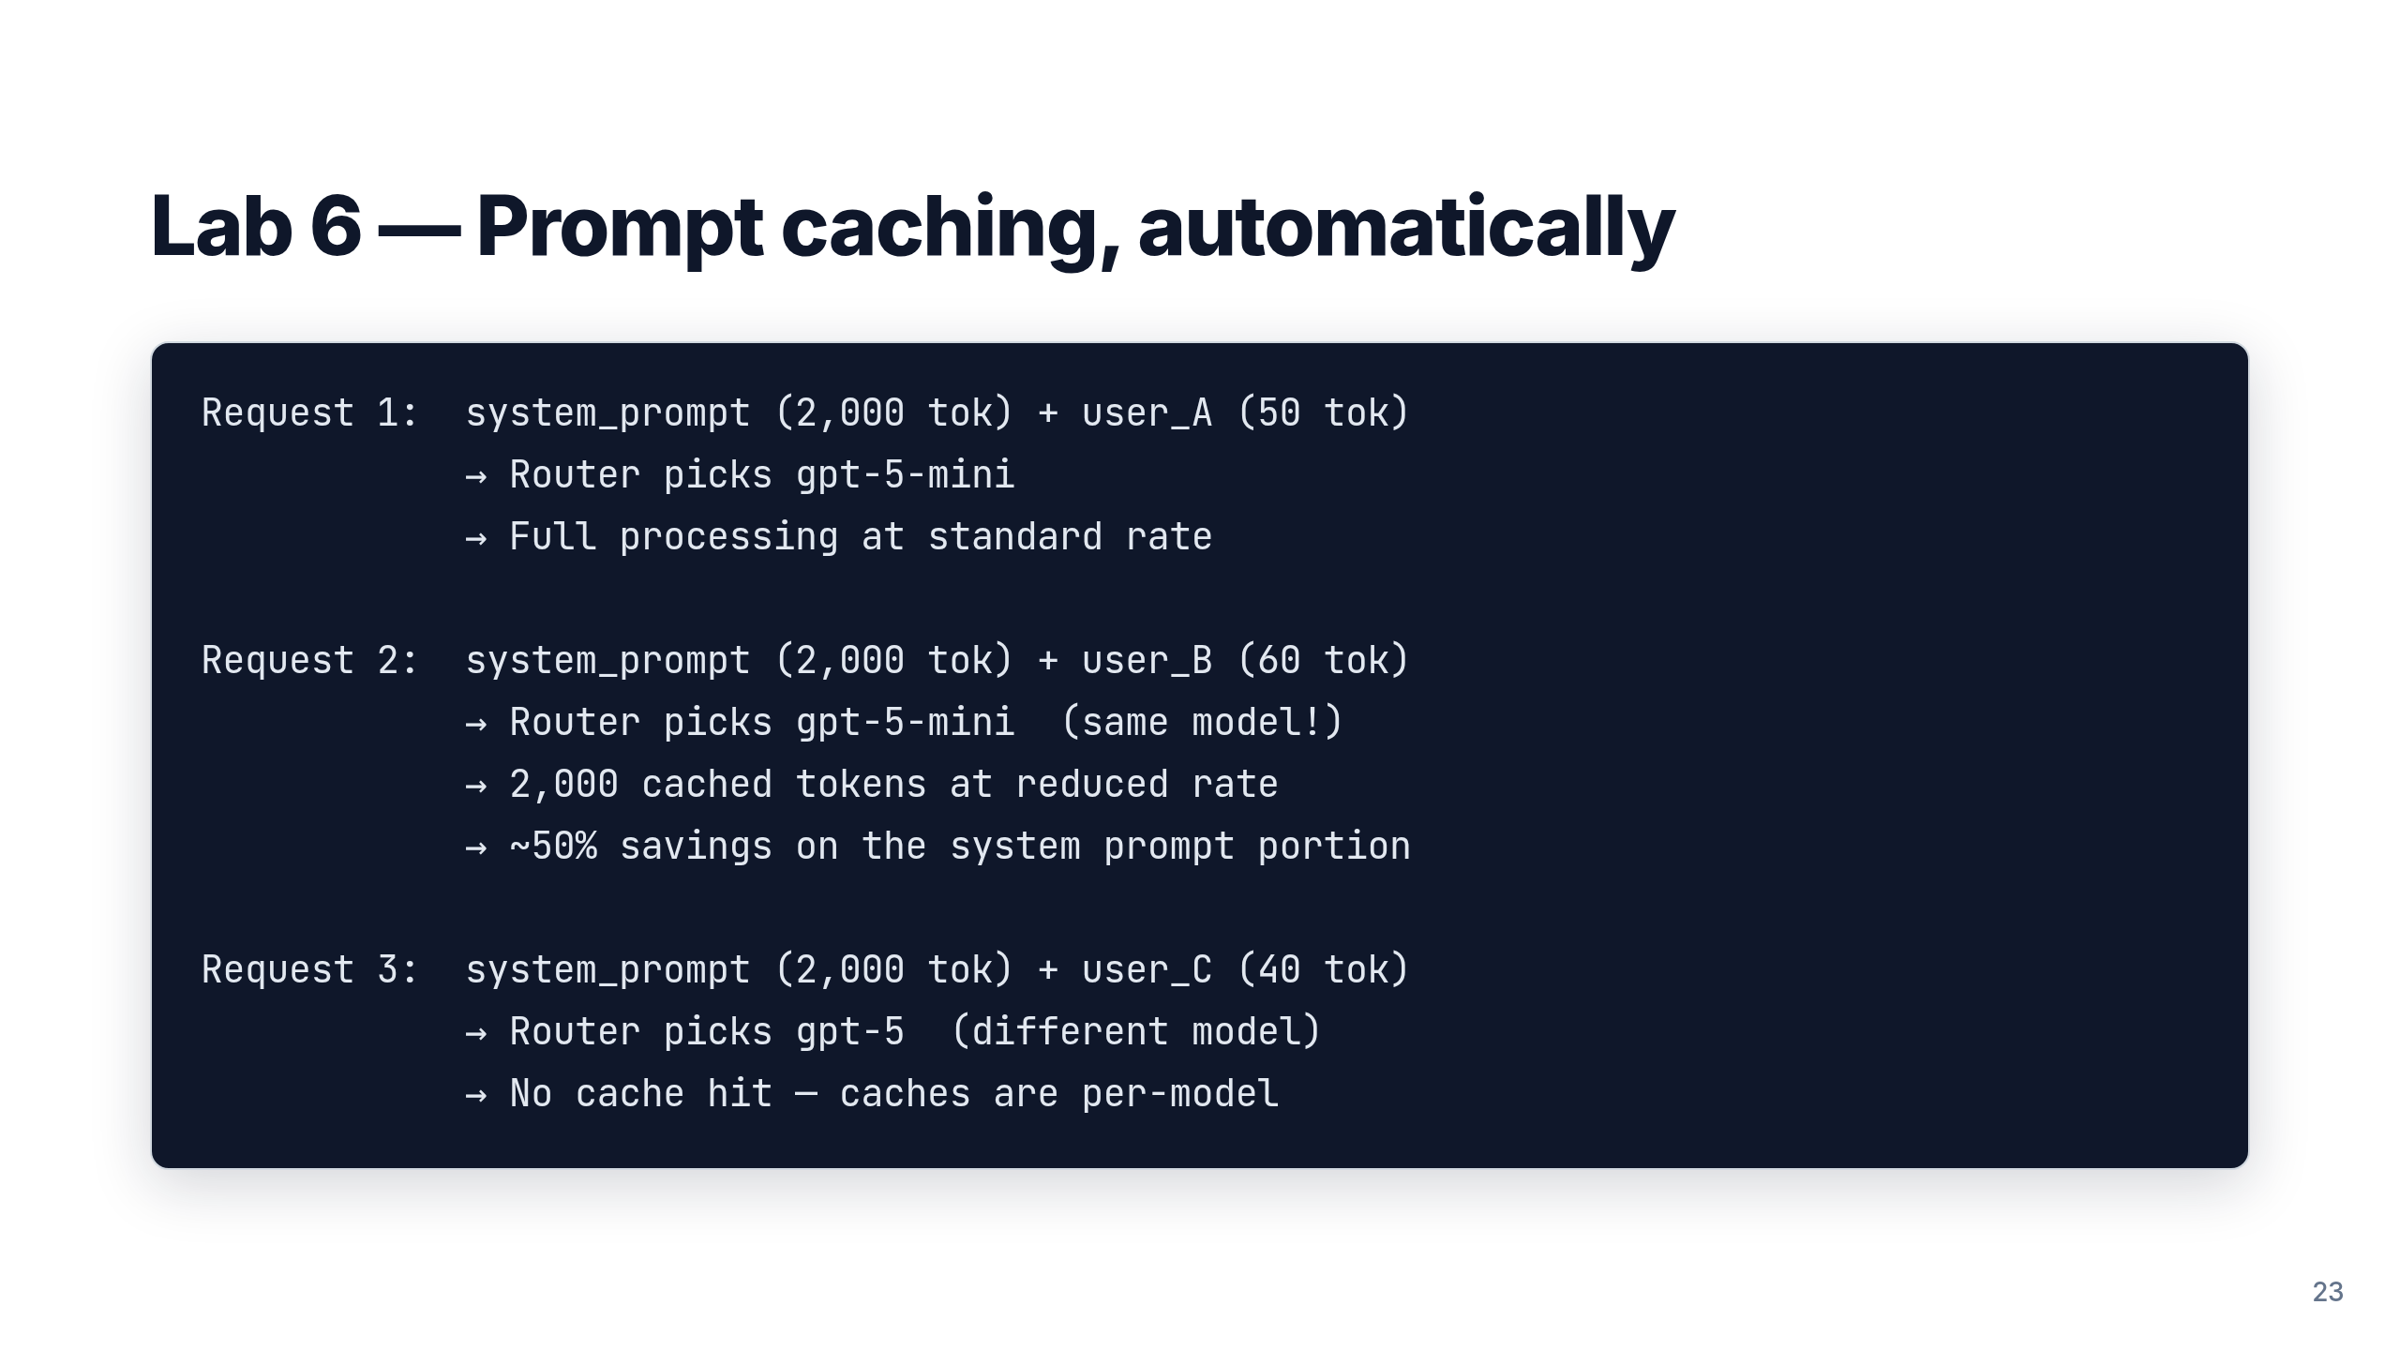
Notes:
Caching is automatic on supported models — you don't configure it,
you design *for* it: long stable system prompts + narrow subset =
high hit rate. This is why subset and caching combine multiplicatively.

Slide 24
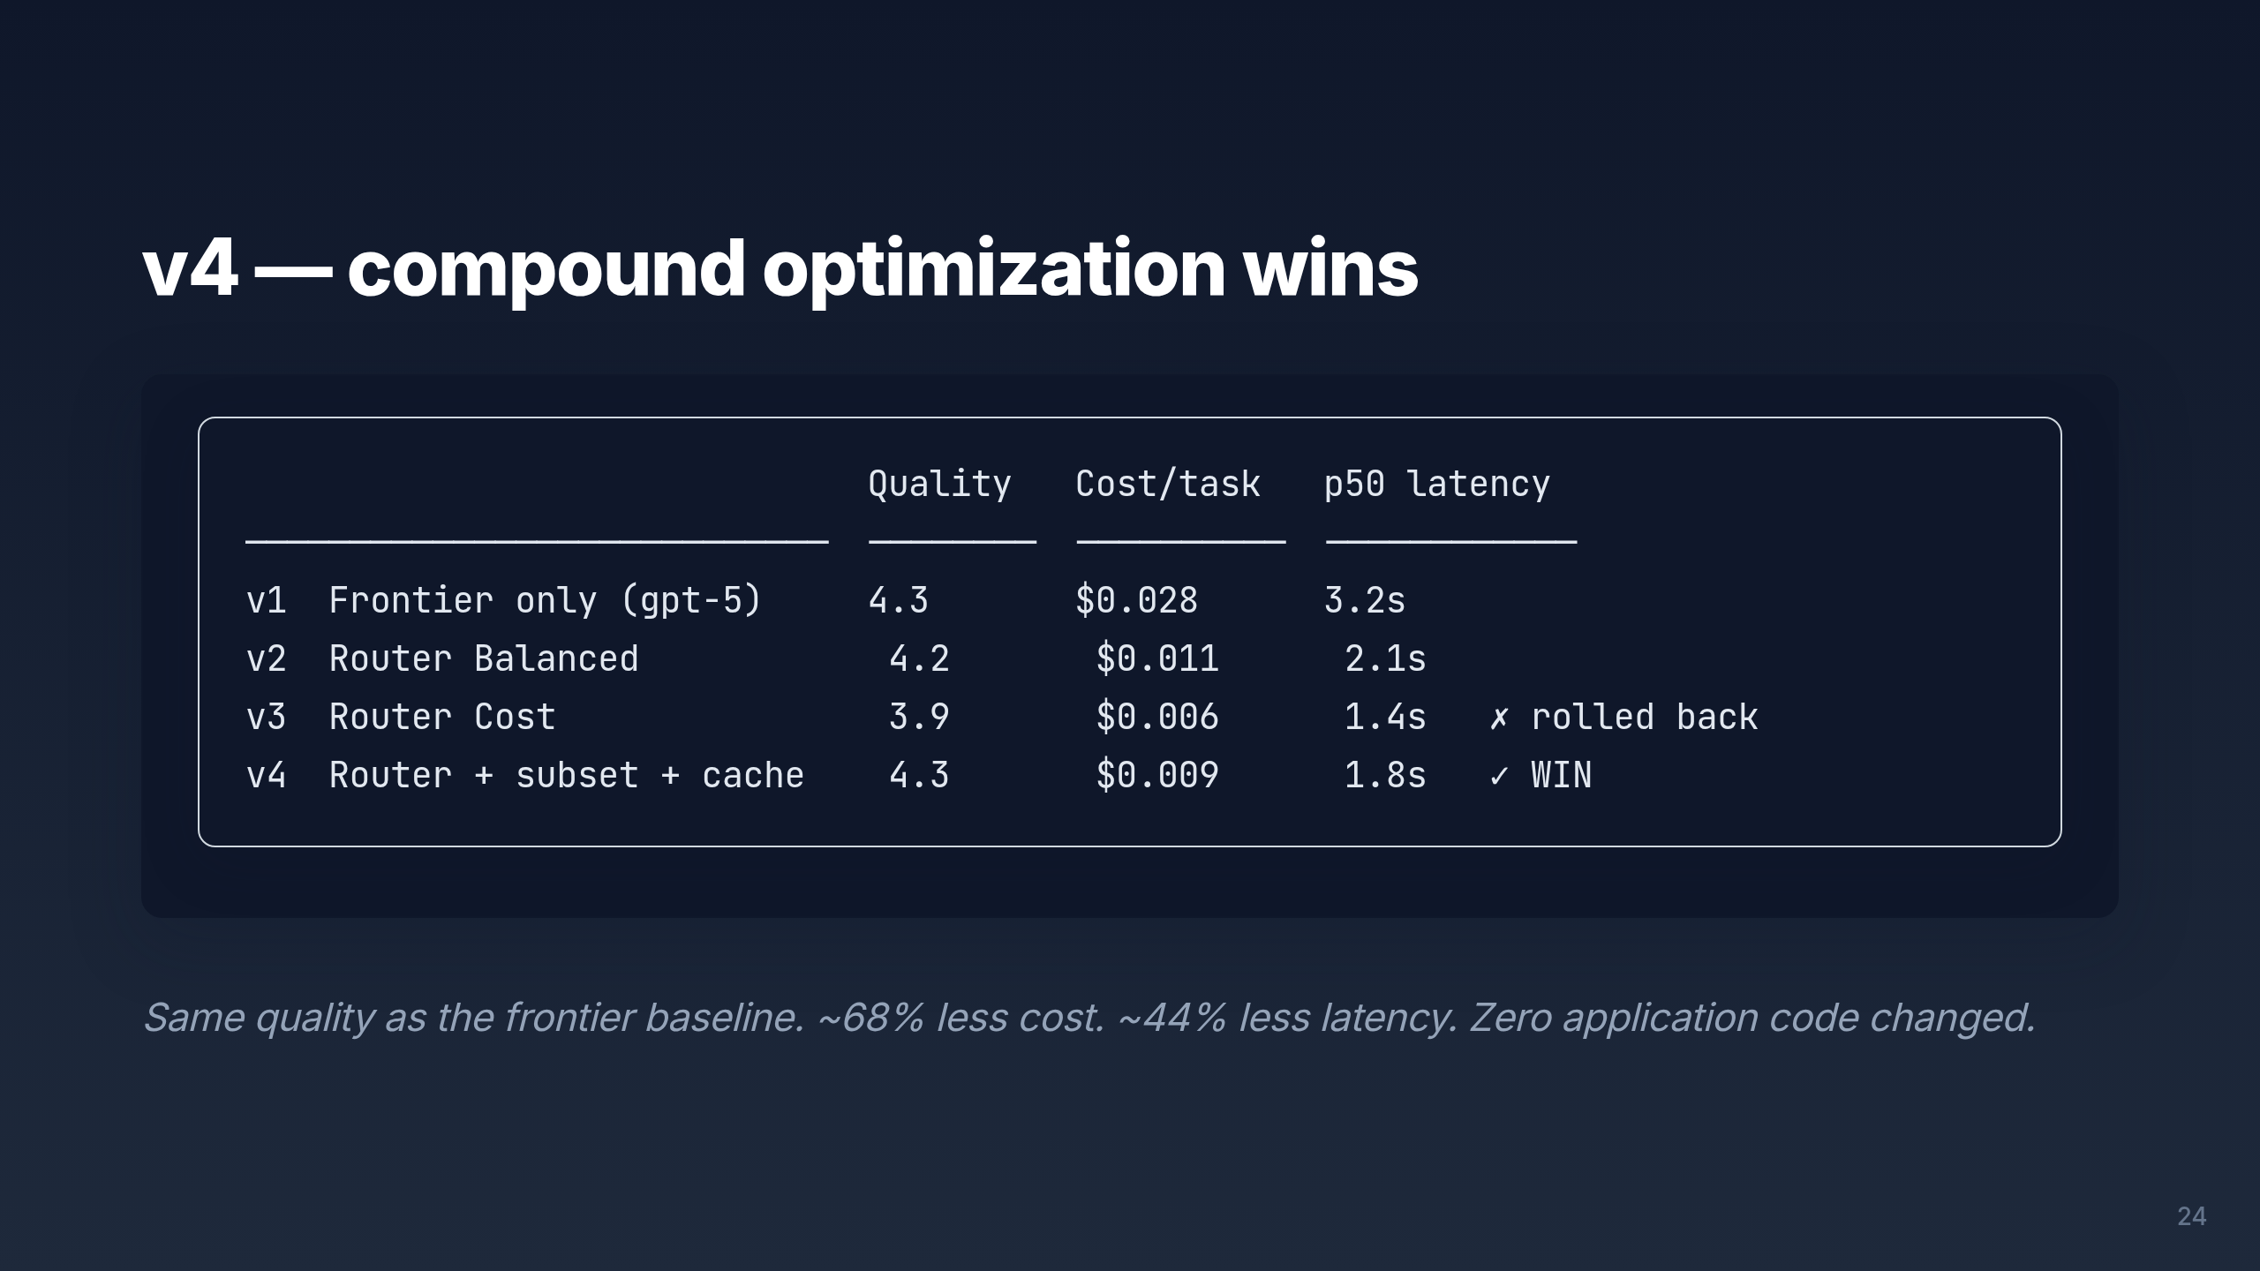
Notes:
Land the closing scorecard. The v3 → v4 rollback is the
methodological lesson: hill-climbing means you keep a change only
if the scorecard supports it.

Slide 25


Slide 26
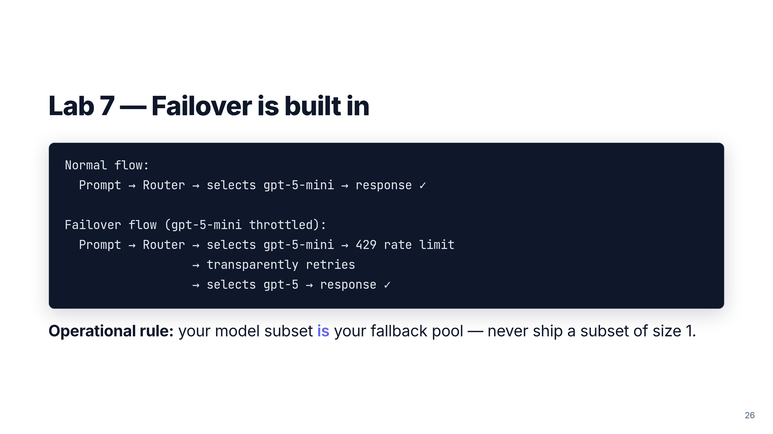
Notes:
Failover is the unsung feature. It also means you should think of the
subset as both an optimization tool AND a reliability tool.

Slide 27
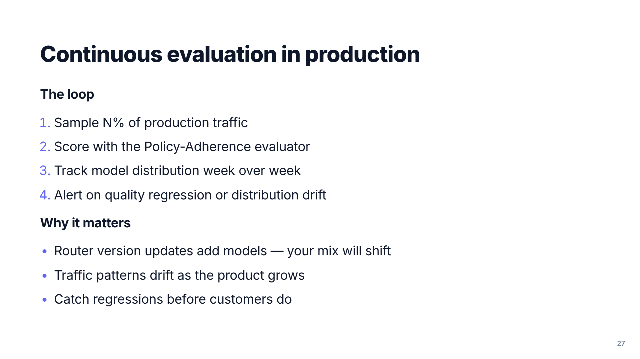
Notes:
Move the workshop from "one-off comparison" to "ongoing practice."
Continuous eval is the bridge between Day-1 deployment and a
year-in production posture.

Slide 28
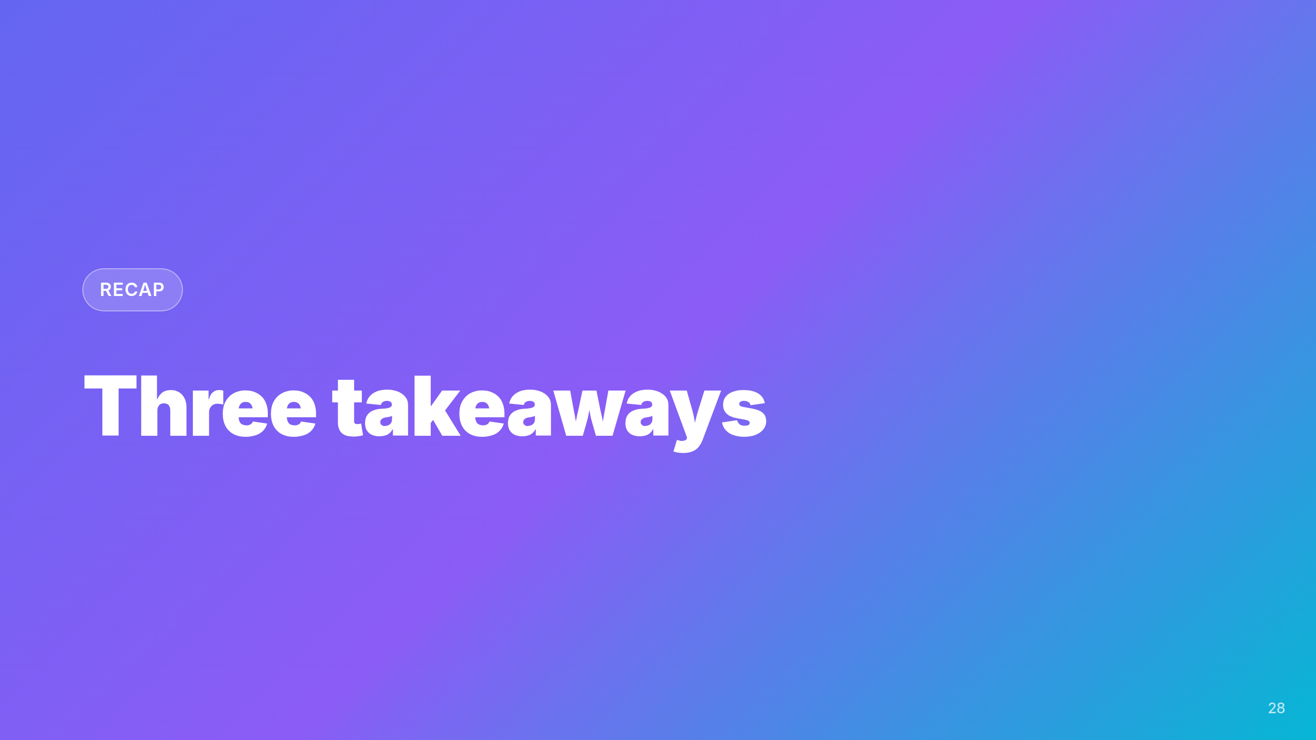

Slide 29
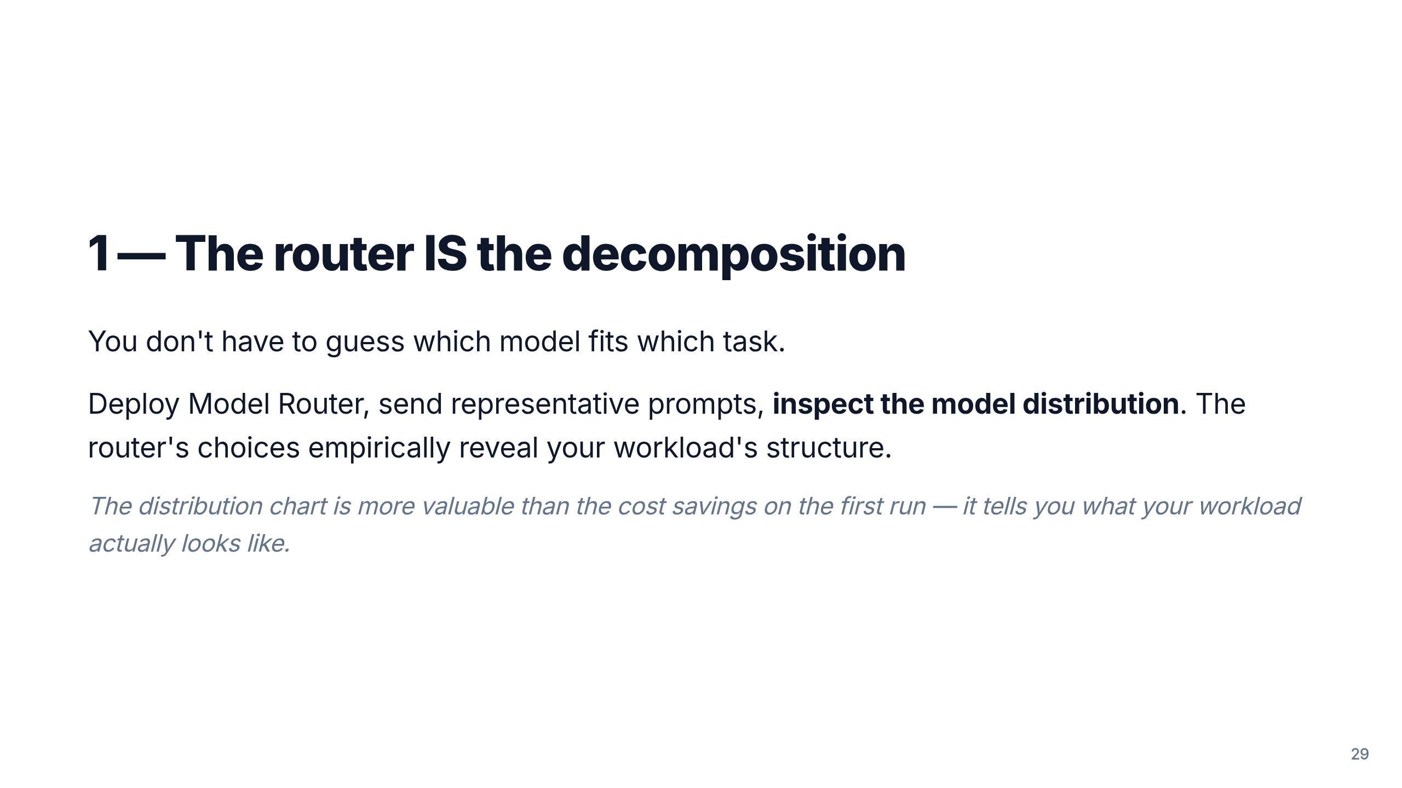

Slide 30
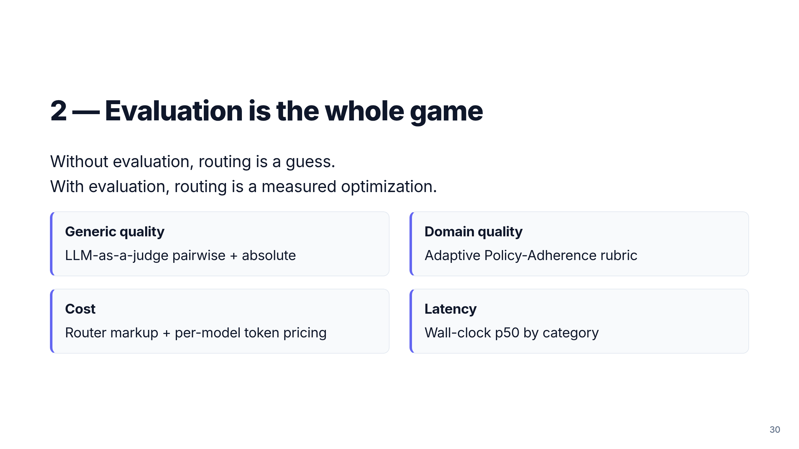

Slide 31
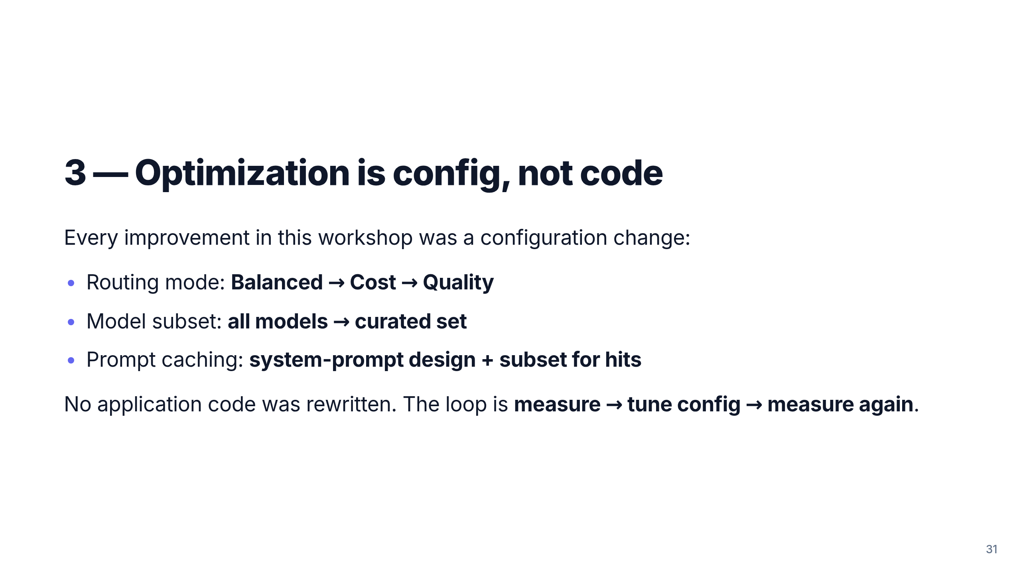

Slide 32
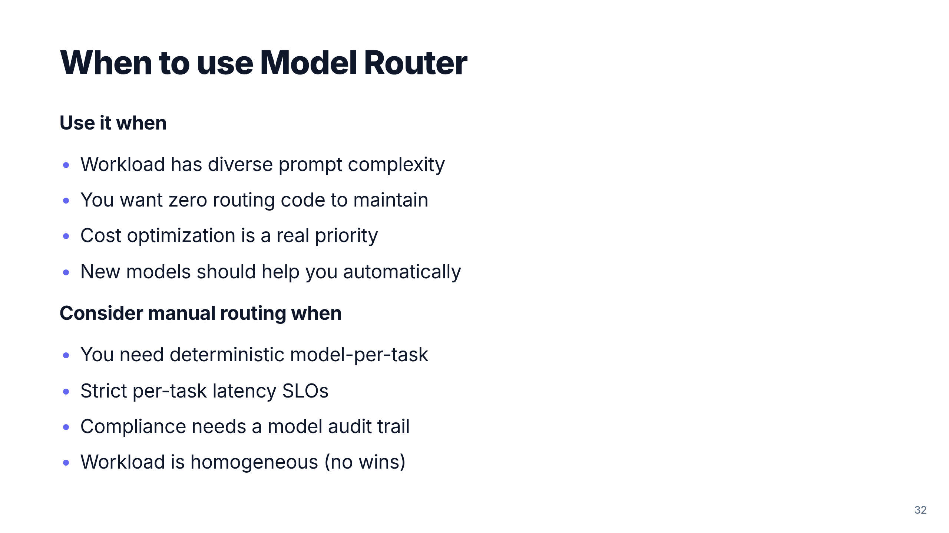

Slide 33
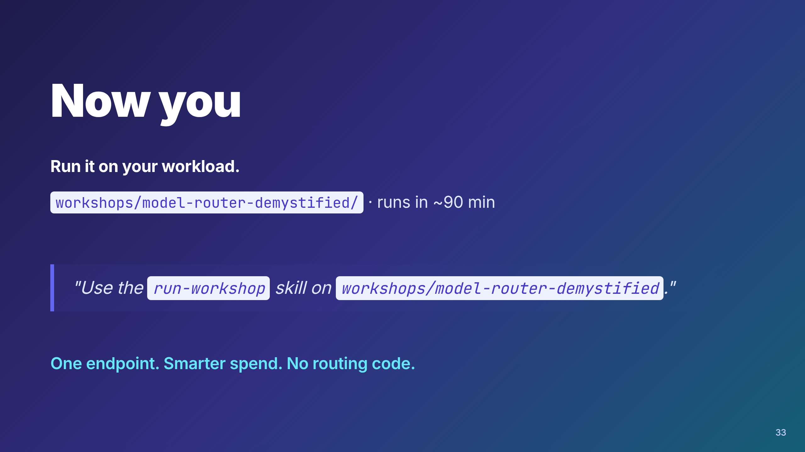
Notes:
Call to action. Point at the repo, the workshop folder, and the
run-workshop skill. Encourage measuring on their own prompts — the
methodology transfers even if the numbers don't.

