Slide 1
Digital Image Processing - Elementary Methods
Assignment Implementation: Python Scripts & Results

Slide 2


1. Image Negative
Input: Grayscale circle image
Input Image

Slide 3





2. Gamma Encoding / Correction
Input: RGB test image
γ = 0.3: Brightening (over-emphasizes highlights)
γ = 0.5: Moderate brightening
Input Image
γ = 1.0: No change (linear)

Slide 4


3. Logarithmic Transformation
Input: Grayscale circle image
Input Image

Slide 5

4. Contrast Stretching
Input: Grayscale circle image
Input Image

Slide 6

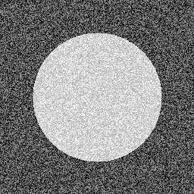
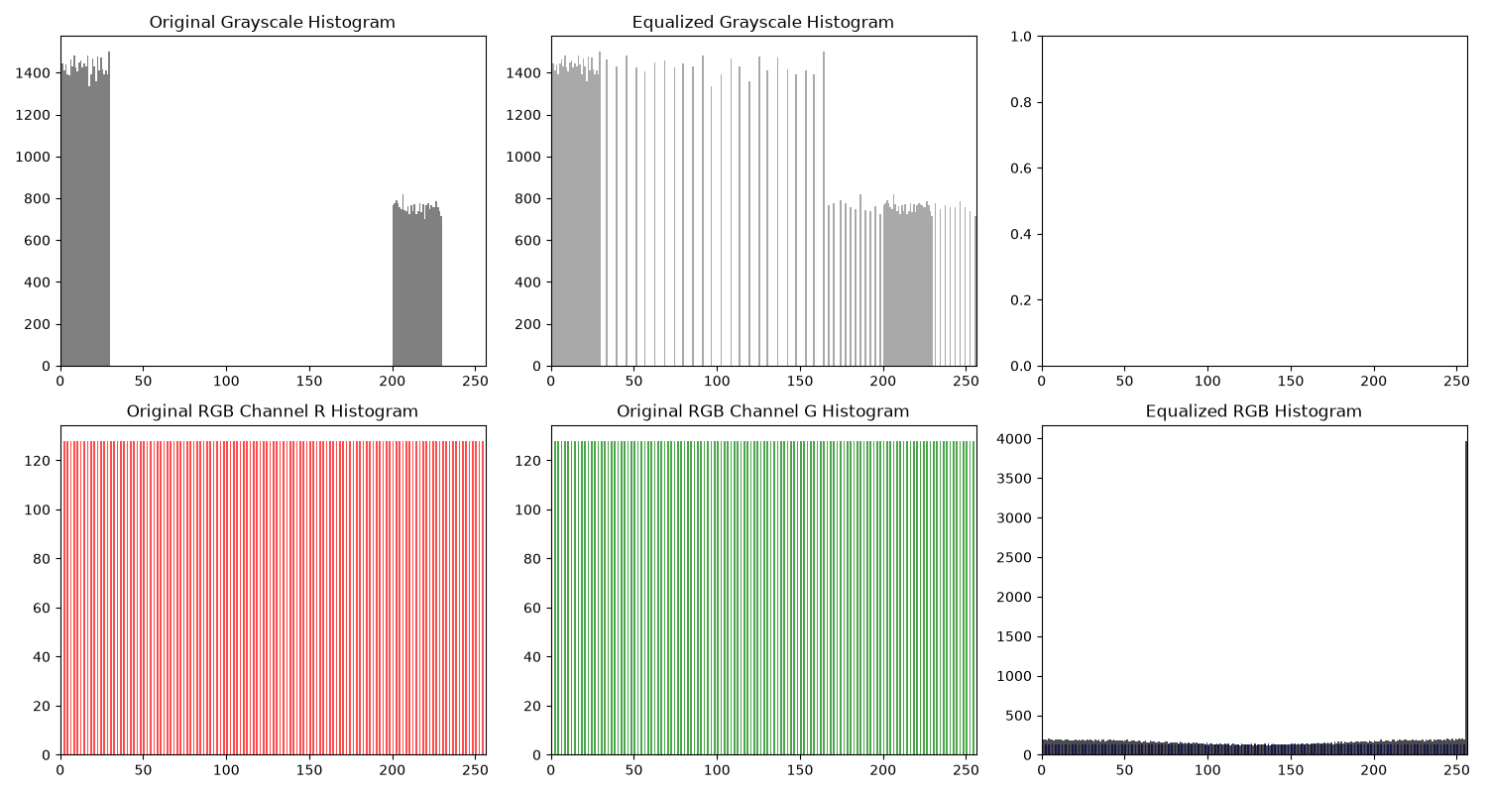
5. Histogram Equalization
Input: Grayscale circle image (left) and RGB test (right)
Output: Equalized grayscale histogram
Input Image

Slide 7


6. Intensity Level Slicing
Input: Grayscale circle image
Input Image

Slide 8

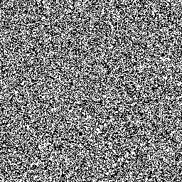
7. Bit Plane Slicing
Input: Grayscale circle image
Input Image

Slide 9
Summary
Completed Elementary Methods in Digital Image Processing
1. Image Negative: Inverts pixel values (s = L - 1 - r)
2. Gamma Correction: Power law transformation s = c * r^γ
3. Logarithmic Transformation: s = c * log(1 + r)
4. Contrast Stretching: Linear mapping to full range
5. Histogram Equalization: Redistributes histogram for max contrast
6. Intensity Level Slicing: Isolates specific intensity ranges
7. Bit Plane Slicing: Extracts individual bit planes from image
All methods handle both grayscale and RGB images.
Output images saved to: D:\Projects\Digital-image-processing\images

