Slide 1
Digital Image Processing
Elementary Methods - Assignment Implementation
C: Digital Image Processing Assignment
Methods: Image Negative, Gamma Correction, Log Transform, Contrast Stretching,
Histogram Equalization, Intensity Slicing, Bit Plane Slicing

Slide 2
Methods Overview
1
Image Negative
Pixel value inversion: s = L - 1 - r
2
Gamma Correction
Power-law transformation: s = c·r^γ
3
Logarithmic Transform
Logarithmic mapping: s = c·log(1+r)
4
Contrast Stretching
Linear scaling to full 0-255 range
5
Histogram Equalization
CDF-based histogram redistribution
6
Intensity Level Slicing
Isolate and enhance specific intensity ranges
7
Bit Plane Slicing
Extract individual bit planes (0-7) from image

Slide 3


1. Image Negative
Pixel Value Inversion
The image negative (or photographic negative) is obtained by subtracting each pixel value
from the maximum possible value L-1 (for 8-bit images, L=255).
Formula: s = 255 - r
Effect: Bright areas become dark and vice versa. Creates a photographic negative effect.
Applications:
• Medical imaging for examining transparent structures
• Document processing and OCR preprocessing
• Artistic image effects
• Quick visual inspection of image dynamics
Key Property: Complete reversal of intensity ordering. Minimum becomes maximum, maximum becomes minimum.
Input: Grayscale circle image
Original pixel values range from dark center to bright edges
Output: Negative transformation
s = 255 - r - bright areas become dark and vice versa

Slide 4



2. Gamma Encoding / Correction
Power-Law Transformation
Gamma correction applies a power-law function to adjust the luminance of an image.
Formula: s = 255 · (r/255)^γ
γ < 1 (e.g., 0.3, 0.5): Brightens the image, expands dark regions
γ = 1: No change (linear)
γ > 1 (e.g., 2.0, 3.0): Darkens the image, compresses highlights
Use Cases:
• γ < 1: Enhancing dark details in medical/satellite images
• γ > 1: Compressing bright skies or overexposed areas
• Calibration for display monitors with gamma ~2.2
Tested Gamma Values:
γ = 0.3: Strong brightening • γ = 0.5: Moderate brightening • γ = 1.0: No change
γ = 2.0: Moderate darkening • γ = 3.0: Strong darkening
Input: RGB test image (γ = 1.0, no correction)
γ = 0.5: Moderate brightening - expands dark details
γ = 2.0: Moderate darkening - compresses highlights

Slide 5


3. Logarithmic Transformation
Logarithmic Pixel Mapping
The logarithmic transformation expands pixel values in the dark range while compressing
values in the bright range. This is particularly useful for enhancing details in
low-intensity images.
Formula: s = c · log(1 + r)
Where c is a scaling constant chosen to maximize the output range.
Key Advantages:
• Expands small differences in dark regions
• Compresses large differences in bright regions
• Enhances visibility of faint details
• Useful for astronomy, radiography, low-light photography
Unlike gamma correction, logarithmic transformation has an infinite dynamic range
compression characteristic that mimics human visual response to light.
Output: Logarithmic transformed grayscale image
Details in shadows are enhanced
Output: Logarithmic transformed RGB image
Color image with enhanced shadow details

Slide 6

4. Contrast Stretching
Linear Intensity Scaling
Contrast stretching (also called normalization) maps the range of pixel intensity
values to the full available range (e.g., 0-255 for 8-bit images). This enhances
the overall contrast of the image.
Formula: s = (r - r_min) / (r_max - r_min) · (s_max - s_min) + s_min
Automatic version uses percentiles (e.g., 2nd and 98th percentile) to determine
r_min and r_max, making it robust to outliers.
Applications:
• Enhancing images with washed-out or dark backgrounds
• Preparing images for display on monitors
• Medical imaging enhancement
• Satellite and remote sensing imagery
Output: Contrast stretched grayscale image
Full 0-255 range utilized

Slide 7
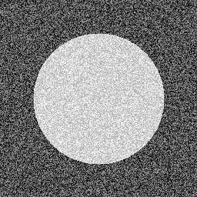
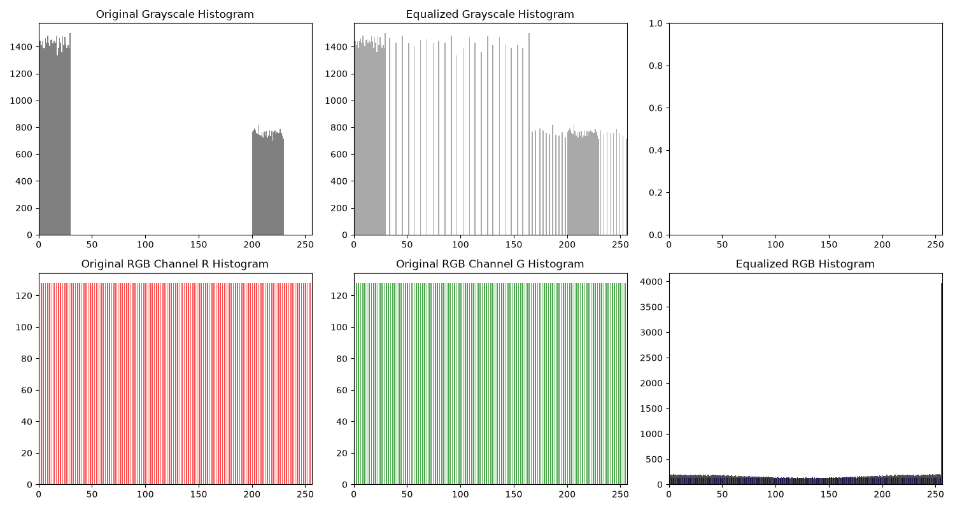
5. Histogram Equalization
CDF-Based Intensity Redistribution
Histogram equalization improves image contrast by redistributing the pixel intensity
values so that the resulting histogram is approximately uniform. It uses the Cumulative
Distribution Function (CDF) of the original image to map old pixel values to new ones.
Formula: s_k = T(r_k) = (CDF(r_k) - CDF_min) / (N - CDF_min) · (L - 1)
Where:
• CDF(r_k) = cumulative sum of histogram up to r_k
• N = total number of pixels
• CDF_min = CDF value at minimum intensity
• L = number of intensity levels (256 for 8-bit)
For color images, the process is applied to the V (value) channel in HSV color space,
preserving color while enhancing contrast.
Note: Over-enhancement can create noise amplification and unnatural appearances.
Output: Equalized grayscale histogram
Histogram spread across full range
Comparison: Original vs Equalized histograms
Left: original concentrated histogram Right: equalized uniform histogram

Slide 8
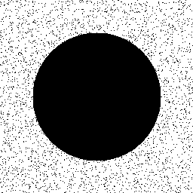

6. Intensity Level Slicing
Isolate Specific Intensity Ranges
Intensity level slicing isolates a specific range of gray levels in an image and
either highlights them or darkens the remaining levels. This is useful for revealing
features within a particular intensity band.
Two modes:
1. HIGHLIGHT mode: Pixels within the selected range are set to maximum brightness (255),
pixels outside are set to background (0).
2. DARKEN mode: Pixels within the selected range retain their original values,
pixels outside are darkened to background (0).
Parameters used: width = 20 intensity levels around the median intensity
Applications:
• Highlighting tumors in medical images
• Enhancing specific features in satellite imagery
• Artistic effects and image segmentation
• Inspecting specific gray level bands
Highlight mode: Isolated intensity range brightened to 255
Darken mode: Selected range kept, outside darkened

Slide 9
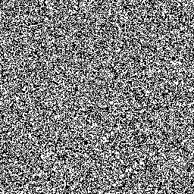

7. Bit Plane Slicing
Extract Individual Bit Planes
An 8-bit image can be decomposed into 8 bit planes. Bit plane 0 is the least significant
bit (LSB) and bit plane 7 is the most significant bit (MSB).
Bit Plane Significance:
• Bit Plane 7 (MSB): Contains the major structural information of the image.
Removing it produces a heavily degraded image. Contains the coarse features.
• Bit Planes 6-5: Contain important structural details. Image is recognizable but
with reduced contrast.
• Bit Planes 4-3: Contain finer details. Image becomes sketchy.
• Bit Planes 2-1: Contain fine details and noise.
• Bit Plane 0 (LSB): Contains the finest detail and noise. If removed, image appears
almost unchanged - the LSB contributes minimally to overall visual appearance.
Visual Demonstration:
The bit plane slices show how much information each plane contributes to the overall
image. Typically, 3-4 MSB planes contain ~90% of the image information.
Bit Plane 0 (LSB): Least significant bit
Contains fine detail and minor noise
Bit Plane 7 (MSB): Most significant bit
Contains major structural image information

Slide 10
Summary
Digital Image Processing - Elementary Methods Summary
1. Image Negative (s = 255 - r): Complete reversal of intensity ordering. Quick visual inspection tool.
2. Gamma Correction (s = 255·(r/255)^γ): Power-law adjustment. γ < 1 brightens, γ > 1 darkens. Display monitors typically use γ ≈ 2.2.
3. Logarithmic Transform (s = c·log(1+r)): Expands dark details, compresses bright. Mimics human vision. Useful for low-light and scientific imagery.
4. Contrast Stretching: Maps specified intensity range to full 0-255. Automatic version uses percentiles for robustness. Enhances overall contrast.
5. Histogram Equalization: CDF-based redistribution for uniform histogram. Maximizes contrast. Can amplify noise if overdone.
6. Intensity Level Slicing: Isolates/highlights or darkens specific intensity ranges. Useful for feature enhancement and segmentation.
7. Bit Plane Slicing: Decomposes 8-bit image into 8 bit planes. MSB (7-5) contains structural info; LSB (0) contains fine detail/noise. Information compression insight.
All methods properly handle both grayscale and RGB images.

